Slide 1



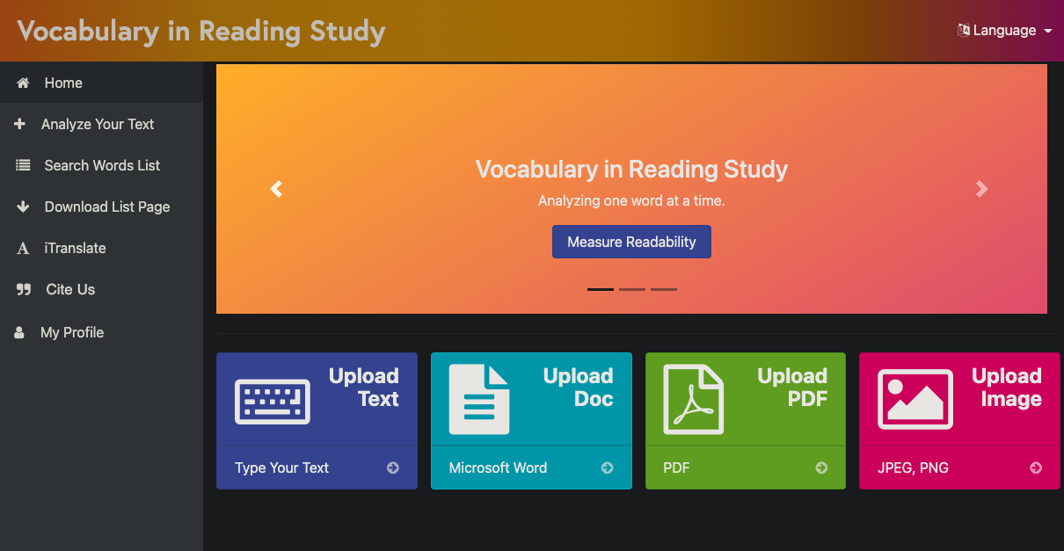
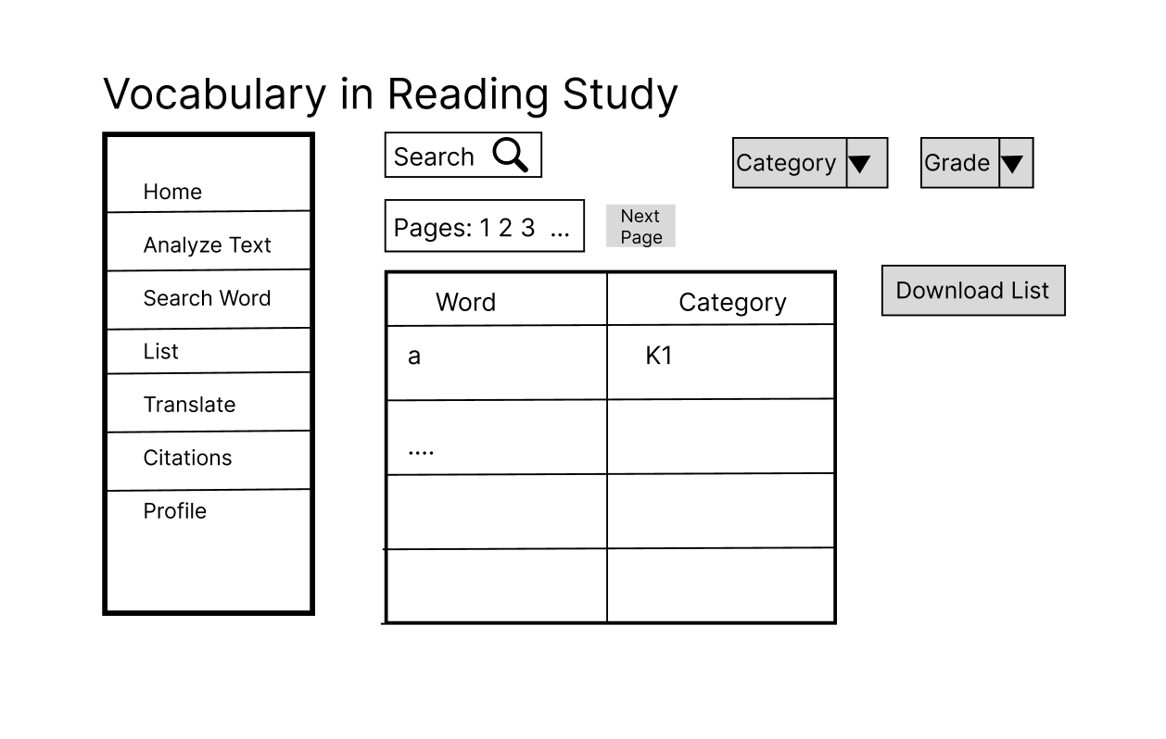
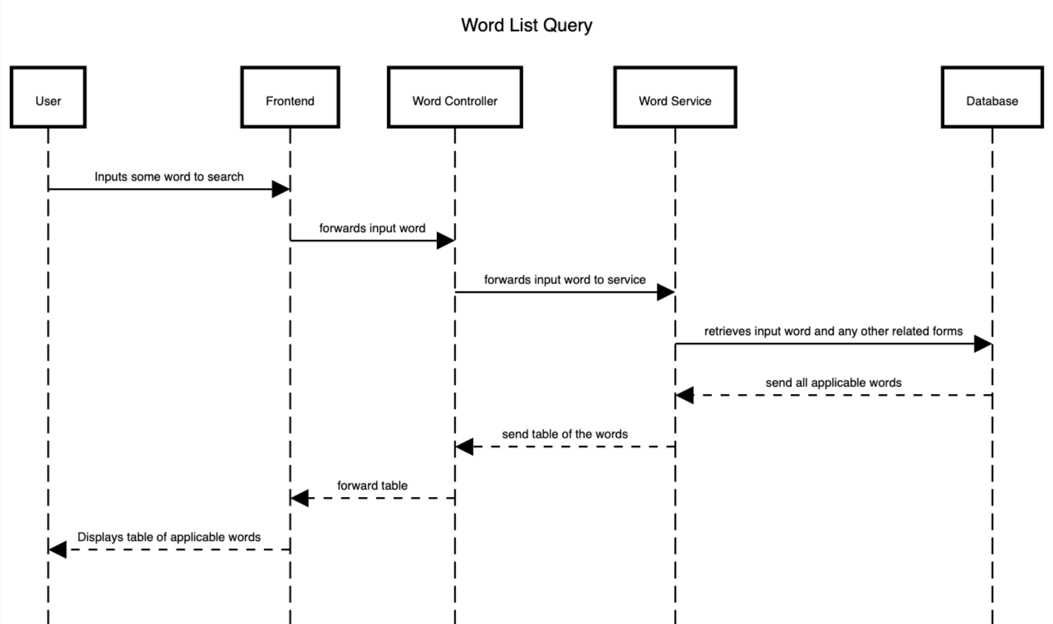
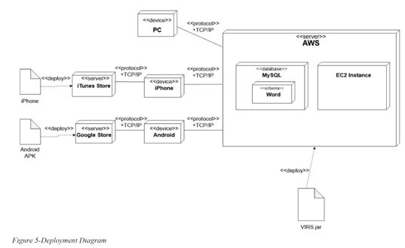
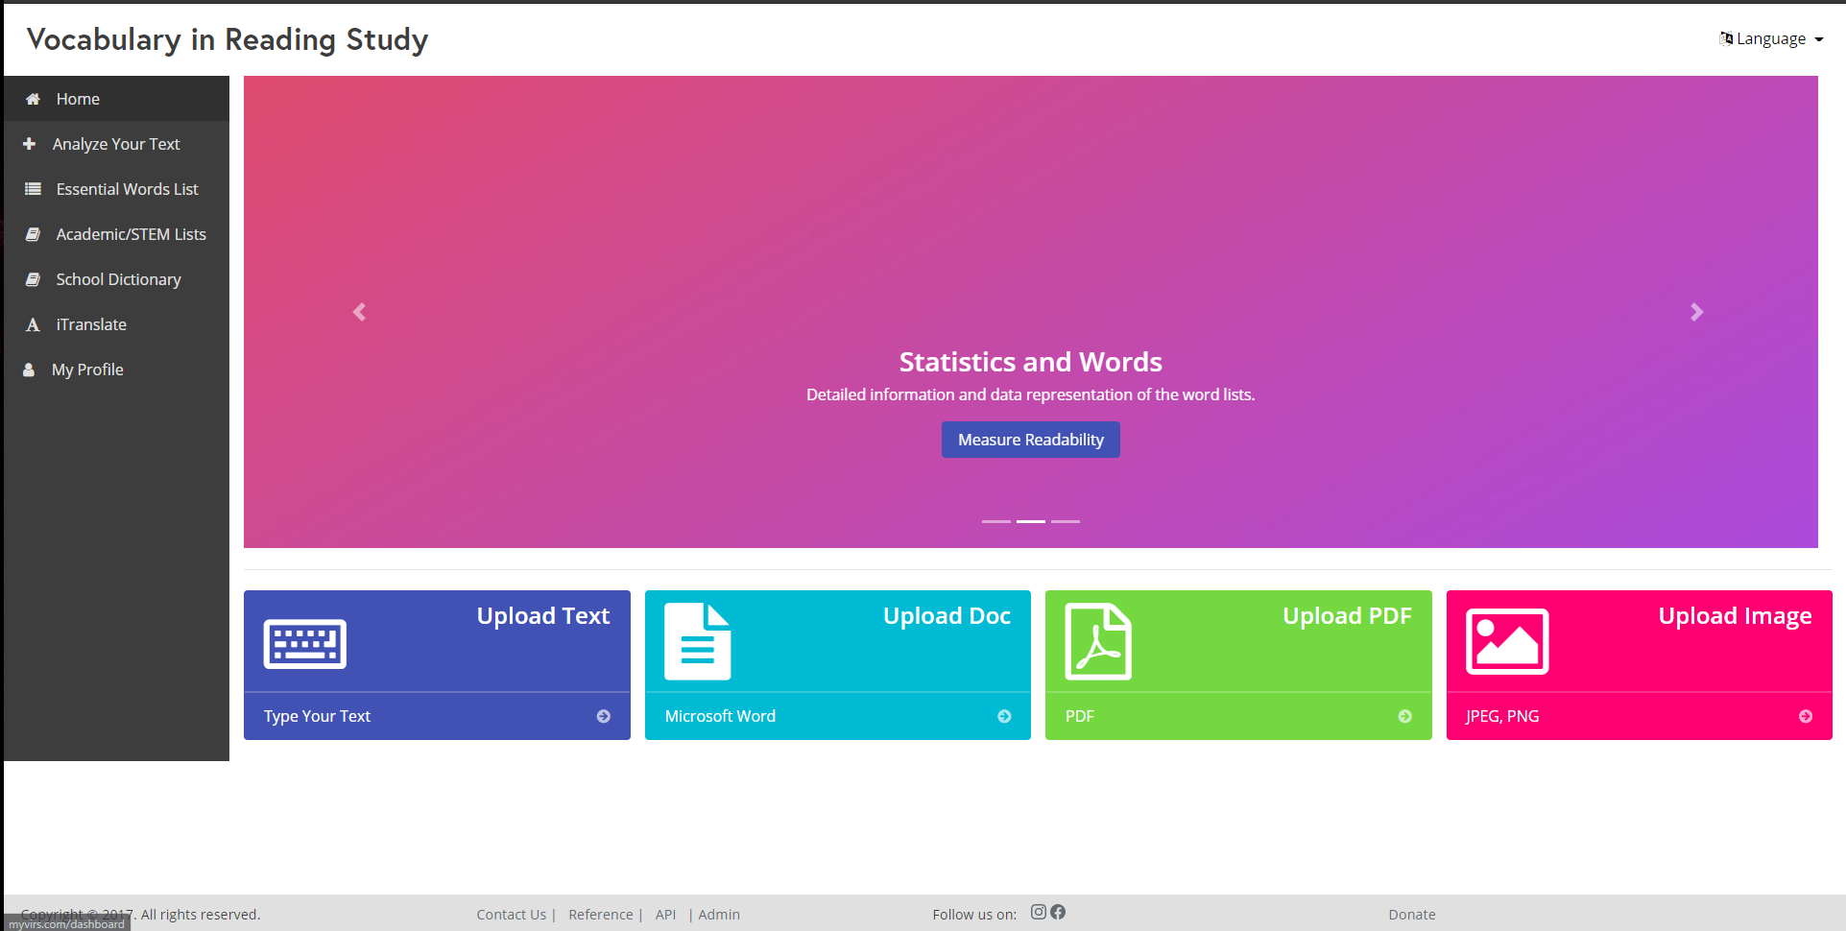
Knight Foundation School of Computing & Information Sciences
Fall 2022 Senior Design Project
Vocabulary In Reading Study
Students: Jeffrey Quispe
Mentor: Dr. S. J. Ehsanzadehsorati
Instructor: Dr. Masoud Sadjadi, Florida International University
PROBLEM
CURRENT SYSTEM
REQUIREMENTS
Vocabulary In Readings Study (VIRS) provides an all-encompassing solution for English Language Learners (ELL) who often have trouble learning vocabulary. VIRS can measure the difficulty of text based on input, allow users to see the definitions and frequency of words in a text they are reading, and provide vocabulary tests to assess learning.
Issues tackled this semester:
Improve search method for the definitions database.
Improve word categorization, and ensure accuracy
Update/Refine UI design
The UI should be simple and direct so the user may find whatever they search for easily and quickly
Searching for a specific definition/word in the database should be straight forward
The user should be provided visual representations that aid in their analyzing of text excerpts
SYSTEM DESIGN
Figure 1 – New Design
OBJECT DESIGN
IMPLEMENTATION
The site Is hosted on AWS and the mobile apps display the site through WebView object
The Frontend consists of Angular Typescript, Bootstrap, CSS and HTML 5. The backend is Java Spring Boot and MySQL
Figure 2 – Deployment Diagram
Figure 3 – UI Design Sketch
Figure 4 – Sequence Diagram
UI DESIGN
OLD UI DESIGN
SUMMARY
Initially, the VIRS website was cluttered with various navbar options that were redundant or did not belong.
Having the lists of essential words, stem, and school dictionary be divided create a sense of confusion. Consolidating these lists into a single list simplifies the action of searching for a specific word, rather than having three possible search queries only one would be needed.
I helped come up with the ideas for improving UI design as well as reducing clutter
I helped to include explanations for each category regarding word grade levels
I helped to combine the separate word lists into a single database of definitions in order to simplify searching for definitions.
Figure 5 – Old Design
ACKNOWLEDGEMENT
The material presented in this poster is based upon the work supported by Dr. Eric Dwyer. I'll thank Dr. Eric Dwyer for their assistance and mentorship that I received throughout the senior design project.

