Slide 1

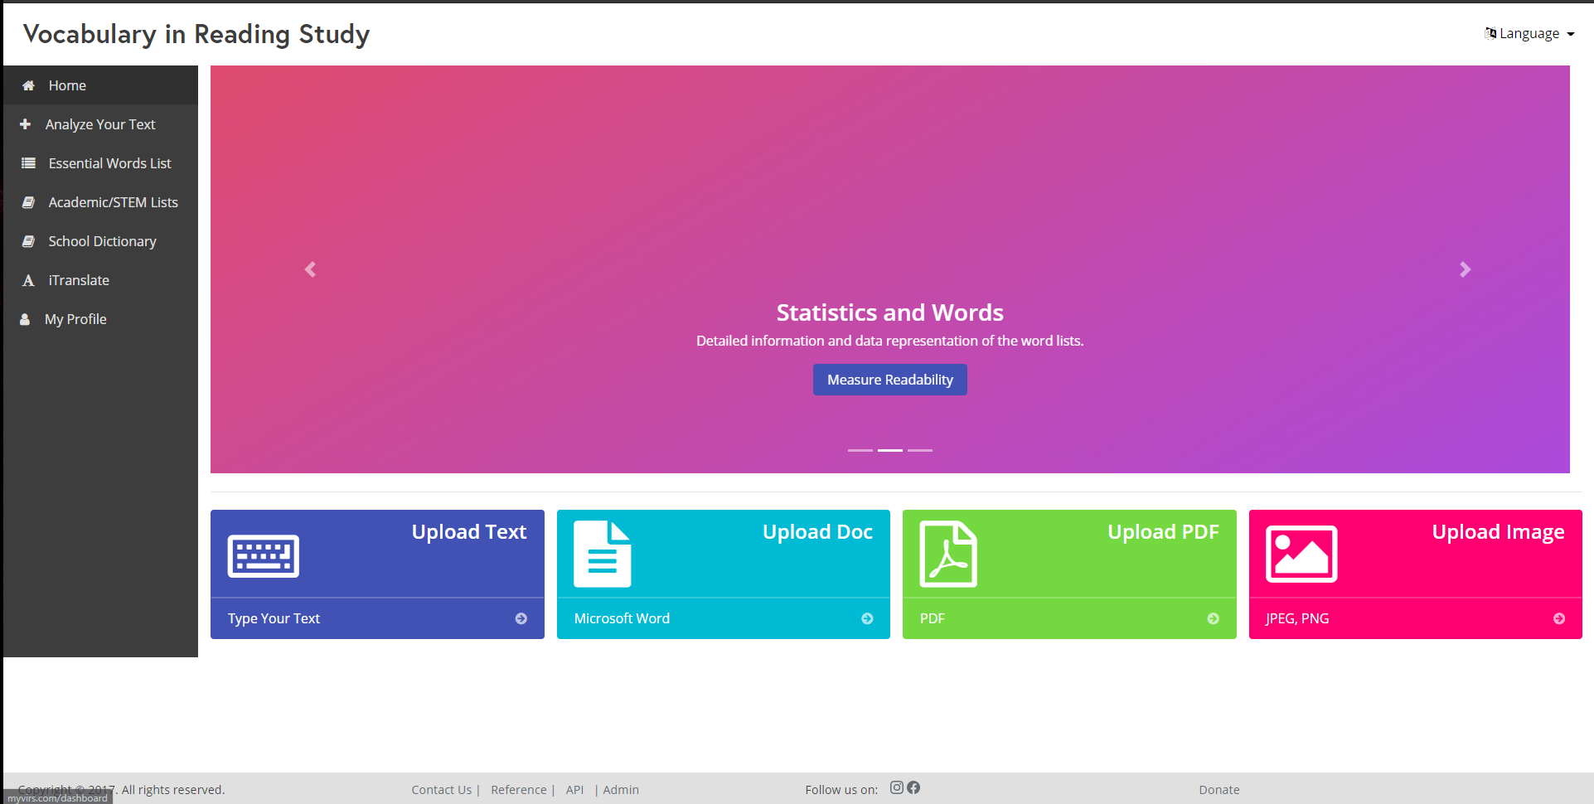
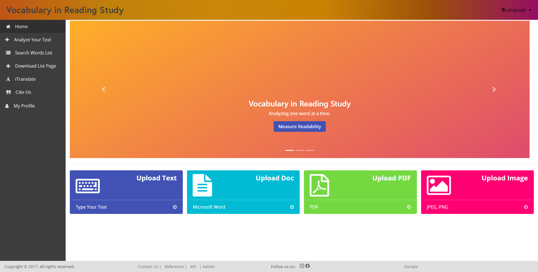
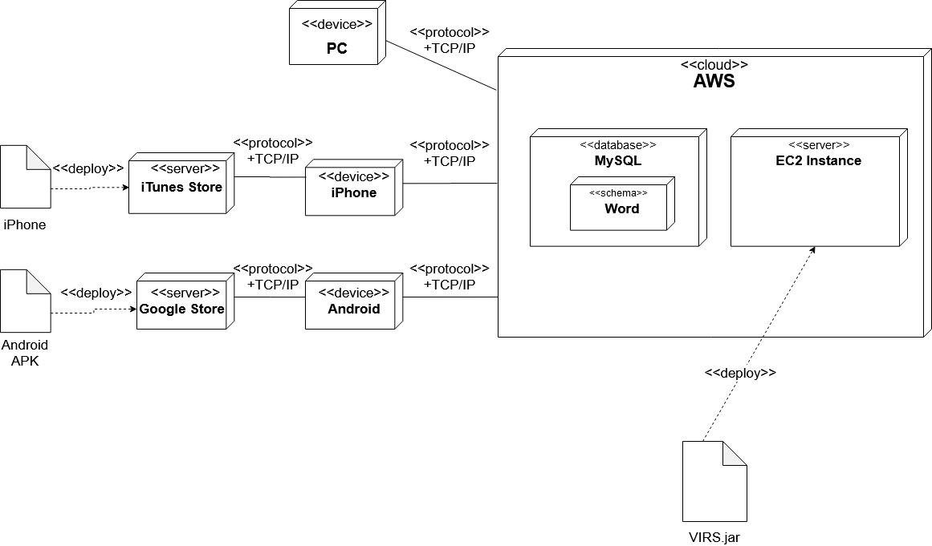
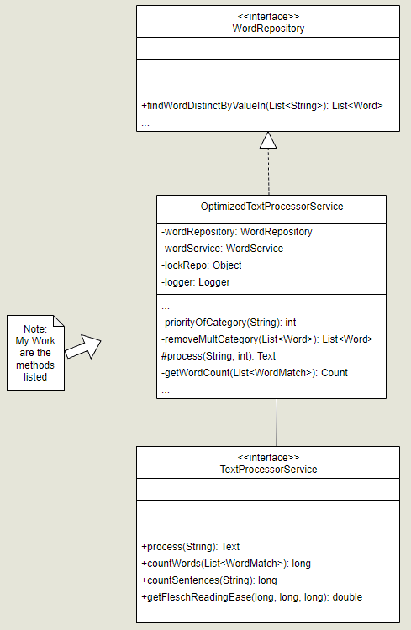
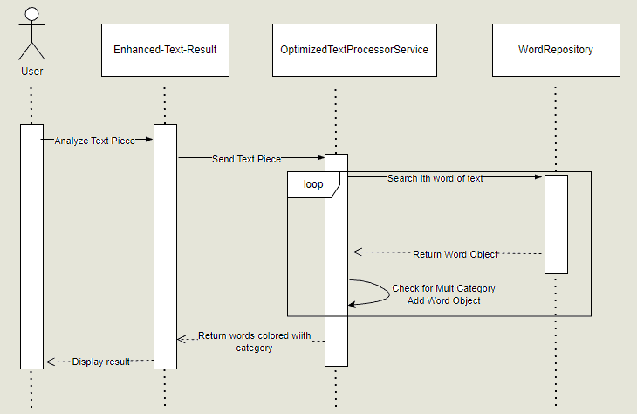
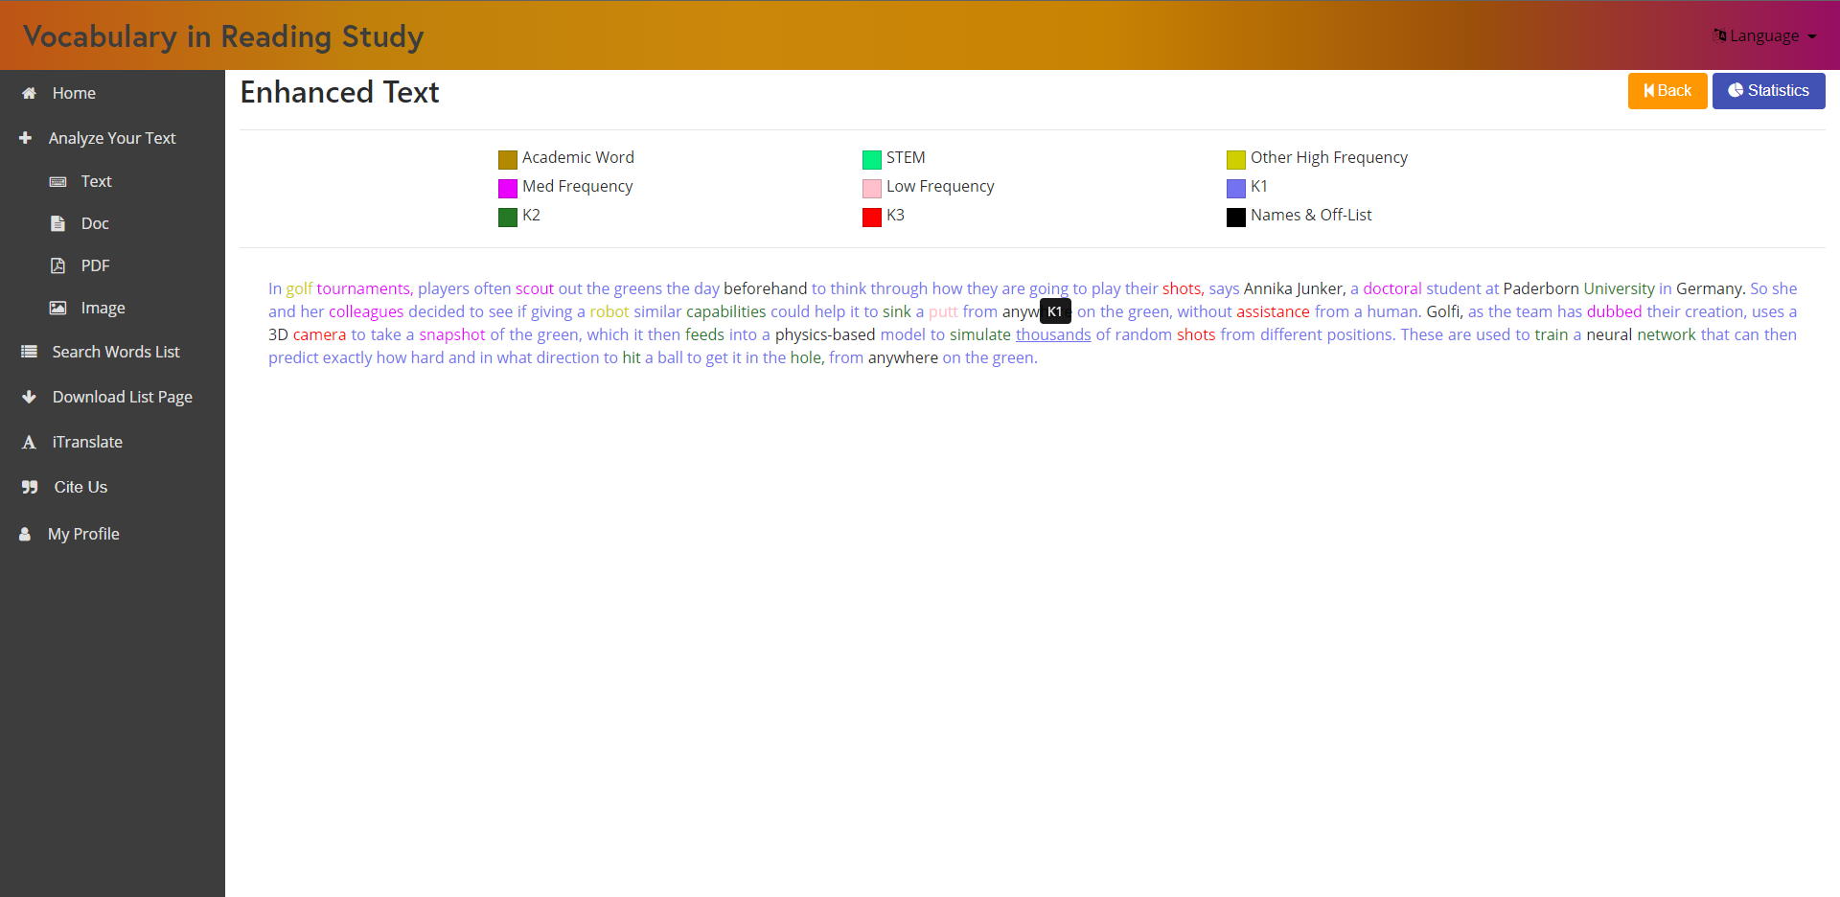
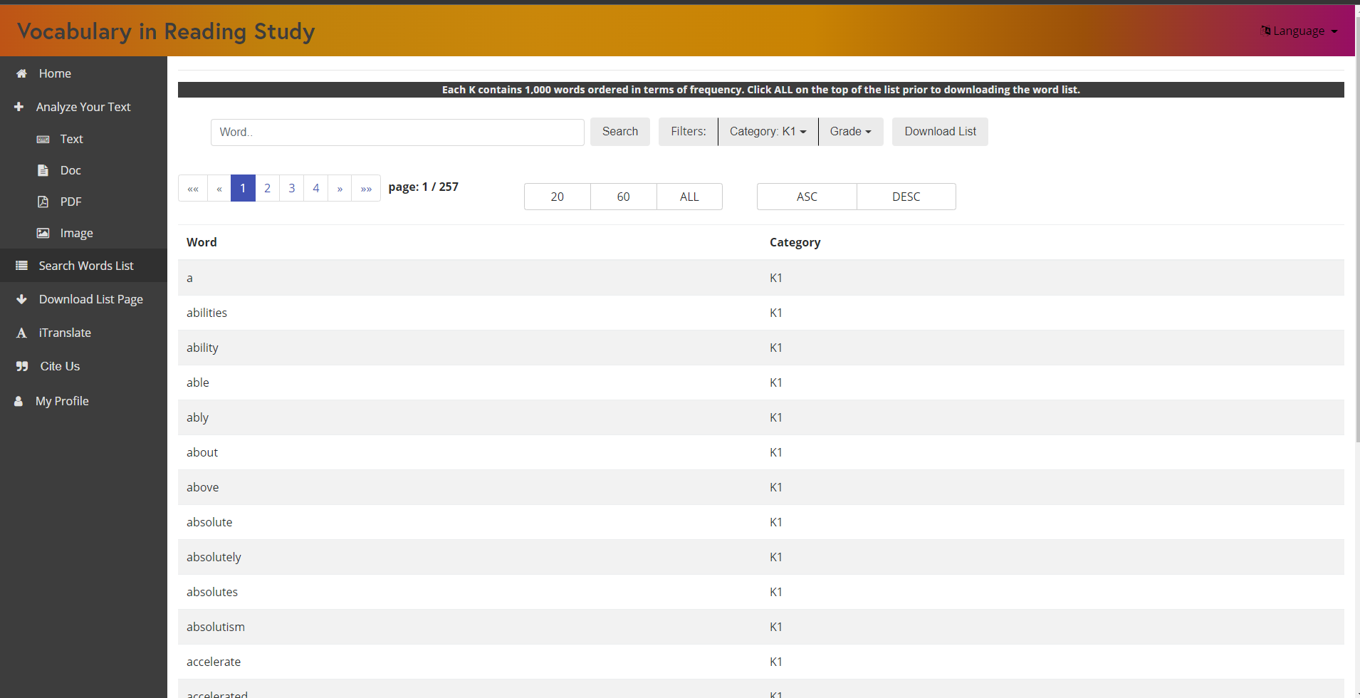
Knight Foundation School of Computing
& Information Sciences
Fall 2022 Senior Design Project
Vocabulary In Reading Study
Students: Oscar Molina
Mentor: Eric Dwyer
Instructor: Dr. Masoud Sadjadi
Florida International University
Problem
Current System
Requirements
Background of the website:
VIRS is a website dedicated to evaluate texts in such a manner that English Learners can understand at which level is a given text. It does so by giving specific statistics on the text’s readability as well as the frequency of each word in the English language (that is contained in the provided text).
Issues resolved this semester:
The installation instructions for the project were vague and this delayed production.
Some words were not going into their respective categories when analyzing a text.
Design of the website looked incomplete and misaligned.
The website had several redundant components.
Searching a word in the words lists was difficult.
Uploading documents and pdfs did not work.
Figure 1 – Old Design
When analyzing text each word should get into one category. In the case of words with multiple categories the word should go into the category with the highest priority.
Remove redundant components (Essential and academic words lists as well the dictionary) from the website and add new ones that combine the functionality of the previous ones (one main word list). The website should maintain its old functionality and gain new features.
Update the version of the code of the live website as the documents and pdfs uploads where already fixed but the code of the live version did not contain that fix.
Figure 2 – New Design
Figure 1 shows how the old home page looked. In Figure 2 we can see that the header of the website got a gradient fill to look more modern, the sidebar was properly aligned to fill to the bottom of the page, and the newly added components are located on the sidebar as well.
System Design
Object Design
Implementation
Figure 5 – Sequence Diagram
Figure 4 – UML Diagram
Figure 3 – Provided by previous groups
The site is hosted on AWS and the
mobile apps display the site through
a WebView object.
The Frontend consists of Angular Typescript, Bootstrap, CSS and HTML5
The backend is Java SpringBoot and MySQL.
The old design used lambda expressions and streams to collect the words retrieved from the database, and this caused errors when words had multiple categories as it would take an arbitrary word. The new design checks all the possible categories and selects the one with the highest priority.
Figure 5 shows the process when a text is analyzed. The enhanced text result component will send the text entered by the user to the optimized text processor service which will then return each of the words colored with their respective category.
Verification
Screenshots
Summary
Figure 6 – Enhanced Text
I was able to fix the defaulting of words which has been an issue for several years.
Me and the team removed redundant components and created one big component that preserves all the previous functionality.
I improved the design of the website to the product owner’s liking.
I added several small features throughout the website which improved its functionality and utility. Some of those include: the ‘Cite us’ component which when clicked it copies the citation of the website, hover over words to show the categories on the enhanced text result.
Test Case ID: Enhanced_Text_Result
Description: Words with multiple categories should default to one category when analyzing a text.
Test steps:
Navigate to virs code directory
Run ‘virs.cmd build’ and ‘virs.cmd’ run command
Navigate to localhost:8080
Click ‘Analyze Your Text’ and then ‘Text’. Paste a text paragraph that contains words with multiple categories and single category.
Check the words to see if they were defaulted correctly.
Expected result: Words with multiple categories should have defaulted to the category with the highest priority. Single category words should default to said category.
Actual Result: As expected
Status(Pass/Fail): Pass
Figure 7 – Search Words List
Figure 6 shows an analyzed text, the word ‘thousands’ which has multiple categories is hovered and shows ‘K1’ which is the category of highest priority. This shows that the defaulting works as intended .
Figure 7 shows the Search Words List component which is the combination of the redundant components in the old website.
The website still needs to be worked on in several areas, but the product owner mentioned that he was pleased with the amount of work done throughout the semester.
Acknowledgement
I thank Eric Dwyer for the assistance, cooperation and mentorship that I received throughout this process.

