Slide 1

Vocalize

Slide 2
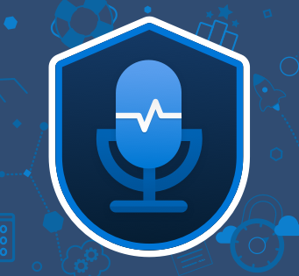
Speech Service Azure
Speech to Text
Text to Speech
Recognize audio

Slide 3
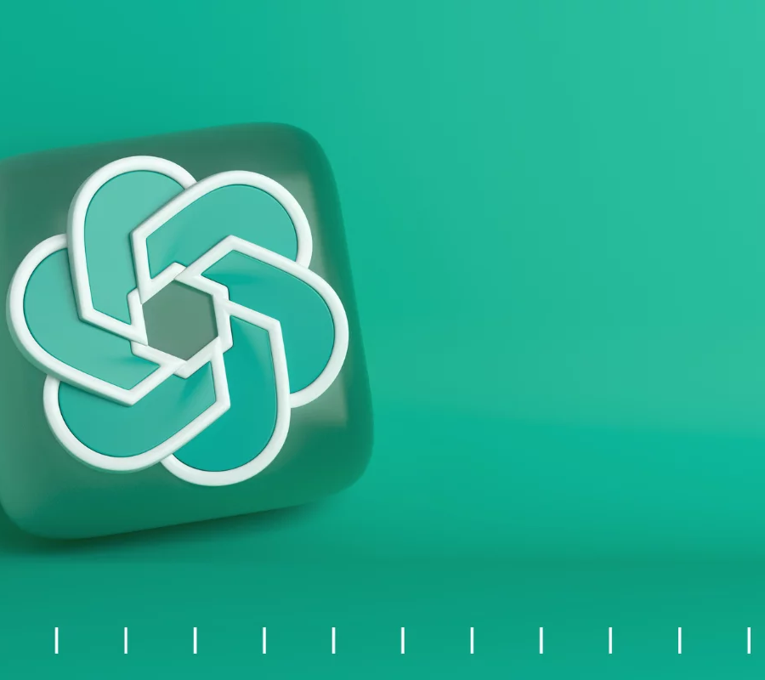
Integração chatGPT

