Slide 1

Slide 1
Employee Analysis
Prediction Model for Attrition and Salary
DDSAnalytics
Vo Nguyen
Notes:
Hi Welcome!

Slide 2

Slide 10
Agenda
Attrition Predictors
Modeling Attrition
Modeling Salary
Vo Nguyen
1
Notes:
Agenda will be Attrition Predictors
Modeling Attrition
Modeling Salary

Slide 3
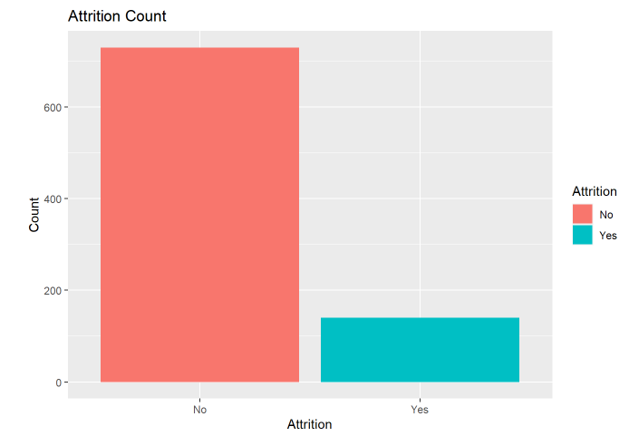

Slide 6
SUMMARY OF ATTRTION
ATTRITION PERCENTAGE
Attrition counts for 19% - 870 Total
730 – No
140 - Yes
About 1 in out 5 employee will leave the DDSAnalytics
19%
2
Notes:
First we are going to start with just a quick summary of attrition
As you can see here the data given has an attrition response of Yes and No
There are 730 No and 140 Yes

Slide 4
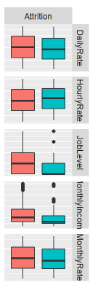
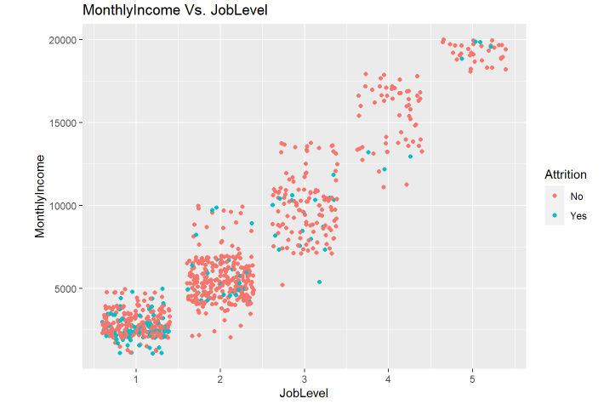
Slide 3
Linking Attrition to Wages and Job Level
71%
45%
Monthly Income
MARKETING
Statistical Output:
Difference in Means of about 71% in Monthly Income
>40%
Job Level
SCHEDULING
Statistical Output:
There is a clear difference of Attrition in job level. Additionally, over 40% of our Attrition – “Yes” have lower job level than 3.
Vo Nguyen
3
Notes:
We are going to look at important factors that could cause this which could be related to the wages and variables related to incomes and revenue.

Slide 5
Slide 5
Strong Predictors
Monthly Income
Job Level
Vo Nguyen
4
Notes:
Here are our top two predictors so far which is Monthly Income and Job Level

Slide 6


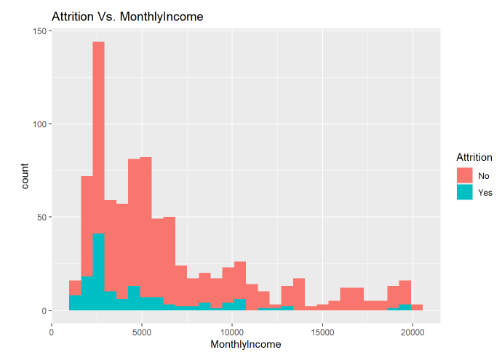
Slide 7
Monthly Income
Average Income of Attrition “Yes”
$4,765
Average Income of Attrition “No”
$6,702
Welch Two-Sample t-test indicates Difference in Means
Vo Nguyen

Slide 7
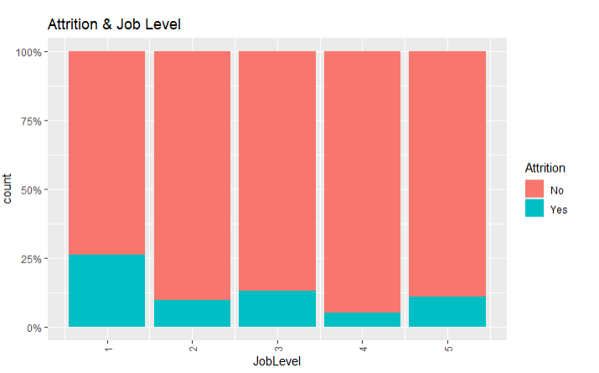
Slide 7
Job Level
Highest Job Attrition “Yes” at Job Level 1
Lowest Job Attrition “No” at Job Level 4
Welch Two-Sample t-test indicates Difference in Means
Vo Nguyen

Slide 8
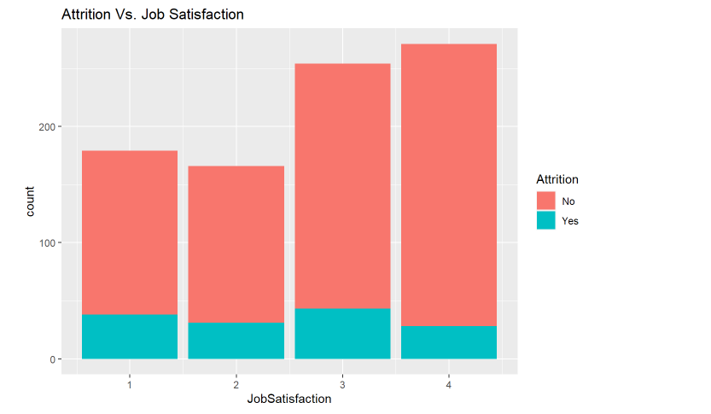
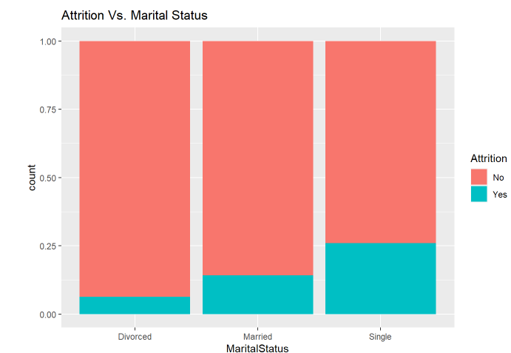
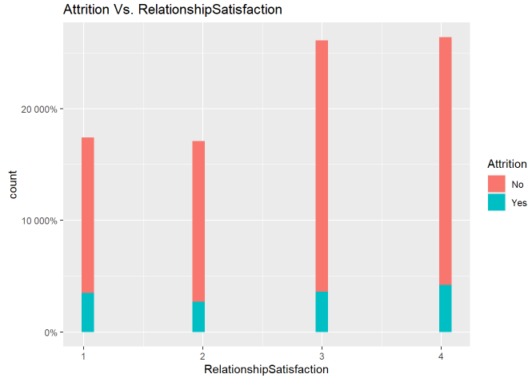
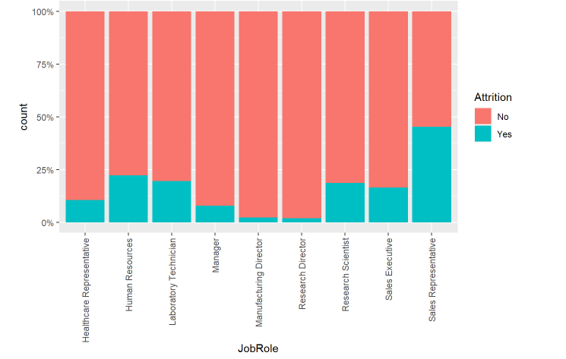
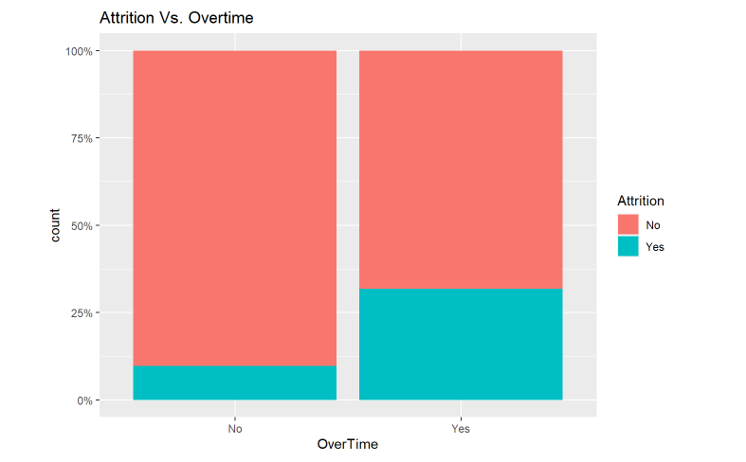
Slide 8
Data Analysis On Other Factors
7

Slide 9
Slide 5
Strong Predictors
Job Level
Over Time
Monthly Income
Vo Nguyen
8

Slide 10
Slide 9
Modeling Attrition
Data Clean Up
Using the Naïve Bayes Model
Categorical Variables are set to Dummy Variables.
Scale Dataset with a 70-30 split.
Use initial analysis of all predictors and then ran the model using only statistically significant variables
Step 2
Step 5
Step 1
Step 3
Picking the Model
Final Model
Naïve Bayes compared to KNN and Linear Regression was our best model
Using our Final Models with our best Predictor Variables to predict Attrition
Your logo
9

Slide 11
Slide 4
Final Model Comparisons
KNN
Linear Regression
Naïve Bayes
Accuracy : 89%
Sensitivity 89%
Specificity: 84%
Accuracy : 85%
Sensitivity 97%
Specificity: 20%
Accuracy : N/A
Sensitivity N/A
Specificity: N/A
We were unable to perform linear regression because our response was categorical, and thus logistic regression was needed, but not required.
Naïve Bayes is our best model with best Accuracy, Sensitivity, and Specificity.
We performed a KNN model to train our dataset but failed to meet the requirement of 60% for both sensitivity and specificity. Our KNN model gave us Thus, we will move onto Naive Bayes model.
Vo Nguyen
10

Slide 12
Slide 4
Final Model Naïve Bayes
Best Predictor Variables:
JobLevel
MonthIyncome
NumCompaniesWorked
MonthlyRate
OverTime
PerformanceRating YearsWithCurrManager RelationshipSatisfaction YearsAtCompany YearsSinceLastPromotion
BTRare
KNN
Naïve Bayes
Accuracy : 89%
Sensitivity 89%
Specificity: 84%
Naïve Bayes is our best model with best Accuracy, Sensitivity, and Specificity.
Vo Nguyen
10

Slide 13
Slide 9
Modeling Salary
Data Clean Up
Using Linear Regression
Categorical Variables are set to Dummy Variables.
Split dataset as 70-30 split.
Performed an initial Linear Regression using all Predictors and Interactions
Step 2
Step 5
Step 1
Step 3
Picking the Model
Final Model: Linear Regression
Linear Regression was chosen to best predict Salary
We chose the predictor values that was statistically significant at the alpha . 05 level with the interaction using Forward Selection method
Your logo
9

Slide 14
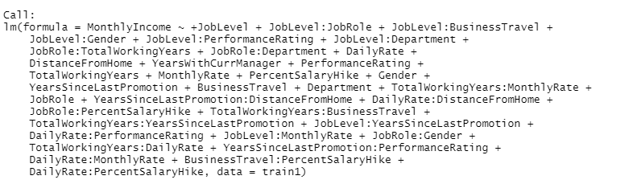
Slide 6
Modeling Salary: Multiple Linear Regression
Phase 1
Phase 2
Phase 3
Run Multiple Linear Regression on all Predictors
- Find The Statistically Significant Values
Run Multiple Linear Regression again with just
The statistically significant values:
JobLevel, JobRole, TotalWorkingYears,
Business Travel, Gender, Daily Rate, Monthly Rate
Years with Current Manager, YearsSinceLast Promo,
Distance From Home, Performance Rating
Percent Salary Hike, Department
Run Multiple Linear Regression again with just
The statistically significant values with interactions
Statistics
RSME | 970.6
Adjusted R² | .9554
Regression Equation
11

Slide 15
Slide 2
Conclusion
Prediction on Attrition
Prediction on Salary
Top Three Predictors
Monthly Income
Job Level
Overtime
Top Three Predictors
Job Role
Job Level
Total Working Years
Best Model: Naïve Bayes
Accuracy: 89%
Sensitivity: 89%
Specificity: 84%
Best Model: Multiple Linear Regression
RSME: 970.6
Adjusted R^{2:} .994
12

Slide 16
Slide 2
RShiny
https://vochannguyen.shinyapps.io/VoShiny2/
13

Slide 17

Slide 11
THANK YOU

