Slide 1
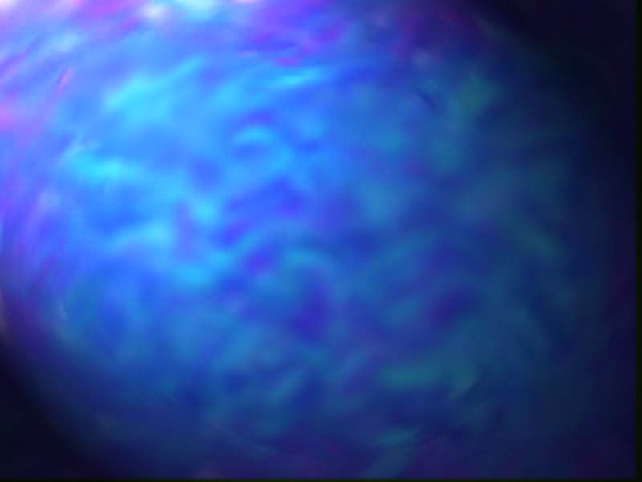
Isothermal Sections
Isothermal sections in ternary phase diagrams are horizontal slices through the three dimensional diagram. All points on the section are at the same temperature, unlike the normal view of the ternary diagram where the liquidus surface is seen.
Drawing isothermal sections in ternary phase diagrams, with no solid solutions, is a relatively simple procedure if it is gone about in a very systematic manner. The next few slides will demonstrate this step by step process.
The diagram used in this tutorial is Fig. 630 in Phase Diagrams for Ceramists: Volume 1. It will be helpful to follow along using the book, as many of the details are hard to see.
Click to continue

Slide 2
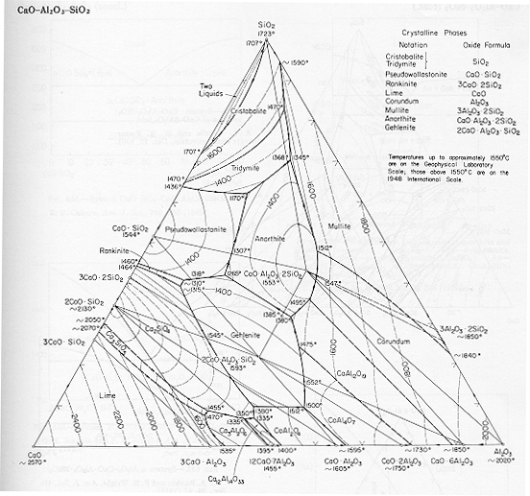

Tracing Isotherms
Trace the boundary of the diagram.
Identify and trace all the isotherms of the temperature for which you want the isothermal section, in this case 1400 ºC.
L
Identify the portion of the diagram where the liquidus surface is still below the temperature of interest and label this section: Liquid (L).
L
Click to continue

Slide 3
Intersection of Boundary Lines and Isotherms
At any point where the traced isotherm intersects a phase boundary line, including the edge of the diagram, draw a line from the intersection point back to the composition on either side of the phase boundary line.
L
From each composition that a line was drawn back to, draw tie lines to the liquidus line(s).
L
Click to continue

Slide 4
Alkemades Lines
Draw in any alkemades lines that don’t come into contact with the liquidus line(s), or cross any of the tie lines drawn so far.
L
L
Click to continue

Slide 5
Identifying Phase Regions
To understand the last step it is necceasary to describe the different regions of the isothermal section first.
There should now be up to four different regions on the isothermal section.
  Liquid region, composed entirely of a liquid of varying composition. This region was labeled on the first slide.
  Two Phase region, composed of a solid and a liquid. The composition of the liquid is found using the tie lines that were drawn in on the second slide. This region shares a border with the Liquid region.
  Three Phase region, composed of two compositions and one unvarying liquid composition. This region is easily recognized by its sole point of contact with the Liquid region.
  Solid region, composed of three solids. This region is triangular, and has no contact with the Liquid region.
Click to continue

Slide 6
Labeling
Identify the phases present in each of the three different types of regions, and label each of the different regions in the diagram.
  Two Phase Regions
L₈
  Three Phase Regions
L₂
L₁
L₇
  Solid Regions
L
L₃
Phases Present
L₄
L₆
L₅
2CaO ·SiO₂ +
2CaO ·Al₂O₃ ·SiO₂ +
L₄
CaO ·6Al₂O₃ +
CaO ·Al₂O₃ ·2SiO₂ +
L₆
2CaO ·Al₂O₃ ·SiO₂ +
CaO ·6Al₂O₃ +
L₅
CaO ·Al₂O₃ ·2SiO₂ +
3Al₂O₃ · 2SiO₂ +
L₇
2CaO ·SiO₂ +
2CaO ·Al₂O₃ ·SiO₂ +
L₁₀
2CaO ·Al₂O₃ ·SiO₂ +
CaO · Al₂O₃ +
L₁₁
3CaO · Al₂O₃ +
2CaO ·Al₂O₃ ·SiO₂ +
CaO ·2Al₂O₃
2CaO ·Al₂O₃ ·SiO₂ +
CaO ·2Al₂O₃ +
CaO ·6Al₂O₃
CaO ·6Al₂O₃ +
CaO ·Al₂O₃ ·2SiO₂ +
Al₂O₃
Al₂O₃ +
CaO ·Al₂O₃ ·2SiO₂ +
3Al₂O₃ ·2SiO₂
3Al₂O₃ · 2SiO₂ +
SiO₂ +
L₈
2CaO ·SiO₂ +
3CaO · Al₂O₃ +
L₉
CaO ·SiO₂ +
3CaO ·2SiO₂ +
L₂
3CaO ·2SiO₂ +
2CaO ·SiO₂ +
L₃
2CaO ·SiO₂ +
3CaO ·SiO₂ +
3CaO · Al₂O₃
SiO₂ +
CaO ·SiO₂ +
L₁
3CaO ·SiO₂ +
CaO +
3CaO · Al₂O₃
L₁₀
CaO ·Al₂O₃ ·2SiO₂ + Liquid
2CaO ·Al₂O₃ ·SiO₂ + Liquid
2CaO ·Al₂O₃ ·SiO₂ + Liquid
12CaO ·7Al₂O₃ + Liquid
3Al₂O₃ ·2SiO₂ + Liquid
3CaO ·2SiO₂ + Liquid
CaO ·6Al₂O₃ + Liquid
3CaO ·Al₂O₃ + Liquid
2CaO ·SiO₂ + Liquid
2CaO ·SiO₂ + Liquid
CaO ·Al₂O₃ + Liquid
CaO ·SiO₂ + Liquid
L₁₁
SiO₂ + Liquid
L₉
L
Click to continue

Slide 7
Things To Remember
Use the representative tie lines to determine the percent of each phase present in a Two Phase region, and to determine the liquid composition.
Use parallel lines in the Three Phase and the Solid regions to determine the percent of each phase present.
If making the isothermal section on a copy of a diagram, use colored pencils for the different steps.
Use tracing paper when the best results are desired.
Click to Continue
Main Menu

