Slide 1

Podcast Summarization
Abdelrahman Zanatii
Supervied by: Prof. Wael Hassan

Slide 2
Introduction
01
Podcasts has a vast and expanding collection of audio records.
Summarization will help users aiming to find their preferences.
Abstractive summarization generates text instead of just picking important sentences (extractive summarization).
Deep learning models shown lots of success in abstractive summarization.
Spotify large-scale dataset with more than 100,000 English transcriptions.

Slide 3
Problem Statement
02
The struggle to find and consume relevant podcasts.
Lack of informative descriptive text about the podcast content.
Absence of automated podcast summarization solution.

Slide 4
Objective
03
Transcribe the audio in podcast episodes using Automatic Speech Recognition (ASR) to produce reliable transcripts.
Utilize NLP pre-processing techniques and machine learning models (BART) to summarize the transcripts.
Evaluate the performance using relevant evaluation metrics such as Bert-Score and Rouge metrics.
The system aims to enhance accessibility and efficiency in audio content consumption.

Slide 5
Related Work (1)
04
Zheng, C., Zhang, K., Wang, H. J., & Fan, L. (2020). A two-phase approach for abstractive podcast summarization.
DATASET
The dataset used in this work is the TREC Spotify podcast dataset, a 105,360 podcast episodes from 18,376 shows produced by 17,473 creators. The average duration of a single episode is 30 minutes, while the longest can be over 5 hours and the shortest is only 10 seconds. (“100,000 Podcasts: A Spoken English Document Corpus” by Ann Clifton, etc. (2020))
Methodology
The authors had a “two phase approach” for podcast summarization, The key is to select important sentences from the input document and use it as the input for the abstractive summarization model.
To identify the selected sentences they used two methods ROUGE-based Approach & Topic-Enhanced Approach. ROUGE-based approach had two implementations Sliding Window ROUGE-based Approach & Novelty-Enhanced ROUGE-based Approach.
This work chose to use BART framework (distilBART) developed by HugingFace as their model.

Slide 6
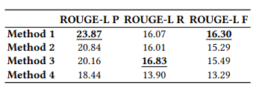
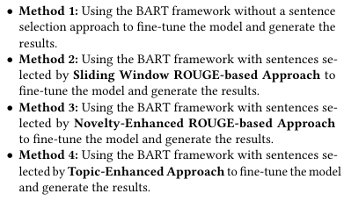
Related Work (1)
04
Zheng, C., Zhang, K., Wang, H. J., & Fan, L. (2020). A two-phase approach for abstractive podcast summarization.
Results & Limitations
Given their methodology for the selected sentences the result had four methods using ROUGE-metrics.
Their reference summary had issues such as social media links or sponsorships in the episode description.

Slide 7
Related Work (2)
04
Saxena, P., & El-Haj, M. (2023). Exploring Abstractive Text Summarisation for Podcasts: A Comparative Study of BART and T5 Models.
DATASET
The dataset used in this work is the TREC Spotify podcast dataset, a 105,360 podcast episodes from 18,376 shows produced by 17,473 creators. The average duration of a single episode is 30 minutes, while the longest can be over 5 hours and the shortest is only 10 seconds. (“100,000 Podcasts: A Spoken English Document Corpus” by Ann Clifton, etc. (2020))
Methodology
Their research explores the usage of abstractive summarization techniques to produce premium summaries of the podcast episodes.
Removed low-quality descriptions dominated by emojis, URLs, advertisements, and promotions.
Utilizing the TextRank algorithm, they enhanced the accuracy and relevance of the reference summaries by maintaining only high quality episodes with precision >88%.
Specifically, they fine-tune transformer-based models such as BART and T5, on Spotify’s 100K podcasts dataset to compare their performance.

Slide 8
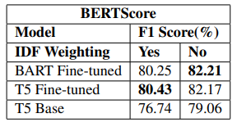
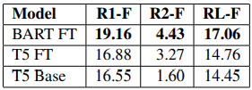
Related Work (2)
04
Saxena, P., & El-Haj, M. (2023). Exploring Abstractive Text Summarisation for
Podcasts: A Comparative Study of BART and T5 Models.
Results & Limitations
Both models produced high-quality summaries.
Revealing that the BART model achieved higher ROUGE scores.
While, The T5 model performed better in terms of semantic meaning.

Slide 9
Dataset
05
TREC Spotify Podcast Dataset.
This dataset consists of over 100,000 episodes each in English from different podcast shows on Spotify. The dataset is available for research purposes.
Each of the episodes in the dataset includes an audio file, a text transcript, episode description and some associated metadata.
Contains a golden dataset of 150 record graded from (E-B).
“100,000 Podcasts: A Spoken English Document Corpus” by Ann Clifton, etc. (2020)

Slide 10
06
Proposed Solution
The usage of the TREC Spotify Podcast Dataset.
Chunk selection with a classifier-based module.
Extensive pre-processing on descriptions, selecting a subset from the episodes.
Utilizing and fine-tuning models for podcast summarization.
Further enhance the performance evaluation of prior-work.

Slide 11
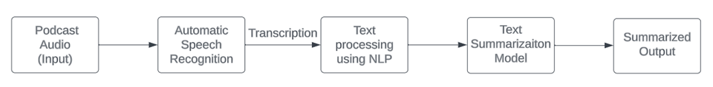
07
Methodology
Obtain the podcast audio as input.
Transcribing the audio to text using ASR (Whisper OPEN-AI).
Pre-process the text using NLP techniques (tokenization, stop word removal, stemming, and lemmatization).
Use the fine-tuned BART model to generate the summarization.
A compact UI to enhance the user experience.

Slide 12
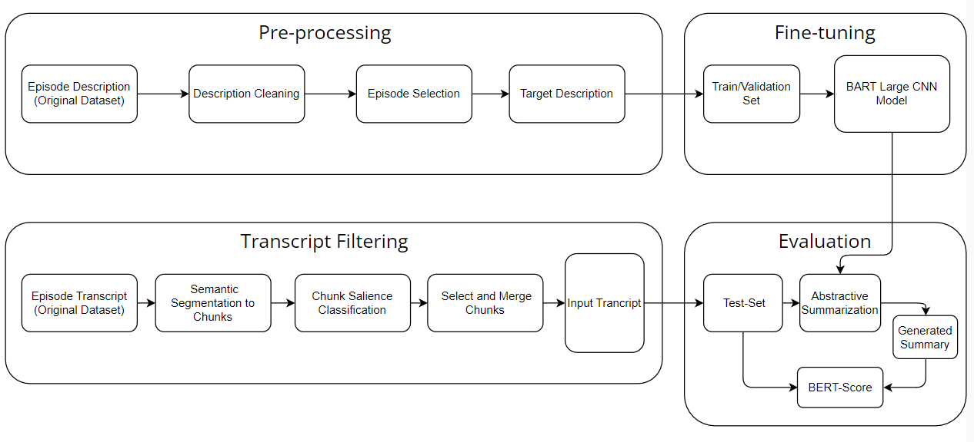
System Architecture
07

Slide 13
System Architecture Description-Cleaning
07
Removed episodes with very long or short Descriptions. (max =700, min=50)
Episode selection based on similarity in description between the show and other episodes.
(>60% similarity with its show description)
(>70% similarity with other episode description in the same show)
Removal of useless sentences such as(sponsorships, mentions, URLs, and emojiis).
Removal of ambiguous sentences using Inverse Document Frequency (IDF).

Slide 14
System Architecture Pre-processing
07
If you like ASMR you will love this White Noise Machine on Amazon!
Tap here to check it out! If you enjoyed this make sure to give us a 5 star rating! ---
This episode is sponsored by · Anchor: The easiest way to make a podcast.
https://anchor.fm/app
Support this podcast: https://anchor.fm/AdamDino/support
If you like ASMR you will love this White Noise Machine on Amazon!
Tap here to check it out!
If you enjoyed this make sure to give us a 5 star rating!

Slide 15
System Architecture Episode Selection
07
Today, three of the worlds straightest males have gathered to talk about the straightest things.
On the Wearings-Socks Podcast, three of the worlds straightest males have gathered to talk about the straightest things.
Show description Similarity to episode description (86%)
In this exercise, drift off to sleep while listening to nature sounds.
In the full version of this exercise, focus on muscle relaxation while listening to nature sounds.
Episode description Similarity to another episode description (71%)

Slide 16
System Architecture Semantic Segmentation
07
Sentence embeddings are generated through the utilization of Sentence-BERT.
Self-semantic segmentation calculates the similarity between sentence embedding.
The semantic similarity between sentences is computed and averaged by chunks.

Slide 17
System Architecture Chunks Filtering
07
Important segments chunks should be similar with their description.
Trained a classifier model to predict important chunks similarity with the descriptions, using the golden dataset as the training data.
Chunks with a rouge score exceeding a certain threshold (20%) are included in the dataset.

Slide 18
Evaluation
08
The test-set contains 1027 episodes.
After filtering 2 episodes were removed.
Chosen Metrics:
BERTScore evaluates based on semantics, using contextual word embedding.
ROUGE-Metrics evaluates based on matching n-grams, not optimal for abstractive summarization.

Slide 19
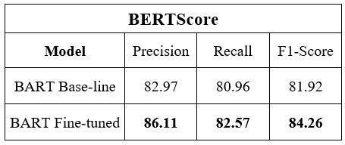
Results
08
BERT-score Results
Results shows that the generated summaries are highly correlated with the references (episode description).
Reflecting a notable improvement of +2.34% over BART base-line model.

Slide 20
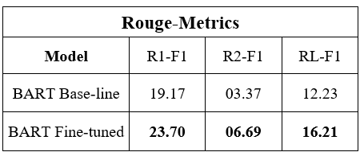
Results
08
ROUGE-Metrics (F1 score) Results
Results reveals that the fine-tuned model outperforms the BART base-line model in all ROUGE-Metrics.
Since the model is based on abstractive summarization, ROUGE-metric may not be appropriate (due to its matching n-grams comparison).

Slide 21
Comparative Results
08
BERTScore:
Our model outperformed Saxena, P., & El-Haj, M. (2023). by 2.05%

Slide 22
Comparative Results
08
ROUGE-Metrics:
Our model performs slightly better Zheng, C., Zhang, K., Wang, H. J., & Fan, L. (2020) Methods.

Slide 23
DEMO
09

Slide 24
Conclusion & Future Work
10
Fine-tuning considerably improved the model.
BERTScore results showed that the generated summaries are meaningful.
Longer training might enhance the model performance.
Using entity recognition to extract extra semantic data can help find key information.

Slide 25
References
11
Zheng, C., Zhang, K., Wang, H. J., & Fan, L. (2020). A two-phase approach for abstractive podcast summarization. arXiv preprint arXiv:2011.08291.
Saxena, P., & El-Haj, M. (2023). Exploring Abstractive Text Summarisation for Podcasts: A Comparative Study of BART and T5 Models. In Proceedings of the 14th International Conference on Recent Advances in Natural Language Processing (pp. 1023-1033).
Clifton, A., Reddy, S., Yu, Y., Pappu, A., Rezapour, R., Bonab, H., ... & Jones, R. (2020, December). 100,000 podcasts: A spoken English document corpus. In Proceedings of the 28th International Conference on Computational Linguistics (pp. 5903-5917).

Slide 26
THANK YOU

