Slide 1

Podcast Summarization
Abdelrahman Zanatii
Supervied by: Prof. Wael Hassan

Slide 2
Introduction
01
Podcasts constitute a vast and expanding collection of records.
Significant enhancement in information pertaining to new databases: fresh subjects, extended duration, diverse formats.
Summarization will help users aiming to find their preferences.
Spotify large-scale dataset with more than 100,000 transcriptions.

Slide 3
Problem Statement
02
The struggle to find and consume relevant podcasts.
Lack of descriptive text about the podcast content.
Absence of automated podcast summarization solution.

Slide 4
Objective
03
Develop a system to transcribe the audio in podcast episodes using Automatic Speech Recognition (ASR) to produce reliable transcripts.
Utilize NLP techniques and machine learning models to summarize the transcripts.
Evaluate the performance using relevant evaluation metrics such as Bert-Score and Rouge metrics.
The system aims to enhance accessibility and efficiency in audio content consumption.

Slide 5
Related Work (1)
04
Vartakavi, A., Garg, A., & Rafii, Z. (2021). Audio summarization for podcasts.
DATASET
Created their own dataset from 19 podcast series, the dataset contains 309 different podcast episodes with an average duration of 36.5 minute per episode.
Where, 17 different annotators annotated the 309 podcast episodes.
Methodology
The authors created a podcast summarization tool (PodSumm) by transcribing the podcast audio using automatic speech recognition (ASR), then utilizing PreSumm model (A pre-trained BERT model on a CNN/DailyMail dataset).
Lastly, to get to their best performance they fine-tuned the PreSumm model to handle podcast summaries using their own dataset.
Results & Limitations
Their final model achieved the best performance given a ROUGE(1/2/L) F-scores of 64%/53%/63%.
The lack of a larger dataset was an issue for the research.

Slide 6
Related Work (2)
04
Zheng, C., Zhang, K., Wang, H. J., & Fan, L. (2020). A two-phase approach for abstractive podcast summarization.
DATASET
The dataset used in this work is the TREC Spotify podcast dataset, a 105,360 podcast episodes from 18,376 shows produced by 17,473 creators. The average duration of a single episode is 30 minutes, while the longest can be over 5 hours and the shortest is only 10 seconds. (“100,000 Podcasts: A Spoken English Document Corpus” by Ann Clifton, etc. (2020))
Methodology
The authors had a “two phase approach” for podcast summarization, The key is to select important sentences from the input document and use it as the input for the abstractive summarization model.
To identify the selected sentences they used two methods ROUGE-based Approach & Topic-Enhanced Approach. ROUGE-based approach had two implementations Sliding Window ROUGE-based Approach & Novelty-Enhanced ROUGE-based Approach.
This work chose to use BART framework (distilBART) developed by HugingFace as their model.

Slide 7
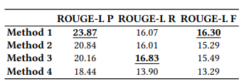
Related Work (2)
04
Zheng, C., Zhang, K., Wang, H. J., & Fan, L. (2020). A two-phase approach for abstractive podcast summarization.
Results & Limitations
Given their methodology for the selected sentences the result had four methods using ROUGE-metrics.
Their reference summary had issues such as social media links or sponsorships in the episode description.

Slide 8
Dataset
05
TREC Spotify Podcast Dataset.
This dataset consists of over 100,000 episodes each in English from different podcast shows on Spotify. The dataset is available for research purposes.
Each of the episodes in the dataset includes an audio file, a text transcript, and some associated metadata.
“100,000 Podcasts: A Spoken English Document Corpus” by Ann Clifton, etc. (2020)

Slide 9
06
Proposed Solution
The usage of the TREC Spotify Podcast Dataset.
Selecting chunks with a classifier-based module.
Extensive pre-processing on descriptions, selecting a subset from the episodes.
Utilizing and fine-tuning models for podcast summarization.
To further enhance the performance evaluation of prior-work.

Slide 10
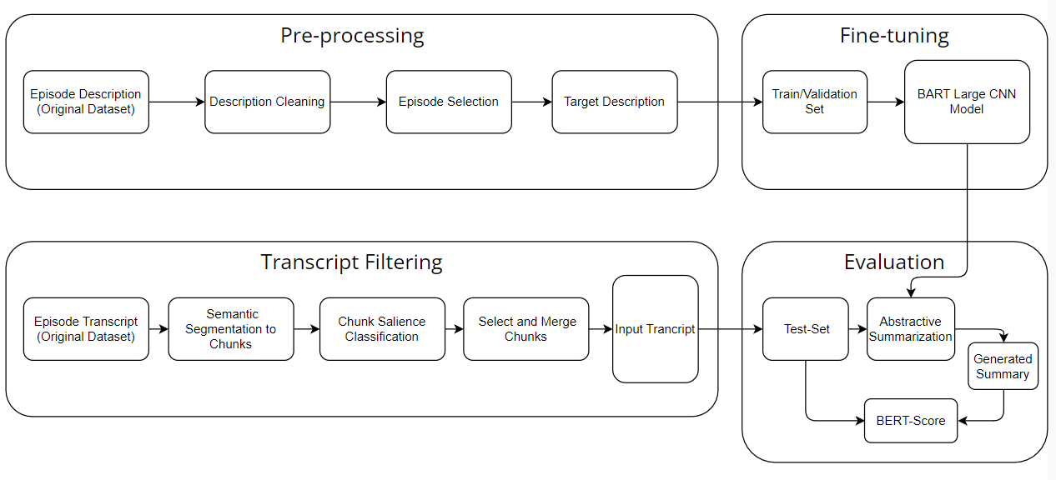
System Architecture
07

Slide 11
System Architecture Description-Cleaning
07
Episode selection on duration and similarity in description between the show and other episodes.
Removal of useless sentences such as(sponsorships, mentions, URLs, and emojiis).
Removal of ambiguous sentences using Inverse Document Frequency (IDF).

Slide 12
System Architecture Pre-processing
07
If you like ASMR you will love this White Noise Machine on Amazon!
Tap here to check it out! If you enjoyed this make sure to give us a 5 star rating! ---
This episode is sponsored by · Anchor: The easiest way to make a podcast.
https://anchor.fm/app
Support this podcast: https://anchor.fm/AdamDino/support
If you like ASMR you will love this White Noise Machine on Amazon!
Tap here to check it out!
If you enjoyed this make sure to give us a 5 star rating!

Slide 13
System Architecture Episode Selection
07
Today, three of the worlds straightest males have gathered to talk about the straightest things.
On the Wearings-Socks Podcast, three of the worlds straightest males have gathered to talk about the straightest things.
Show description Similarity to episode description (86%)
In this exercise, drift off to sleep while listening to nature sounds.
In the full version of this exercise, focus on muscle relaxation while listening to nature sounds.
Episode description Similarity to another episode description (71%)

Slide 14
System Architecture Semantic Segmentation
07
Sentence embeddings are generated through the utilization of Sentence-BERT.
Self-semantic segmentation calculates the similarity between sentence embedding.
The semantic similarity between sentences is computed and averaged across chunks.

Slide 15
System Architecture Chunks Filtering
07
To check the salient chunks similarity with their description.
Trained a classifier model to predict salient chunks similarity with the descriptions, using the golden dataset as the training data.
Chunks with a rouge score exceeding a certain threshold are included in the dataset.

Slide 16
System Architecture Summary
07
Behavior bitches is a weekly podcast from Beertown.org. The podcast focuses on the psychology of women and their behavior. This week, the hosts talk about the importance of eye contact and how it can be applied to men.
In this episode, Dr. Kelly and her husband, Alan, talk about the importance of eye contact in behavior analysis and how it can be applied in therapy. They also talk about how important it is to reinforce eye contact and why it's so important in the field of behavior analysis.
Pre-Trained
Fine-tuned

Slide 17

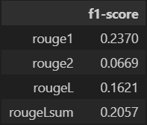
Results
08
BERT-score
ROUGE-Metrics (F1 score)

Slide 18
References
09
Vartakavi, A., Garg, A., & Rafii, Z. (2021, August). Audio summarization for podcasts. In 2021 29th European signal processing conference (EUSIPCO) (pp. 431-435). IEEE.
Zheng, C., Zhang, K., Wang, H. J., & Fan, L. (2020). A two-phase approach for abstractive podcast summarization. arXiv preprint arXiv:2011.08291.
Clifton, A., Reddy, S., Yu, Y., Pappu, A., Rezapour, R., Bonab, H., ... & Jones, R. (2020, December). 100,000 podcasts: A spoken English document corpus. In Proceedings of the 28th International Conference on Computational Linguistics (pp. 5903-5917).

Slide 19
THANK YOU

