Slide 1


CHALLENGE
MAX BLOC
BLOCS
< ENTER CODE >
#1
5
WHILE < CONDITION>
GO RIGHT
WHILE < has cell on right>
HAS CELL ON RIGHT
GO RIGHT
REPEAT N TIMES
CASE 1
CASE 2
CASE 3
GO TO THE LAST CELL
!!! PROGRAMM MUST FOR THE 3 CASES !!

Slide 2

CHALLENGE
MAX BLOC
BLOCS
< ENTER CODE >
#2
4
WHILE < CONDITION>
GO RIGHT
WHILE < has diamond on right>
HAS DIAMOND ON RIGHT
GO RIGHT
HAS NO DIAMOND ON RIGHT
PICK UP
CASE 1
CASE 2
CASE 3
TAKE ALL DIAMOND
!!! PROGRAMM MUST FOR THE 3 CASES !!

Slide 3
CHALLENGE
MAX BLOC
BLOCS
#3
5
WHILE < CONDITION>
GO RIGHT
WHILE < has no diamon>
HAS DIAMOND
PICK UP
GO RIGHT
HAS NO DIAMOND
PICK UP
CASE 1
CASE 2
CASE 3
TAKE THE ONLY ONE DIAMOND
!!! PROGRAMM MUST FOR THE 3 CASES !!

Slide 4
CHALLENGE
MAX BLOC
BLOCS
< ENTER CODE >
#4
5
WHILE < CONDITION>
GO RIGHT
WHILE < has not diamond>
HAS DIAMOND
GO UP
GO UP
HAS NOT DIAMOND
PICK UP
GO RIGHT
CASE 1
CASE 2
PICK UP
TAKE THE ONLY ONE DIAMONDS
!!! PROGRAMM MUST FOR THE 3 CASES !!

Slide 5

CHALLENGE
MAX BLOC
BLOCS
#7
9
IF < CONDITION>
GO RIGHT
WHILE < has cell on right>
WHILE < CONDITION>
PICK UP
IF < has cake>
EAT
EAT
HAS CAKE
HAS DIAMOND
HAS CELL ON RIGHT
IF < has diamond>
CASE 1
PICK UP
GO RIGHT
CASE 2
TAKE ALL DIAMOND
EAT ALL CAKES
SIZE OF THE ROAD CAN CHANGE !!!!!!!
!!! PROGRAMM MUST FOR THE 3 CASES !!
CASE 3

Slide 6
CHALLENGE
MAX BLOC
BLOCS
WHILE < has cell on right>
#8
9
WHILE < CONDITION>
IF< CONDITION>
GO RIGHT
HAS DIAMOND
GO LEFT
IF< has diamond>
HAS CELL ON RIGHT
GO RIGHT
PICK UP
HAS CELL ON LEFT
PICK UP
CASE 1
WHILE < has cell on left>
GO LEFT
CASE 2
TAKE ALL DIAMONDS
COME BACK TO THE INITIAL POINT
SIZE OF THE ROAD CAN CHANGE !!!!!!!
!!! PROGRAMM MUST FOR THE 3 CASES !!
CASE 3

Slide 7
REPEAT <4>
CHALLENGE
MAX BLOC
GO DOWN
IF < CONDITION>
WHILE < Has cell on right>
#9
18
REPEAT N TIMES
GO LEFT
GO RIGHT
GO RIGHT
IF < Has diamond>
HAS CELL ON LEFT
PICK UP
HAS DIAMOND
PICK UP
GO UP
HAS CELL ON RIGHT
GO DOWN
WHILE <Has cell on left>
CASE 1
CASE 2
CASE 3
GO Left
IF < Has diamond>
PICK UP
TAKE ALL DIAMONDS
!!! PROGRAMM MUST WORK FOR THE 3 CASES !!

Slide 8

GO FOWARD
PICK UP
REPEAT < N time >
#10
MAX=11
TURN AROUND
JUMP
Take all diamonds
And go the green cell
Bring diamonds to
The left side of
the river

Slide 9
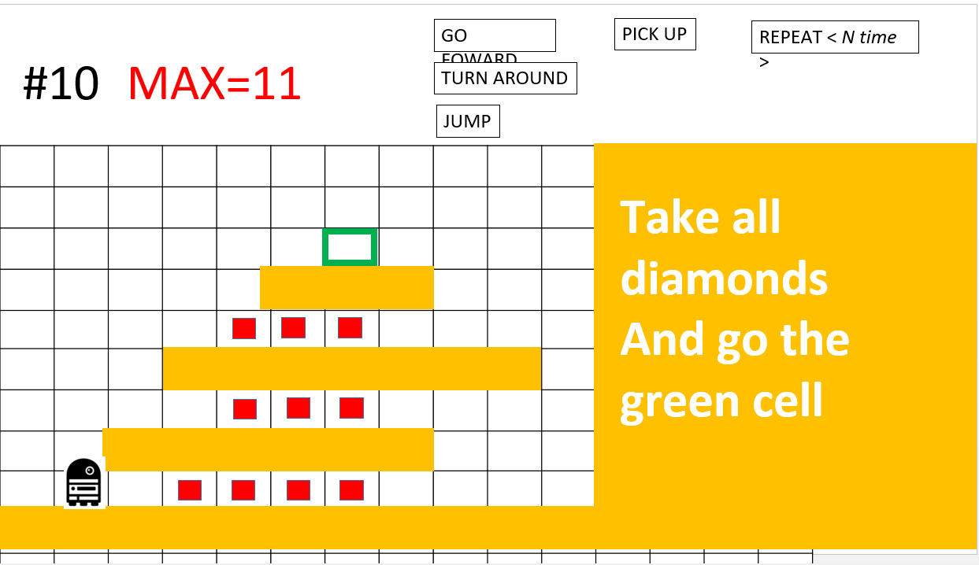
GO FOWARD
GO FOWARD
PICK UP
REPEAT < 3 >
REPEAT < 3 >
GO FOWARD
PICK UP
GO FOWARD
JUMP
TURN AROUND
GO FOWARD

Slide 10

GO UP
IF < CONDITION>
PICK UP
#11
MAX=15
HAS DIAMOND
GO DOWN
DROP
REPEAT < N time >
GO RIGHT
GO LEFT
Pick up all
And
bring diamonds
To the green cell
Bring diamonds to
The left side of
the river

Slide 11
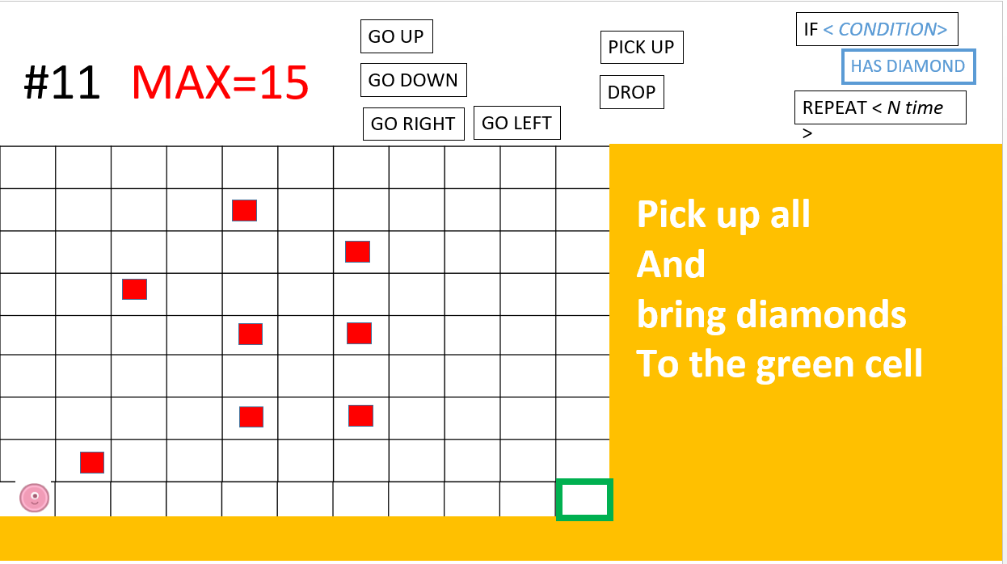
REPEAT < 3 >
GO RIGHT
REPEAT <8>
GO UP
IF <has diamond>
PICK UP
GO RIGHT
REPEAT <8>
GO DOWN
IF <has diamond>
PICK UP
REPEAT < 4 >
GO RIGHT
DROP

