Slide 1

BOOLEAN
TRUE
FALSE

Slide 2
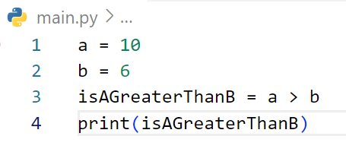
Find output of the code?
Answer: True

Slide 3
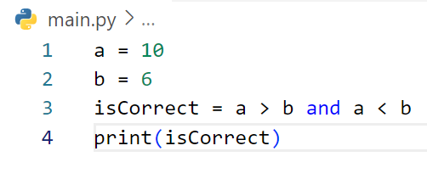
Find output of the code?
Answer: False

Slide 4
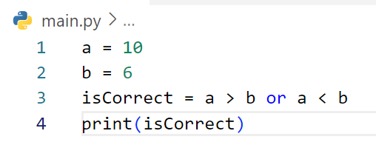
Find output of the code?
Answer: True

Slide 5
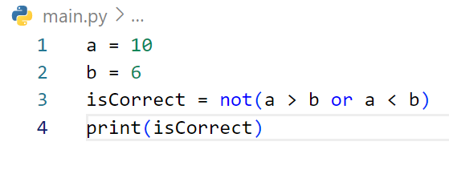
Find output of the code?
Answer: False

Slide 6
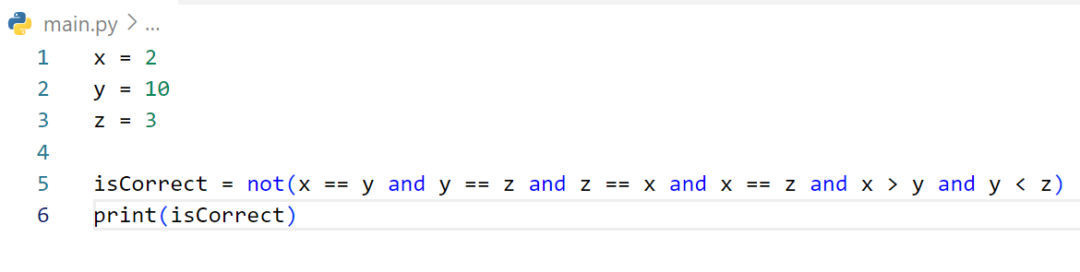
Find output of the code?
Answer: True

Slide 7
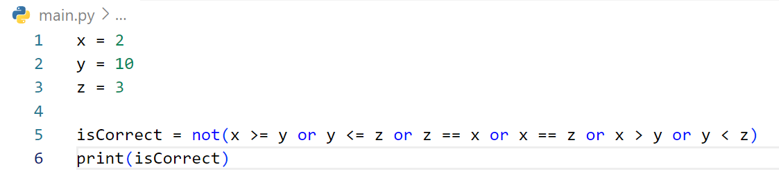
Find output of the code?
Answer: True

Slide 8
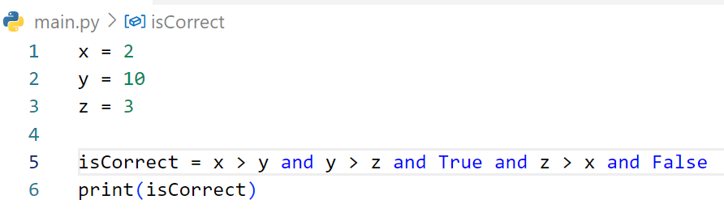
Find output of the code?
Answer: False

Slide 9
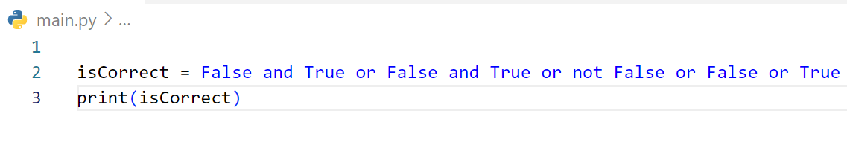
Find output of the code?
Answer: True

Slide 10
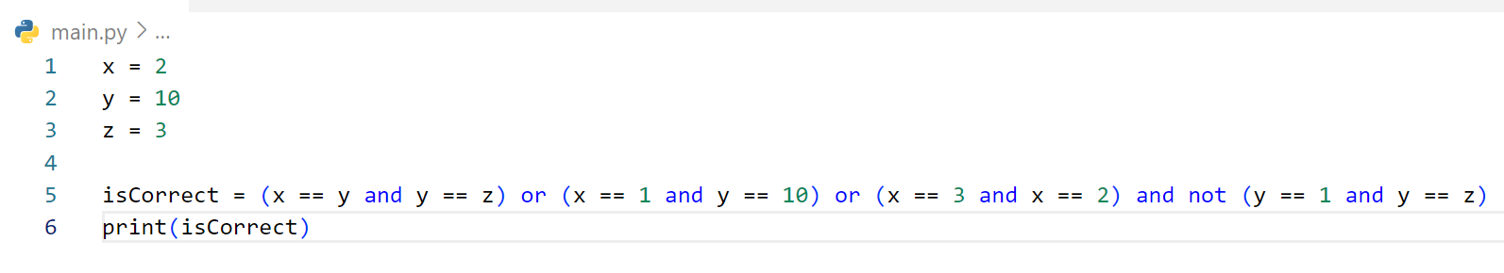
Find output of the code?
Answer: False

Slide 11
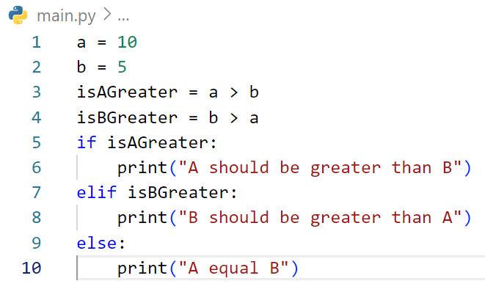
Find output of the code?
Answer: A should be greater than B

Slide 12
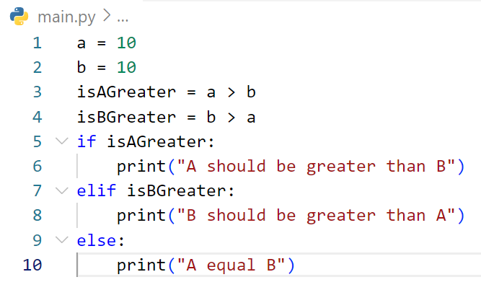
Find output of the code?
Answer: A equla B

Slide 13
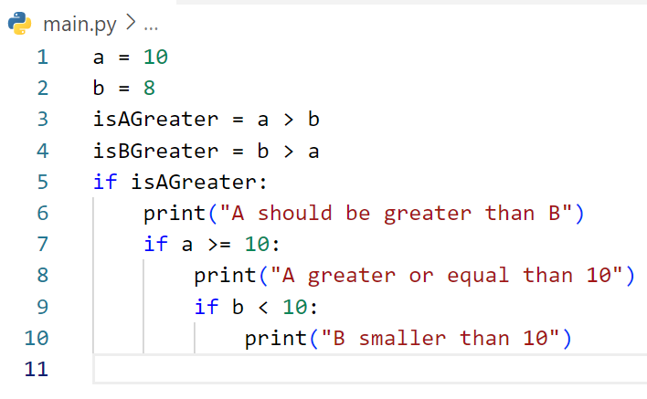
Find output of the code?
Answer: A should be greater than B
A greater or equal than 10
B smaller than 10

Slide 14
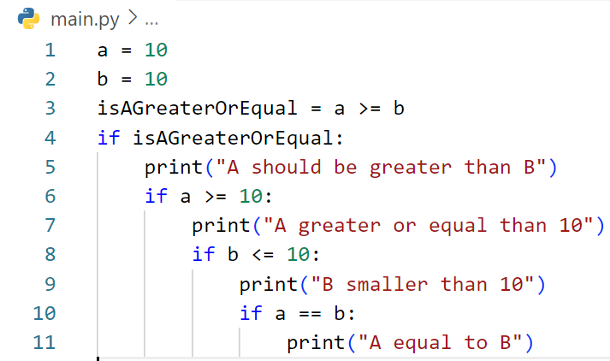
Find output of the code?
Answer: A should be greater than B
A greater or equal than 10
B smaller than 10
A equal to B

Slide 15
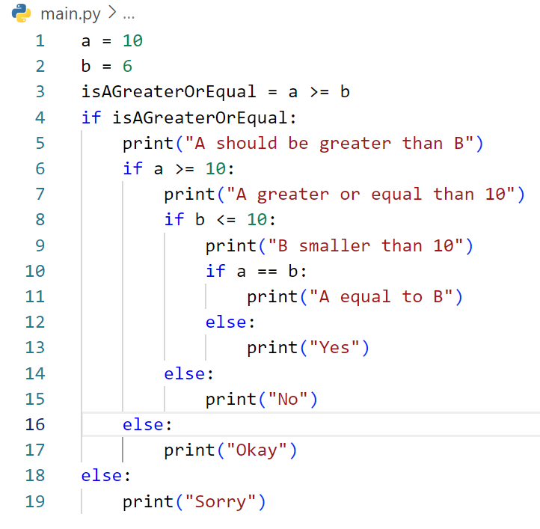
Find output of the code?
Answer: A should be greater than B
A greater or equal than 10
B smaller than 10
Yes

Slide 16
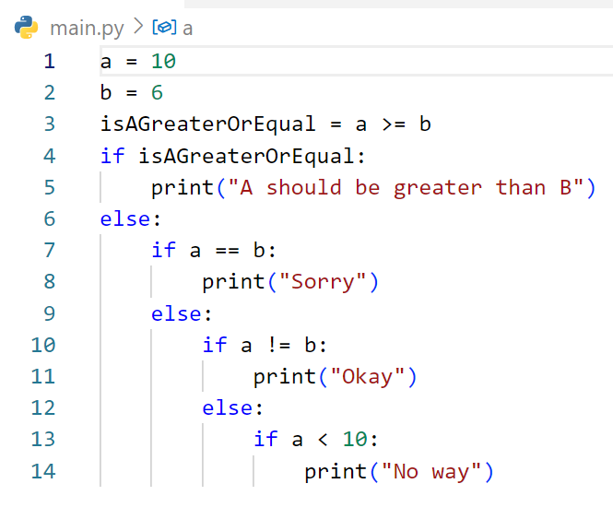
Find output of the code?
Answer: A should be greater than B

Slide 17

Write code to display number from 0 - 9?

Slide 18
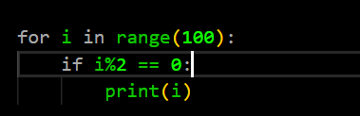
Write code to display only even number from 0-100

Slide 19
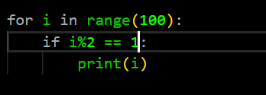
Write code to display only odd number from 0-100

Slide 20
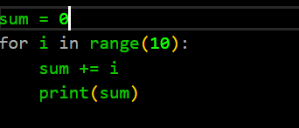
Write code to display sum number from 0-10

Slide 21
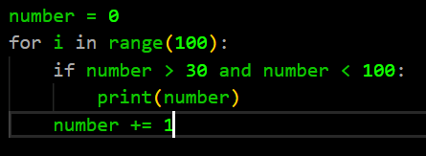
Write code to display only number are greater than 30 from 0-100

Slide 22
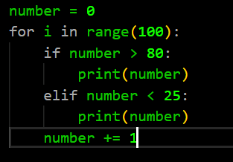
Write code to display only number are greater than 80 and
Less than 25 from 0-100

Slide 23
Write code to display only number are greater than 80 and
Less than 25 from 0-100

Slide 24
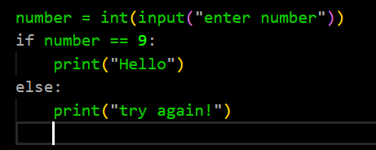
Write code to display “Hello” only when
I enter number 9 otherwise display try again!

