Slide 1
RULE OF EXERCISE
STEP 1: Execute in paper first to find the output
STEP 2: Write code test and compare result with STEP 1

Slide 2
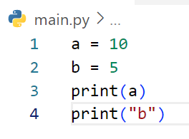
Define the output of code below
=10
=b

Slide 3
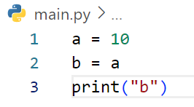
Define the output of code below
Answer = b

Slide 4
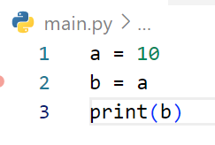
Define the output of code below
Answer = 10

Slide 5
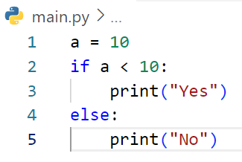
Define the output of code below
Answer = No

Slide 6
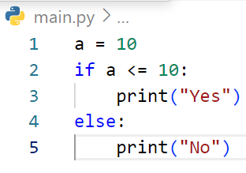
Define the output of code below
Answer = Yes

Slide 7
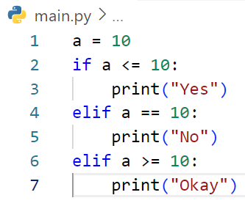
Define the output of code below
Answer = Yes

Slide 8
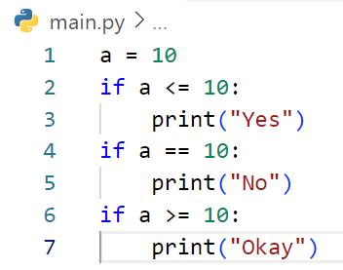
Define the output of code below
Answer = Yes
= No
= Okay

Slide 9
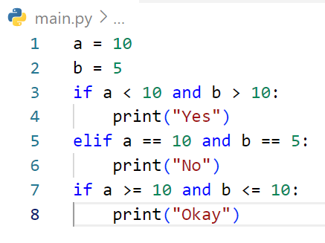
Define the output of code below
Answer = No
= Okay

Slide 10
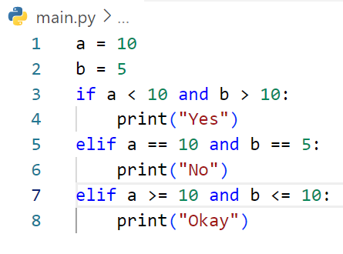
Define the output of code below
Answer = No

Slide 11
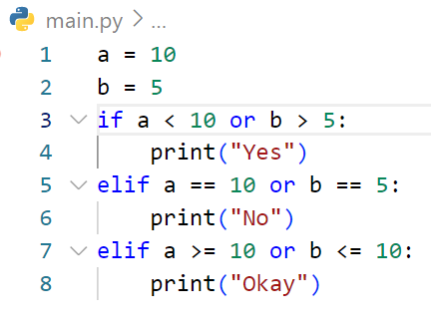
Define the output of code below
Answer = No

Slide 12
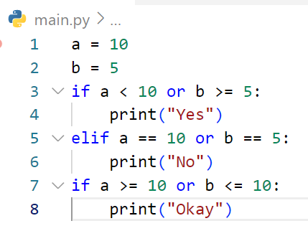
Define the output of code below
Answer = Yes
= Okay

Slide 13
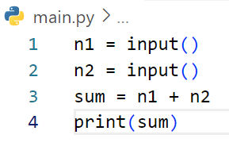
Define the output of code below
# If user enter first : 3 and second 5
Answer = 35

Slide 14
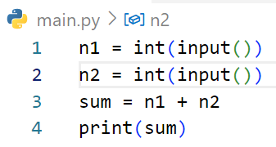
Define the output of code below
# If user enter first : 3 and second 5
Answer = 8

Slide 15
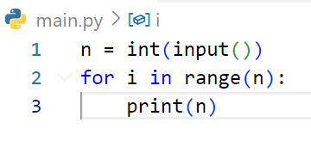
Define the output of code below
# If user enter : 3
Answer = 3
= 3
= 3

Slide 16
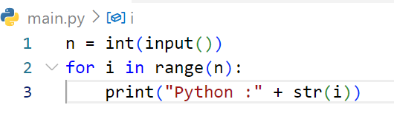
Define the output of code below
# If user enter : 3
Answer = Phython : 0
= Phyton : 1
= Phyton : 2

Slide 17
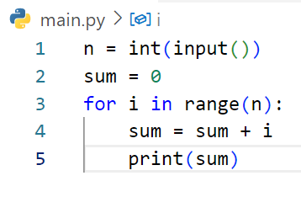
Define the output of code below
# If user enter : 3
Answer = 0
= 1
= 3

Slide 18
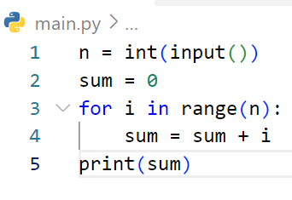
Define the output of code below
# If user enter : 2
Answer = 1

Slide 19
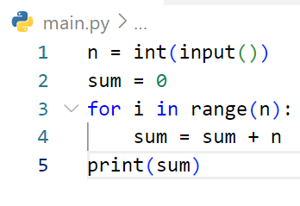
Define the output of code below
# If user enter : 4
Answer = 6

Slide 20
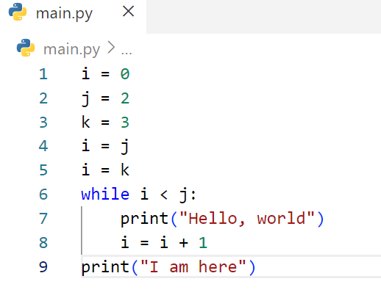
Define the output of code below
Answer = I am here.

Slide 21
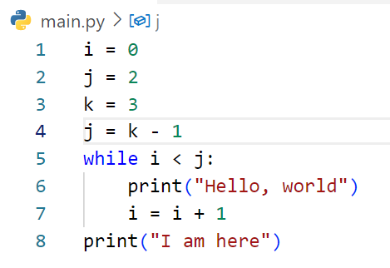
Define the output of code below
Answer = Hello, world
= Hello, world
= I am here

Slide 22
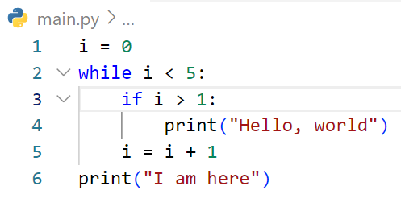
Define the output of code below
Answer = Hello, world
= Hello, world
= Hello, world
= I am here

Slide 23
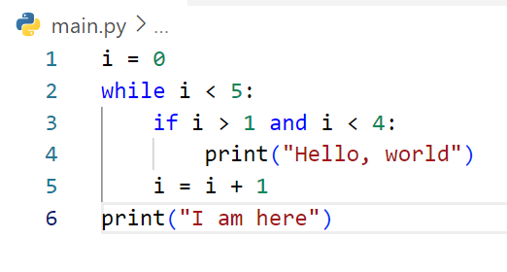
Define the output of code below
Answer = Hello, world
= Hello, world
= I am here

Slide 24
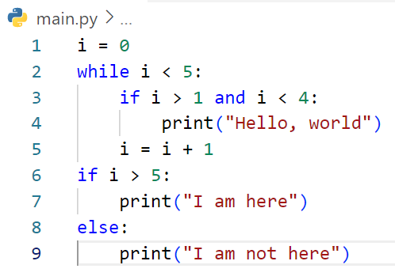
Define the output of code below
Answer = Hello, world
= Hello, world
= I am not here

Slide 25
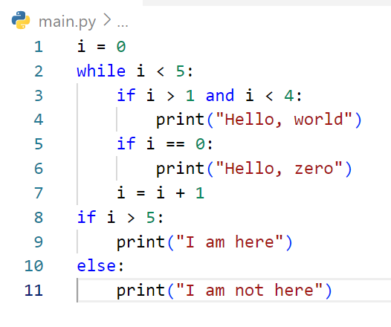
Define the output of code below
Answer = Hello, zero
= Hello, world
= Hello, world
= I am not here

Slide 26
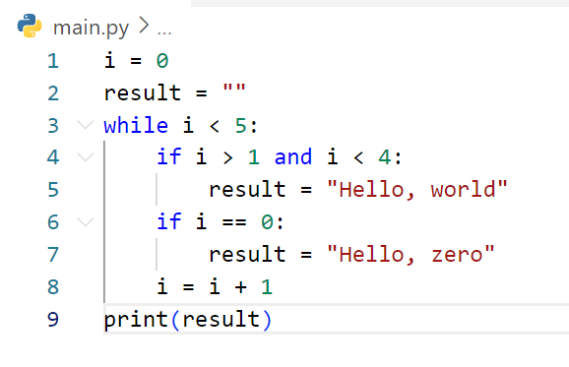
Define the output of code below
Answer = Hello, world

Slide 27
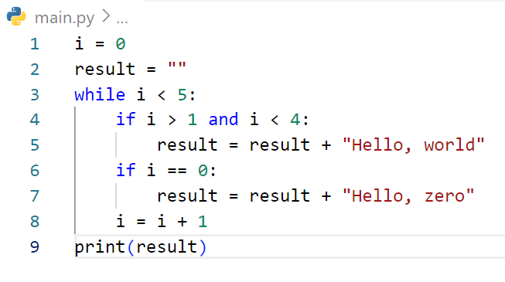
Define the output of code below
Answer = Hello, zeroHello, worldHello, world

Slide 28
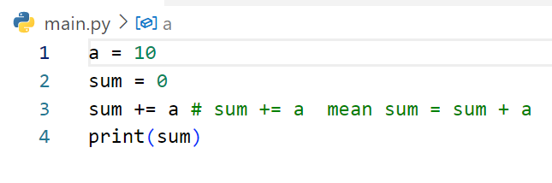
Define the output of code below
Answer = 10

Slide 29
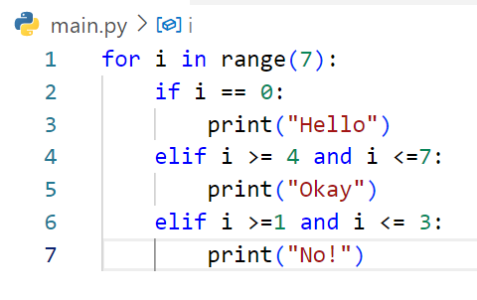
Define the output of code below
Answer = Hello
= No
= No
= No
= Okay
= Okay
= Okay

Slide 30
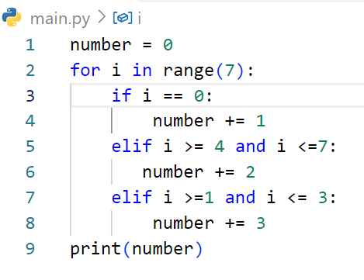
Define the output of code below
Answer = 16

Slide 31
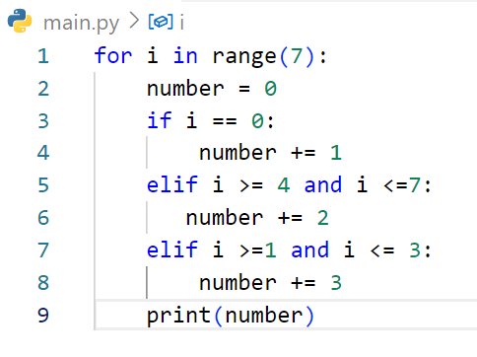
Define the output of code below
Answer = 1
= 3
= 3
= 3
= 2
= 2
= 2

Slide 32
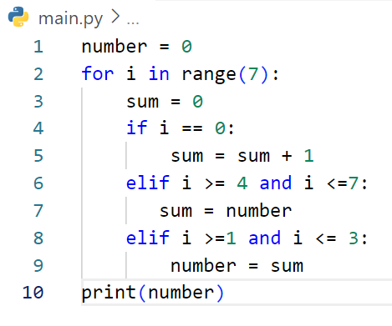
Define the output of code below
Answer = 0

Slide 33
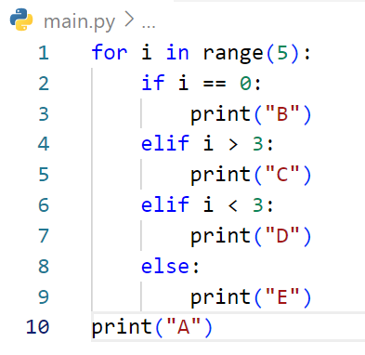
Define the output of code below
Answer = B
= D
= D
= E
= C
= A

Slide 34
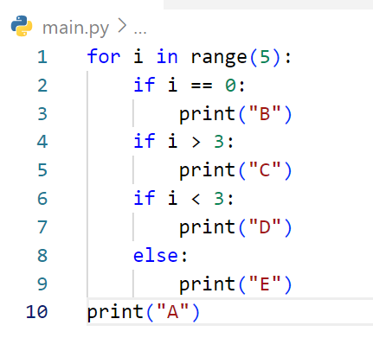
Define the output of code below
Answer = B
= D
= D
= D
= E
= C
= E
= A

Slide 35
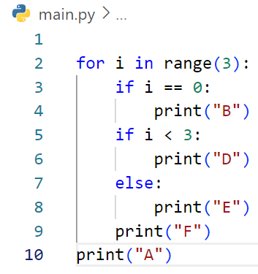
Define the output of code below
Answer = B
= D
= F
= D
= F
= D
= F
= A

Slide 36
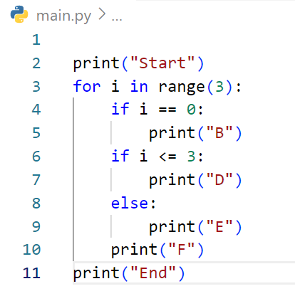
Define the output of code below
Answer = Start
= B
= D
= F
= D
= F
= D
= F
= End

Slide 37
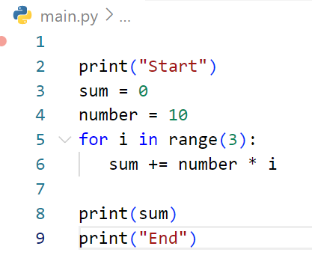
Define the output of code below
Answer = Start
= 30
= End

Slide 38
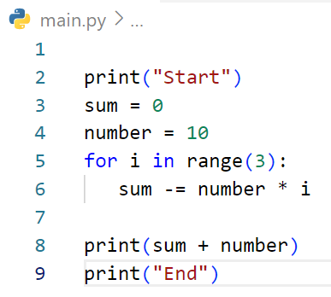
Define the output of code below
Answer = Start
= -20
= End

Slide 39
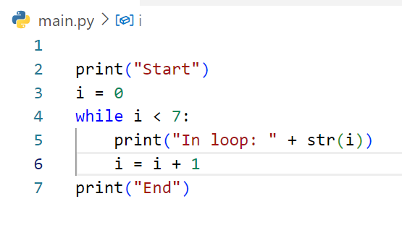
Define the output of code below
Answer = Start
= In loop: 0
= In loop: 1
= In loop: 2
= In loop: 3
= In loop: 4
= In loop: 5
= In loop: 6
= End

Slide 40
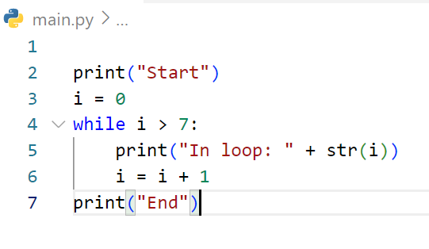
Define the output of code below
Answer = Start
= End

Slide 41
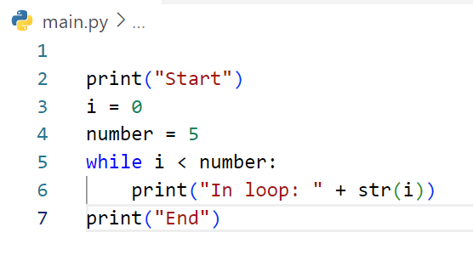
Define the output of code below

Slide 42
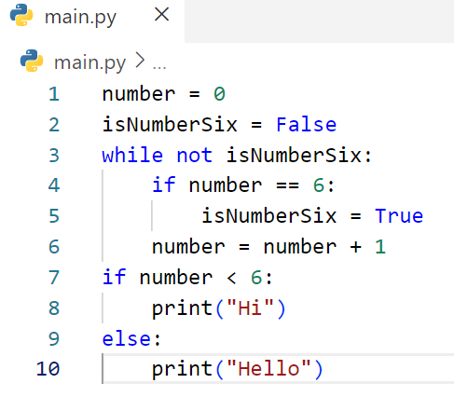
Define the output of code below
Answer = Hello

