Slide 1
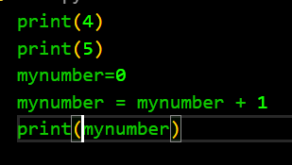
#1
Transform this code into Python
print()
x = y
WRITE<4>
WRITE<5>
SET<MY-NUMBER> TO <0>
INCREMENT<MY-NUMBER> TO <1>
WRITE<MY-NUMBER>

Slide 2
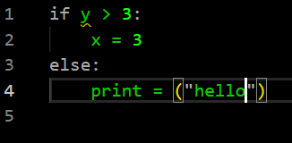
#2
Transform this code into Python
print()
x = y
if condition :
else:
IF <Y > 3>
SET <X> TO 3
ELSE
WRITE “hello”

Slide 3
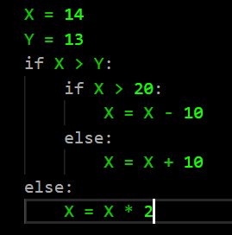
#3
Transform this code into Python
print()
x = y
if condition :
else:
X =14
Y =13
IF X>Y
IF X>20
X = X-10
ELSE
X = X+10
ELSE
X = X*2

Slide 4
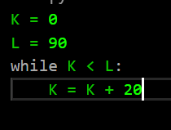
#4
Transform this code into Python
print()
x = y
while condition :
K = 0
L = 90
WHILE K < L
K = K + 20

Slide 5
#5
print()
x = y
while condition :
1- Transform this python into blocs
n= 0
while n<10 :
print(n)
n = n + 1
set<n> to <0>
while n<10
Write<n>
n = n + 1
2- Execute : what will be the value of N?

Slide 6
#6
print()
x = y
if condition :
else:
1- Transform this python into blocs
for n in range(value):
number = 5
if number < 0:
print(“BBB")
else :
for n in range(4) :
print(“AAA")
Set<number> to <5>
If <number<0>
Write<BBB>
else:
Repeat<4>
number
Write<AAA>
2- Execute : what will be the result ?

