Slide 1
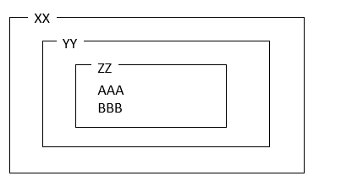
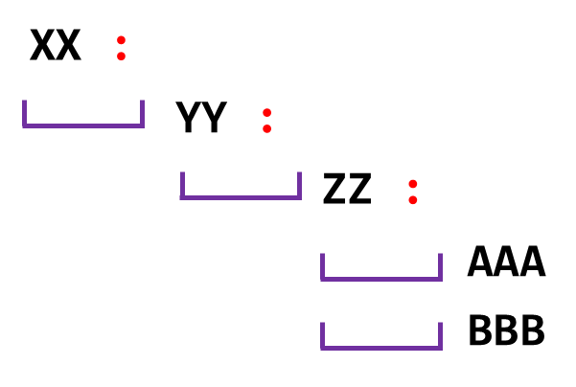
BLOC
PYTHON
SET <NUMBER> TO 5
NUMBER = 5
VARIABLE
INCREMENT <NUMBER> OF 2
NUMBER = NUMBER + 2
IF <HAS-DIAMOND>
IF HAS-DIAMOND :
PRINT <hello>
PRINT(“hello”)
SET <X> TO 5
X = 5
CONDITION
IF <HAS-DIAMOND>
IF HAS-DIAMOND :
PRINT <hello>
PRINT(“hello”)
ELSE
ELSE :
PRINT <helli>
PRINT(“helli”)
WHILE <HAS-DIAMOND>
WHILE HAS-DIAMOND :
PRINT <hello>
PRINT(“hello”)
SET <X> TO 5
X = 5
REPEAT
REPEAT 10 TIMES
FOR N IN RANGE (10) :
PRINT <hello>
PRINT(“hello”)
SET <X> TO 5
X = 5
BLOC NESTED

