Slide 1
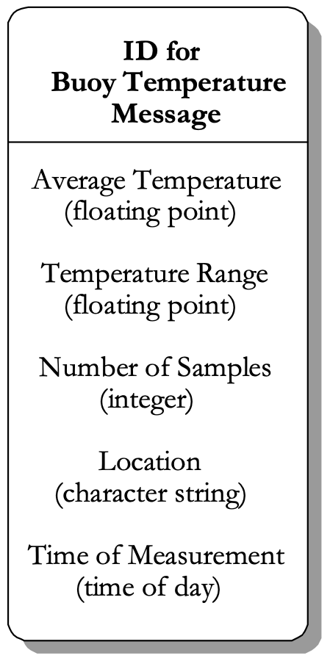
示例：定义浮标温度消息的表记录项
Message Begin
NumFields 5
MessageName “Buoy Temperature Message”
Field 1, FloatingPoint, "Average Temperature”
Field 2, FloatingPoint, "Temperature Range”
Field 3, Integer, "Number of Samples"
Field 4, String, "Location"
Field 5, TimeOfDay, "Time of Measurement"
Message End

