Slide 1
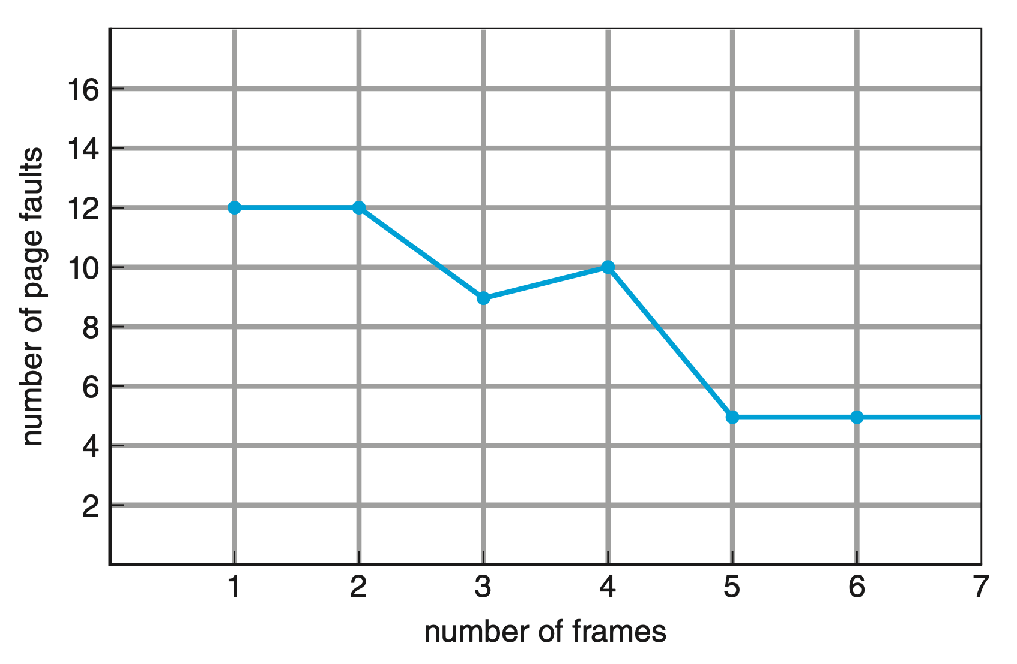
page address
stream
1 |  | 2 |  | 3 |  | 4 |  | 1 |  | 2 |  | 5 |  | 1 |  | 2 |  | 3 |  | 4 |  | 5
1 |  | 1 |  | 1 |  | 4 |  | 4 |  | 4 |  | 5 |  | 5 |  | 5 |  | 5 |  | 5 |  | 5
 |  | 2 |  | 2 |  | 2 |  | 1 |  | 1 |  | 1 |  | 1 |  | 1 |  | 3 |  | 3 |  | 3
 |  |  |  | 3 |  | 3 |  | 3 |  | 2 |  | 2 |  | 2 |  | 2 |  | 2 |  | 4 |  | 4
F |  | F |  | F |  | F |  | F |  | F |  | F |  |  |  |  |  | F |  | F
FIFO
3 frames, 9 page-faults
page address
stream
1 |  | 2 |  | 3 |  | 4 |  | 1 |  | 2 |  | 5 |  | 1 |  | 2 |  | 3 |  | 4 |  | 5
1 |  | 1 |  | 1 |  | 1 |  | 1 |  | 1 |  | 5 |  | 5 |  | 5 |  | 5 |  | 4 |  | 4
 |  | 2 |  | 2 |  | 2 |  | 2 |  | 2 |  | 2 |  | 1 |  | 1 |  | 1 |  | 1 |  | 5
 |  |  |  | 3 |  | 3 |  | 3 |  | 3 |  | 3 |  | 3 |  | 2 |  | 2 |  | 2 |  | 2
 |  |  |  |  |  | 4 |  | 4 |  | 4 |  | 4 |  | 4 |  | 4 |  | 3 |  | 3 |  | 3
F |  | F |  | F |  | F |  |  |  |  |  | F |  | F |  | F |  | F |  | F |  | F
FIFO
4 frames, 10 page-faults

