Slide 1
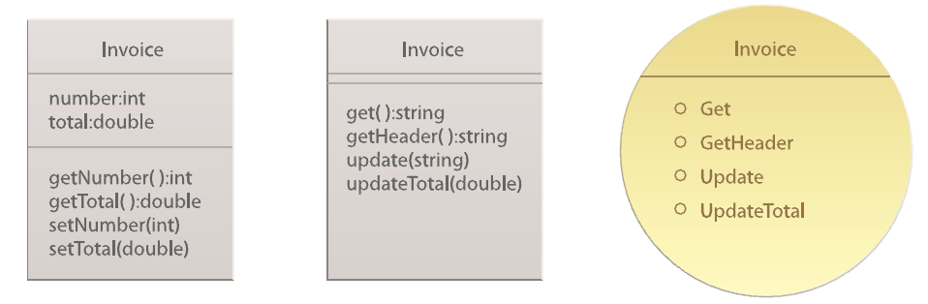
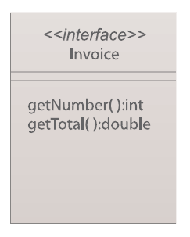
“OO-Styled” class
(with attribute and method)
“Service-Styled” class (without attribute)
Interface
Service contract with service capabilities

