Slide 1
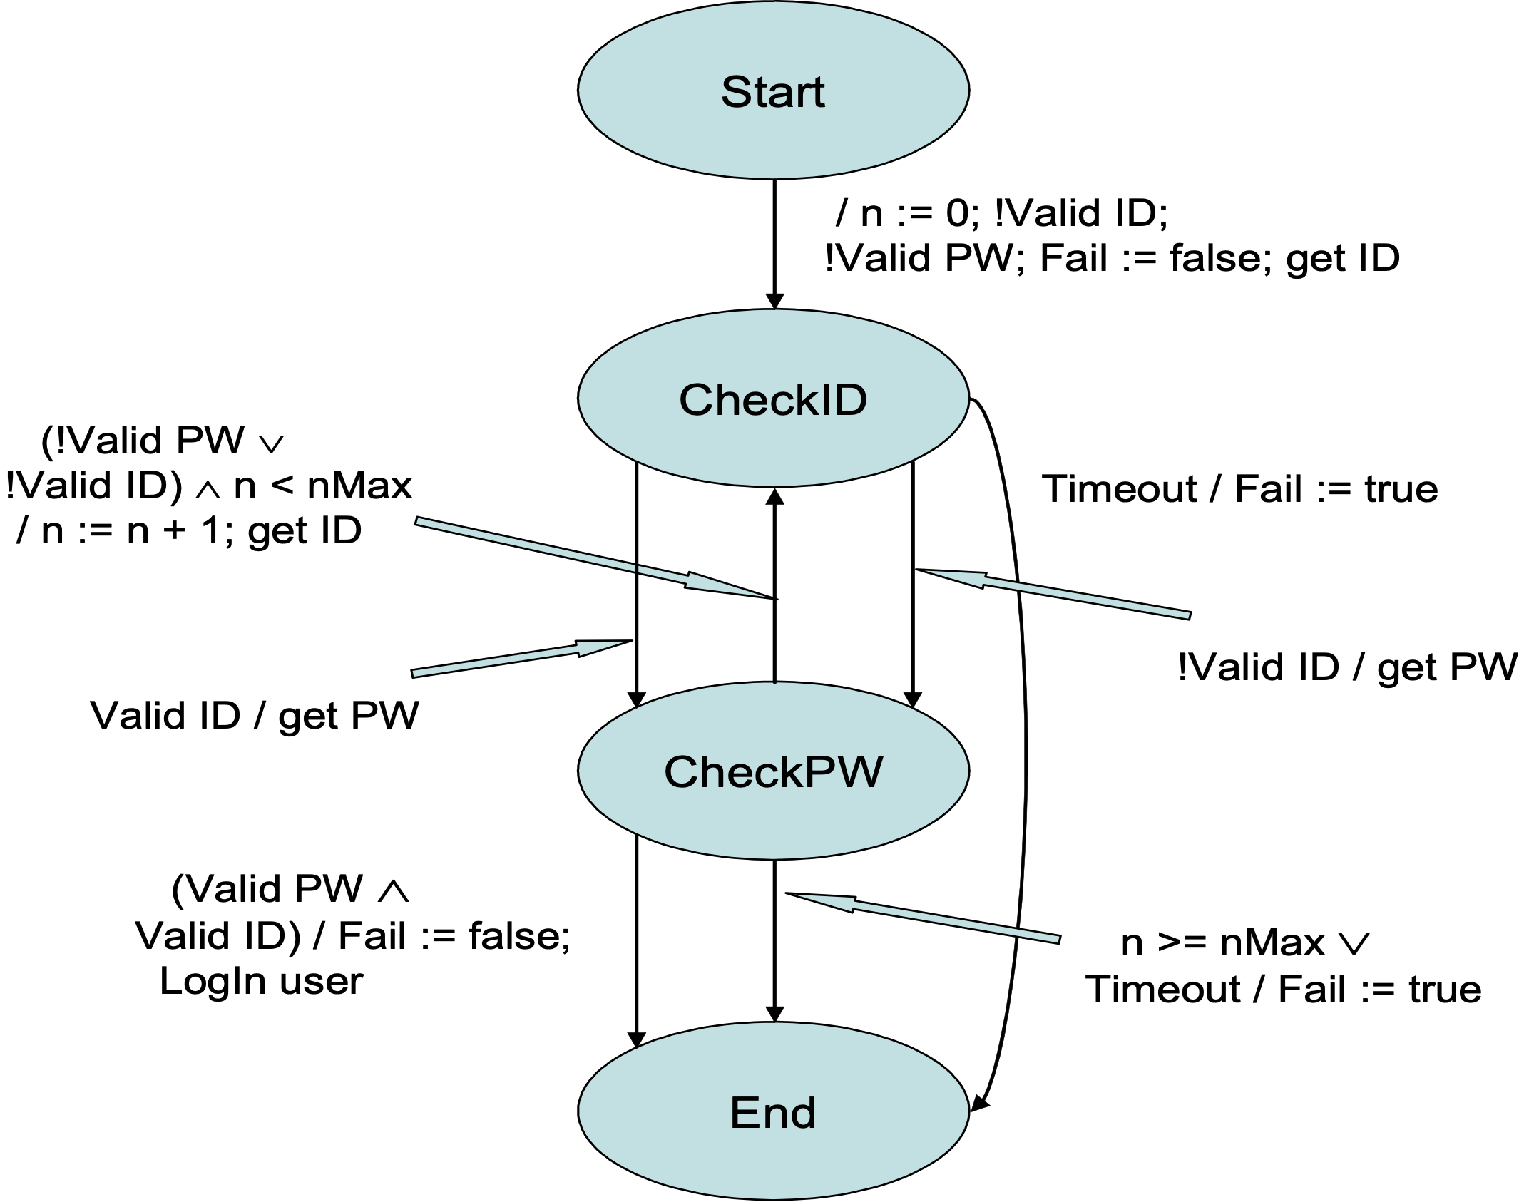
A: (!ValidID ∨ !ValidPW) ∧ n < nMax ∧ !Timeout → CheckID / n := n + 1
B: ValidID ∧ ValidPW → End / Fail := false and LogIn user
C: n >= nMax ∨ Timeout → End / Fail := true and cut off user

