Slide 1
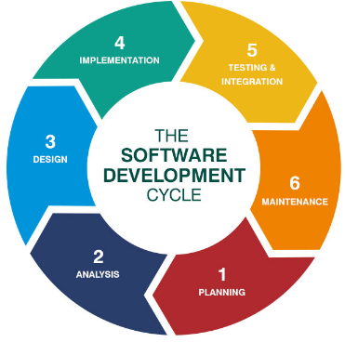
Software life cycle models and their comparison
June 2018

Slide 2
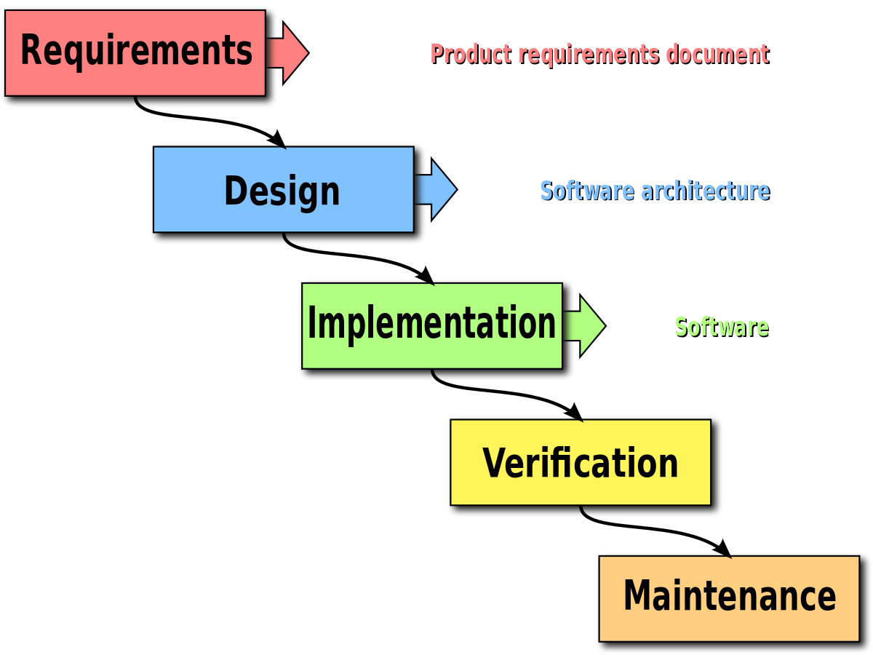
Waterfall model
Advantages:
stability of requirements throughout the development life cycle;
Disadvantages:
the sequence of the linear structure of the development process, as a result, a return to the previous steps to solve the arising problems leads to an increase in costs and a disruption to the work schedule;

Slide 3
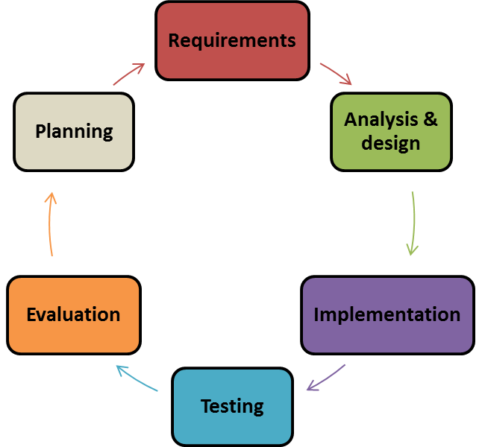
Iterative Model
Advantages:
organization of effective feedback of the project team to the customer and the creation of a product that really meets its needs;
Initial planning
Disadvantages:
Deployment
a holistic understanding of the possibilities and limitations of the project is missing for a long time;

Slide 4
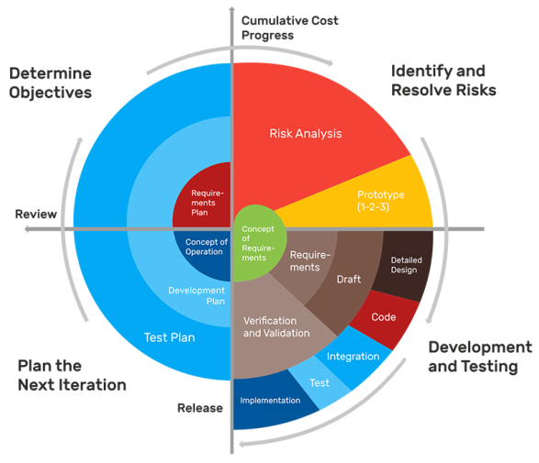
Spiral Model
Advantages:
the possibility of making changes and adding new functionality even at relatively late stages;
improved risk analysis;
Disadvantages:
the success of the process depends to a large extent on the stage of the risk analysis;

Slide 5
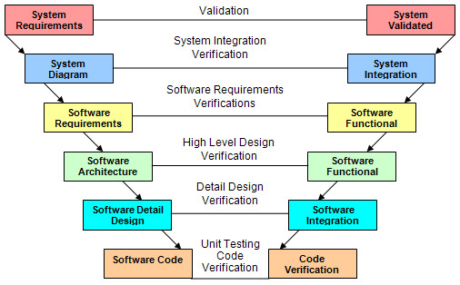
V-shaped Model
Advantages:
test planning and system verification are carried out at an early stage;
intermediate testing;
Disadvantages:
insufficient risk analysis;
insufficient flexibility of the model;

Slide 6
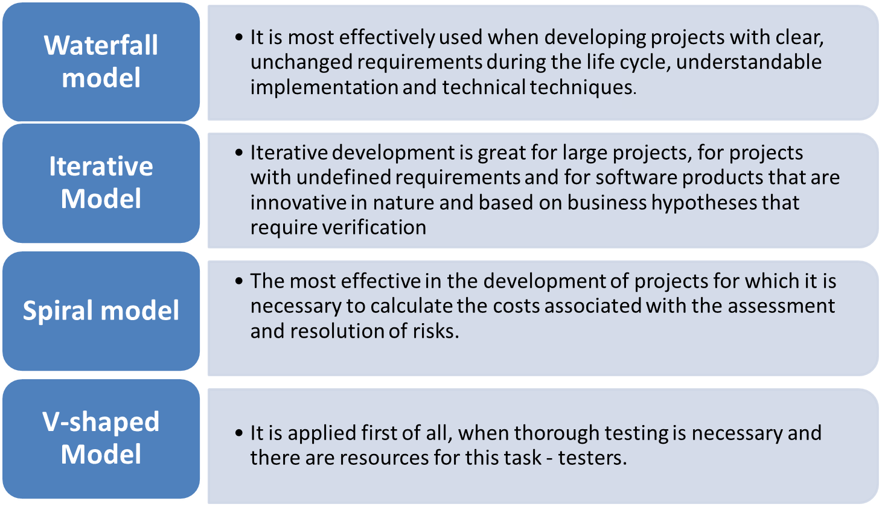
Analysis of the models’ usage main differences

Slide 7
Models comparison
 | Waterfall model | Iterative Model | Spiral Model | V-shaped Model
Model complexity | Easy to use and simple | More flexible then waterfall | High amount of risk analysis | Easy to use and simple
Projects complexity | Better for small projects where requirements are understood | Moderate and large size projects | Large projects with high risks analysis prioritization. Doesn't work well with small projects | Small and medium-sized projects where requirements are understood
Deliverables management | Easy to manage due to the rigidity of the model, but can be managed just one by one | Implementation of easy areas does not need to wait for the hard once | Software is produced early in the software life cycle | Higher chance of success over the Waterfall model due to test plane development

Slide 8
Models comparison
 | Waterfall model | Iterative Model | Spiral Model | V-shaped Model
Risks evaluation | NO | YES | YES | Lack of risks analysis
Risks possibility | High amount of risks and uncertainty | Unforeseen dependencies can create problems | Minimum | High amount of risks
Project life cycle timing and recourse utilization | Clear understanding of timings and recourses needed | Precise recourses distribution between all project stages. Longer than Waterfall and V-shaped Models | The most time consuming and recourse utilization model | Understanding of timings and recourses needed

Slide 9
Models comparison
 | Waterfall model | Iterative Model | Spiral Model | V-shaped Model
Changes introduction | Poor model where requirements are at a moderate to high risks of changing | Changes are possible | Changes can be implemented | Model doesn’t provide a clear path for problems found during testing phases
Main disadvantages of each model | No working software is produced until late during the life cycle . Adjusting scope can kill a project. | Activities performed in parallel so it can cost misunderstanding and mistaken assumptions. Milestones are more ambiguous the in the Waterfall model | Risks analysis requires highly specific expertise. Can be costly model to use. | Little flexibility and adjusting scope is difficult and expensive. Very rigid like the Waterfall model

Slide 10

Questions:
What are the main software life cycle models?
What are the advantages and disadvantages of each model?
In which cases is it recommended to use each model?
What are the differences between software life cycle models?
The main disadvantages of each model?

Slide 11


