Slide 1



by Vladimir Fedotov

Slide 2

  Fiddler had been written by Eric Lawrence while he was working at Microsoft in the IE development team. In 2012, Fiddler was acquired by Telerik, and Eric also went to Telerik to continue working on his product.

Slide 3
  Fiddler is a powerful tool for web debugging, web traffic monitoring, session manipulation, etc.
  In addition, Fiddler has the ability to use it as an independent proxy server on the machine where it is running.
PC
Android
Proxy
(PC)
Internet
Iphone

Slide 4
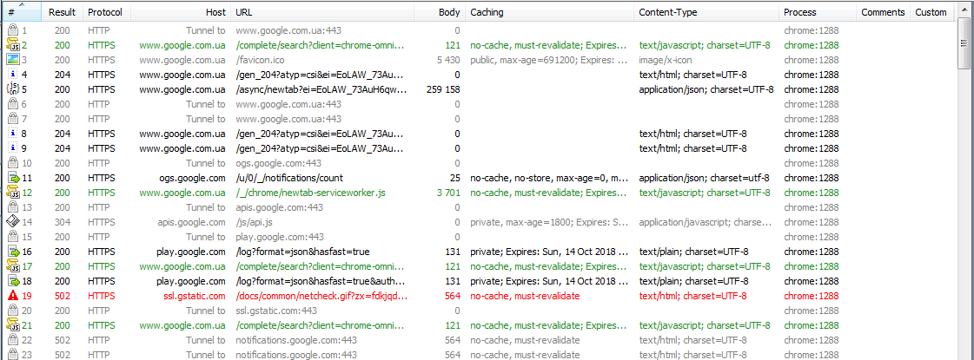
User Interface
1. The Web Sessions List

Slide 5
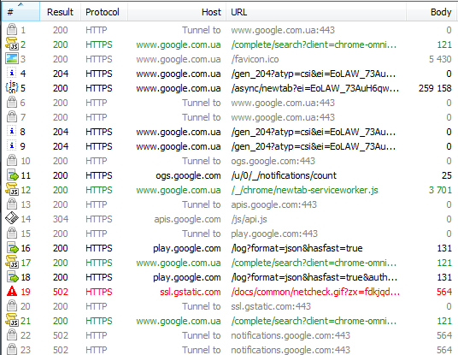
1
2
3
4
5
6
  # - An ID# of the request generated by Fiddler for your convenience
  Result - The Result code from the HTTP Response
  Protocol - The Protocol (HTTP/HTTPS/FTP) used by this session
  Host - The hostname of the server to which the request was sent
  URL - The path and file requested from the server
  Body - The number of bytes in the Response body

Slide 6
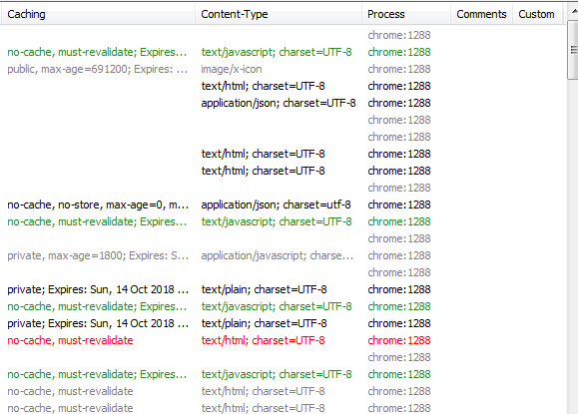
7
8
9
10
11
  Caching - Values from the Response's Expires or Cache-Control headers
  Content-Type - The Content-Type header from the Response
  Process - The local Windows Process from which the traffic originated
  Comments - A text field you can set from scripting or the session's context menu
  Custom - A text field you can set via scripting

Slide 7
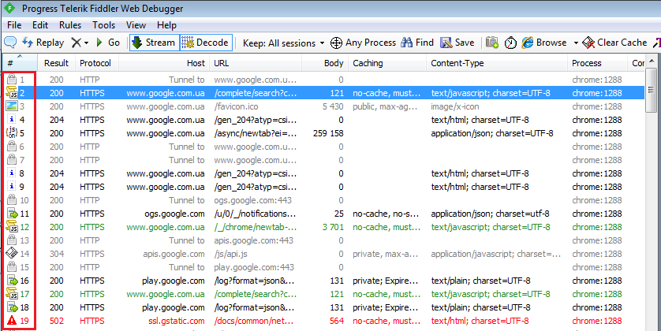
  In the list of sessions, each of them has its own data type icon.

Slide 8
Icon designation
Request is being sent to the server
Response was JSON
Response is being read from the server
Response was an audio file
Request is paused at a breakpoint
Response was a video file
Response is paused at a breakpoint
Response was a Silverlight applet
Request used HTTP HEAD method; response should
have no body
Response was a Flash applet
Response was a font
Request used HTTP POST method
Request used HTTP CONNECT method; this establishes
a tunnel used for HTTPS traffic
Generic successful response
Response was HTTP/300,301,302,303 or 307 redirect
Response was HTML
Response was HTTP/304: Use cached version
Response was an image
Response was a request for client credentials
Response was a script
Response was a server error
Response was Cascading Style Sheet
Session was aborted by the client, Fiddler, or the Server
Response was XML

Slide 9
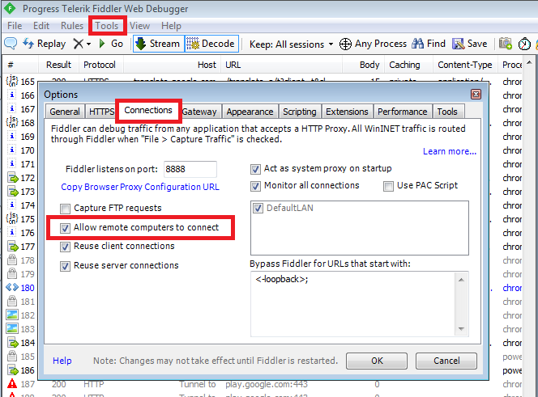
Configuration
  Go to the Tools > Options… > Connections.
  Tick “Allow remote computers to connect”.
  Reload the Fiddler.

Slide 10
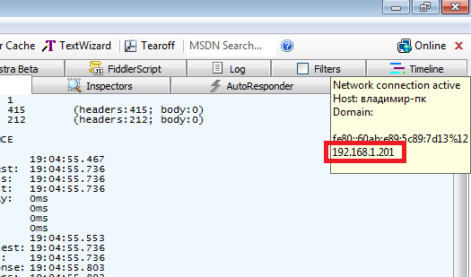
  4. We will use this IP in the settings of our device.

Slide 11
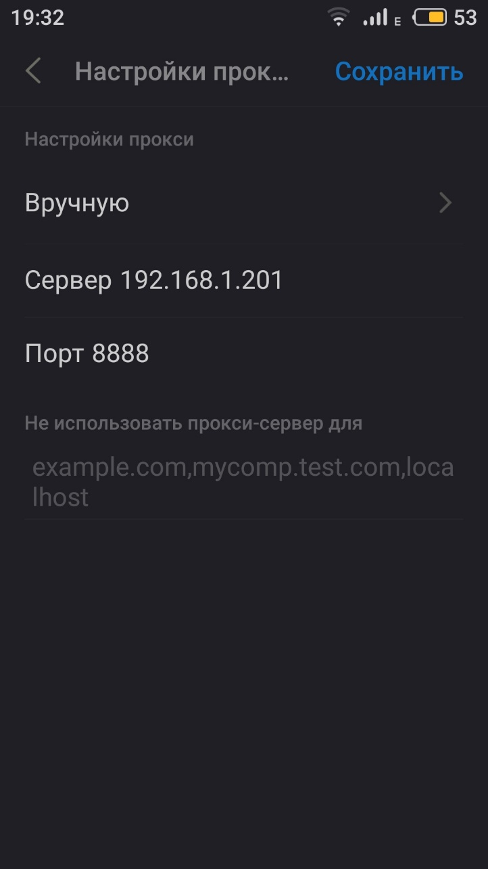
Configuration Android
Go to your device Settings.
Wi-Fi settings.
In section HTTP-proxy, we selected manually.
We enter the data IP and port 8888.
It’s all, all traffic from your device goes through the Fiddler.

Slide 12
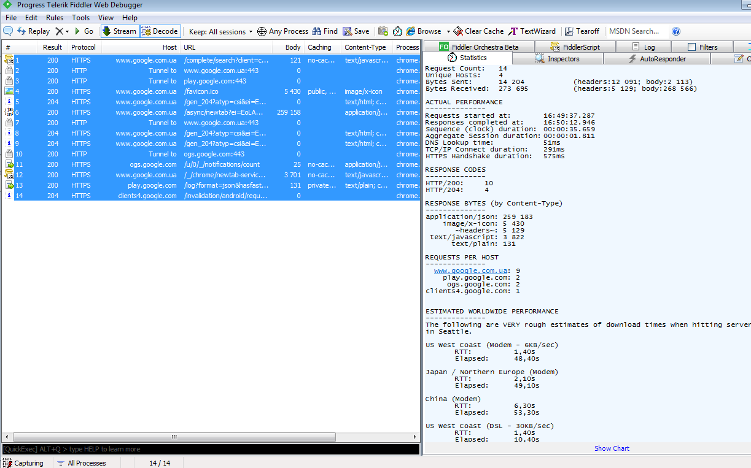
Examine Web Traffic
Statistics
After completing a request to http://www.google.com you can see that 14 requests were actually fulfilled.

Slide 13
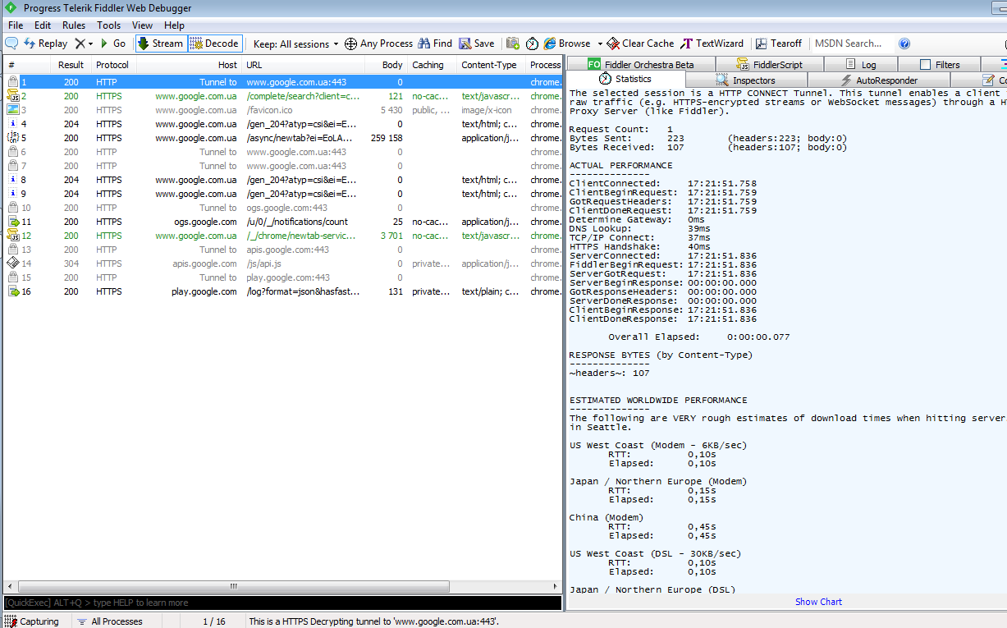
Information on each session or in general can be viewed in the statistics tab

Slide 14
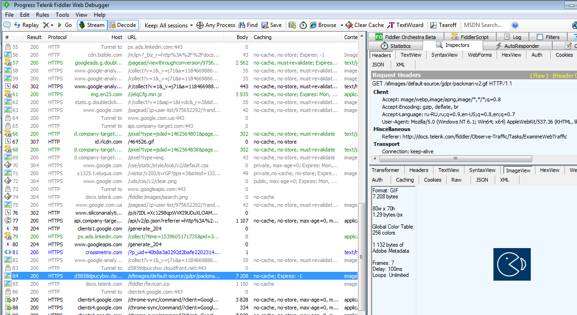
Content
  Can view the contents of the session

Slide 15
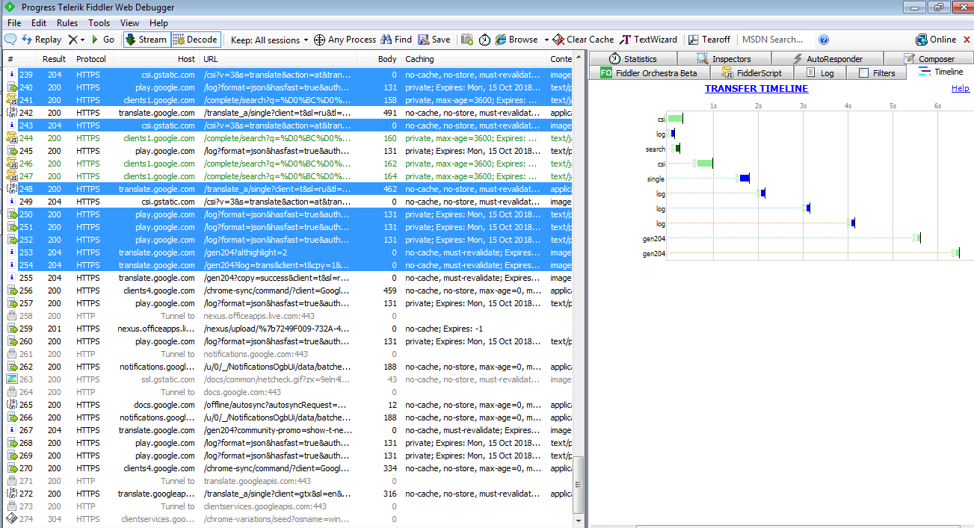
Timeline
  Can view session time

Slide 16

Questions?

