Slide 1


by Vladimir Fedotov

Slide 2
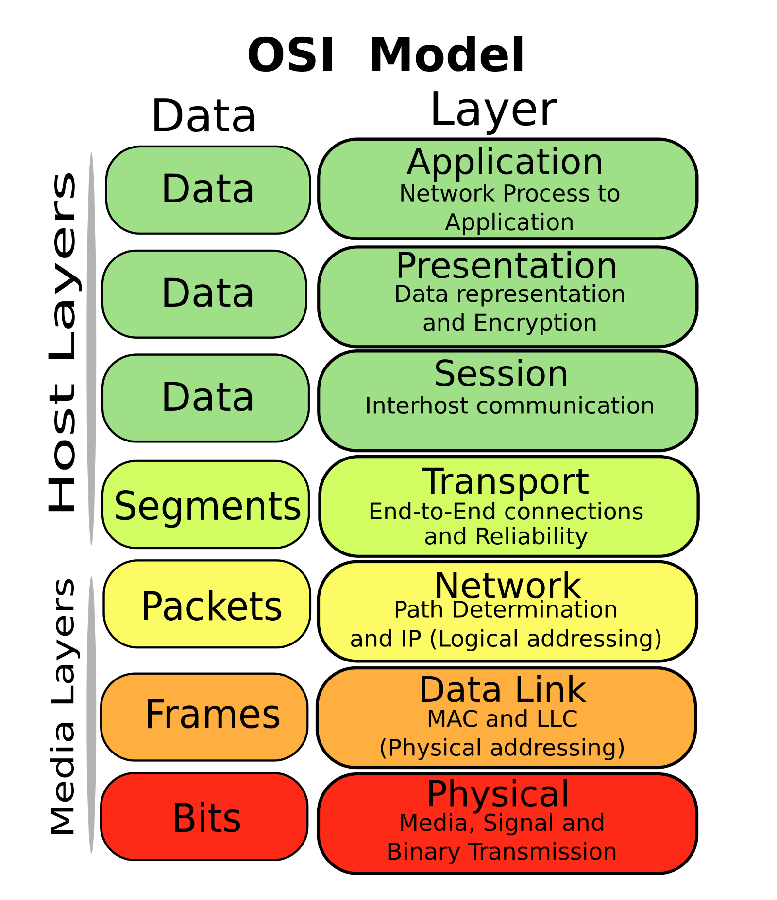
Model OSI
  The Open Systems Interconnection model (OSI model) is a conceptual model that characterizes and standardizes the communication functions of a telecommunication or computing system.
  The original version of the model defined seven layers.

Slide 3
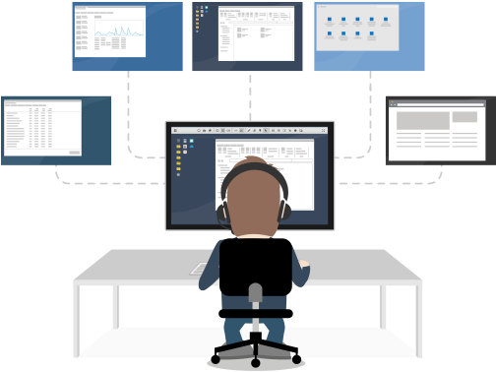
Layer 7: Application Layer
  The application layer is the highest level of the model. It connects user applications to the network.

Slide 4
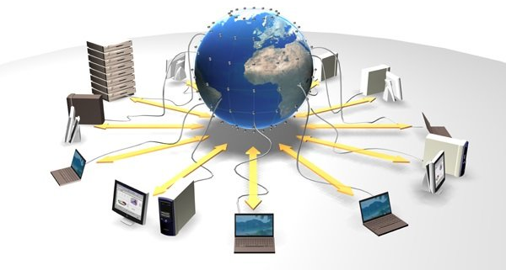
Layer 6: Presentation Layer
  The presentation layer provides protocol conversion and data encoding / decoding.

Slide 5

Layer 5: Session Layer
  The session layer controls the dialogues (connections) between computers. It establishes, manages and terminates the connections between the local and remote applications.

Slide 6

Layer 4: Transport Layer
  Transport layer model is designed to ensure reliable transmission of data from the sender to the recipient.

Slide 7

Layer 3: Network Layer
  The network layer is intended for determining the data transmission path and is responsible for the translation of logical addresses and names into physical ones.

Slide 8
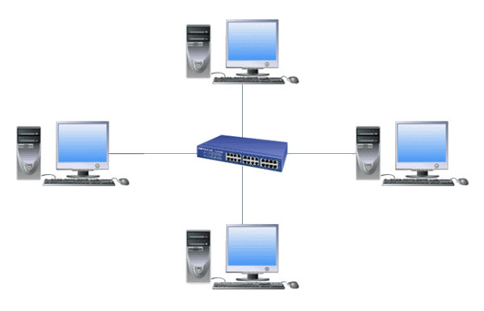
Layer 2: Data Link Layer
  The data link layer is designed to provide interoperability of networks at the physical level and to monitor errors that may occur.

Slide 9
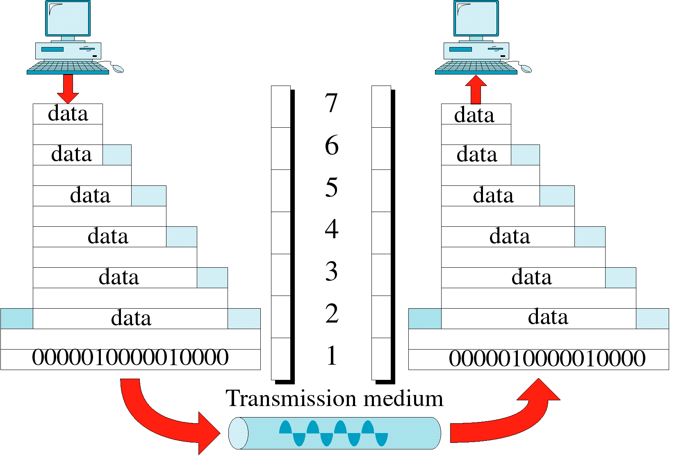
Layer 1: Physical Layer
  The physical layer is the lower layer of the model, which defines the method of transferring data represented in binary form from one device (computer) to another.

Slide 10





















Application
9P, BitTorrent, BOOTP, DNS, FTP, HTTP, NFS, POP, POP3, IMAP, RTP, SMTP, SNMP, SPDY, Telnet, SSH, X.400, X.500, RDP
Data
Presentation
AFP, ICA, LPP, NCP, NDR, XDR, X.25
Data
Session
ADSP, ASP, H.245, ISO-SP, iSNS, L2F, L2TP, NetBIOS, PAP, PPTP, RPC, RTCP, SMPP, SCP, ZIP, SDP
Data
Transport
ATP, CUDP, DCCP, FCP, IL, NBF, NCP, SCTP, SPX, SST, TCP, UDP
Segment/Datagram
Network
IP/IPv4/IPv6, IPX, X.25, CLNP, IPsec, RIP, OSPF
Packet
Data link
ARCnet, ATM, CAN, Econet, Ethernet, EAPS, FDDI, Frame Relay, HDLC, IEEE 802.2, Link Access Procedures, LAPD, LAN, LocalTalk, MPLS, PPP, PPPoE, StarLan, Token ring, UDLD, x.25, ARP.
Frame
Physical
IEEE 802.15 (Bluetooth), IRDA, EIA RS-232, EIA-422, EIA-423, RS-449, RS-485, DSL, ISDN, SONET/SDH, 802.11Wi-Fi, Etherloop, GSM Um radio interface, ITU и ITU-T, TransferJet, ARINC 818, G.hn/G.9960
Bit

Slide 11



