Slide 1
Set-UID Privileged Programs

Slide 2
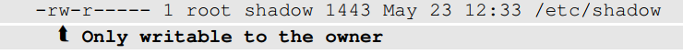
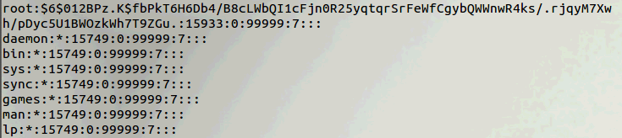
Need for Privileged Programs
Password Dilemma
Permissions of /etc/shadow File:
How would normal users change their password?
Notes:
Should be able to write to a particular section of a protected file , Example: Shadow File
Can be done using Privileged programs
Daemons
Set-UID Programs

Slide 3
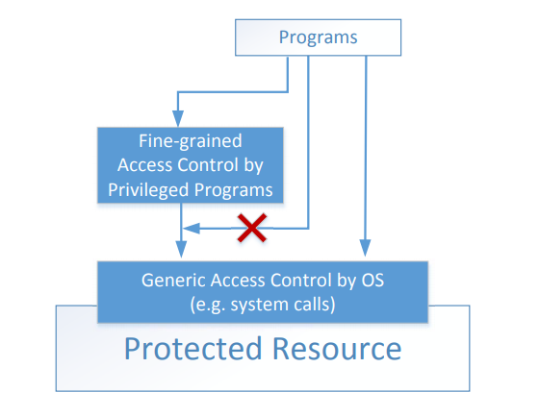
Two-Tier Approach
Implementing fine-grained access control in operating systems make OS over complicated.
OS relies on extension to enforce fine-grained access control
Privileged programs are such extensions

Slide 4
Types of Privileged Programs
Daemons
Computer program that runs in the background
Needs to run as root or other privileged users
Set-UID Programs
Widely used in UNIX systems
Program marked with a special bit

Slide 5

Superman Story
Power Suit
Superpeople: Directly give them the power
Issues: bad superpeople
Power Suit 2.0
Computer chip
Specific task
No way to deviate from pre-programmed task
Set-UID mechanism: A Power Suit mechanism implemented in Linux OS

Slide 6
Set-UID Concept
Allow user to run a program with the program owner’s privilege.
Allow users to run programs with temporary elevated privileges
Example: the passwd program
$ ls -l /usr/bin/passwd
-rwsr-xr-x 1 root root 41284 Sep 12 2012 /usr/bin/passwd

Slide 7
Set-UID Concept
Every process has two User IDs.
Real UID (RUID): Identifies real owner of process
Effective UID (EUID): Identifies privilege of a process
Access control is based on EUID
When a normal program is executed, RUID = EUID, they both equal to the ID of the user who runs the program
When a Set-UID is executed, RUID ≠ EUID. RUID still equal to the user’s ID, but EUID equals to the program owner’s ID.
If the program is owned by root, the program runs with the root privilege.
Notes:
Explanation of different types of user id
Relationship showing changes in RUID and EUID for user SEED when they run a program which is owned by themselves, by MARY and by ROOT.

Slide 8
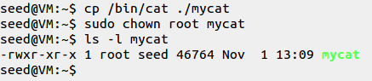
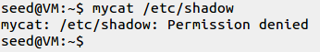
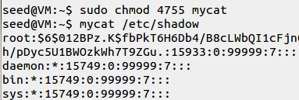
Turn a Program into Set-UID
Change the owner of a file to root :
Before Enabling Set-UID bit:
After Enabling the Set-UID bit :
Notes:
Create a program which runs like cat and change its ownership to root
Try to cat the /etc/shadow file
Convert the program into Set-UID program
Now try to cat the /etc/shadow file

Slide 9
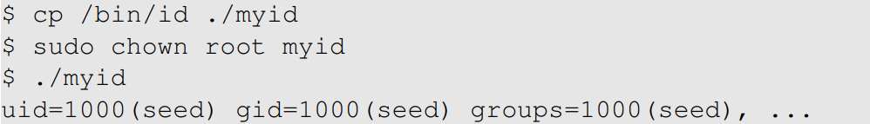
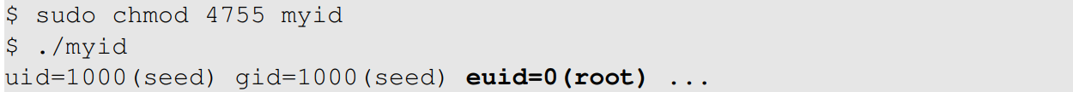
How it Works
A Set-UID program is just like any other program, except that it has a special marking, which a single bit called Set-UID bit

Slide 10
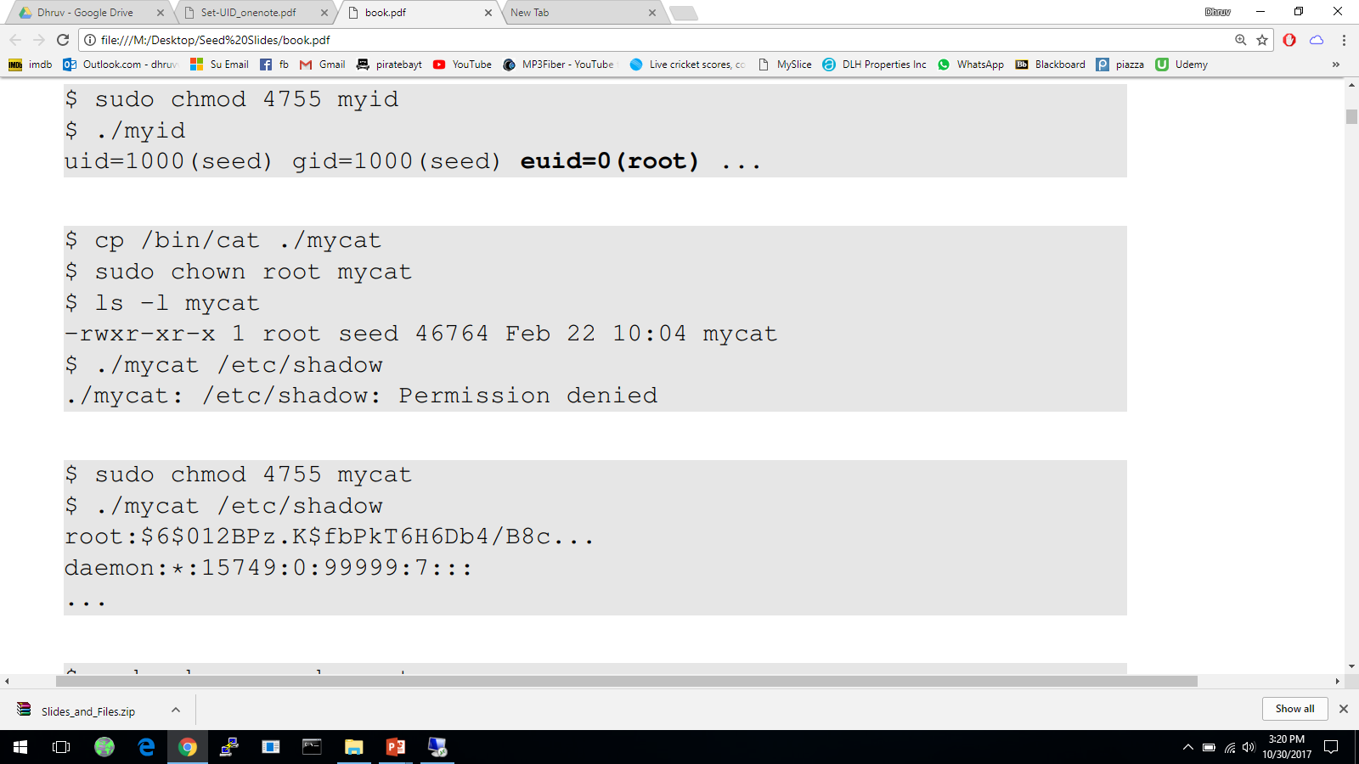
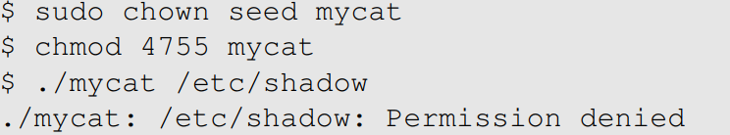

Example of Set UID
Not a privileged program
Become a privileged program
It is still a privileged program, but not the root privilege

Slide 11
How is Set-UID Secure?
Allows normal users to escalate privileges
This is different from directly giving the privilege (sudo command)
Restricted behavior – similar to superman designed computer chips
Unsafe to turn all programs into Set-UID
Example: /bin/sh
Example: vi
Notes:
Difference between set-uid and sudo
Defining why set-uid is secure and relating it to superman story
What programs should not be turned into set-uid and why?

Slide 12
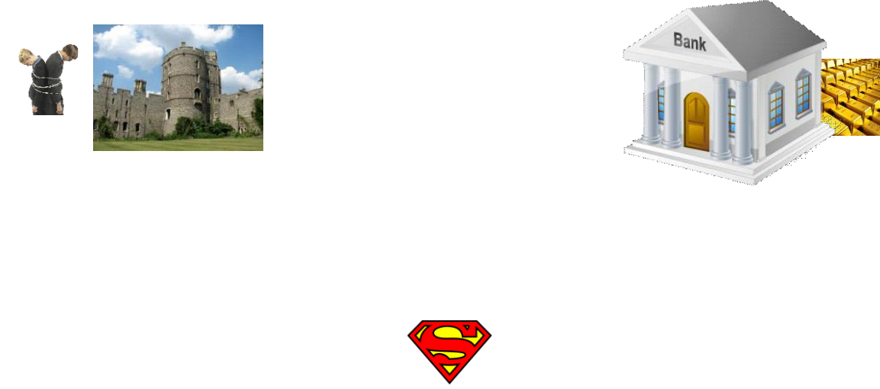
Attack on Superman
Cannot assume that user can only do whatever is coded
Coding flaws by developers
Superperson Mallroy
Fly north then turn left
How to exploit this code?
Superperson Malorie
Fly North and turn West
How to exploit this code?
1
2
Superperson is supposed to take path 1, but they take path 2
Notes:
Talking about attacks on superman’s strategy and relating it to how hackers can try to attack any mechanism

Slide 13
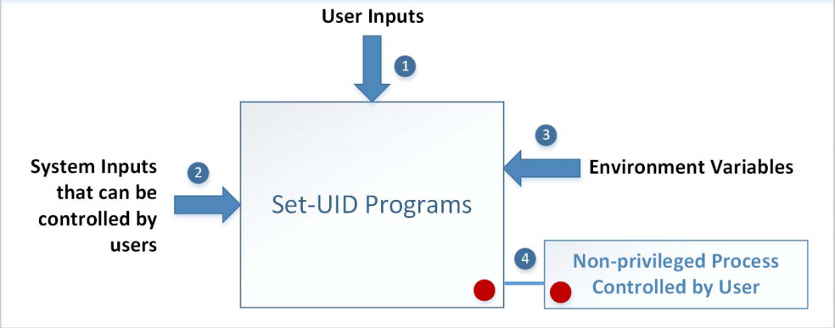
Attack Surfaces of Set-UID Programs
Notes:
Carrying on from superman story, relate it to the attack surface on set-uid programs

Slide 14
Attacks via User Inputs
User Inputs: Explicit Inputs
Buffer Overflow – More information in Chapter 4
Overflowing a buffer to run malicious code
Format String Vulnerability – More information in Chapter 6
Changing program behavior using user inputs as format strings

Slide 15
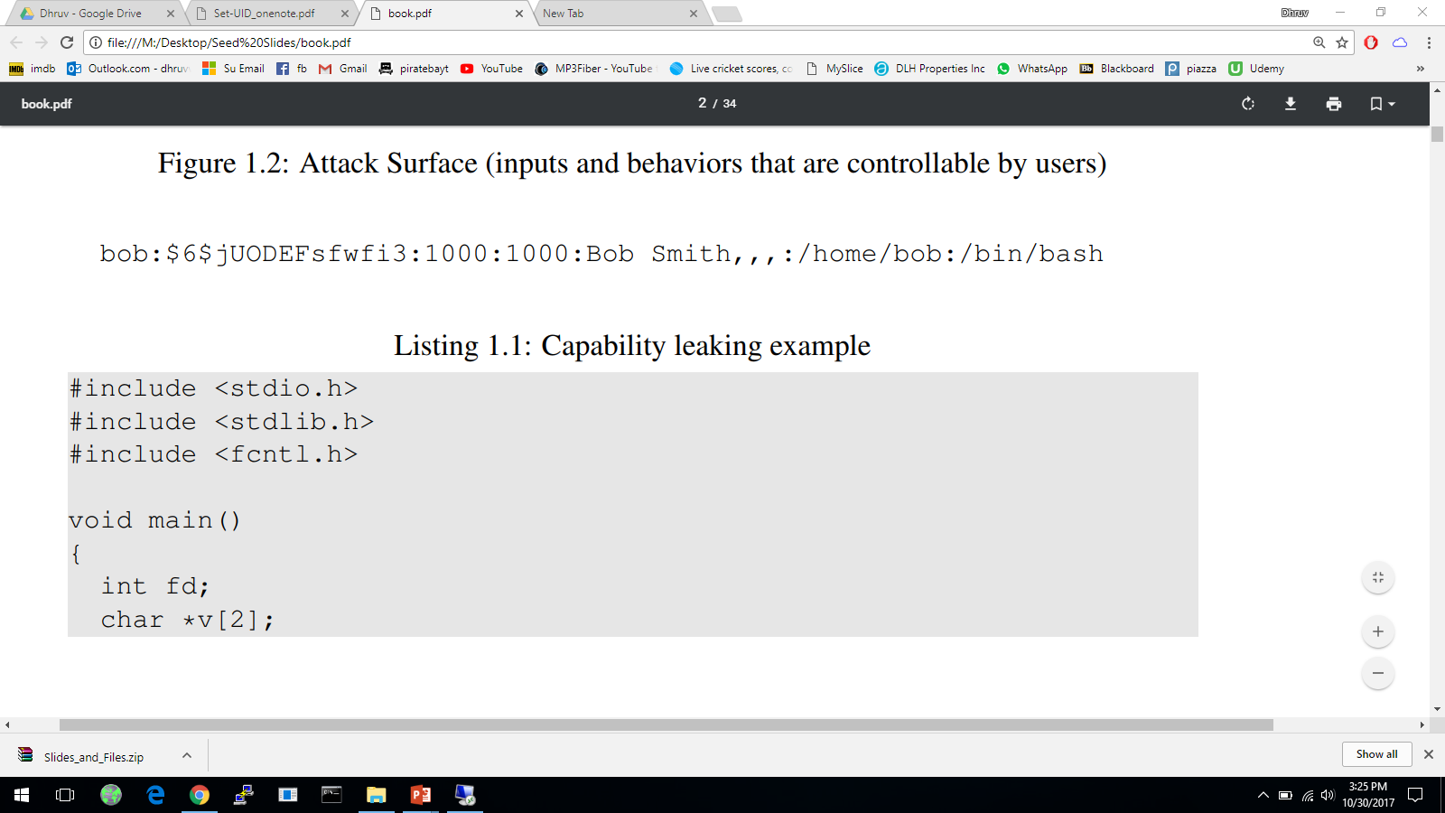
Attacks via User Inputs
CHSH – Change Shell
Set-UID program with ability to change default shell programs
Shell programs are stored in /etc/passwd file
Issues
Failing to sanitize user inputs
Attackers could create a new root account
Attack

Slide 16
Attacks via System Inputs
System Inputs
Race Condition – More information in Chapter 7
Symbolic link to privileged file from a unprivileged file
Influence programs
Writing inside world writable folder

Slide 17
Attacks via Environment Variables
Behavior can be influenced by inputs that are not visible inside a program.
Environment Variables : These can be set by a user before running a program.
Detailed discussions on environment variables will be in Chapter 2.
Notes:
What are environment variables?
What are path environment variables?
How does System() work?
How can System(“ls”) be exploited?

Slide 18
Attacks via Environment Variables
PATH Environment Variable
Used by shell programs to locate a command if the user does not provide the full path for the command
system(): call /bin/sh first
system(“ls”)
/bin/sh uses the PATH environment variable to locate “ls”
Attacker can manipulate the PATH variable and control how the “ls” command is found
More examples on this type of attacks can be found in Chapter 2
Notes:
What is path environment variable?
How does System() work?
Attack on System(“ls”)

Slide 19
Capability Leaking
In some cases, Privileged programs downgrade themselves during execution
Example: The su program
This is a privileged Set-UID program
Allows one user to switch to another user ( say user1 to user2 )
Program starts with EUID as root and RUID as user1
After password verification, both EUID and RUID become user2’s (via privilege downgrading)
Such programs may lead to capability leaking
Programs may not clean up privileged capabilities before downgrading

Slide 20
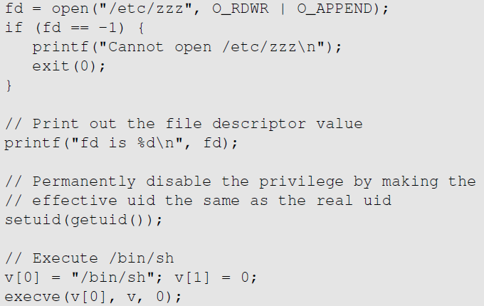
Attacks via Capability Leaking: An Example
The /etc/zzz file is only writable by root
File descriptor is created
(the program is a root-owned Set-UID program)
The privilege is downgraded
Invoke a shell program, so the behavior restriction on the program is lifted

Slide 21
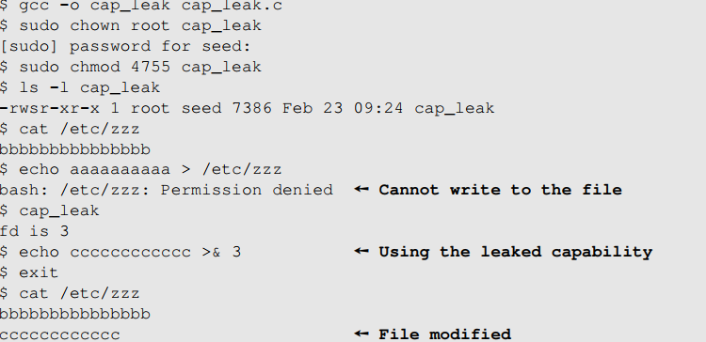
Attacks via Capability Leaking (Continued)
The program forgets to close the file, so the file descriptor is still valid.
Capability Leak
How to fix the program?
Destroy the file descriptor before downgrading the privilege (close the file)

Slide 22
Capability Leaking in OS X – Case Study
OS X Yosemite found vulnerable to privilege escalation attack related to capability leaking in July 2015 ( OS X 10.10 )
Added features to dynamic linker dyld
DYLD_PRINT_TO_FILE environment variable
The dynamic linker can open any file, so for root-owned Set-UID programs, it runs with root privileges. The dynamic linker dyld, does not close the file. There is a capability leaking.
Scenario 1 (safe): Set-UID finished its job and the process dies. Everything is cleaned up and it is safe.
Scenario 2 (unsafe): Similar to the “su” program, the privileged program downgrade its privilege, and lift the restriction.
Notes:
Talk about the case study
Different scenarios
Why scenario 2 is vulnerable and how
Fix

Slide 23
Invoking Programs
Invoking external commands from inside a program
External command is chosen by the Set-UID program
Users are not supposed to provide the command (or it is not secure)
Attack:
Users are often asked to provide input data to the command.
If the command is not invoked properly, user’s input data may be turned into command name. This is dangerous.

Slide 24
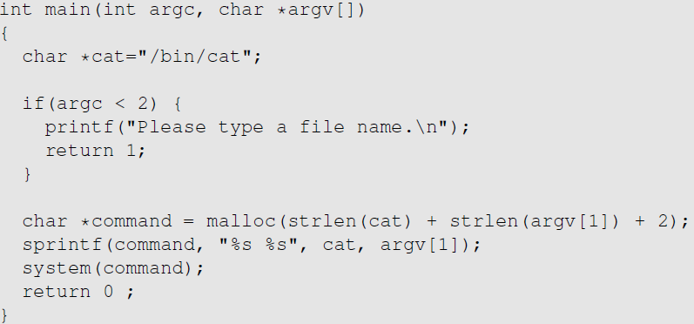
Invoking Programs : Unsafe Approach
The easiest way to invoke an external command is the system() function.
This program is supposed to run the /bin/cat program.
It is a root-owned Set-UID program, so the program can view all files, but it can’t write to any file.
Question: Can you use this program to run other command, with the root privilege?

Slide 25
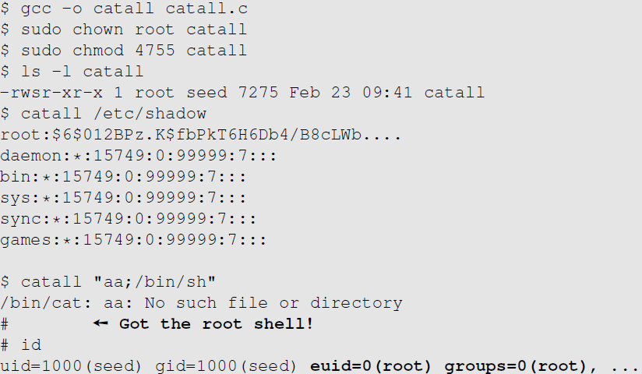
Invoking Programs : Unsafe Approach ( Continued)
Problem: Some part of the data becomes code (command name)
We can get a root shell with this input

Slide 26
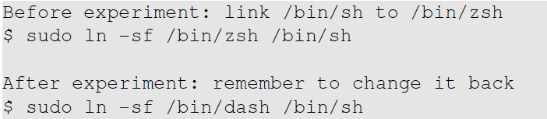
A Note
In Ubuntu 16.04, /bin/sh points to /bin/dash, which has a countermeasure
It drops privilege when it is executed inside a set-uid process
Therefore, we will only get a normal shell in the attack on the previous slide
Do the following to remove the countermeasure

Slide 27
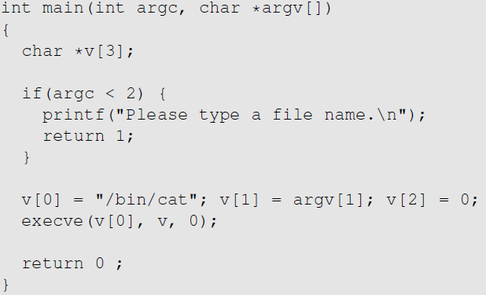
Invoking Programs Safely: using execve()
execve(v[0], v, 0)
Command name is provided here (by the program)
Input data are provided here (can be by user)
Why is it safe?
Code (command name) and data are clearly separated; there is no way for the user data to become code

Slide 28
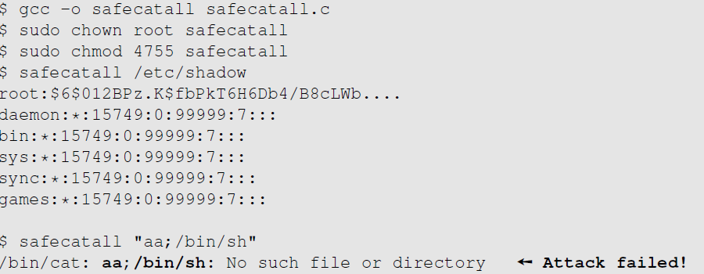
Invoking Programs Safely ( Continued)
The data are still treated as data, not code

Slide 29
Additional Consideration
Some functions in the exec() family behave similarly to execve(), but may not be safe
execlp(), execvp() and execvpe() duplicate the actions of the shell. These functions can be attacked using the PATH Environment Variable

Slide 30
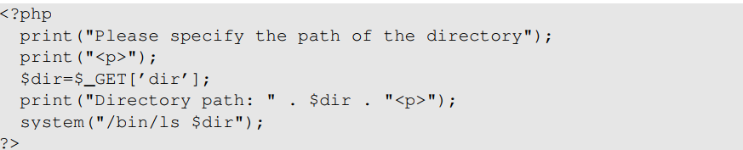
Invoking External Commands in Other Languages
Risk of invoking external commands is not limited to C programs
We should avoid problems similar to those caused by the system() functions
Examples:
Perl: open() function can run commands, but it does so through a shell
PHP: system() function
Attack:
http://localhost/list.php?dir=.;date
Command executed on server : “/bin/ls .;date”

Slide 31
Principle of Isolation
Principle: Don’t mix code and data.
Attacks due to violation of this principle :
system() code execution
Cross Site Scripting – More Information in Chapter 10
SQL injection - More Information in Chapter 11
Buffer Overflow attacks - More Information in Chapter 4

Slide 32
Principle of Least Privilege
A privileged program should be given the power which is required to perform it’s tasks.
Disable the privileges (temporarily or permanently) when a privileged program doesn’t need those.
In Linux, seteuid() and setuid() can be used to disable/discard privileges.
Different OSes have different ways to do that.

Slide 33
Summary
The need for privileged programs
How the Set-UID mechanism works
Security flaws in privileged Set-UID programs
Attack surface
How to improve the security of privileged programs

