Slide 1
Game Algorithms
GAM 1574
Dan Lingman
lingmad@algonquincollege.com
https://www.facebook.com/Dan.Lingman
https://www.linkedin.com/pub/dan-lingman/1/51a/300
https://twitter.com/Lingman
dlingman@gmail.com

Slide 2
Line Renderer 101
A line renderer connects
To use it, there are a few steps.
1) add a line renderer component to something in the scene
2) get that component in a script
3) set the number of points for it to render
4) assign the points to it
5) to turn it off, number of points = 0

Slide 3
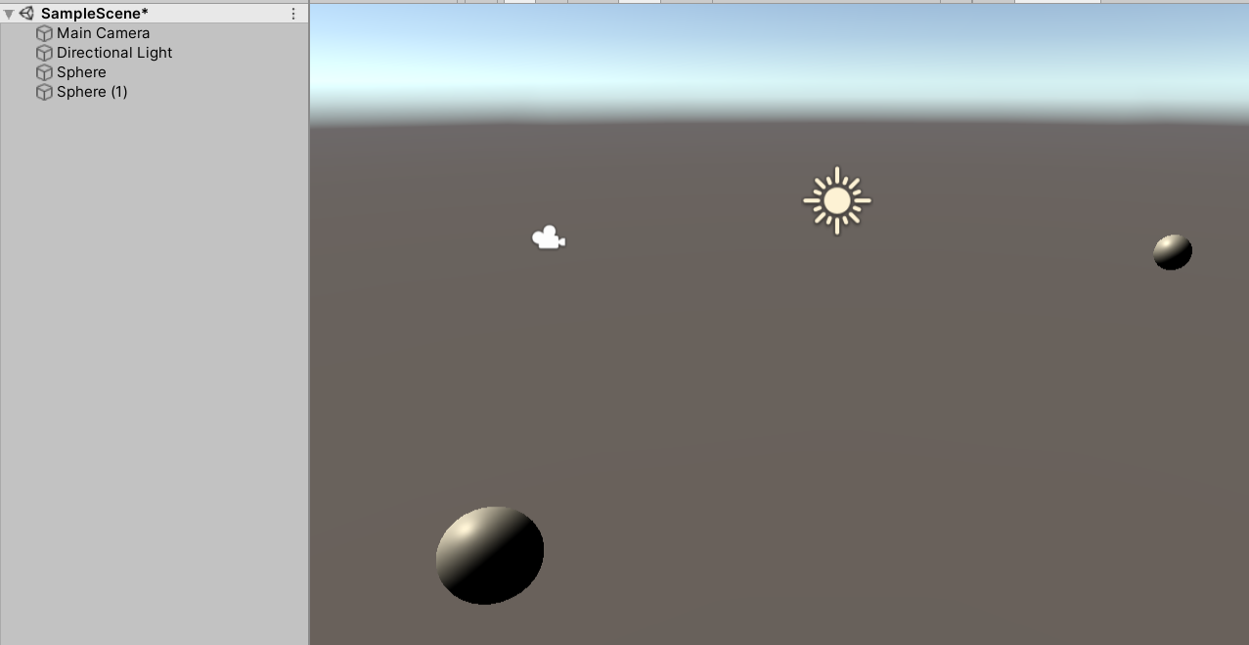
Line Renderer 101
Here I’ve added 2 spheres to the scene.

Slide 4
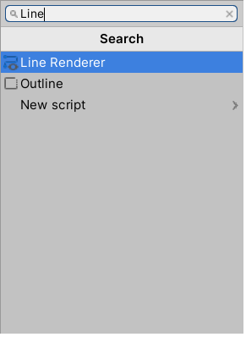
Line Renderer 101
Select one, then hit Add Component in the inspector. Start typing Line and you’ll see the Line Renderer component. Select it.

Slide 5
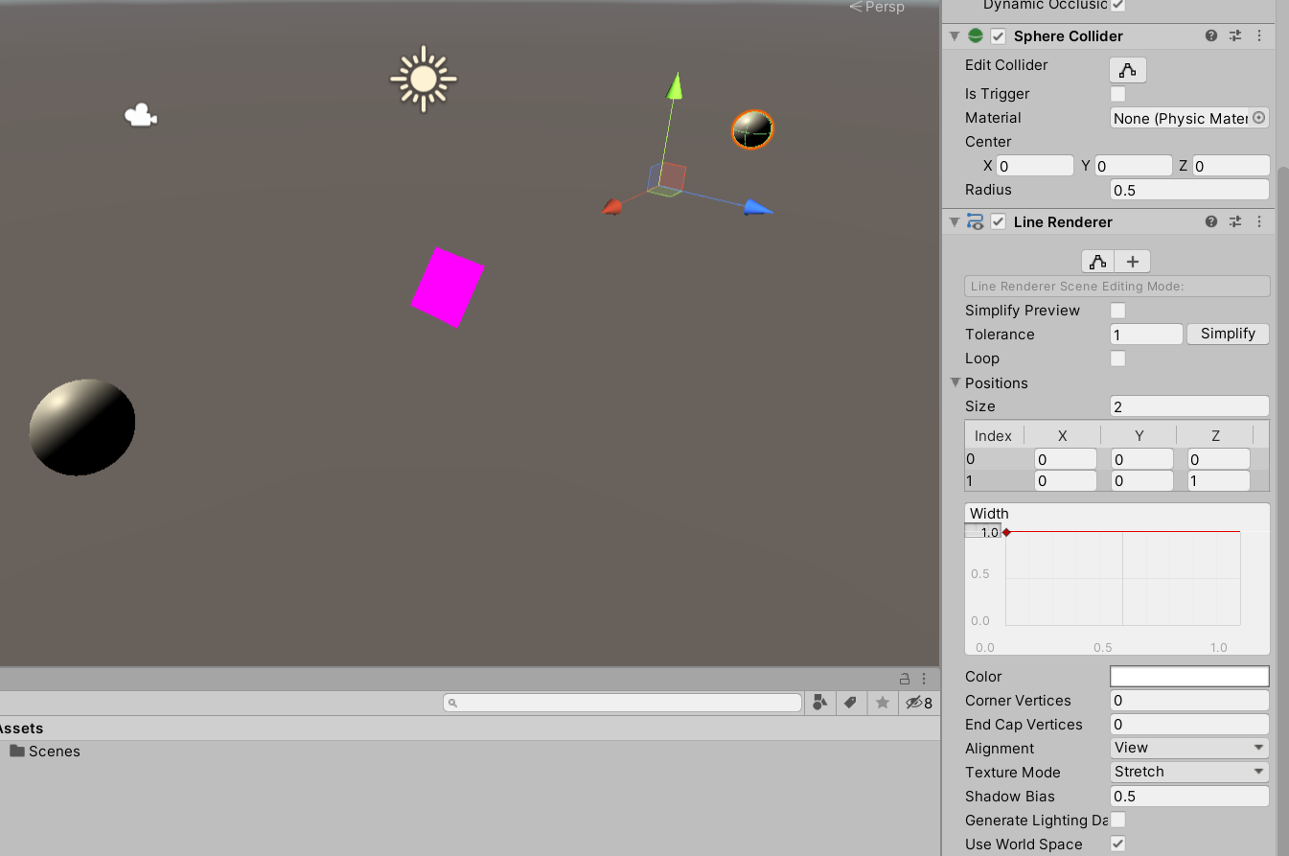
Line Renderer 101
By default, it has two points. Reset that to zero.

Slide 6
Line Renderer 101
Now, add a script to the sphere with the line renderer on it – doesn’t really matter what you name it. Open that script in Visual studio, and add a few member variables:
public GameObject target;
LineRenderer line;
Save, then drag the OTHER sphere into the target well.

Slide 7
Line Renderer 101
In start, retrieve the line renderer component. We want to set it’s color to something suitably garish. This is done by adding an unlit/color material to the line renderer.
void Start()
{
line = GetComponent<LineRenderer>();
}

Slide 8
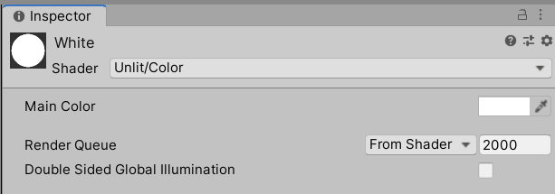
Line Renderer 101
Define a new material, then in the inspector for it, set the shader type to unlit/color, and pick a color. Drag this onto the material field in the line renderer inspector.

Slide 9
Line Renderer 101
We can now, set the points for the line renderer. For our first case, we want the points to track the target, so we’ll set them in update.
void Update()
{
line.positionCount = 2;
line.SetPosition(0, transform.position);
line.SetPosition(1, target.transform.position);
}

Slide 10
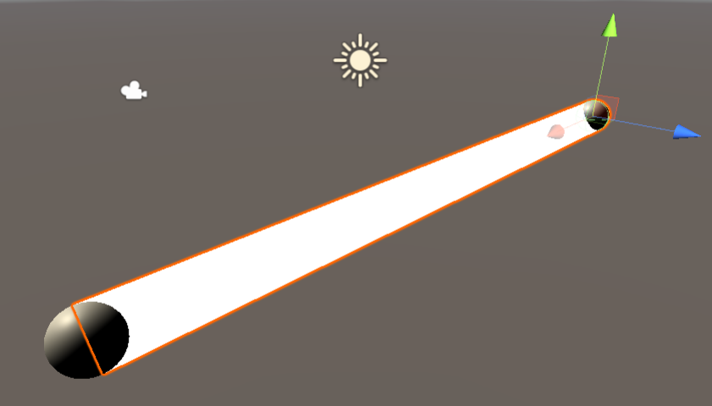
Line Renderer 101
If you move either end, the line will track.

Slide 11
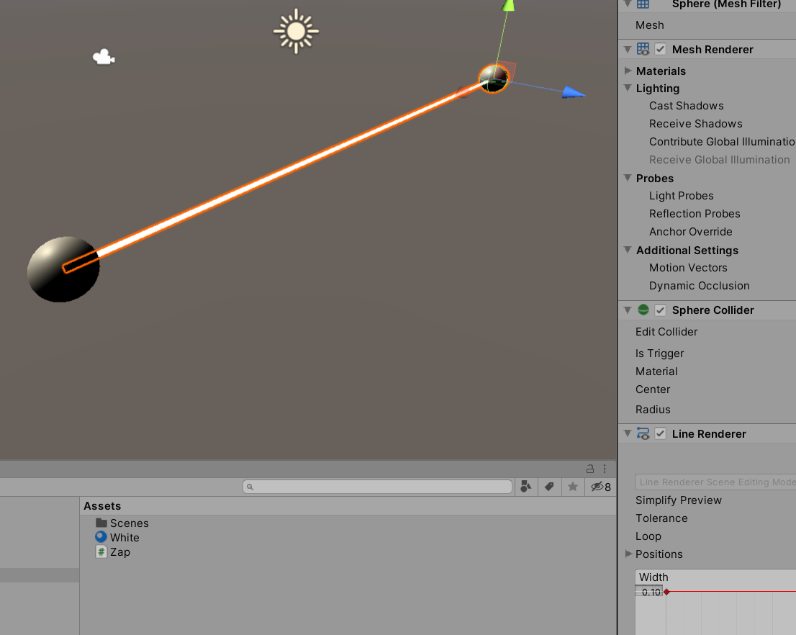
Line Renderer 101
Lets liven this up a bit – make a lightning bolt. First, we need a narrower line. In the width area, where there is a 1.0, enter in a 0.1.

Slide 12
Line Renderer 101
Next, we’ll need more points. Lets opt for 20 between these two locations. We want to interpolate between the points, then add an amount of randomness. With 20 segments, we need 21 points – this is the classic fence post problem. (see below for an example with 3 segments and 4 points)

Slide 13
Line Renderer 101
This does not have the randomness yet.
void Update()
{
line.positionCount = 21;
for (int i = 0; i <= 20; i++)
{
Vector3 pos = Vector3.Lerp(
transform.position,
target.transform.position,
(float)i / 20.0f);
line.SetPosition(i, pos);
}
}

Slide 14
Line Renderer 101
This does.
Add a public float so it can be modified in the inspector
public float zap = 0.0f;
And modify pos before setting it.
pos += UnityEngine.Random.insideUnitSphere * zap;
line.SetPosition(i, pos);
Now, while running, alter zap and see what happens.

Slide 15
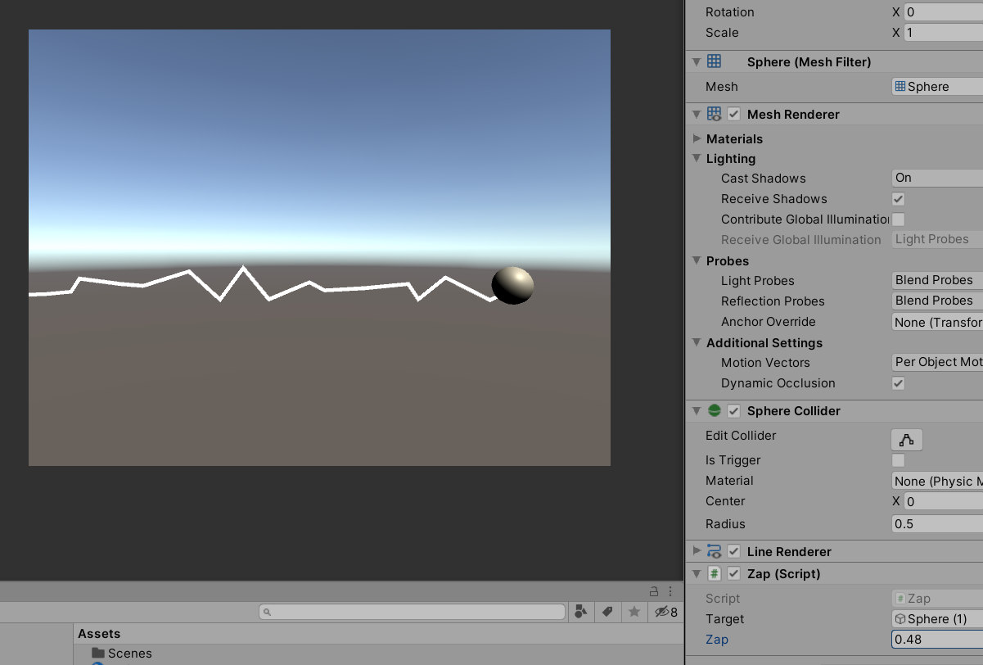
Line Renderer 101
Looks better animated, but…

