Slide 1

EcomVerse

Slide 2
What Is EcomVerse? The Future of 3D E- commerce
EcomVerse is an innovative project that aims to combine the power of metaverse and ecommerce. The basic idea behind EcomVerse is to create a virtual world that mimics the real world, but with added layers of interactivity and engagement. Fully immersive 3D environment where customers can browse, interact with products and shop like never before.
The metaverse is a virtual space that allows users to interact with a computer-generated environment in real-time. It is a fully immersive and interactive world that can be accessed through a variety of devices such as virtual reality headsets, computers, and mobile devices.

Slide 3
Problems
Customers may not be able to get an accurate idea of a product's size, shape, texture and other features with just 2D images, leading to returns due to dissatisfaction.
Traditional e-commerce has limited customer engagement.
3D e-commerce offers the ability to view products from various angles and zoom in and out.
Interact with the product in a virtual environment.
It is difficult for customers to imagine and personalize products.

Slide 4
Solutions
EcomVerse offers a three-dimensional shopping experience that is both engaging and realistic, which decreases the likelihood of returns and increases customer satisfaction.
EcomVerse provides customers with the ability to customize their products to their exact preferences, giving them a unique and memorable shopping experience.
EcomVerse offers games to make the customer experience more enjoyable and engaging, allowing customers to stay on the platform for longer and boosting customer loyalty. This process is known as gamification.
﻿
﻿

Slide 5
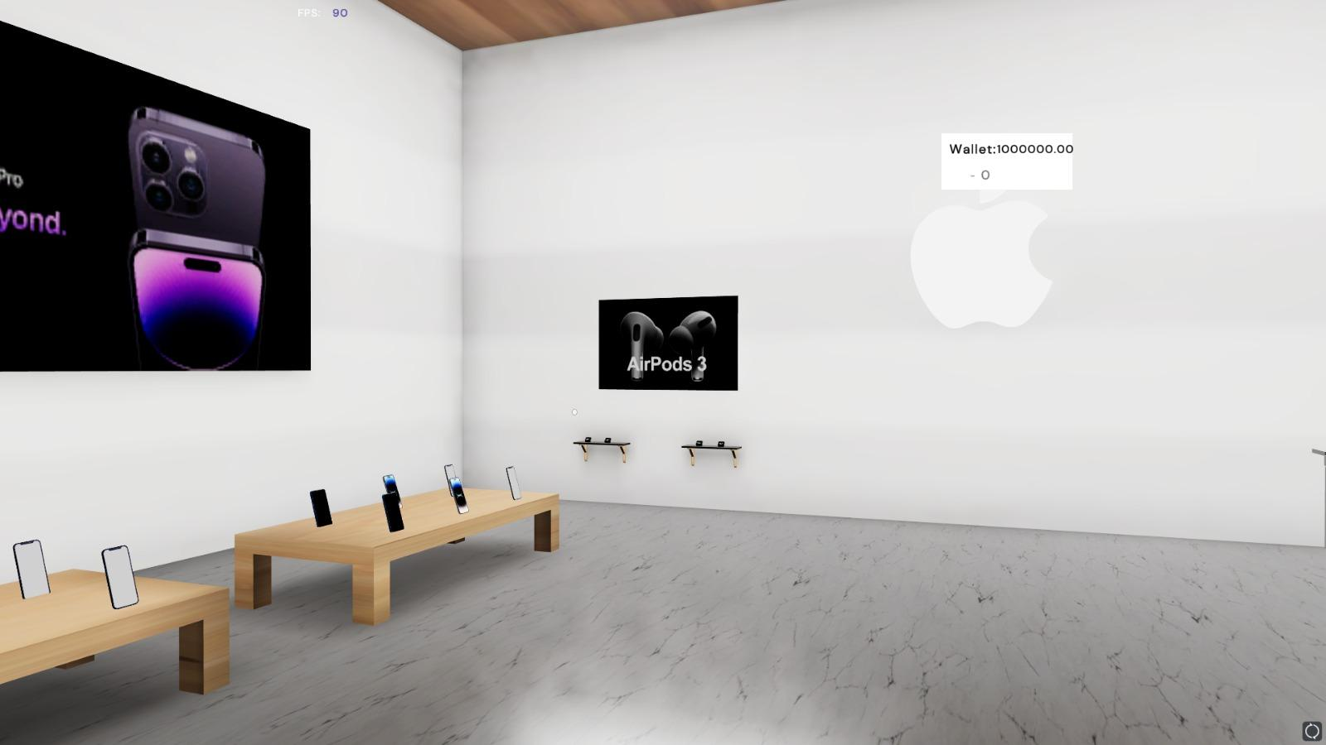
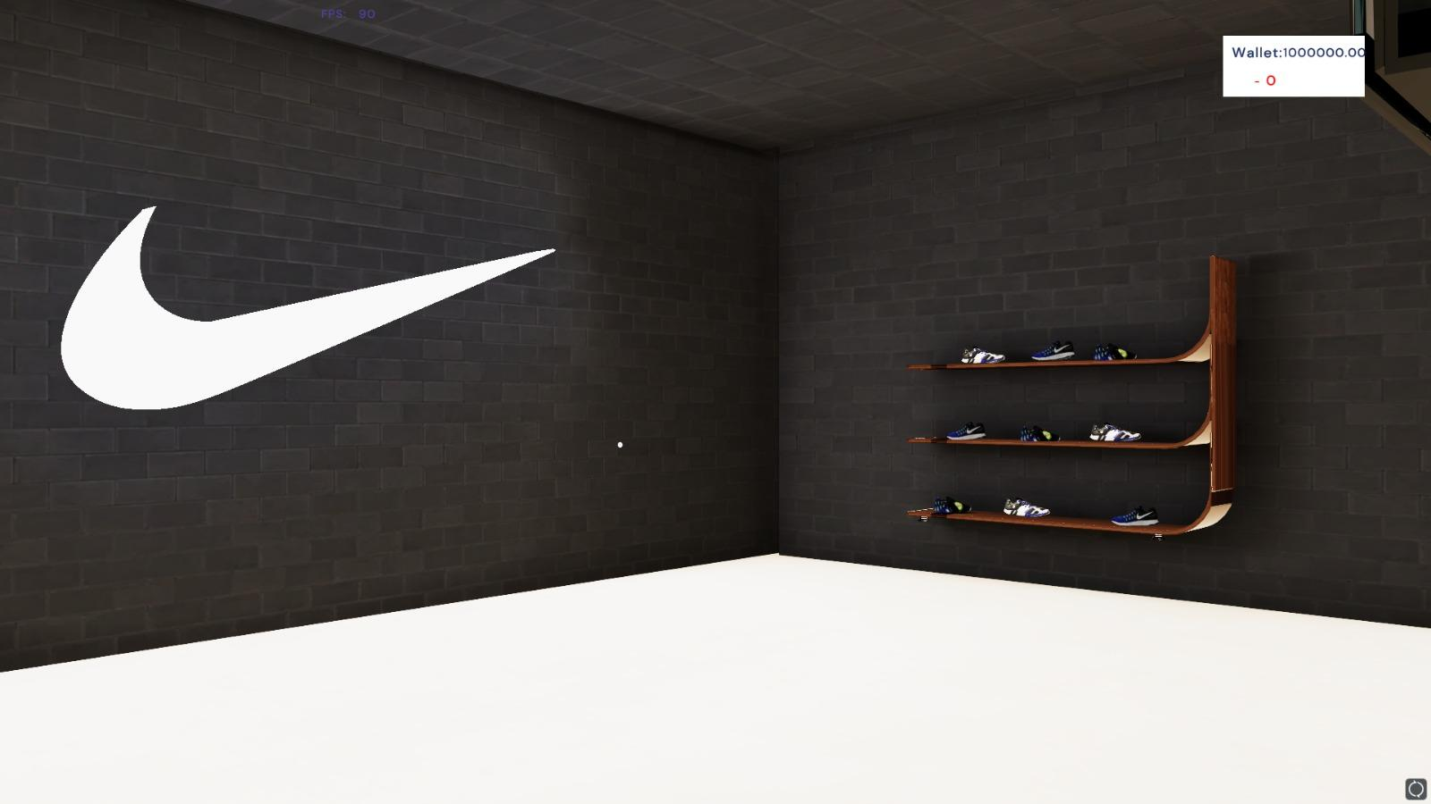
Features
3D Shopping Experience -
EcomVerse offers an immersive 3D shopping experience that allows customers to interact with products in a more engaging and realistic way

Slide 6
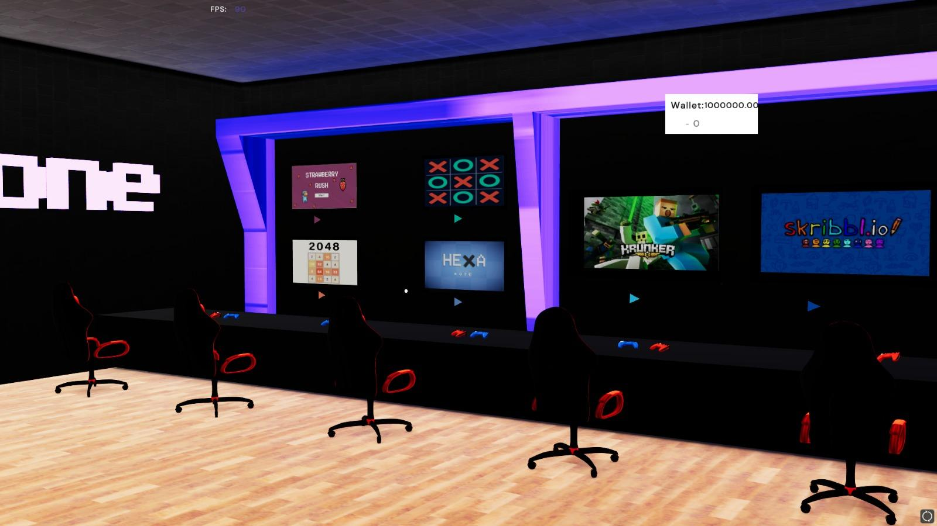
Features
Gaming Area for better engagement
EcomVerse provides embedded games to engage customers in a fun and interactive way, keeping them on the platform for longer periods of time and increasing customer loyalty.

Slide 7
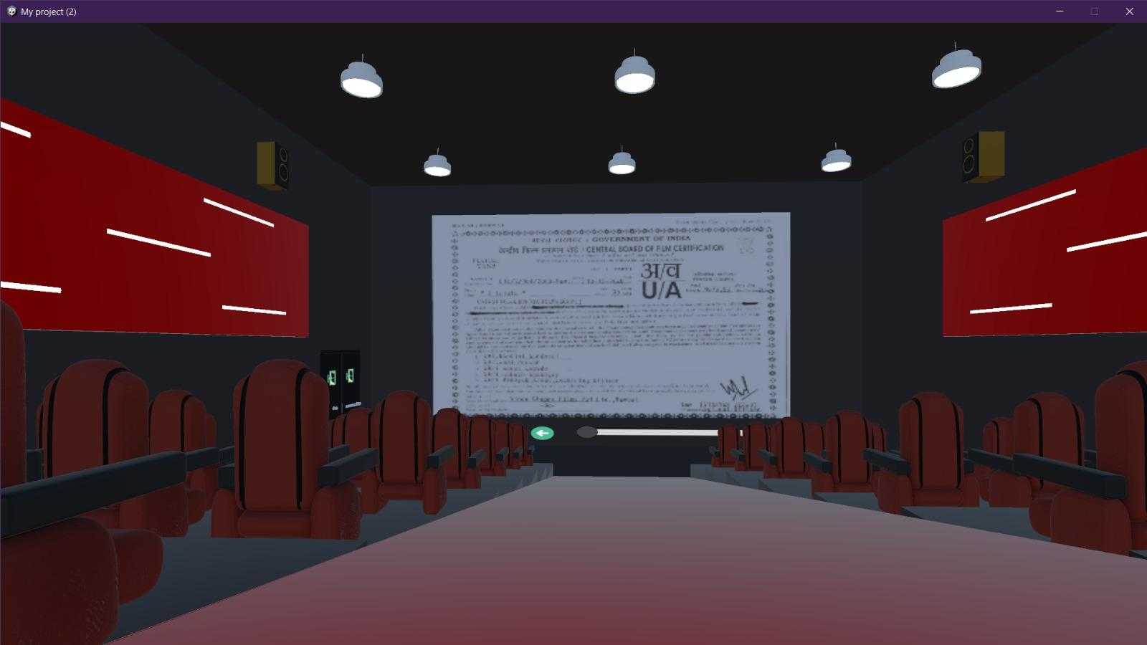
Features
3D Virtual Streaming/Cinema Hall
EcomVerse provides a 3D streaming cinema area for users to watch movies and series. This feature allows users to experience a virtual cinema experience with friends and family from the comfort of their own home.

Slide 8

Tech Stack
Unity 3D: Game engine for creating 2D/3D games and interactive applications
Blender: Free and open-source 3D creation software used to create 3D models, animations, and visual effects
Dokan: Multivendor for WordPress.
WordPress: Main Seller Backend
HTML/CSS: Languages used to create the structure, style, and layout of web pages.
Node.js: used to embed games.

Slide 9
Thank You

