Slide 1
The Introduction of ABY
ABY: A Framework for Efficient Mixed-Protocol Secure Two-Party Computation

Slide 2
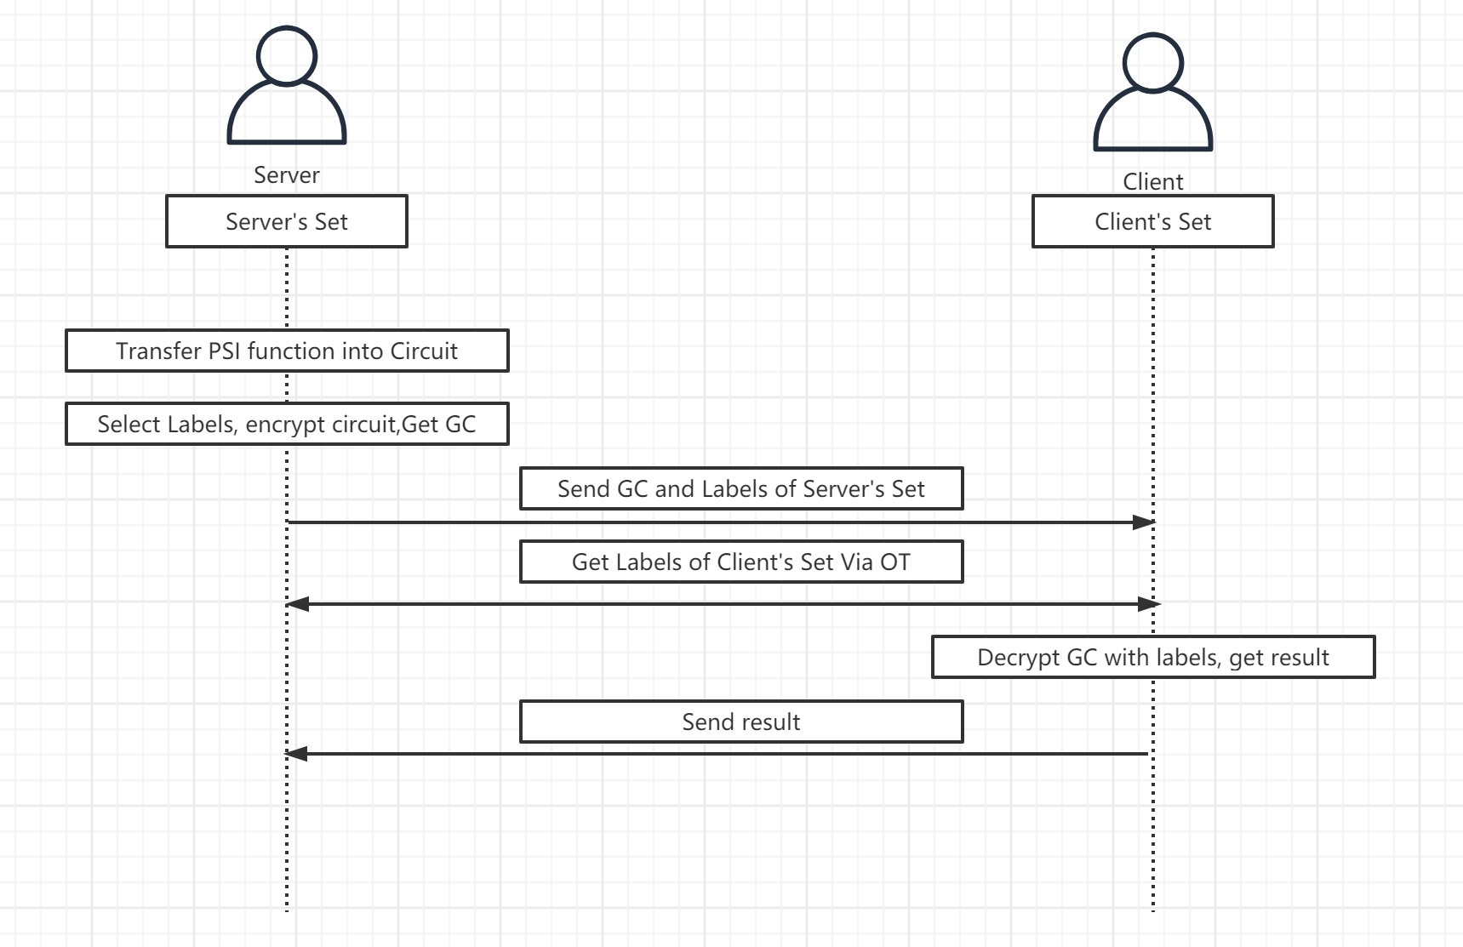
Framework of 2PC with GC & OT

Slide 3
Simple Introduction Of ABY
Design and implement a mixed-protocol framework.
Combines Secure computation based on
Arithmetic sharing
Boolean Sharing
Yao’s Garbled circuit.
Features:
Pre-compute almost all cryptographic operations
Provide efficient conversions between secure computation schemes
Perform benchmarks.

Slide 4
Target of ABY
Evaluate operations
have an efficient representation as an Arithmetic circuit using HE
Efficient representation as an Boolean circuit using yao’s garbled circuit
Other mixed-protocol framework
The conversion costs between HE and Yao’s Garbled Circuit are relatively expensive
And the performance of HE scales very poorly.

Slide 5
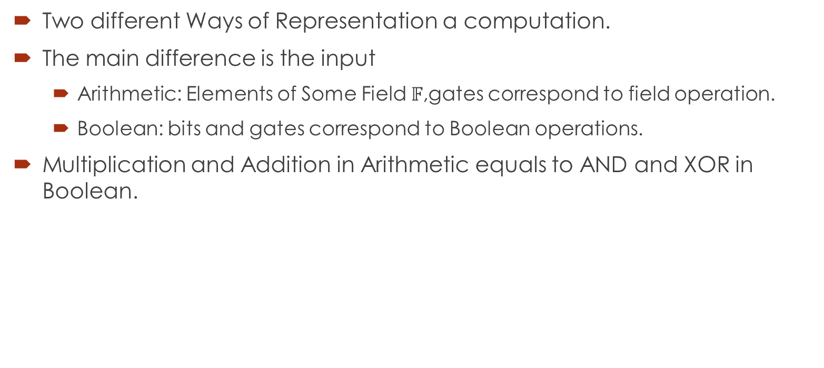
Arithmetic Circuit and Boolean Circuit
Two different Ways of Representation a computation.
The main difference is the input
Arithmetic: Elements of Some Field $𝔽$,gates correspond to field operation.
Boolean: bits and gates correspond to Boolean operations.
Multiplication and Addition in Arithmetic equals to AND and XOR in Boolean.

Slide 6
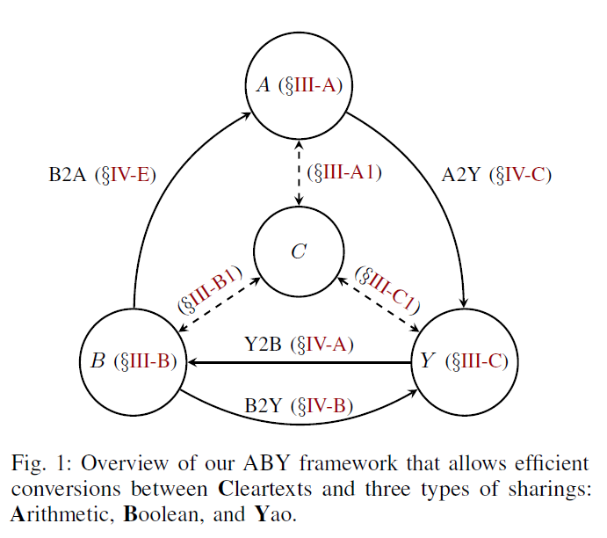
ABY Sharings
Arithmetic Sharings based on Beaver’s multiplication triples.
Boolean Sharings Based on Protocol of GMW.
Yao Sharings based on Yao’s garbled circuit protocol.
Cleartexts based on plaintext.

Slide 7
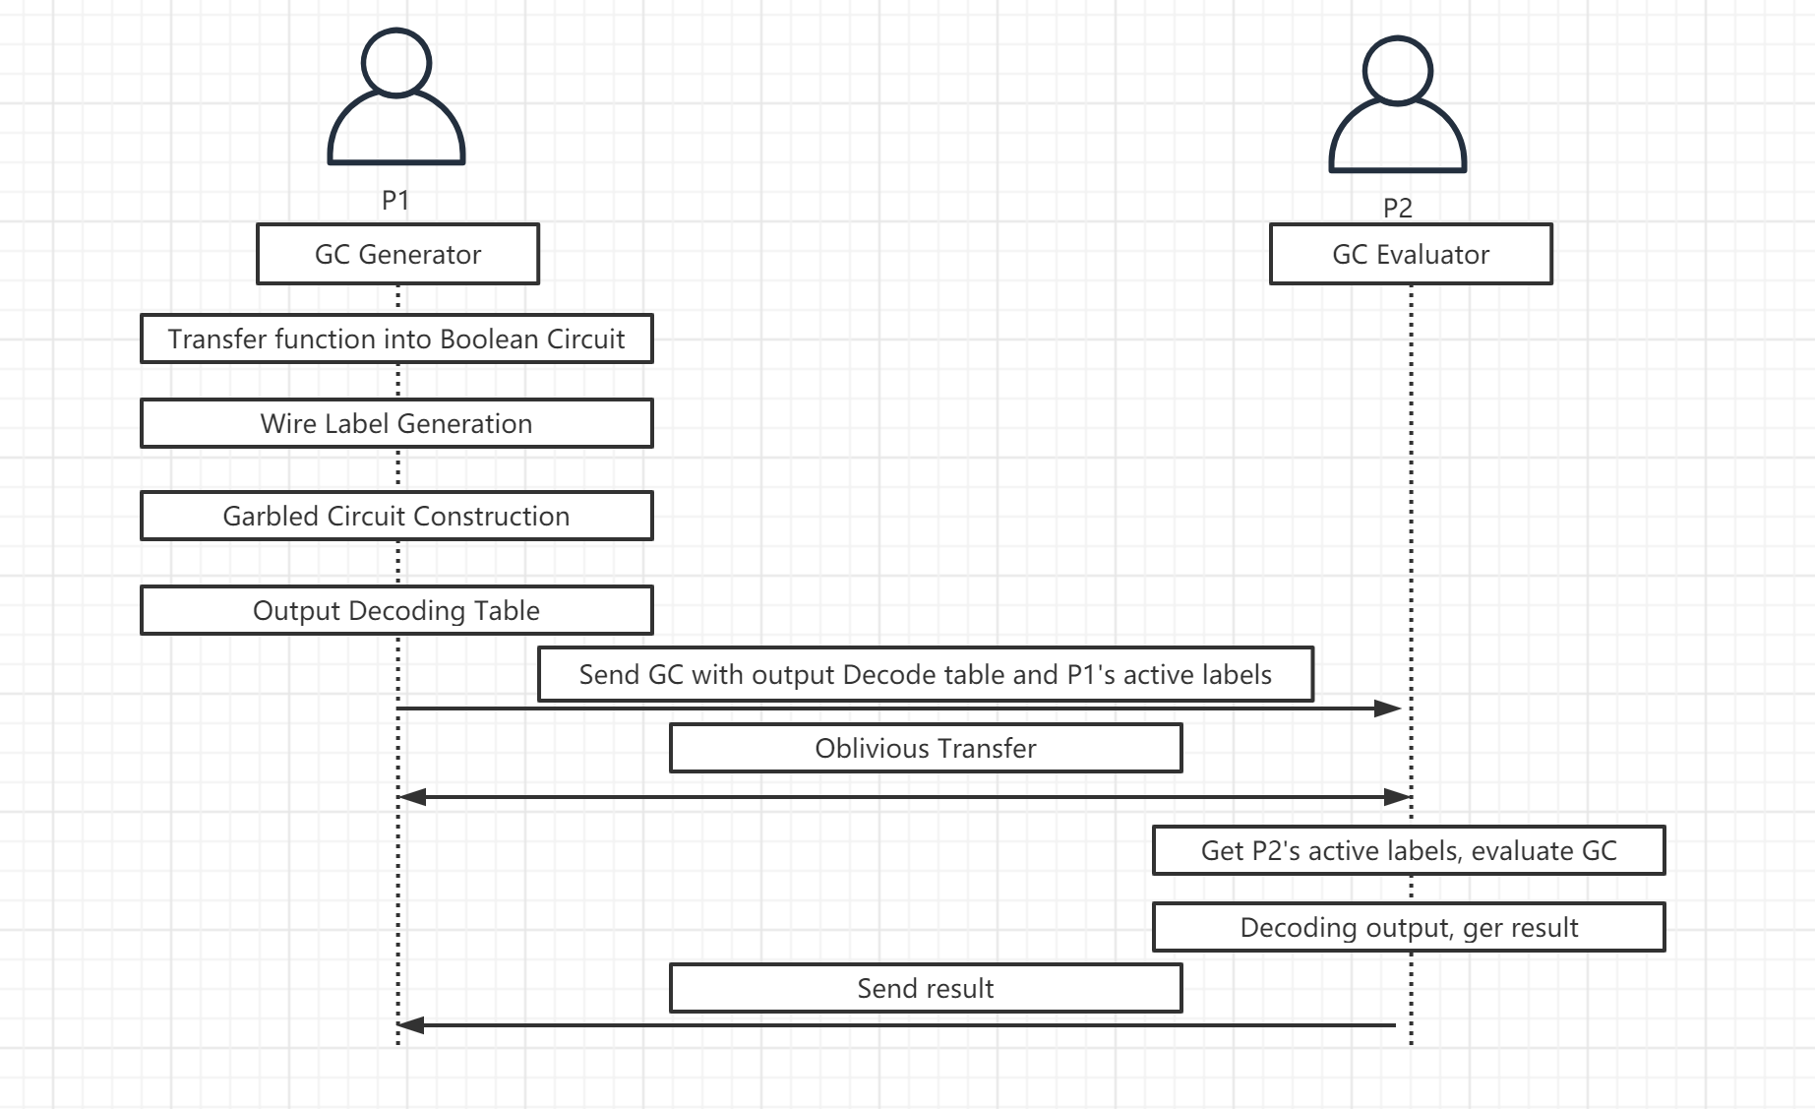
Yao’s GC protocol, Just for 2PC

Slide 8

Yao’s GC protocol
Establish Service Connection With metadata of inputs
Client
Server
Boolean Circuit
GC Generator
With Labels
Generate check
With Decoding Table(Optional)
Generate check
With Decoding Table
Send GC
Oblivious Transfer
Oblivious Transfer
GC Evaluator
Result
Result (Optional)

Slide 9
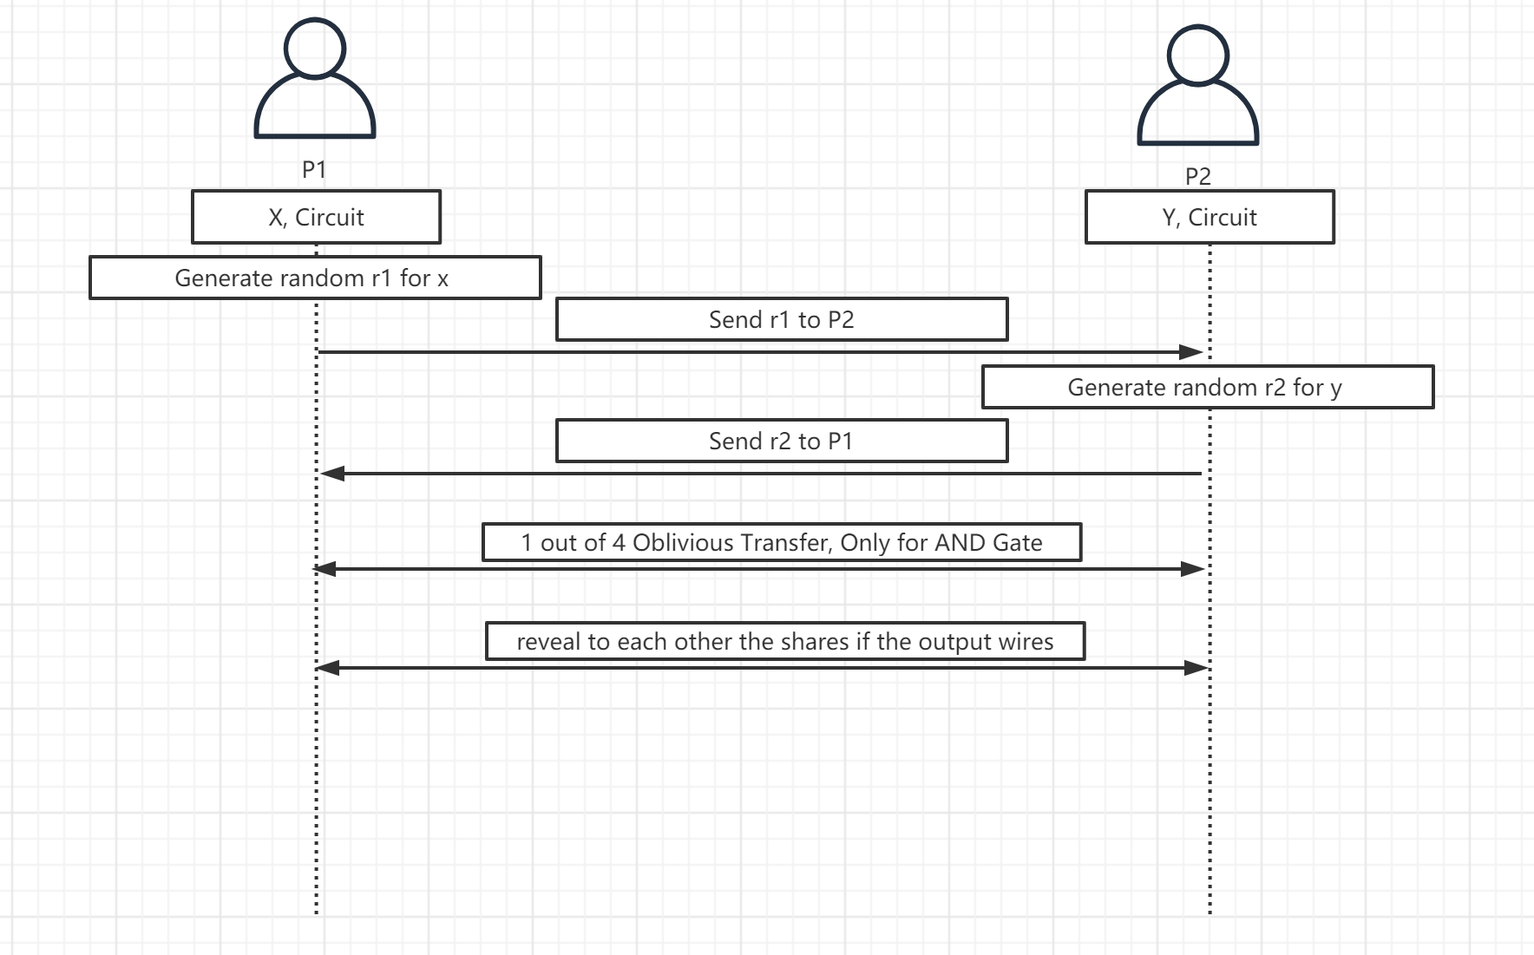
GMW protocol for 2PC

Slide 10
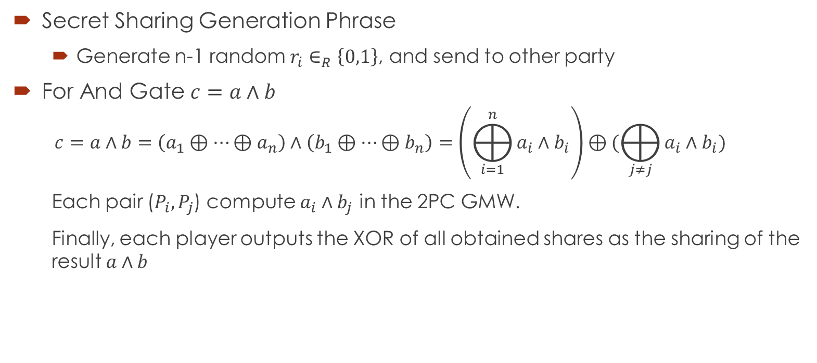
GMW protocol for MPC
Secret Sharing Generation Phrase
Generate n-1 random $r_{i}∈_{R}\left\{0,1\right\}$, and send to other party
For And Gate $c=a∧b$
$$c=a∧b=\left(a_{1}⊕…⊕a_{n}\right)∧\left(b_{1}⊕…⊕b_{n}\right)=\left(⨁_{i=1}^{n}{a_{i}∧b_{i}}\right)⊕(⨁_{j≠j}{a_{i}∧b_{i}})$$
Each pair ($P_{i},P_{j}$) compute $a_{i}∧b_{j}$ in the 2PC GMW.
Finally, each player outputs the XOR of all obtained shares as the sharing of the result $a∧b$

Slide 11
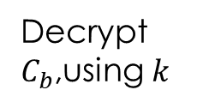
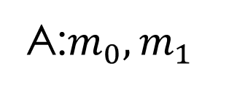




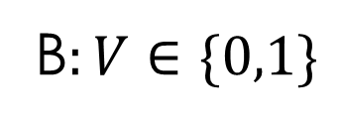
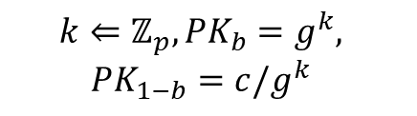
OT: Bellare-Micali Construction
A:$m_{0},m_{1}$
B$:V∈\{0,1\}$
A random $c←G$
$$(PK_{0},PK_{1})$$
$$k⇐ℤ_{p}, PK_{b}=g^{k},$$
$$PK_{1−b}=c/g^{k}$$
Check $PK_{0}PK_{1}=c$
$C_{0}=$Enc(${PK_{0}, x}_{0}$),$C_{1}=$Enc($PK_{1},x_{1}$)
$$C_{0},C_{1}$$
Decrypt $C_{b}$,using $k$

Slide 12



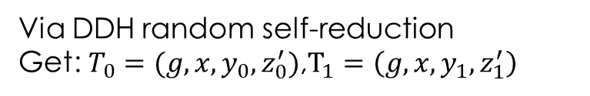

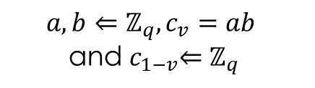

OT: Naor-Pinkas construction
Random Self-reduction: We have tuple $\left(g, g^{x}, g^{y}, g^{z}\right)$, Then to perform a random self reduction. Pick random $a, b←ℤ_{P}^{∗}$, and output $g, g^{\left(x+b\right)a}$,$g^{y}$,$g^{\left(z+by\right)a}$.
A:$m_{0},m_{1}$
B$:V∈\{0,1\}$
$$(g, x=g^{a},y=g^{b}, z_{0}=g^{c_{0}},z_{1}=g^{c_{1}})$$
$$a, b⇐ℤ_{q},c_{v}=ab$$
and${ c}_{1−v}⇐ℤ_{q}$
Via DDH random self-reduction
Get: $T_{0}=(g,x,y_{0},z_{0}^{′})$,$T_{1}=\left(g, x, y_{1},z_{1}^{′}\right)$
$$({CT}_{0}=(y_{0},mz_{0}^{′}), {CT}_{1}=(y_{1},mz_{1}^{′}))$$
Enc($m_{0}, T_{0}$) and Enc$(m_{1},T_{1})$
Decrypt $CT_{v}$

Slide 13

BGW protocol
Be used to evaluate an arithmetic circuit over a field $𝔽$.
The protocol is based on Shamir secret sharing, which are homomorphic.
A dealer chooses a random polynomial $p$ of degree at $t$.
Such $p\left(0\right)=v$, and $P_{i}$’s Secret sharing is$p(i)$.
Any collection of $t$ shares reveals no information about $v$.

Slide 14
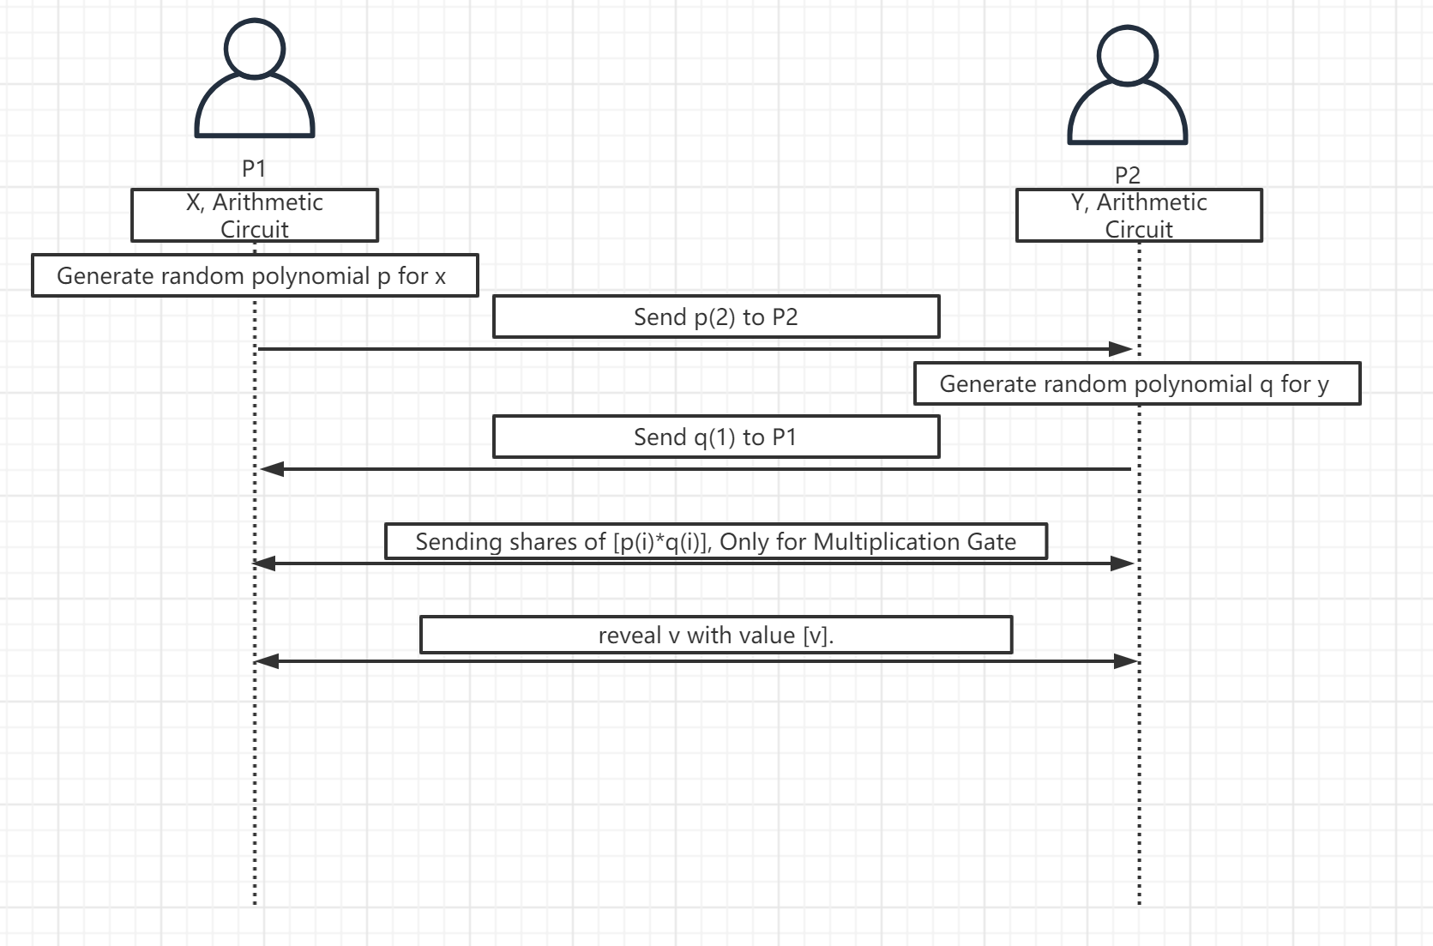
BGW protocol for 2PC

Slide 15
Preprocessed Multiplication Triples
Split MPC Protocol into pre-processing phase(Before the parties’ inputs are know) and online phase
Beaver triple, is ([a],[b],[c]), c = ab, each multiplication consumed one triple, and Each triple can only be used for one multiplication.
Key Idea:
Extend Additive Homomorphic properties to Multiplication properties.

