Slide 1
The Introduction of ABY
ABY: A Framework for Efficient Mixed-Protocol Secure Two-Party Computation

Slide 2
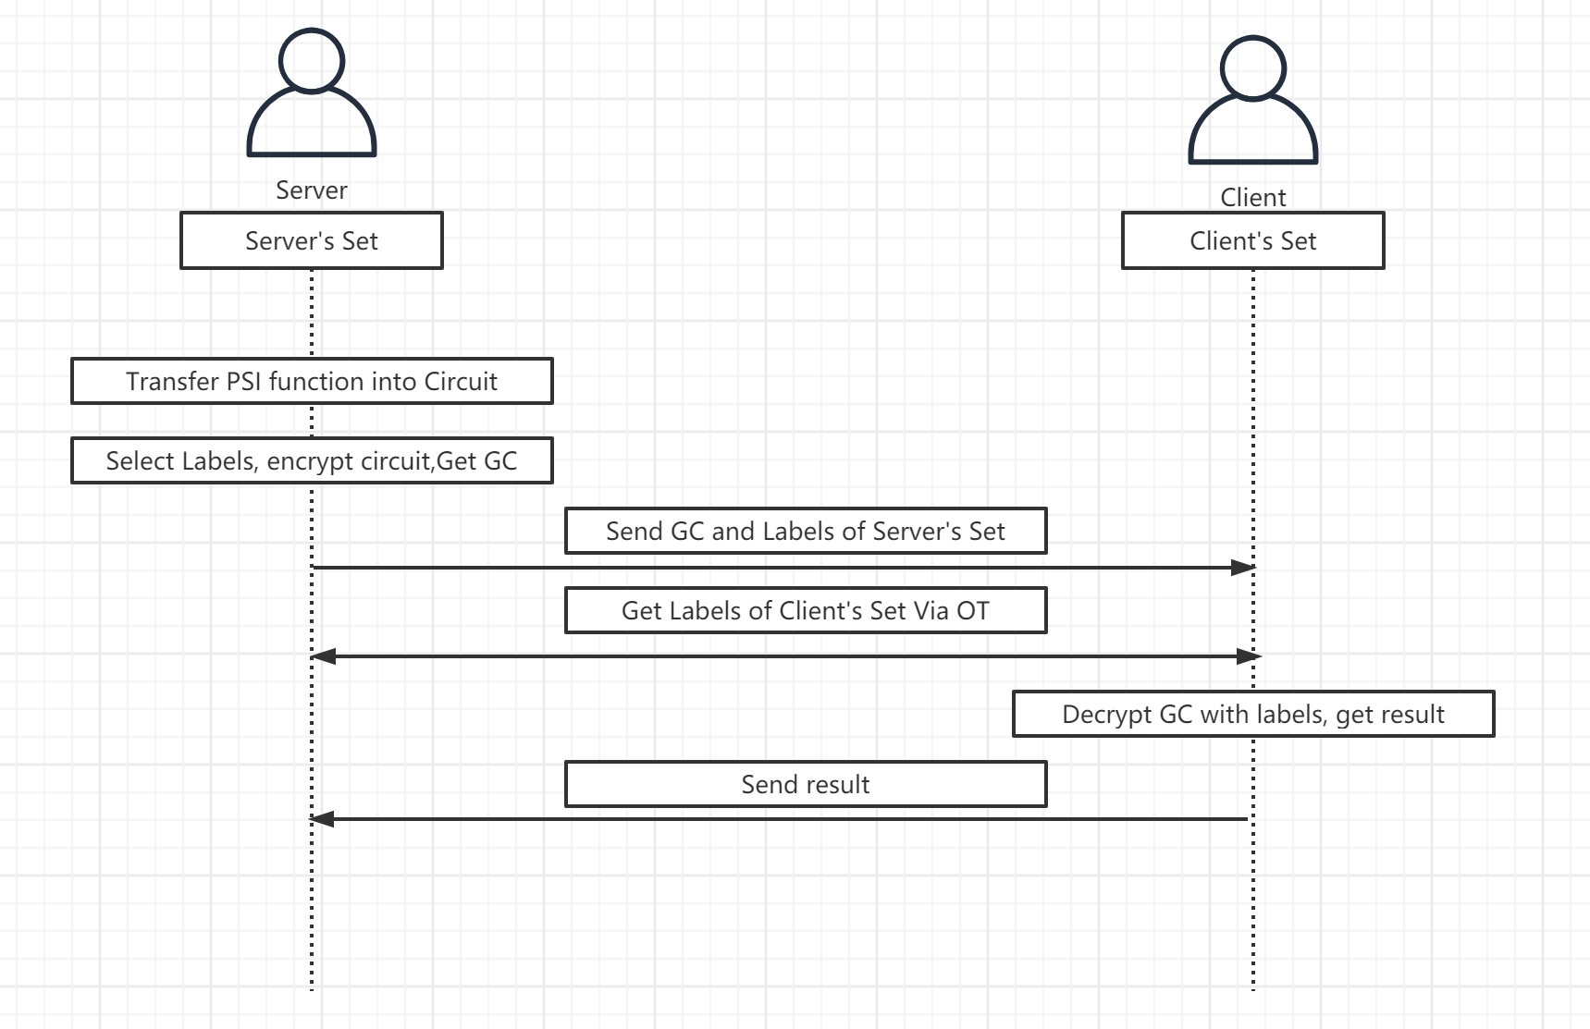
Framework of 2PC with GC & OT

Slide 3
Simple Introduction Of ABY
Design and implement a mixed-protocol framework.
Combines Secure computation based on
Arithmetic sharing
Boolean Sharing
Yao’s Garbled circuit.
Features:
Pre-compute almost all cryptographic operations
Provide efficient conversions between secure computation schemes
Perform benchmarks.

Slide 4
Target of ABY
Evaluate operations
have an efficient representation as an Arithmetic circuit using HE
Efficient representation as an Boolean circuit using yao’s garbled circuit
Other mixed-protocol framework
The conversion costs between HE and Yao’s Garbled Circuit are relatively expensive
And the performance of HE scales very poorly.

Slide 5
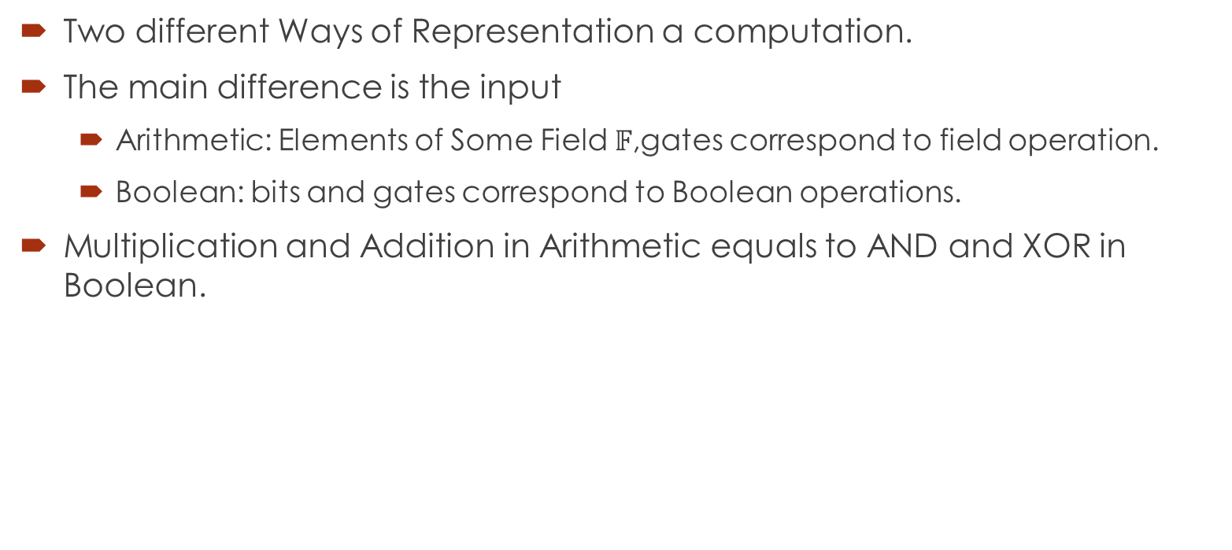
Arithmetic Circuit and Boolean Circuit
Two different Ways of Representation a computation.
The main difference is the input
Arithmetic: Elements of Some Field $𝔽$,gates correspond to field operation.
Boolean: bits and gates correspond to Boolean operations.
Multiplication and Addition in Arithmetic equals to AND and XOR in Boolean.

Slide 6
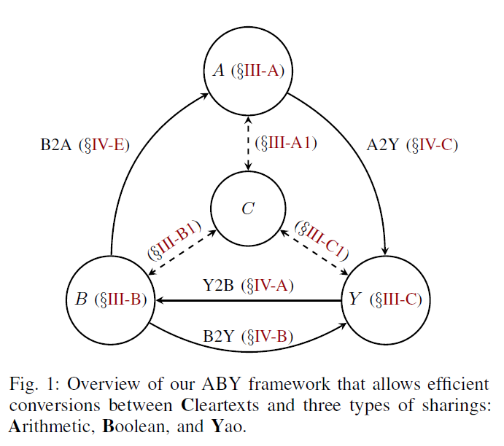
ABY Sharings
Arithmetic Sharings based on Beaver’s multiplication triples.
Boolean Sharings Based on Protocol of GMW.
Yao Sharings based on Yao’s garbled circuit protocol.
Cleartexts based on plaintext.

Slide 7
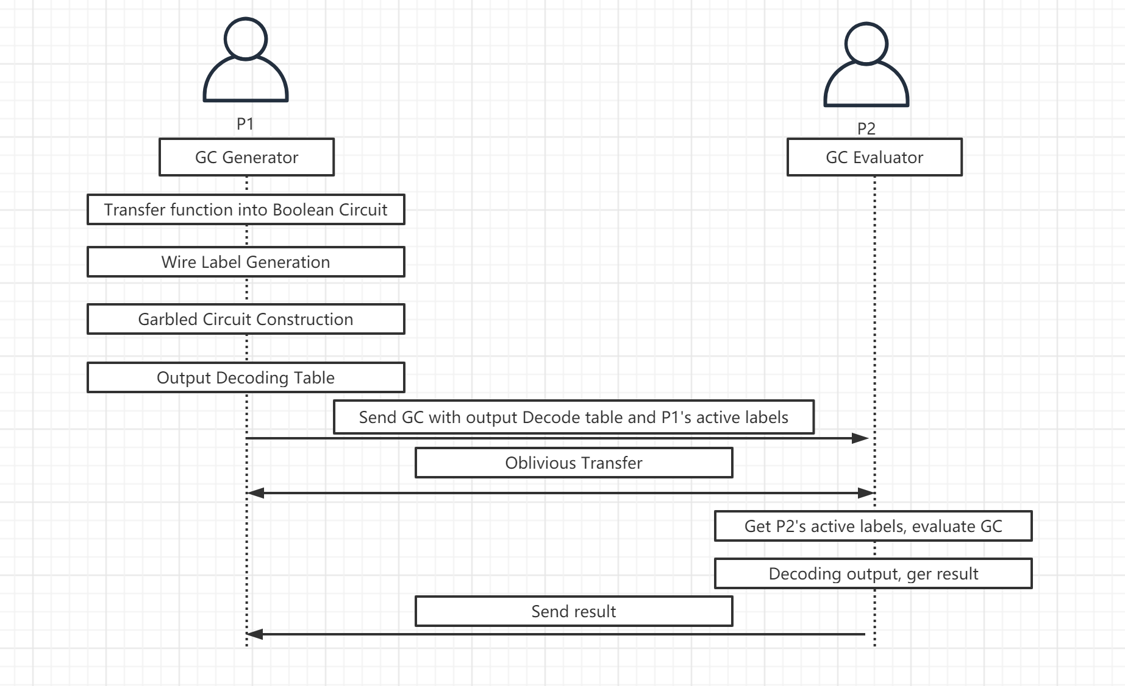
Yao’s GC protocol

Slide 8
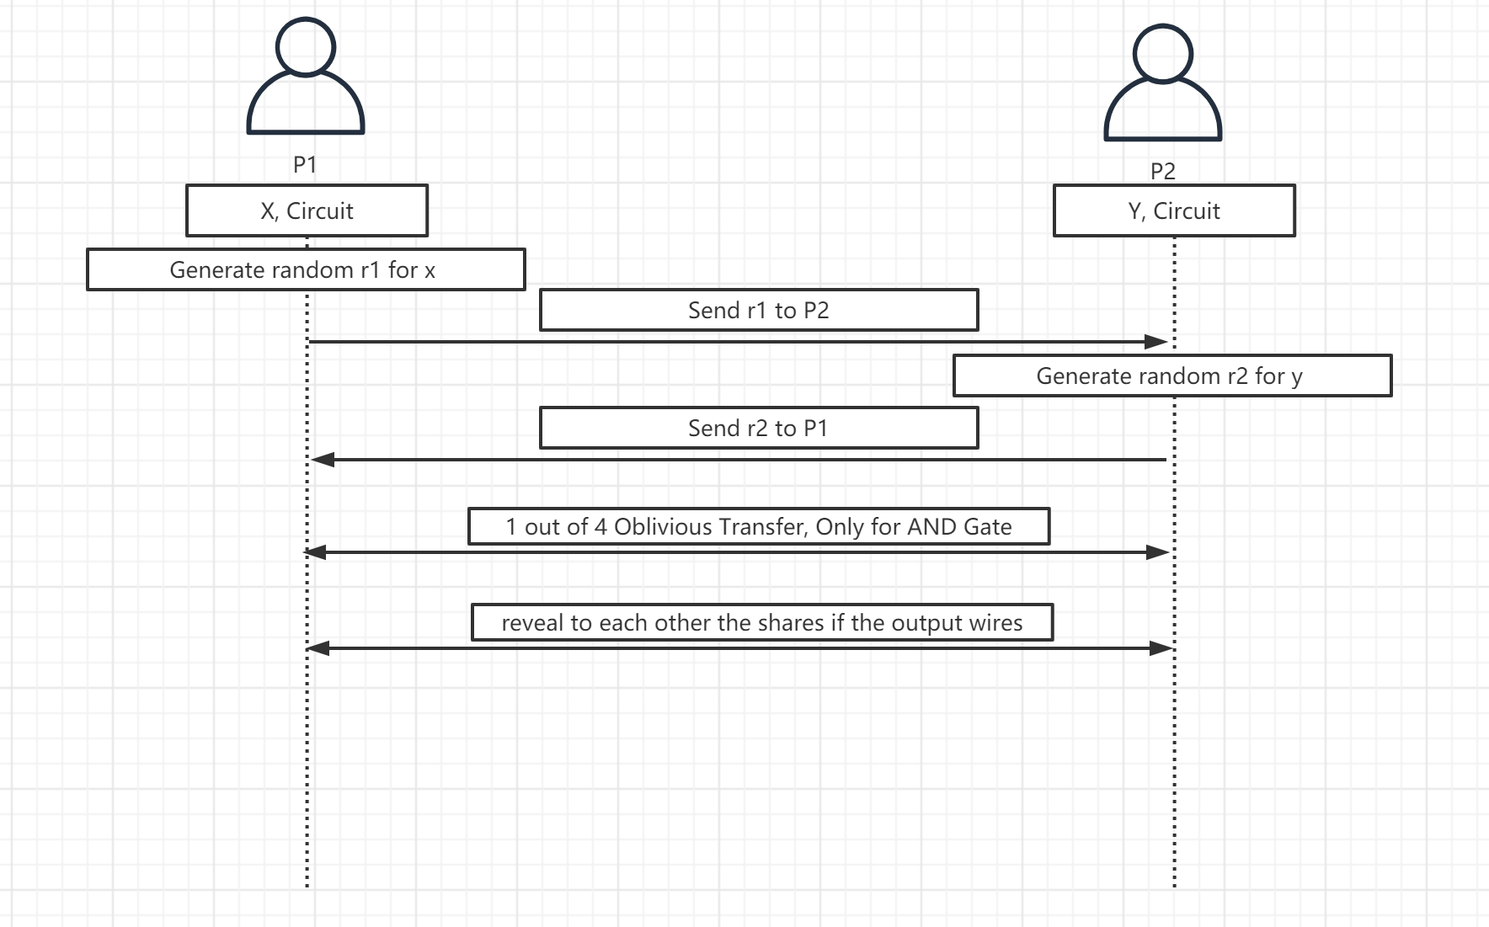
GMW protocol

Slide 9
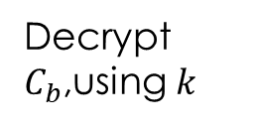
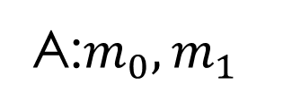





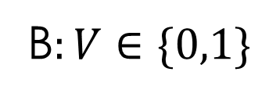
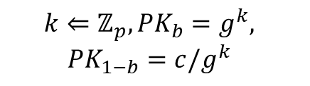
OT: Bellare-Micali COnstruction
Random Self-reduction: We have tuple $\left(g, g^{x}, g^{y}, g^{z}\right)$, Then to perform a random self reduction. Pick random $a, b←ℤ_{P}^{∗}$, and output $g, g^{\left(x+b\right)a}$,$g^{y}$,$g^{\left(z+by\right)a}$.
A:$m_{0},m_{1}$
B$:V∈\{0,1\}$
A random $c←G$
$$(PK_{0},PK_{1})$$
$$k⇐ℤ_{p}, PK_{b}=g^{k},$$
$$PK_{1−b}=c/g^{k}$$
Check $PK_{0}PK_{1}=c$
$C_{0}=$Enc(${PK_{0}, x}_{0}$),$C_{1}=$Enc($PK_{1},x_{1}$)
$$C_{0},C_{1}$$
Decrypt $C_{b}$,using $k$

Slide 10


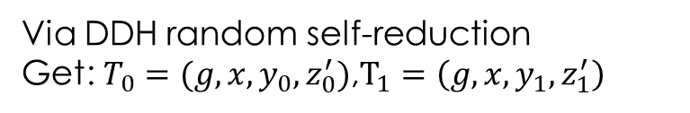

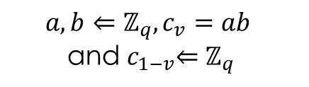

OT: Naor-Pinkas construction
Random Self-reduction: We have tuple $\left(g, g^{x}, g^{y}, g^{z}\right)$, Then to perform a random self reduction. Pick random $a, b←ℤ_{P}^{∗}$, and output $g, g^{\left(x+b\right)a}$,$g^{y}$,$g^{\left(z+by\right)a}$.
A:$m_{0},m_{1}$
B$:V∈\{0,1\}$
$$(g, x=g^{a},y=g^{b}, z_{0}=g^{c_{0}},z_{1}=g^{c_{1}})$$
$$a, b⇐ℤ_{q},c_{v}=ab$$
and${ c}_{1−v}⇐ℤ_{q}$
Via DDH random self-reduction
Get: $T_{0}=(g,x,y_{0},z_{0}^{′})$,$T_{1}=\left(g, x, y_{1},z_{1}^{′}\right)$
$$({CT}_{0}=(y_{0},mz_{0}^{′}), {CT}_{1}=(y_{1},mz_{1}^{′}))$$
Enc($m_{0}, T_{0}$) and Enc$(m_{1},T_{1})$
Decrypt $CT_{v}$

Slide 11
Process of ABY

