Slide 1
Some details about Polkadot
Components and sub-protocols
Wang Kaixuan
December, 2020

Slide 2
Contents
1
NPoS and Validator election
2
Relay Chain State Machine
3
Consensus
4
Parachains
5
Economics, Incentive and Governance

Slide 3
Contents
1
NPoS and Validator election
2
Relay Chain State Machine
3
Consensus
4
Parachains
5
Economics, Incentive and Governance

Slide 4
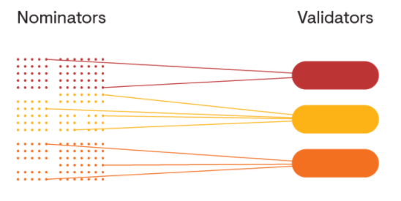
NPoS and Validator election
NPoS(Nominated proof-of-state) is a new type of scheme used to select the validators who are allowed to participate in the consensus protocol.
NPoS’s Adventages:
more efficient than PoW
considerably more secure than conventional forms of PoS such as DPoS(Delegated PoS) and BPoS(Bonded PoS) in Cosmos.

Slide 5
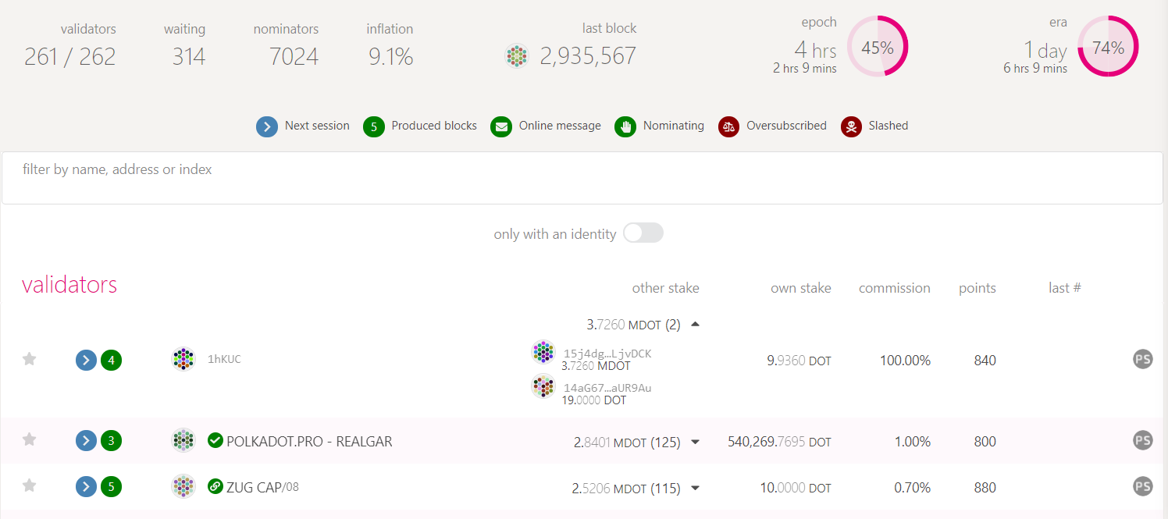
NPoS and Validator election
Staking Overview

Slide 6
NPoS and Validator election
Validator election:
A new set of validators is elected at the beginning of every era( about one day)
Any DOT holder could become a validator candidate or a nominator.
Candidate need stake the amount of stake and spend commission fee for operational costs
Nominator locks some stake and published a list with any number of candidates
A public protocol takes these lists as input and elects the candidates with the most backing to serve as validators for the next era.
About once per day, the system elects a group of entities called validators
An unlimited number of parties can participate as nominators

Slide 7
The goals of validator election: Proportionality
A committee should represent each minority in the electorate proportional to their aggregate vote strength(their stake), with no minority being under-represented.
Related works:
in late 19th century. Edvard Phragmén proposed a method for electing members to country’s parliament, which ensured that seats assigned to each party were proportional to the votes given to them
Validator selection protocol in Polkadot is an adaptation of Phragmén’s methods and is guaranteed to observe the technical property of proportional justified representation (PJR).

Slide 8
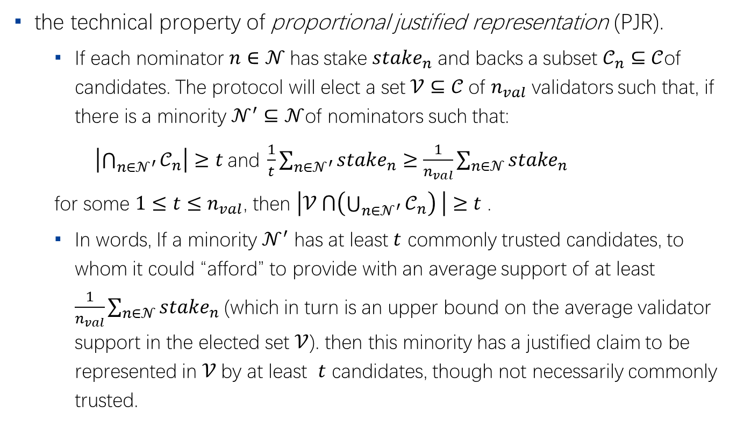
The goals of validator election: Proportionality
the technical property of proportional justified representation (PJR).
If each nominator $n∈𝒩$has stake $stake_{n}$ and backs a subset $𝒞_{n}⊆𝒞$of candidates. The protocol will elect a set $𝒱⊆𝒞$of $n_{val}$ validators such that, if there is a minority $𝒩^{′}⊆𝒩$of nominators such that:
$\left|\bigcap_{n∈𝒩^{′}}{𝒞_{n}}\right|≥t \text{and} \frac{1}{t}\sum_{n∈𝒩^{′}}{stake_{n}}≥\frac{1}{n_{val}}\sum_{n∈𝒩}{stake_{n}}$
for some $1≤t≤n_{val}$, then $\left|𝒱 ⋂\left(\bigcup_{n∈𝒩^{′}}{𝒞_{n}}\right) \right|≥t$ .
In words, If a minority $𝒩^{′}$ has at least $t$ commonly trusted candidates, to whom it could “afford” to provide with an average support of at least $\frac{1}{n_{val}}\sum_{n∈𝒩}{stake_{n} }$(which in turn is an upper bound on the average validator support in the elected set $𝒱$). then this minority has a justified claim to be represented in $𝒱$by at least $t$ candidates, though not necessarily commonly trusted.

Slide 9
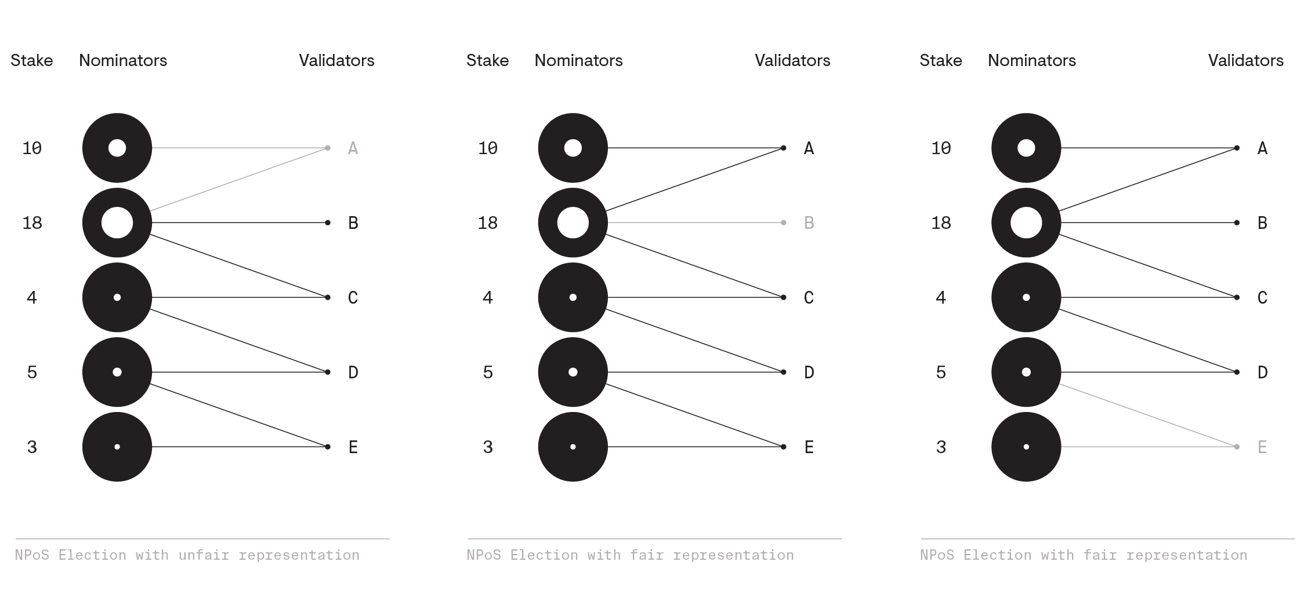
The goals of validator election: Decentralisation
In order to elect k = 4 validators
Fair representation: any nominator holding at least one k-th of the total stake is guaranteed to have at least one of their trusted validators elected.

Slide 10
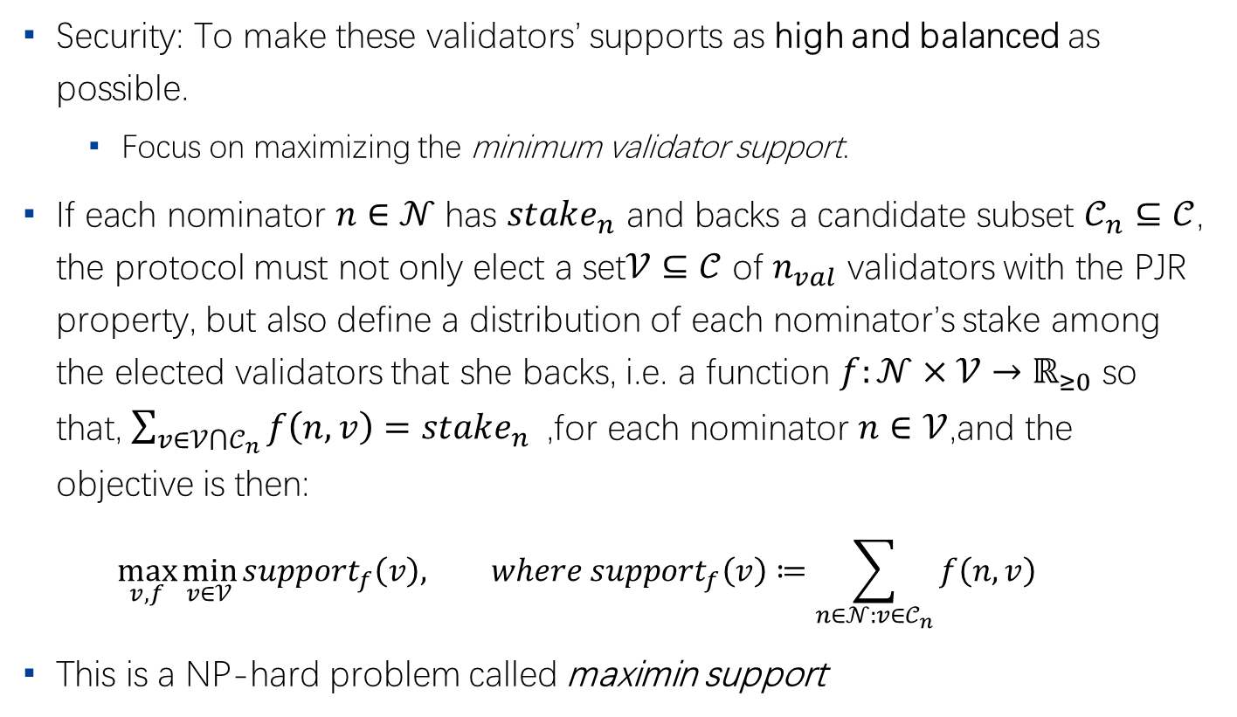
The goals of validator election: Security
Security: To make these validators’ supports as high and balanced as possible.
Focus on maximizing the minimum validator support.
If each nominator $n∈𝒩$has $stake_{n}$ and backs a candidate subset $𝒞_{n}⊆𝒞$, the protocol must not only elect a set$𝒱⊆𝒞$ of $n_{val}$ validators with the PJR property, but also define a distribution of each nominator’s stake among the elected validators that she backs, i.e. a function $f:𝒩×𝒱→ℝ_{≥0}$ so that, $\sum_{v∈𝒱⋂𝒞_{n}}{f\left(n, v\right)=stake_{n}}$,for each nominator $n∈𝒱$,and the objective is then:
$$\max_{v,f}{\min_{v∈𝒱}{support_{f}\left(v\right), where support_{f}\left(v\right)≔\sum_{n∈𝒩:v∈𝒞_{n}}{f\left(n, v\right)}}}$$
This is a NP-hard problem called maximin support

Slide 11
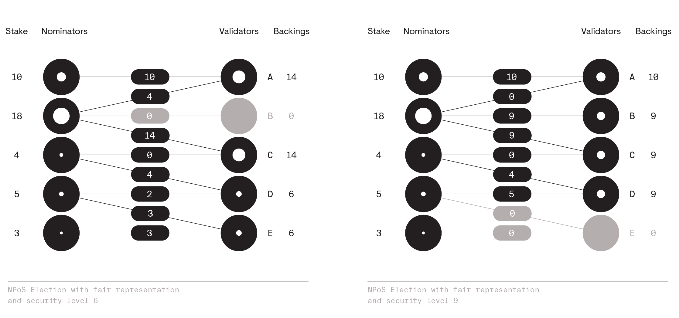
The goals of validator election: Security
The stake distributions which show that they achieve security levels of 6 and 9 respectively.

Slide 12
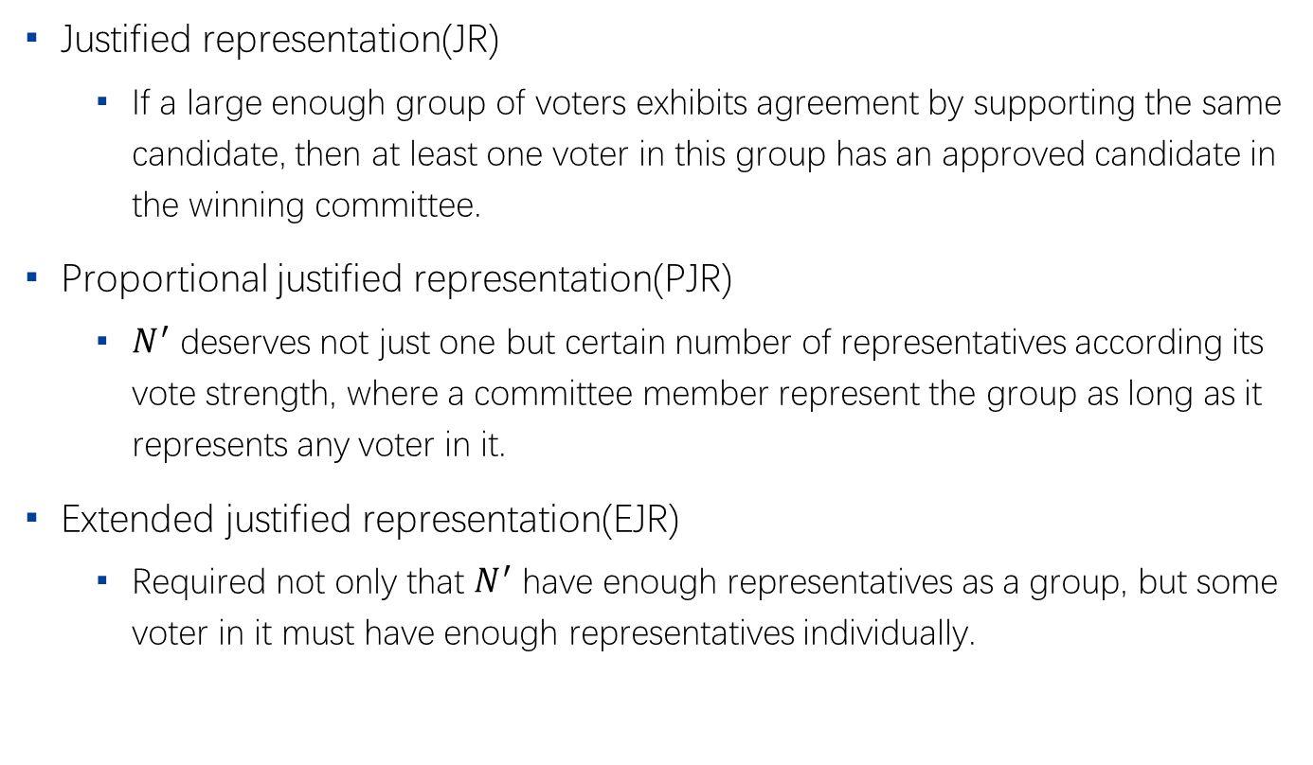
Related axioms about NPoS
Justified representation(JR)
If a large enough group of voters exhibits agreement by supporting the same candidate, then at least one voter in this group has an approved candidate in the winning committee.
Proportional justified representation(PJR)
$N^{′}$ deserves not just one but certain number of representatives according its vote strength, where a committee member represent the group as long as it represents any voter in it.
Extended justified representation(EJR)
Required not only that $N^{′}$ have enough representatives as a group, but some voter in it must have enough representatives individually.

Slide 13
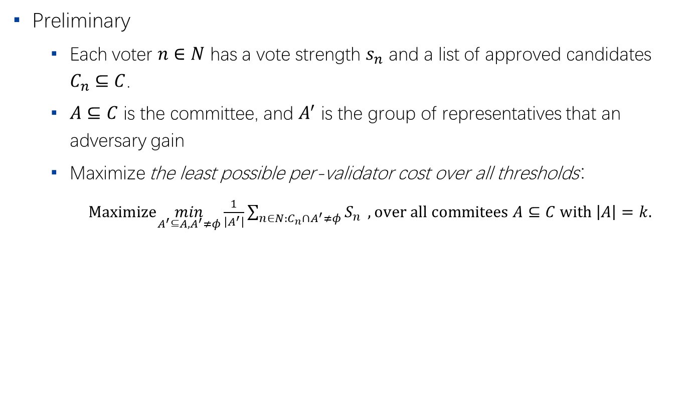
The objective of NPoS
Preliminary
Each voter $n∈N$ has a vote strength $s_{n}$ and a list of approved candidates $C_{n}⊆C$.
$A⊆C$ is the committee, and $A^{′}$ is the group of representatives that an adversary gain
Maximize the least possible per-validator cost over all thresholds：
$Maximize\min_{A^{′}⊆A, A^{′}≠φ}\frac{1}{\left|A^{′}\right|}\sum_{n∈N:C_{n}∩A^{′}≠φ}{S_{n}} , over all commitees A⊆C with \left|A\right|=k.$

Slide 14
目录 Contents
1
NPoS and Validator election
2
Relay Chain State Machine
3
Consensus
4
Parachains
5
Economics, Incentive and Governance

Slide 15
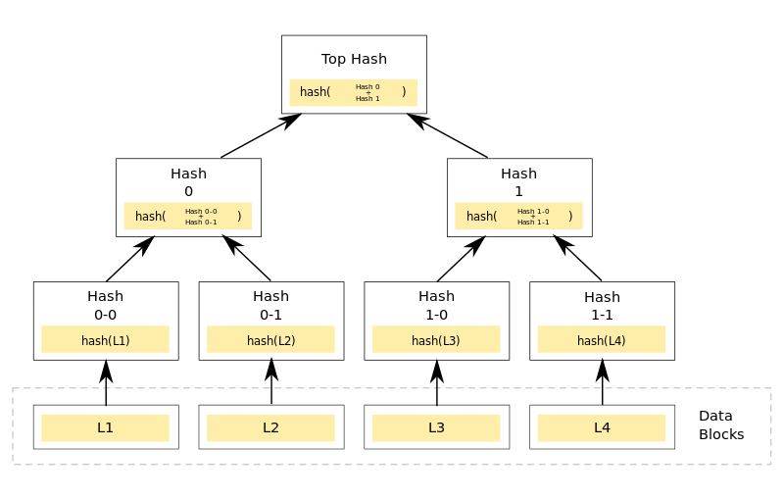
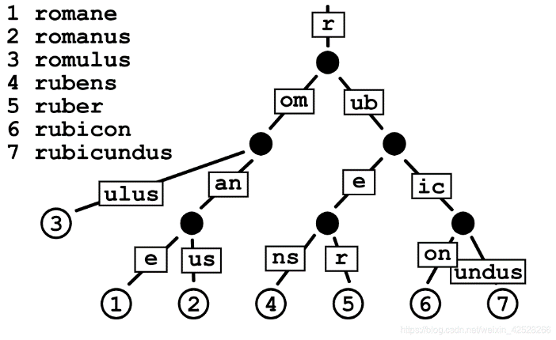
Relay Chain protocol: A state machine
State
Represented by an associative array data structure, composed by a collection of key-value pairs where each key is unique.
Both key and value need to be finite byte arrays
K-V pairs are arranged in a Merkel radix-16 tree
whose root identifies the current state of the relay chain.
provides an efficient mean to produce the proof of inclusion for an individual pair in the state.
Shouldn’t store any information regarding the internal operation of the parachains.

Slide 16
Relay Chain protocol: A state machine
State category
Authorship
Babe
Balances
Claims
Council
Democracy
electionsPhragmen
Grandpa
Identity
technicalCommittee&techinicalMembership
transactionPayment
Treasury
vesting
imOnline
Indeices
Multisig
Offences
Proxy
randomnessCollectiveFlip
Scheduler
Session
Staking
Substrate
System
Timestamp

Slide 17
Relay Chain protocol: A state machine
State transition
Via an executing ordered set of instructions, known as extrinsics, which include transactions submitted by the public and any data which can affect state transition.
Relay chain is divided into “Runtime” and the “Runtime environment”
The execution logic of State-transition function is encapsulated in Runtime
Other generic operation are embedded into the runtime environment
Runtime function
Compiled into a WebAssembly module
Stored as part of the state
The Runtime environment communicates the extrinsics to the Runtime and interacts with it to execute the state transition.
the state transition logic itself can be upgraded as a part of the state transition.

Slide 18
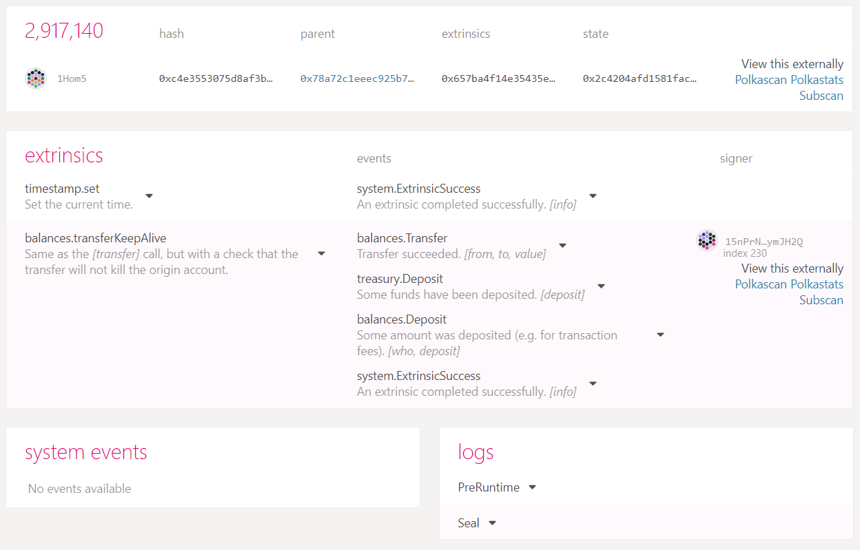
Relay Chain protocol: A state machine
Relay chain block format
Header
Hash of parent block
Block number
The root of the state tree
The root of the Merkle tree
Digest
Store auxiliary information from the consensus engines for validating the block
Body
A list of extrinsics

Slide 19
Relay Chain protocol: A state machine
Extrinsics, an executing ordered set of instructions
are the input data supplied to the Relay-chain state machine to transition to new states.
be stored into blocks of the relay chain to achieve consensus among the state machine replica.
Two categories of Extrinsics
Transactions
Examples: set_code, transfer, bond, validate, nominate, vote
Signed and unsigned
“inherents”, the data that is inherent to a relay chain block.
Example: The timestamp t of blocks
Not signed and not gossiped, rather only when they are included in a block

Slide 20
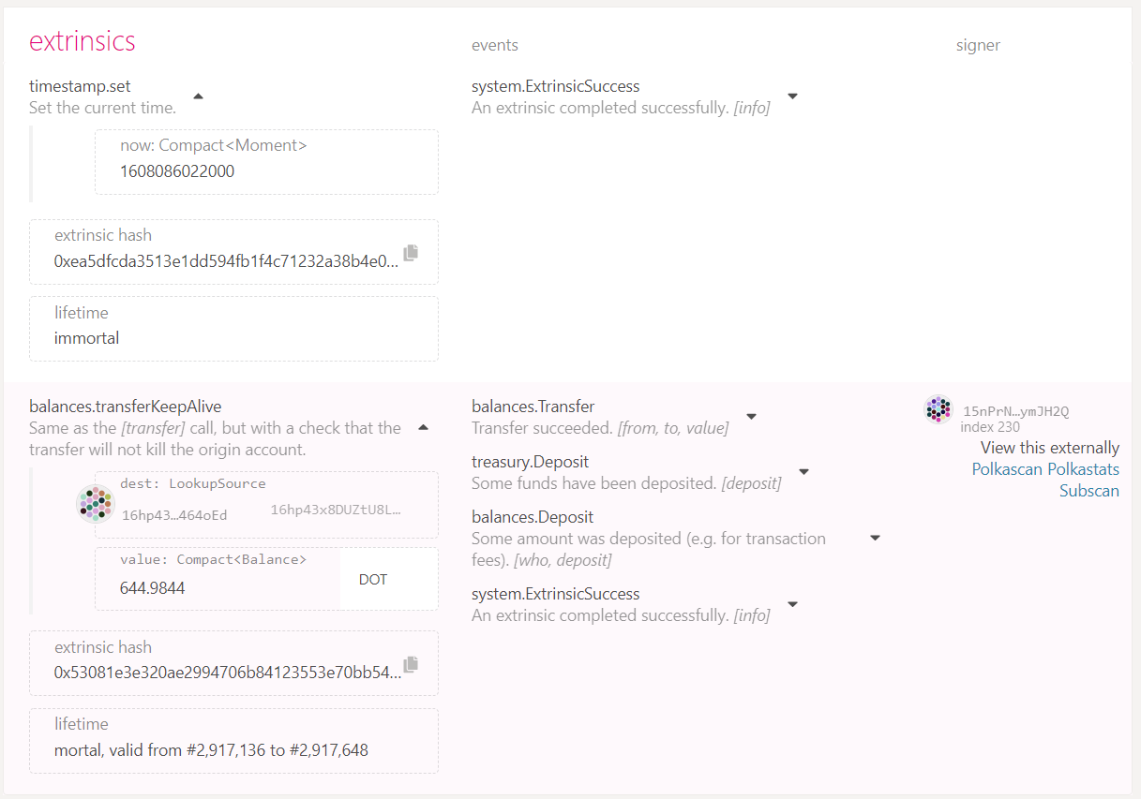
Relay Chain protocol: A state machine
Extrinsics, an executing ordered set of instructions
“Inherents”
Events
Signed transaction

Slide 21
Relay Chain protocol: A state machine
the validator’s operations for building relay chain block
Step one: each relay chain Validators privately knows the time when they should produce a block
Step two: transactions (validated parachain block hash, transfer, staking, nomination or slashing for violation) are submitted to relay chain validators.
Step three: relay chain validators examine the validity and store them in their transaction pool
Step four: When the validator should produce a block, it will estimate the block which most likely represents the state which is going to be finalized by the finality protocol and set it as the current state of the relay chain.
Step five: Validator select and executes transactions and updates the state.
Step Six: Validator attaches a digest of the final stage of relay chain, then signs and publishes the built block.

Slide 22
目录 Contents
1
NPoS and Validator election
2
Relay Chain State Machine
3
Consensus
4
Parachains
5
Economics, Incentive and Governance

Slide 23
Consensus
Separate the mechanisms for block production and finalising blocks.
The Byzantine agreement among the validators on the state of Polkadot and its parachains is needed. But the availability and validity scheme may require us to revert blocks.
Because XCMP, message passing speed is dependent on block time ,not finality time. Thus if we delay finality but do not revert, the message passing is still fast.
Blind Assignment for Blockchain Extension (BABE)
A block production mechanism of the relay chain that provide probabilistic finality( after certain time passes, a block in the relay chain will be finalised with very high probability)
GRANDPA
Provides provable, deterministic finality( a finalized block stays final forever) and works independently from BABE

Slide 24
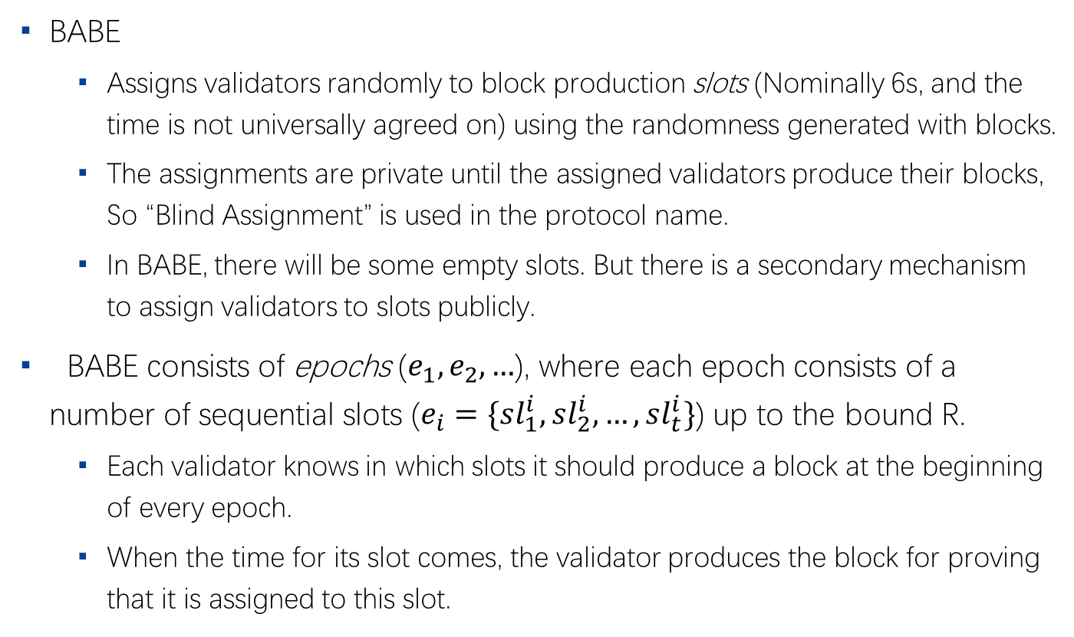
Blind Assignment for Blockchain Extension
BABE
Assigns validators randomly to block production slots (Nominally 6s, and the time is not universally agreed on) using the randomness generated with blocks.
The assignments are private until the assigned validators produce their blocks, So “Blind Assignment” is used in the protocol name.
In BABE, there will be some empty slots. But there is a secondary mechanism to assign validators to slots publicly.
BABE consists of epochs ($e_{1},e_{2},…$), where each epoch consists of a number of sequential slots ($e_{i}=\{sl_{1}^{i},sl_{2}^{i},…,sl_{t}^{i}\}$) up to the bound R.
Each validator knows in which slots it should produce a block at the beginning of every epoch.
When the time for its slot comes, the validator produces the block for proving that it is assigned to this slot.

Slide 25
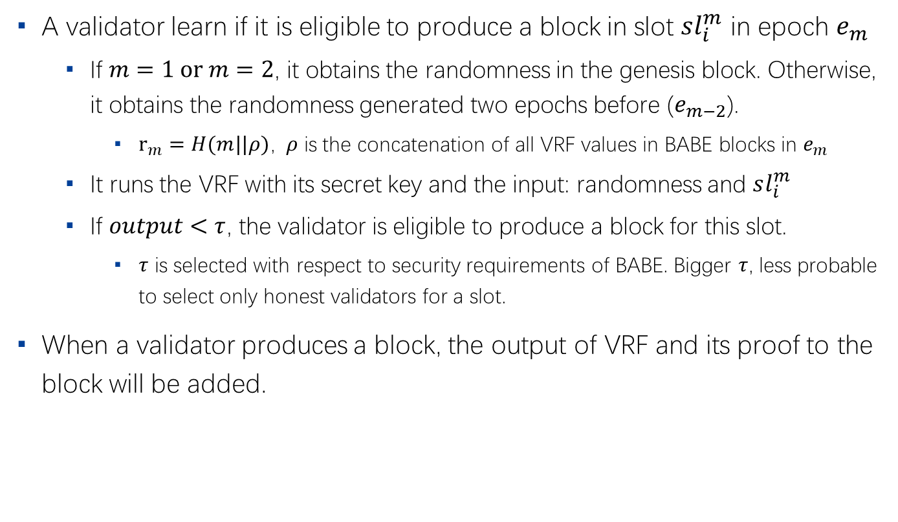
Blind Assignment for Blockchain Extension
A validator learn if it is eligible to produce a block in slot $sl_{i}^{m}$ in epoch $e_{m}$
If $m=1 \text{or} m=2$, it obtains the randomness in the genesis block. Otherwise, it obtains the randomness generated two epochs before ($e_{m−2}$).
$r_{m}=H(m||ρ)$, $ρ$ is the concatenation of all VRF values in BABE blocks in $e_{m}$
It runs the VRF with its secret key and the input: randomness and $sl_{i}^{m}$
If $output<τ$, the validator is eligible to produce a block for this slot.
$τ$ is selected with respect to security requirements of BABE. Bigger $τ$, less probable to select only honest validators for a slot.
When a validator produces a block, the output of VRF and its proof to the block will be added.

Slide 26
GRANDPA
Purpose:
Change the fork-choice rule : instead of building on the longest chain, a validator producing a block should build on the longest chain including all blocks that it sees as finalized.
To make this more robust, we try to agree on the prefix of the chain that 2/3 of validators agree on.

Slide 27
Contents
1
NPoS and Validator election
2
Relay Chain State Machine
3
Consensus
4
Parachains
5
Economics, Incentive and Governance

Slide 28
Parachains: Block Production
General parachains

Slide 29
Contents
1
NPoS and Validator election
2
Relay Chain State Machine
3
Consensus
4
Parachains
5
Economics, Incentive and Governance

Slide 30
谢谢！

