Slide 1
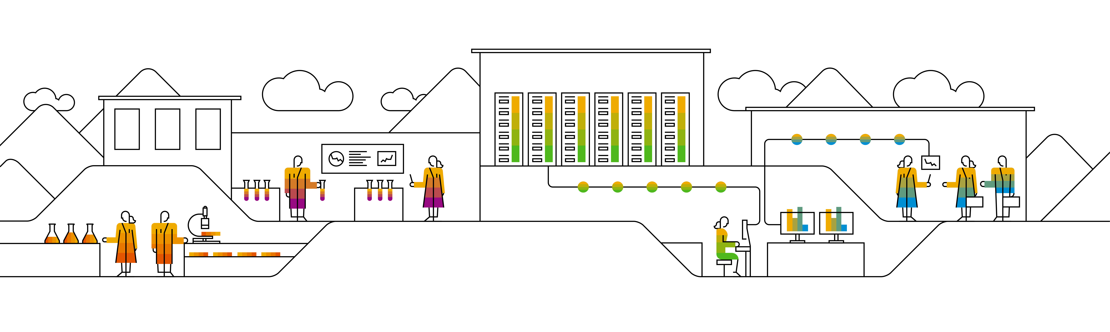
The Survey On Neo4j A Traditional Graph Database
Keith Wang, SAP
Sep 02, 2020
Partner logo

Slide 2
Agenda
Graph Database Concepts
Details
The Introduction of Cypher
The Graph query language
Techniques of Neo4j
Details

Slide 3
Graph database concepts

Slide 4
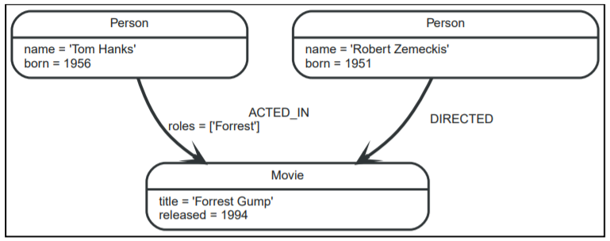
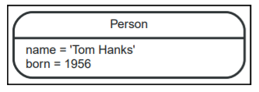
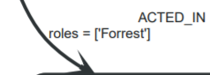

Graph database concepts
Property graph:
This is the example graph to introduce the basic concepts of the property graph
Nodes:
Nodes are often used to represent entities. The simplest possible graph is a single node. Consider the graph below, consisting of a single node.
Relationships:
A relationship connects two nodes, and includes type and properties.
Relationships organize nodes into structures, allowing a graph to resemble a list, a tree, a map, or a compound entity
Relationships always have a direction

Slide 5
Graph database concepts Labels and Properties in Nodes
Labels:
used to shape the domain by grouping nodes into sets where all nodes that have a certain label belongs to the same set.
Since labels can be added and removed during runtime, they can also be used to mark temporary states for nodes.
Properties:
Properties are name-value pairs that are used to add qualities to nodes and relationships.
In this example, we have used the properties name and born on person nodes.
And the relations also have property.

Slide 6
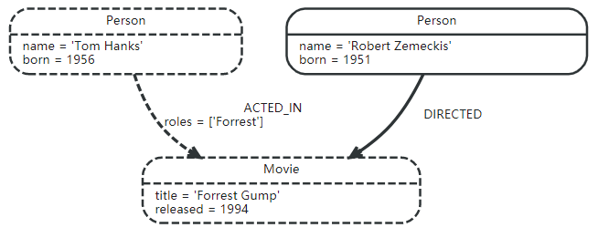
Graph database concepts Traversals and paths
Traversal
Is how you query a graph in order to find answers to questions
Traversing a graph means visiting nodes by following relationships according to some rules.
Path
The traversal result could be returned as a path with the length one.
The shortest possible path has length zero.
When the relations type is knows, the path has length one.
An example:
If we want to find out which movies Tom Hanks acted in according to our tiny example database
the traversal would start from the Tom Hanks node, follow any :ACTED_IN relationships connected to the node,
and end up with Forrest Gump as the result (see the dashed lines):

Slide 7
The Graph Query Language: Cypher

Slide 8
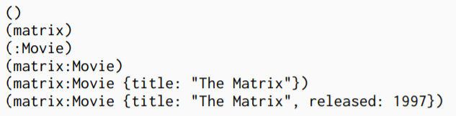
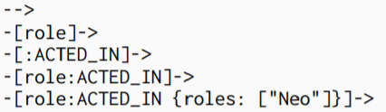

Cypher Query Language Syntax
Node syntax
Cypher uses a pair of parentheses to represent a node: (). This is reminiscent of a circle or a rectangle with rounded end caps.
Relationship syntax
Cypher uses a pair of dashes (--) to represent an undirected relationship.
Directed relationships have an arrowhead at one end (<--, -->).
Bracketed expressions ([…]) can be used to add details.
Pattern syntax
Combining the syntax for nodes and relationships

Slide 9
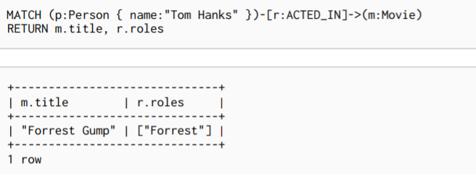

Patterns in practice
Creating data
Matching patterns
Attaching structures

Slide 10
Techniques of Neo4j

Slide 11
Data Model Neo4j Property Graph Data model
Neo4j Graph Database follows the property graph model to store and manage its data.
Following are the key features of property graph model:
The model represents data in Nodes, relationships and Properties.
Properties are key-value pairs
Relationships have directions: Unidirectional and Bidirectional
Each Relationship contains “Start Node” and “To Node”.
Both Nodes and Relationships contain properties

Slide 12
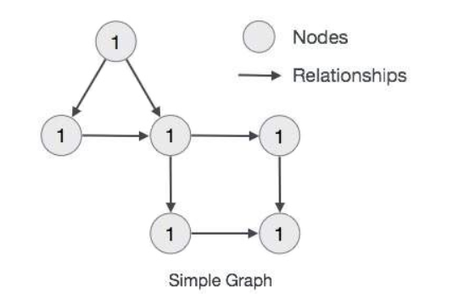
Data Model Neo4j Property Graph Data model
Neo4j Graph Database stores all of its data in Nodes and Relationships.
We neither need any additional RRBMS Database nor any SQL database to store Neo4j database data.
It stores its data in terms of Graphs in its native format.
Neo4j uses Native GPE (Graph Processing Engine) to work with its Native graph storage format.
The main building blocks of Graph DB Data Model are
Nodes
Relationships
Properties
Following is a simple example of a Property Graph.

Slide 13
Storage And System Architecture Model and Procedures
Storage Model
Each node and its properties are stored on the disk using a doubly linked list.
Layout:
The first byte: 4 high bits of previous and 4 bits of next pointer
Bytes 1-4: previous property record, bytes 5-8:next record, bytes 9-40 : payload
Stored Procedures
Stored procedures in Neo4j are called using Cypher calls. Arguments can be supplied directly within the query or taken from the associated parameter set.
System Architecture
Neo4j offers a shared-nothing architecture with a single write master and multiple read replicas thus consumes significant instance based storage.

Slide 14
Neo4j Features
It follows Property Graph Data Model
It supports Indexes by using Apache Lucence
It supports UNIQUE constraints
It contains a UI to execute CQL Commands : Neo4j Data Browser
It supports exporting of query data to JSON and XLS format
It provides REST API to be accessed by any Programming Language like Java, Spring, Scale etc.
It provides Java Script to be accessed by any UI MVC Framework like Node JS.
It supports two kinds of java API: Cypher API and Native Java API to develop Java application

Slide 15
Neo4j Advantages and Drawbacks
Advantages
Easy to represent connected data.
Easy and faster to retrieve/traversal/navigation of more Connected data.
CQL are in humane readable format and very easy to learn.
Simple and powerful data model
It does NOT require complex Joins to retrieve connected/related data as it is vey easy to retrieve it’s a adjacent node or relationship details without Joins or Indexes.
Drawbacks or limitations
AS of Neo4j 2.1.3 latest version, it has a limitation of supporting number of Nodes, Relationships and Properties.
It does not support Sharding.

Slide 16
Reference

Slide 17
Reference
Neo4j’s Documentation
Neo4j-Features & Advantages
Neo4j In Database of Databases

Slide 18
Thank you.
Contact information:
F name L name
Title
Address
Phone number
Partner logo

