Slide 1
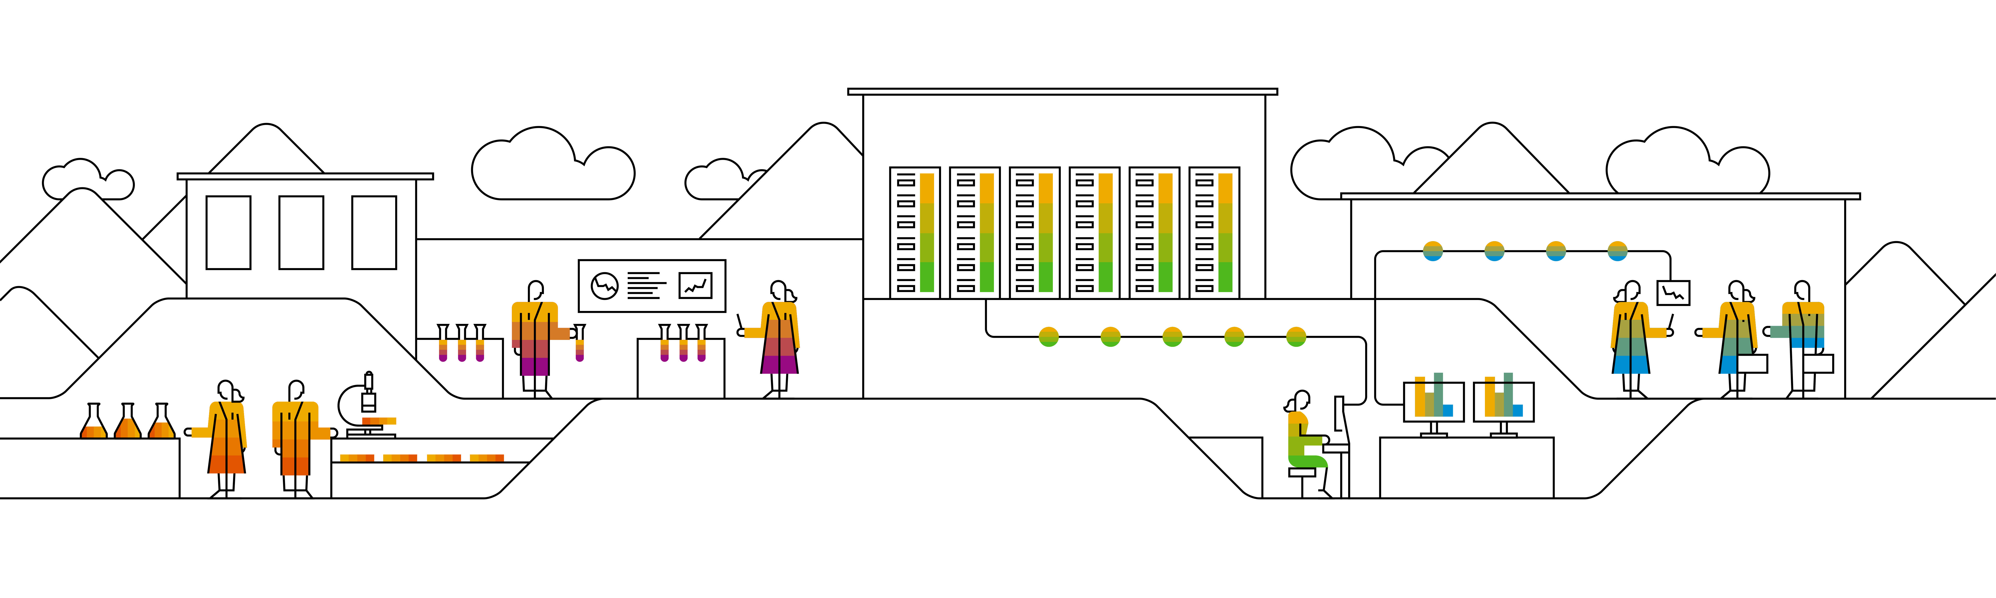
The Survey On OpenTSDB A Distributed, Scalable Monitoring System
Keith Wang, SAP
Sep 00, 2020
Partner logo

Slide 2
Content
Overview of OpenTSDB
Details
Agenda item/divider headline
Details
Agenda item/divider headline
Details
Agenda item/divider headline
Details

Slide 3
Overview of OpenSTDB

Slide 4
OpenTSDB
OpenTSDB
a distributed Time Series Database (TSDB) based on HBase.
written by Benoit Sigoure to collect, store and display metrics of various computer systems (network gears, operating systems, applications), and generate readable data graphs easily.
the first open-source monitoring system built on an open-source distributed database.
written in Java.
History
OpenTSDB was originally written to monitor metrics of the StumbleUpon search engine which requires storing over 1 billion data points per day.
StumbleUpon was in charge of the initial development and its open-source release. Yahoo! is currently maintaining OpenTSDB along with the open-source community.

Slide 5
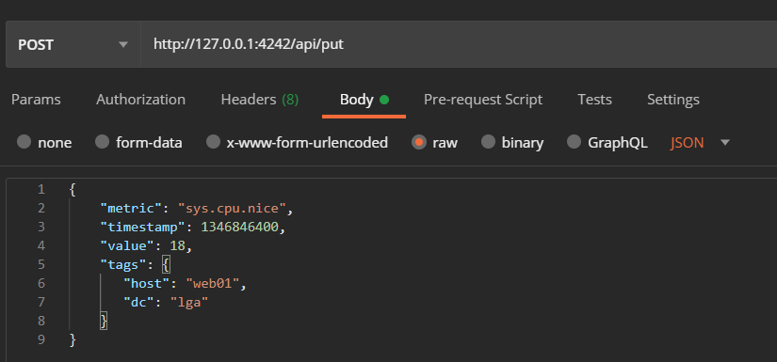
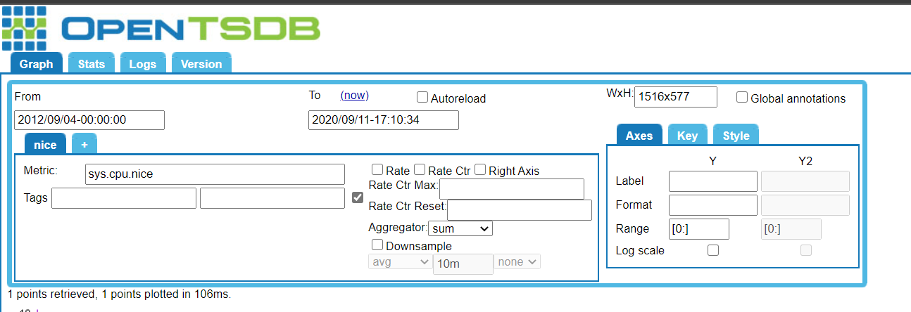
OpenTSDB Writing and Quering
Querying By Browser UI
Writing By Http API

Slide 6
OpenTSDB Techniques
Compression: Naïve (Page-Level) Naïve (Record-Level)
OpenTSDB uses Row Compaction to compress data.
Whenever a cell is to be written, its row key is pushed into a compaction queue.
There is a separate thread that periodically goes through the queue and aggregate data with the same key into a big cell.
It then writes the big cell and deletes the individual cells in the queue.
This process is effective because in HBase the row key is repeated for every single cell, and there is no way to efficiently append byte at the end of a cell.
At data level, OpenTSDB uses LZO compression algorithm.
With these two techniques, OpenTSDB is able to reduce the average size of one data point from 12 bytes to 2-3 bytes.

Slide 7
OpenTSDB Techniques
Concurrency Control
OpenTSDB allows concurrent writes without using locks.
OpenTSDB avoids multiple writers creating duplicate rows in the case of writer restart by making writes idempotent. It enforces a fixed timestamp boundary for each row. When a write reconnects to HBase, it will always write to the appropriate row according to the timestamp instead of creating new rows.
Data Model
Data are stored as time series. Each time series is a collection of data points.
A data point is a key value map(time, value). A time series is identified by its metrics and tags
Identity(Metric+Tag) | Value | Timestamp
Web01.sys.cpu.busy.pct | 45% | 1/1/207 12:01:00
Web01.sys.cpu.busy.pct | 52% | 1/1/207 12:02:00
Web01.sys.cpu.busy.pct | 35% | 1/1/207 12:03:00

Slide 8
OpenTSDB Techniques
Query Interface
There are 2 official supported query interfaces: HTTP/REST API and Telnet style command line API.
Additionally, there are various open-source front-end clients that encapsulate the official APIs, including a Browser interface and Erlang/Java/Go/Python/R/Ruby clients.

Slide 9
OpenTSDB Techniques
System Architecture
OpenTSDB consists of three components: tCollector, Time Series Daemon (TSD), and HBase. One instance of tCollector is deployed on each server. It is responsible to periodically pull metrics data from processes running on the server and the operating system. TSDs receive data from the tCollectors and push data to the HBase backend storage system. Upon receiving queries, TSD scans HBase and retrieves relevant data.
All communications are done via TSD RPC and Hadoop RPC, therefore all components are stateless. There can be as many TSDs as needed to handle the workload as the system scales.

Slide 10
OpenTSDB Use Cases
Salesforce
Backing store for Argus: Open source monitoring and alerting system
50M writes per minute. 23K queries per minute
YAHOO
Monitoring system, network and application performance and statistics.
Central monitoring for all Yahoo properties
Over 1 billion active time series served
Others:
Pinterest
eBay
And so on.

Slide 11
Data’s Features and database’s rules
Time Series Data’s feature
Write at high speed on a timeline where time is an important dimension
Clearly marked tag and metric fields
The total order of magnitude is thousands of times the same of the combination of tags
Basically no point query, common query is time range aggregation query
Database’s Rules
Writing performance
Storage
Aggregation computation and performance
System and Architecture

Slide 12
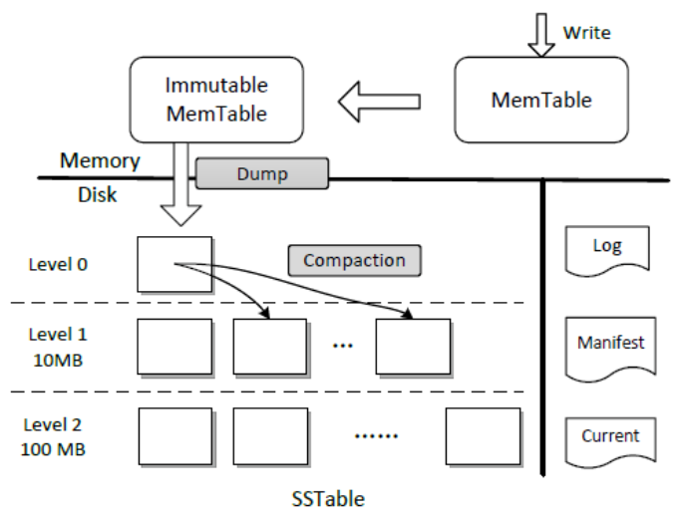
Storage Architecture
LSM-Tree:
Storage Architecture
The back-end storage system is Hbase, an open-source non-relational disk-oriented distributed database. It also supports Google Bigtable as its backend.

Slide 13
Time Series Database Dilemma
OpneTSDB
Dilemma between Key-Value and Time Series.
and Promethus

Slide 14
OpenTSDB Use Cases

Slide 15
Insert page title (sentence case)

Slide 16
Insert page title (sentence case)

Slide 17
Divider page

Slide 18

Divider page

Slide 19
Insert page title (sentence case)

Slide 20
Insert page title (sentence case)

Slide 21
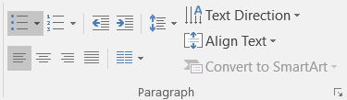
Insert page title (sentence case)
First level
Second level
Third level
NOTE: Delete the yellow stickers when finished.
The text placeholders have different, preformatted text levels. Each level has different formatting (font size, indent, bullet).
To jump between the preformatted text levels, use the Increase List Level and Decrease List Level buttons in the Paragraph toolbar.
Type your text in the placeholder.
Click the Increase List Level button in the Paragraph toolbar to go to the next level.
If you need a bullet list, choose level 2.
Avoid working with spaces, other bullets, or bullets in the wrong level. Only when you use the right levels it is possible to reset the slide layout.

Slide 22
Insert page title (sentence case)
First level
Second level
Third level

Slide 23
Insert page title (sentence case) Subheadline
First level
Second level
Third level

Slide 24
“Quote goes here and here and here.”
Source

Slide 25
“Quote goes here and here and here.”
Source

Slide 26
Insert page title (sentence case)
First level
Second level
Third level

Slide 27
Insert page title (sentence case)
First level
Second level
Third level

Slide 29
Insert page title (sentence case)
First level
Second level
Third level
First level
Second level
Third level

Slide 30
Insert page title (sentence case)
First level
Second level
Third level
First level
Second level
Third level
First level
Second level
Third level

Slide 31
Insert page title (sentence case)
First level
Second level
First level
Second level

Slide 32
Insert page title (sentence case)
First level
Second level
First level
Second level
First level
Second level

Slide 33
Thank you.
Contact information:
F name L name
Title
Address
Phone number
Partner logo

