Slide 1

The Survey On MongoDB A Document Database
Keith Wang, SAP
Aug 28, 2020
Partner logo

Slide 2
Content
Introduction to MongoDB
Details
Technique of MongoDB
Details
Agenda item/divider headline
Details
Agenda item/divider headline
Details

Slide 3
Introduction to MongoDB

Slide 4
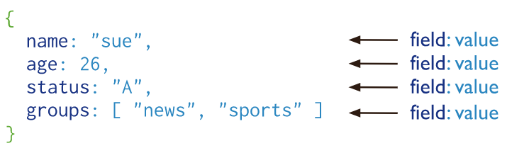
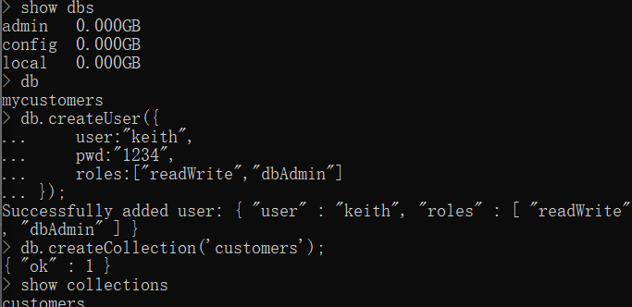
Introduction to MongoDB
MongoDB is a document database
Document Database:
A record in MongoDB is a document
A data structure composed of field and value pairs. Which is similar to JSON
The values include documents, array, and array of documents
The advantages of using documents are:
Documents (i.e. objects) correspond to native data types in many programming languages.
Embedded documents and arrays reduce need for expensive joins.
Dynamic schema supports fluent polymorphism.

Slide 5
Key Features of MongoDB
High Performance
Support for embedded data models reduces I/O activity on database system
Indexes support faster queries and can include keys from embedded documents and arrays
Rich Query Language
Data Aggregation
Text Search and Geospatial Queries
High Availability
Automatic failover
Data redundancy

Slide 6
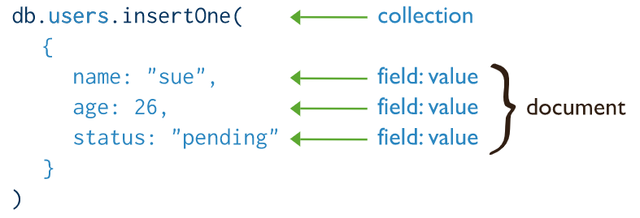
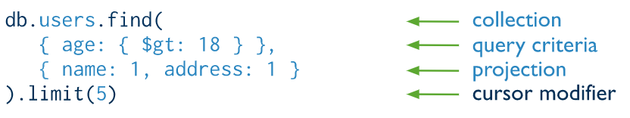
MongoDB CRUD Operation
Create Operations
db.collection.insertOne()
db.collection.insertMany()
Insert operations target a single collection, and all write in mongoDB are atomic on the level of a single document.
Read Operations
db.collection.find()
Read operations retrieve from a collection.

Slide 7
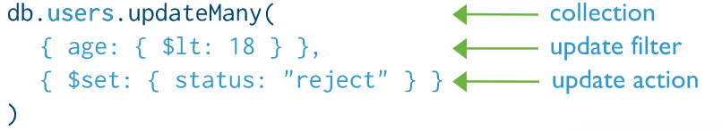
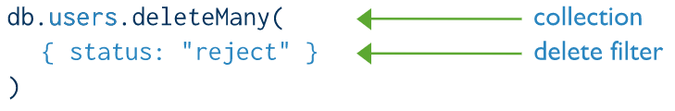
MongoDB CRUD Operation
Update Operations
db.collection.updateOne()
db.collection.updateMany()
db.collection.replaceOne()
Update operations target a single collection, and all write in MongoDB are atomic on the level of a single document.
Delete Operations
db.collection.deleteOne()
db.collection.deleteMany()
Delete operations target a single collection, and all write in MongoDB are atomic on the level of a single document.

Slide 8
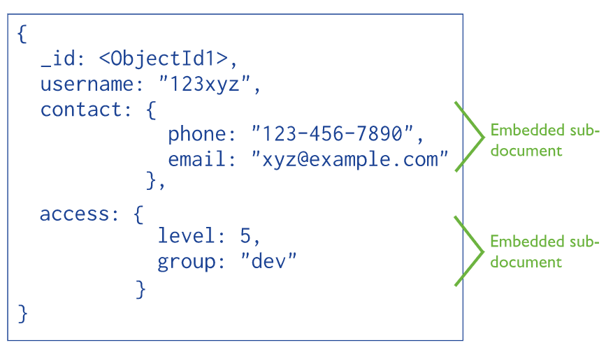
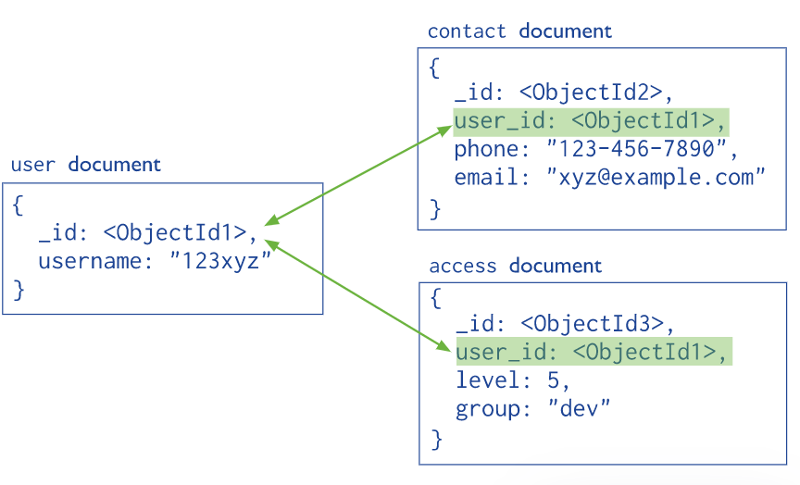
Data Modeling Introduction
Flexible Scheme
MongoDB’s Collections does not require its documents to have the schema.
Documents do not need to have the same set of fields and the data type can differ in a collection.
To change the structure of the documents in a collection is allowed. Such as add new fields or remove.
Document Structure
MongoDB allows related data to be embedded within a single document.
MongoDB documents make it possible to embed document structures in a field or art within a document.

Slide 9
technique of MongoDB

Slide 10
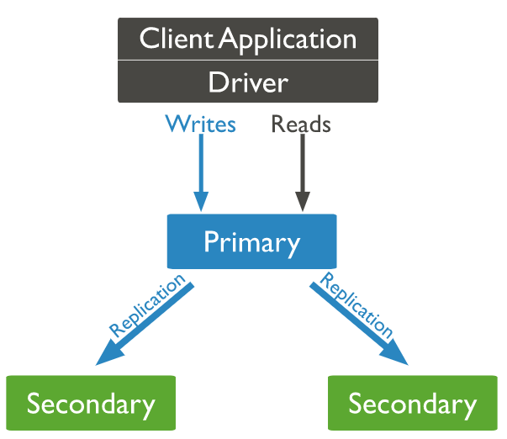
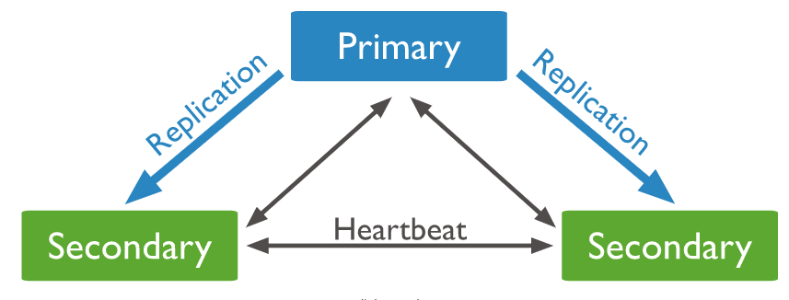
Replication sets
A replica set provides redundancy and high availability, which is a group of mongod instance that maintain the same data set.
The primary node receives all write operations. The primary records all changes to its data sets in its operation log, i.e. oplog.
The secondaries replicate the primary’s oplog and apply the operations to their data sets such that their sets reflect the primary’s data set.
If the primary is unavailable, an eligible secondary will hold an election to elect itself the new primary

Slide 11
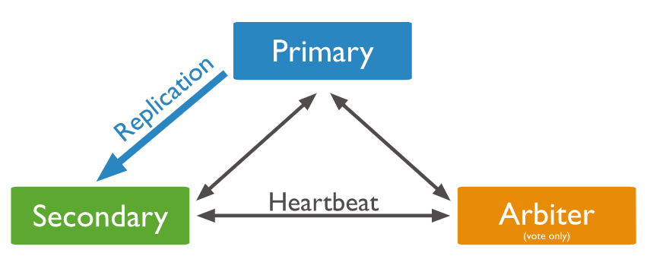
Replication sets
There will be a mongod instance which is chose as an arbiter, An arbiter participates in elections but does not hold data.
An arbiter will always be an arbiter whereas a primary becomes a secondary or a secondary becomes the primary during an election.
There is a PSV architecture, Primary, Secondary and one arbiter.

Slide 12
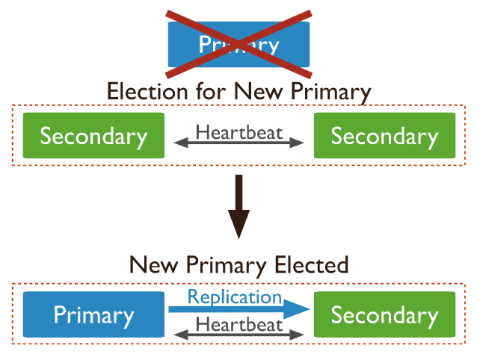
Replication sets Elections
An election is triggered in response to these events:
Adding a new node or initiating a replica set
Performing replica set maintenance or the secondary members losing connectivity.
Voting
All replica set members that have their members[n].votes equal 1 or 0.
Members with priority greater than 0 cannot have 0 votes.

Slide 13
Storage Engines of MongoDB
WiredTiger Storage Engine(Default)
provide a document-level concurrency model, checkpointing and compression, among other features.
In MongoDB Enterprise, it alse supports Encryption at Rest.
In-Memory Storage Engine
Available in MongoDB Enterprise
Rather than storing documents on-disk, it retains them in-memory for more predictable data latencies.

Slide 14
Divider page

Slide 15
Key Features of MongoDB

Slide 16
Key Features of MongoDB

Slide 17
Divider page

Slide 18
Insert page title (sentence case)

Slide 19
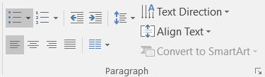
Insert page title (sentence case)
First level
Second level
Third level
NOTE: Delete the yellow stickers when finished.
The text placeholders have different, preformatted text levels. Each level has different formatting (font size, indent, bullet).
To jump between the preformatted text levels, use the Increase List Level and Decrease List Level buttons in the Paragraph toolbar.
Type your text in the placeholder.
Click the Increase List Level button in the Paragraph toolbar to go to the next level.
If you need a bullet list, choose level 2.
Avoid working with spaces, other bullets, or bullets in the wrong level. Only when you use the right levels it is possible to reset the slide layout.

Slide 20
Insert page title (sentence case)
First level
Second level
Third level

Slide 21
Insert page title (sentence case) Subheadline
First level
Second level
Third level

Slide 22
“Quote goes here and here and here.”
Source

Slide 23
“Quote goes here and here and here.”
Source

Slide 24
Insert page title (sentence case)
First level
Second level
Third level

Slide 25
Insert page title (sentence case)
First level
Second level
Third level

Slide 26
Insert page title (sentence case)
First level
Second level
Third level

Slide 28
Insert page title (sentence case)
First level
Second level
Third level
First level
Second level
Third level

Slide 29
Insert page title (sentence case)
First level
Second level
Third level
First level
Second level
Third level
First level
Second level
Third level

Slide 30
Insert page title (sentence case)
First level
Second level
First level
Second level

Slide 31
Insert page title (sentence case)
First level
Second level
First level
Second level
First level
Second level

Slide 32
Thank you.
Contact information:
F name L name
Title
Address
Phone number
Partner logo

