Slide 1

The Survey On MongoDB A Document Database
Keith Wang, SAP
Aug 28, 2020
Partner logo

Slide 2
Content
Introduction to MongoDB
Details
Technique of MongoDB
Details
CouchDB vs MongoDB
Details

Slide 3
Introduction to MongoDB

Slide 4
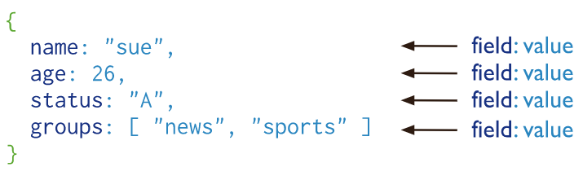
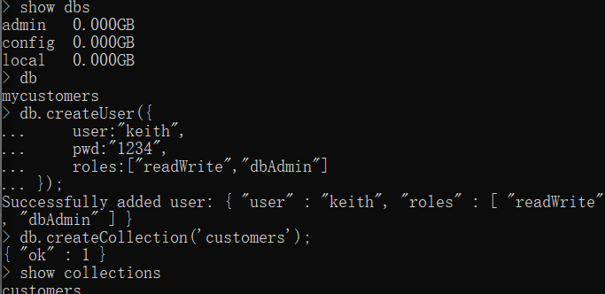
Introduction to MongoDB
MongoDB is a document database
Document Database:
A record in MongoDB is a document
A data structure composed of field and value pairs. Which is similar to JSON
The values include documents, array, and array of documents
The advantages of using documents are:
Documents (i.e. objects) correspond to native data types in many programming languages.
Embedded documents and arrays reduce need for expensive joins.
Dynamic schema supports fluent polymorphism.

Slide 5
Key Features of MongoDB
High Performance
Support for embedded data models reduces I/O activity on database system
Indexes support faster queries and can include keys from embedded documents and arrays
Rich Query Language
Data Aggregation
Text Search and Geospatial Queries
High Availability
Automatic failover
Data redundancy

Slide 6
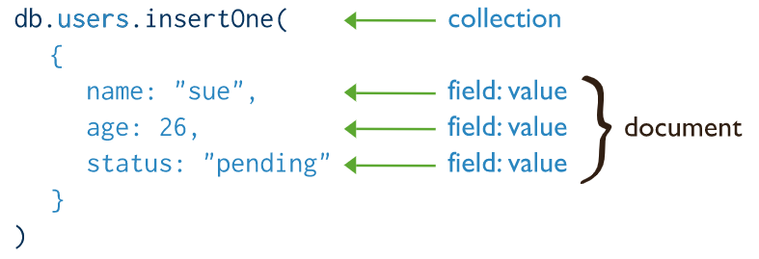
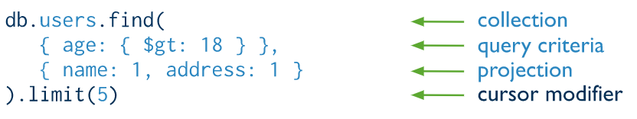
MongoDB CRUD Operation
Create Operations
db.collection.insertOne()
db.collection.insertMany()
Insert operations target a single collection, and all write in mongoDB are atomic on the level of a single document.
Read Operations
db.collection.find()
Read operations retrieve from a collection.

Slide 7
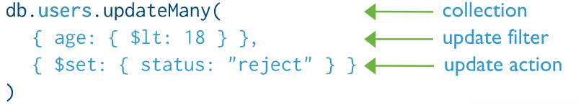
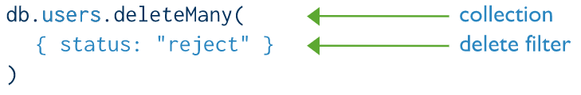
MongoDB CRUD Operation
Update Operations
db.collection.updateOne()
db.collection.updateMany()
db.collection.replaceOne()
Update operations target a single collection, and all write in MongoDB are atomic on the level of a single document.
Delete Operations
db.collection.deleteOne()
db.collection.deleteMany()
Delete operations target a single collection, and all write in MongoDB are atomic on the level of a single document.

Slide 8
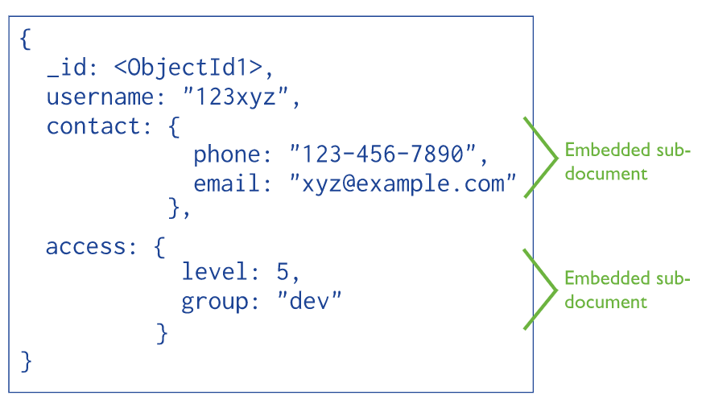
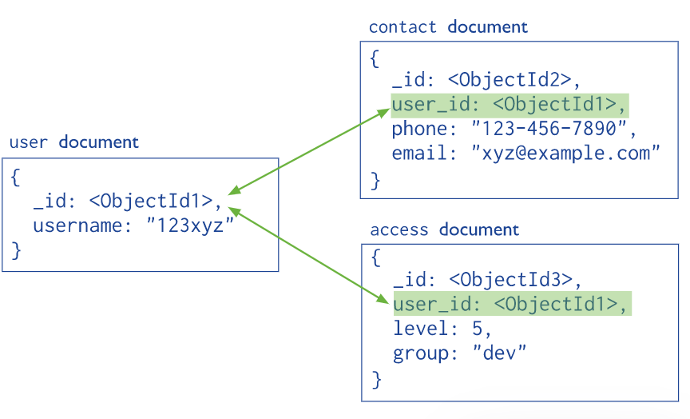
Data Modeling Introduction
Flexible Scheme
MongoDB’s Collections does not require its documents to have the schema.
Documents do not need to have the same set of fields and the data type can differ in a collection.
To change the structure of the documents in a collection is allowed. Such as add new fields or remove.
Document Structure
MongoDB allows related data to be embedded within a single document.
MongoDB documents make it possible to embed document structures in a field or art within a document.

Slide 9
technique of MongoDB

Slide 10
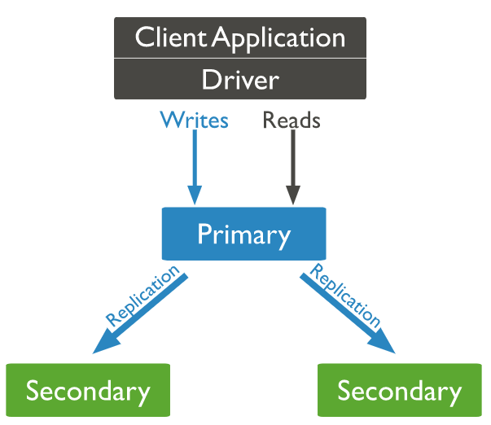
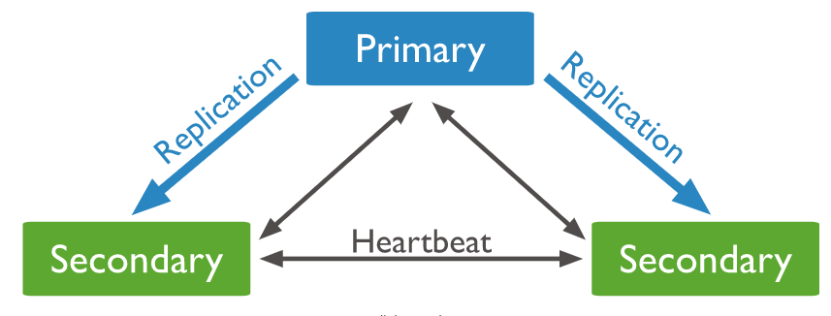
Replication sets
A replica set provides redundancy and high availability, which is a group of mongod instance that maintain the same data set.
The primary node receives all write operations. The primary records all changes to its data sets in its operation log, i.e. oplog.
The secondaries replicate the primary’s oplog and apply the operations to their data sets such that their sets reflect the primary’s data set.
If the primary is unavailable, an eligible secondary will hold an election to elect itself the new primary

Slide 11
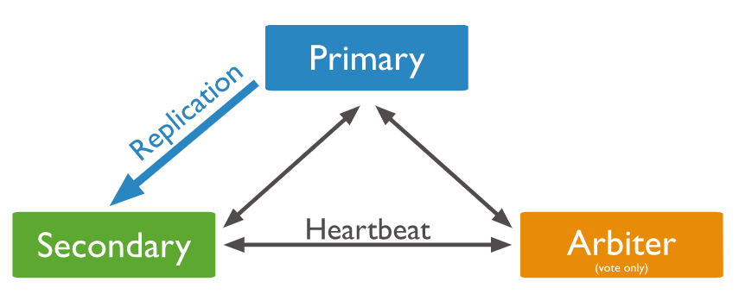
Replication sets
There will be a mongod instance which is chose as an arbiter, An arbiter participates in elections but does not hold data.
An arbiter will always be an arbiter whereas a primary becomes a secondary or a secondary becomes the primary during an election.
There is a PSV architecture, Primary, Secondary and one arbiter.

Slide 12
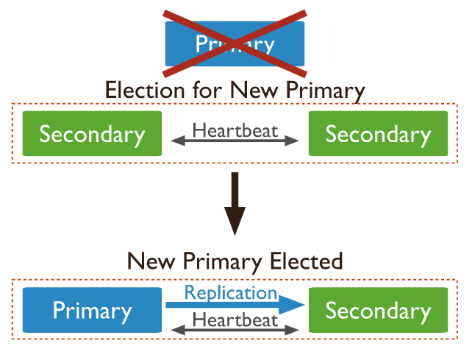
Replication sets Elections
An election is triggered in response to these events:
Adding a new node or initiating a replica set
Performing replica set maintenance or the secondary members losing connectivity.
Voting
All replica set members that have their members[n].votes equal 1 or 0.
Members with priority greater than 0 cannot have 0 votes.

Slide 13
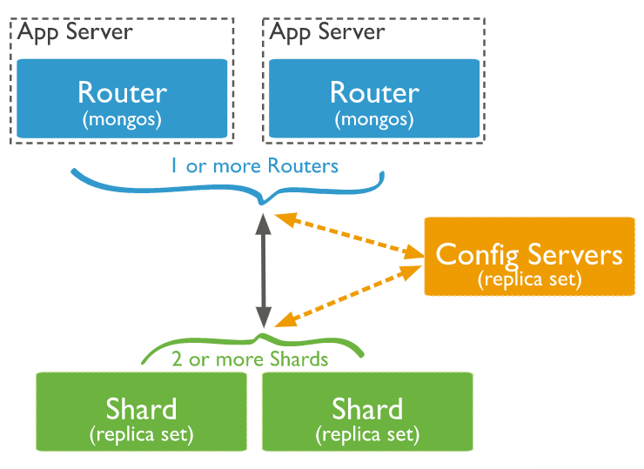
Sharding of MongoDB
MongoDB supports horizontal scaling through sharding
Sharded Cluster
Shard: contains a subset of the data, and can be deployed as a replica set.
Mongos: acts as a query router, interface between applications and cluster.
Config servers: config servers store metadata and configuration settings for the cluster.

Slide 14
Advantages of Sharding
Reads/Writes
Distributes the read and write, allowing each shard to process a subset of cluster operations.
read and write workloads can be scaled horizontally across the cluster by adding more shards
Storage capacity
Distributes data across the shards in the cluster, each shard contain a subset of cluster data
Additional shards increase the storage capacity.
High availability
The deployment of config servers and shards as replica sets provide increased availability

Slide 15
Storage Engines of MongoDB
WiredTiger Storage Engine(Default)
provide a document-level concurrency model, checkpointing and compression, among other features.
In MongoDB Enterprise, it alse supports Encryption at Rest.
In-Memory Storage Engine
Available in MongoDB Enterprise
Rather than storing documents on-disk, it retains them in-memory for more predictable data latencies.

Slide 16
CouchDB VS MongoDB

Slide 17
Storage
CouchDB
uses JSON for data storage and does not have its data and relationships in tables.
Each database is stored in a separate document along with its schema.
The databases can be on multiple servers and even on mobile phones and an application can connect to multiple databases. With the help of RESTful API, applications can read, edit, and delete database documents. Its lockless mechanism makes it a perfect choice for any application and the database structure is highly scalable from global servers to mobile devices.
MongoDB
without any schema and stored in a document as well but in BSON format.
The documents do not need to have a particular structure but there are various features of relational databases that are included in it. If one is making a transition from a relational database to NoSQL database, MongoDB is the best choice for such applications.
Winner
CouchDB as JSON is more efficient and faster as it requires less computation time and the data size is smaller.

Slide 18
Replication
CouchDB
it allows master-master and master-slave replication. This ensures that data can be accessed at various locations without the slightest delay. Sending requests to access the database is served instantly.
the append-only modifications mechanism of CouchDB ensures the least chances of conflicts. Moreover, there is an option for selective replication whereby you can control the documents that will be copied. In this way, you can save a lot of space and time.
MongoDB
offers only master-slave replication. Setting up master-master replication is extremely complicated in MongoDB and there are greater chances of having conflicts. Hopefully, in the upcoming versions of MongoDB, a simpler method of replication will be unveiled.
Winner
CouchDB is the clear winner for robust replications in all departments.

Slide 19
Support for programming language
CouchDB
it is available for mobile platforms like Android, iOS, as well as for computer operating systems like Linux, Windows, and OS X.
CouchDB supports all the different genres of programming languages like C, C++, C#, Java, JavaScript, Lisp, Objective C, Perl PHP, Python, Ruby and likewise.
MongoDB
supports all these programming languages and more except for Objective-C. But if your frontend is in C++, it is always better to go for MongoDB as it is developed in C++.
only available for computer operating systems and not for mobile operating systems.
Winner
It depends on your requirements but CouchDB has the edge due to its support for mobile OS.

Slide 20
Final Verdict
Depending on requirements, people have to choose between MongoDB and CouchDB.
If you are looking for higher read speed, rapid growth, and scalability, MongoDB is the best choice.
But if you need a database that can run on mobile devices like Apple iOS and Google Android and you need rapid replication, CouchDB is the only choice you have.

Slide 21
Reference

Slide 22
Reference
mongoDB’s Documentation
CouchDB VS MongoDB: Understanding the difference

Slide 23
Thank you.
Contact information:
F name L name
Title
Address
Phone number
Partner logo

