Slide 1

The Survey On Neo4j A Traditional Graph Database
Keith Wang, SAP
Sep 02, 2020
Partner logo

Slide 2
Agenda
Graph Database Concepts
Details
The Introduction of Cypher
The Graph query language
Agenda item/divider headline
Details
Agenda item/divider headline
Details

Slide 3
Graph database concepts

Slide 4
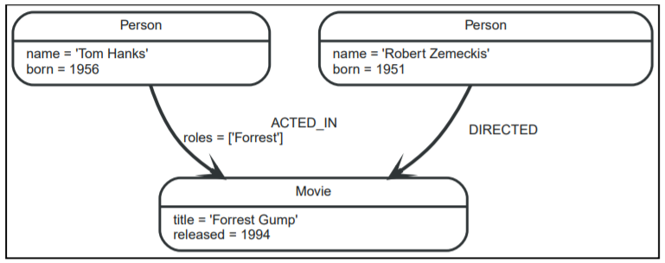
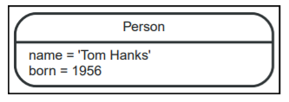
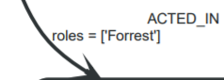

Graph database concepts
Property graph:
This is the example graph to introduce the basic concepts of the property graph
Nodes:
Nodes are often used to represent entities. The simplest possible graph is a single node. Consider the graph below, consisting of a single node.
Relationships:
A relationship connects two nodes, and includes type and properties.
Relationships organize nodes into structures, allowing a graph to resemble a list, a tree, a map, or a compound entity
Relationships always have a direction

Slide 5
Graph database concepts Labels and Properties in Nodes
Labels:
used to shape the domain by grouping nodes into sets where all nodes that have a certain label belongs to the same set.
Since labels can be added and removed during runtime, they can also be used to mark temporary states for nodes.
Properties:
Properties are name-value pairs that are used to add qualities to nodes and relationships.
In this example, we have used the properties name and born on person nodes.
And the relations also have property.

Slide 6
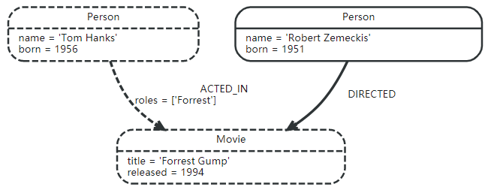
Graph database concepts Traversals and paths
Traversal
Is how you query a graph in order to find answers to questions
Traversing a graph means visiting nodes by following relationships according to some rules.
Path
The traversal result could be returned as a path with the length one.
The shortest possible path has length zero.
When the relations type is knows, the path has length one.
An example:
If we want to find out which movies Tom Hanks acted in according to our tiny example database
the traversal would start from the Tom Hanks node, follow any :ACTED_IN relationships connected to the node,
and end up with Forrest Gump as the result (see the dashed lines):

Slide 7
The Graph Query Language: Cypher

Slide 8
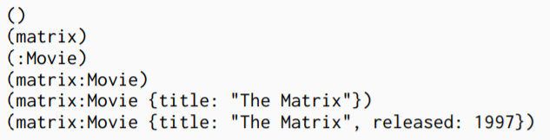
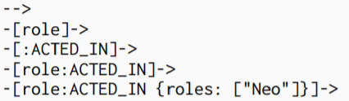

Cypher Query Language Syntax
Node syntax
Cypher uses a pair of parentheses to represent a node: (). This is reminiscent of a circle or a rectangle with rounded end caps.
Relationship syntax
Cypher uses a pair of dashes (--) to represent an undirected relationship.
Directed relationships have an arrowhead at one end (<--, -->).
Bracketed expressions ([…]) can be used to add details.
Pattern syntax
Combining the syntax for nodes and relationships

Slide 9
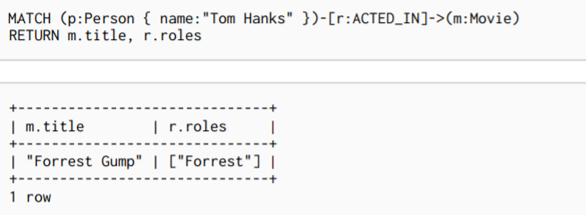

Patterns in practice
Creating data
Matching patterns
Attaching structures

Slide 10
Divider page

Slide 11
OpenTSDB
OpenTSDB
a distributed Time Series Database (TSDB) based on HBase.
written by Benoit Sigoure to collect, store and display metrics of various computer systems (network gears, operating systems, applications), and generate readable data graphs easily.
the first open-source monitoring system built on an open-source distributed database.
written in Java.
History
OpenTSDB was originally written to monitor metrics of the StumbleUpon search engine which requires storing over 1 billion data points per day.
StumbleUpon was in charge of the initial development and its open-source release. Yahoo! is currently maintaining OpenTSDB along with the open-source community.

Slide 12
OpenTSDB Techniques
Compression: Naïve (Page-Level) Naïve (Record-Level)
OpenTSDB uses Row Compaction to compress data. Whenever a cell is to be written, its row key is pushed into a compaction queue. There is a separate thread that periodically goes through the queue and aggregate data with the same key into a big cell. It then writes the big cell and deletes the individual cells in the queue. This process is effective because in HBase the row key is repeated for every single cell, and there is no way to efficiently append byte at the end of a cell.
At data level, OpenTSDB uses LZO compression algorithm.
With these two techniques, OpenTSDB is able to reduce the average size of one data point from 12 bytes to 2-3 bytes.

Slide 13
Insert page title (sentence case) Subheadline

Slide 14
Insert page title (sentence case) Subheadline

Slide 15
Divider page

Slide 16
Reference
Neo4j’s Documentation

Slide 17
Thank you.
Contact information:
F name L name
Title
Address
Phone number
Partner logo

Slide 19

Divider page

Slide 20
Insert page title (sentence case)

Slide 21
Insert page title (sentence case)

Slide 22
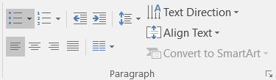
Insert page title (sentence case)
First level
Second level
Third level
NOTE: Delete the yellow stickers when finished.
The text placeholders have different, preformatted text levels. Each level has different formatting (font size, indent, bullet).
To jump between the preformatted text levels, use the Increase List Level and Decrease List Level buttons in the Paragraph toolbar.
Type your text in the placeholder.
Click the Increase List Level button in the Paragraph toolbar to go to the next level.
If you need a bullet list, choose level 2.
Avoid working with spaces, other bullets, or bullets in the wrong level. Only when you use the right levels it is possible to reset the slide layout.

Slide 23
Insert page title (sentence case)
First level
Second level
Third level

Slide 24
Insert page title (sentence case) Subheadline
First level
Second level
Third level

Slide 25
“Quote goes here and here and here.”
Source

Slide 26
“Quote goes here and here and here.”
Source

Slide 27
Insert page title (sentence case)
First level
Second level
Third level

Slide 28
Insert page title (sentence case)
First level
Second level
Third level

Slide 30
Insert page title (sentence case)
First level
Second level
Third level
First level
Second level
Third level

Slide 31
Insert page title (sentence case)
First level
Second level
Third level
First level
Second level
Third level
First level
Second level
Third level

Slide 32
Insert page title (sentence case)
First level
Second level
First level
Second level

Slide 33
Insert page title (sentence case)
First level
Second level
First level
Second level
First level
Second level

Slide 34
Thank you.
Contact information:
F name L name
Title
Address
Phone number
Partner logo

