Slide 1
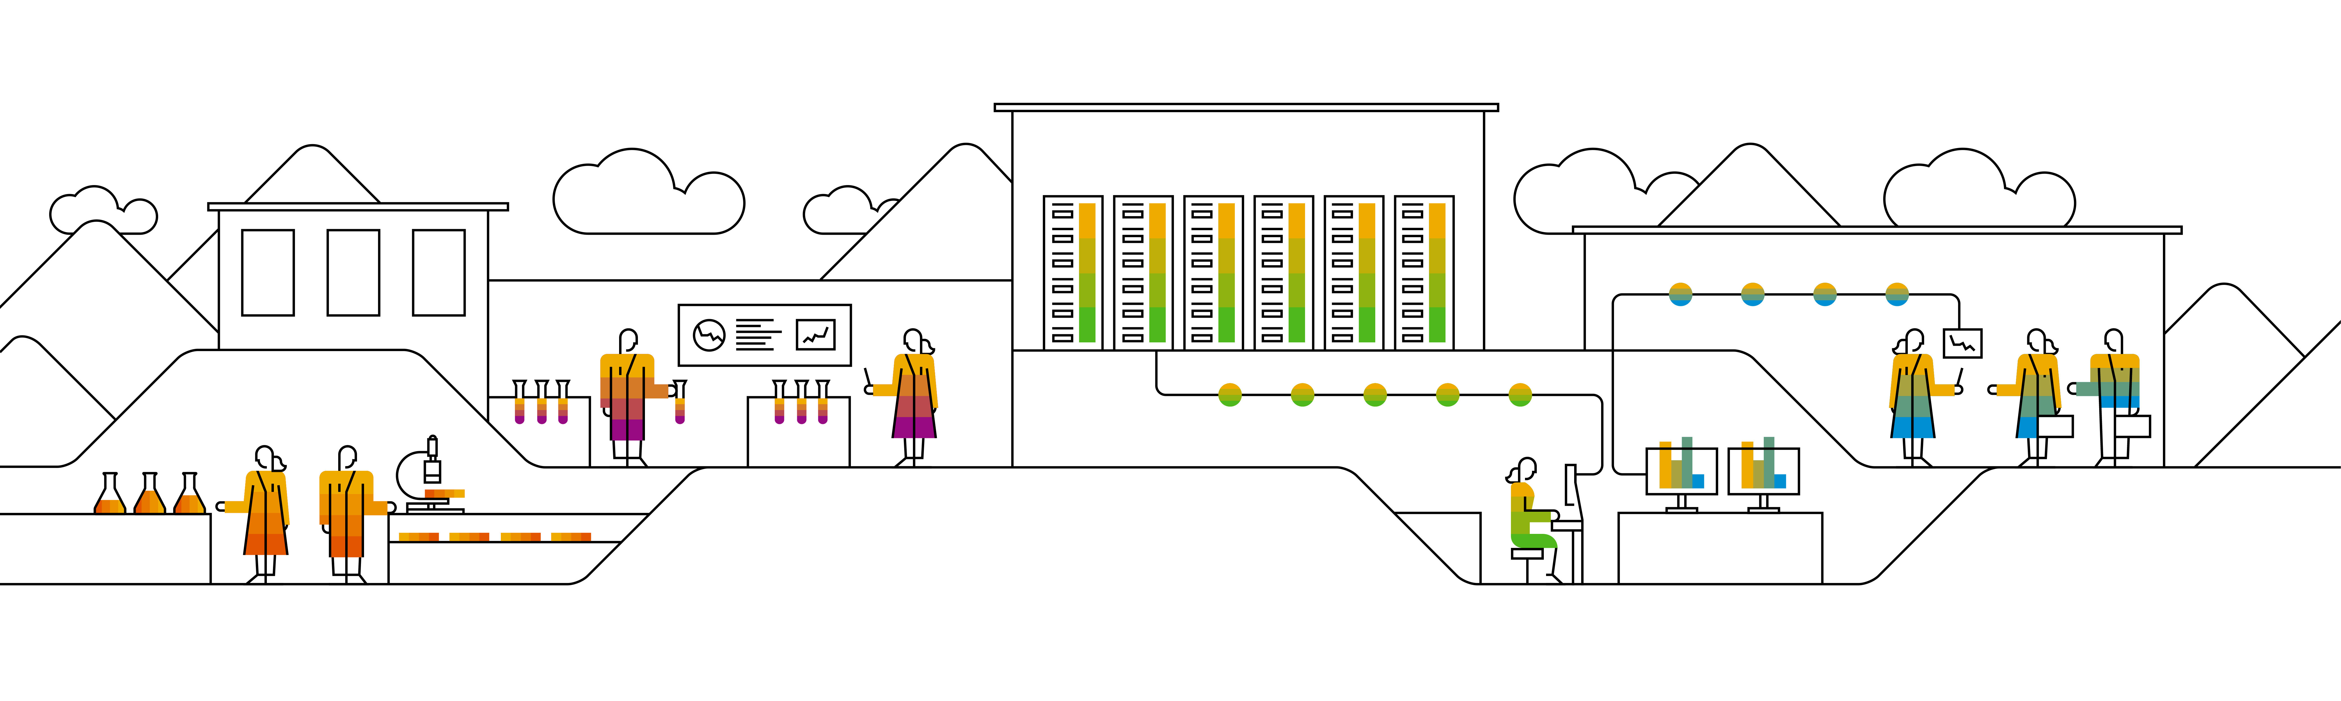
The Survey On OpenTSDB A Distributed, Scalable Monitoring System
Keith Wang, SAP
Sep 00, 2020
Partner logo

Slide 2
Content
Overview of OpenTSDB
Details
Agenda item/divider headline
Details
Agenda item/divider headline
Details
Agenda item/divider headline
Details

Slide 3
Overview of OpenSTDB

Slide 4
OpenTSDB
OpenTSDB
a distributed Time Series Database (TSDB) based on HBase.
written by Benoit Sigoure to collect, store and display metrics of various computer systems (network gears, operating systems, applications), and generate readable data graphs easily.
the first open-source monitoring system built on an open-source distributed database.
written in Java.
History
OpenTSDB was originally written to monitor metrics of the StumbleUpon search engine which requires storing over 1 billion data points per day.
StumbleUpon was in charge of the initial development and its open-source release. Yahoo! is currently maintaining OpenTSDB along with the open-source community.

Slide 5
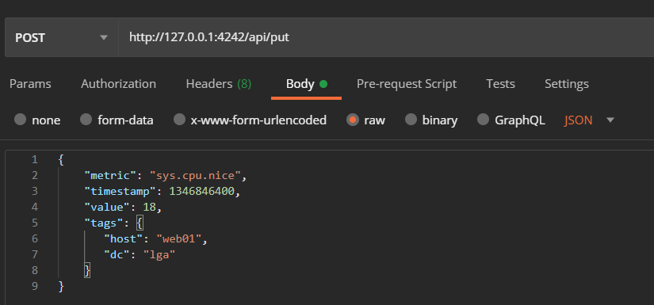
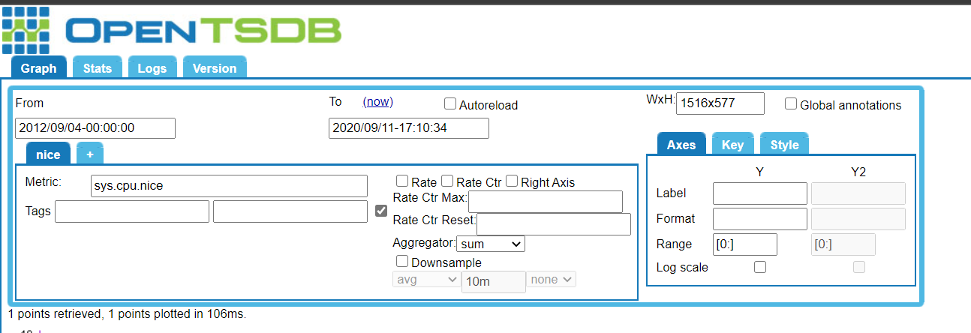
OpenTSDB Writing and Quering
Writing By Http API
Querying By Browser UI

Slide 6
OpenTSDB Techniques
Compression: Naïve (Page-Level) Naïve (Record-Level)
OpenTSDB uses Row Compaction to compress data.
Whenever a cell is to be written, its row key is pushed into a compaction queue.
There is a separate thread that periodically goes through the queue and aggregate data with the same key into a big cell.
It then writes the big cell and deletes the individual cells in the queue.
This process is effective because in HBase the row key is repeated for every single cell, and there is no way to efficiently append byte at the end of a cell.
At data level, OpenTSDB uses LZO compression algorithm.
With these two techniques, OpenTSDB is able to reduce the average size of one data point from 12 bytes to 2-3 bytes.

Slide 7
OpenTSDB Techniques
Concurrency Control
OpenTSDB allows concurrent writes without using locks.
OpenTSDB avoids multiple writers creating duplicate rows in the case of writer restart by making writes idempotent. It enforces a fixed timestamp boundary for each row. When a write reconnects to HBase, it will always write to the appropriate row according to the timestamp instead of creating new rows.
Data Model
Data are stored as time series. Each time series is a collection of data points.
A data point is a key value map(time, value). A time series is identified by its metrics and tags
Identity(Metric+Tag) | Value | Timestamp
Web01.sys.cpu.busy.pct | 45% | 1/1/207 12:01:00
Web01.sys.cpu.busy.pct | 52% | 1/1/207 12:02:00
Web01.sys.cpu.busy.pct | 35% | 1/1/207 12:03:00

Slide 8
OpenTSDB Techniques
Query Interface
There are 2 official supported query interfaces: HTTP/REST API and Telnet style command line API.
Additionally, there are various open-source front-end clients that encapsulate the official APIs, including a Browser interface and Erlang/Java/Go/Python/R/Ruby clients.

Slide 9
OpenTSDB Techniques
System Architecture
OpenTSDB consists of three components: tCollector, Time Series Daemon (TSD), and HBase. One instance of tCollector is deployed on each server. It is responsible to periodically pull metrics data from processes running on the server and the operating system. TSDs receive data from the tCollectors and push data to the HBase backend storage system. Upon receiving queries, TSD scans HBase and retrieves relevant data.
All communications are done via TSD RPC and Hadoop RPC, therefore all components are stateless. There can be as many TSDs as needed to handle the workload as the system scales.

Slide 10
Data’s Features and database’s rules
Time Series Data’s feature
Write at high speed on a timeline where time is an important dimension
Clearly marked tag and metric fields
The total order of magnitude is thousands of times the same of the combination of tags
Basically no point query, common query is time range aggregation query
Database’s Rules
Writing performance
Storage
Aggregation computation and performance
System and Architecture

Slide 11
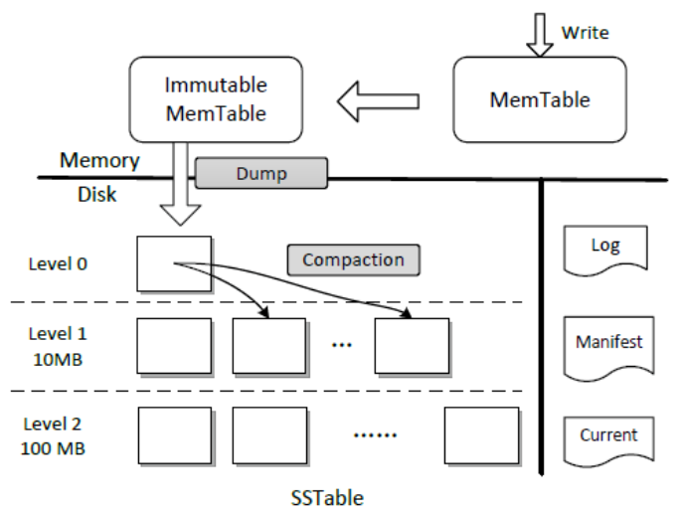
Storage Architecture
LSM-Tree:
Storage Architecture
The back-end storage system is Hbase, an open-source non-relational disk-oriented distributed database. It also supports Google Bigtable as its backend.

Slide 12
Prometheus and Grafana

Slide 13
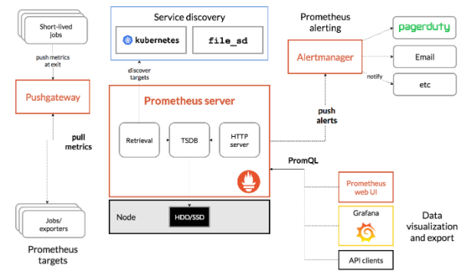
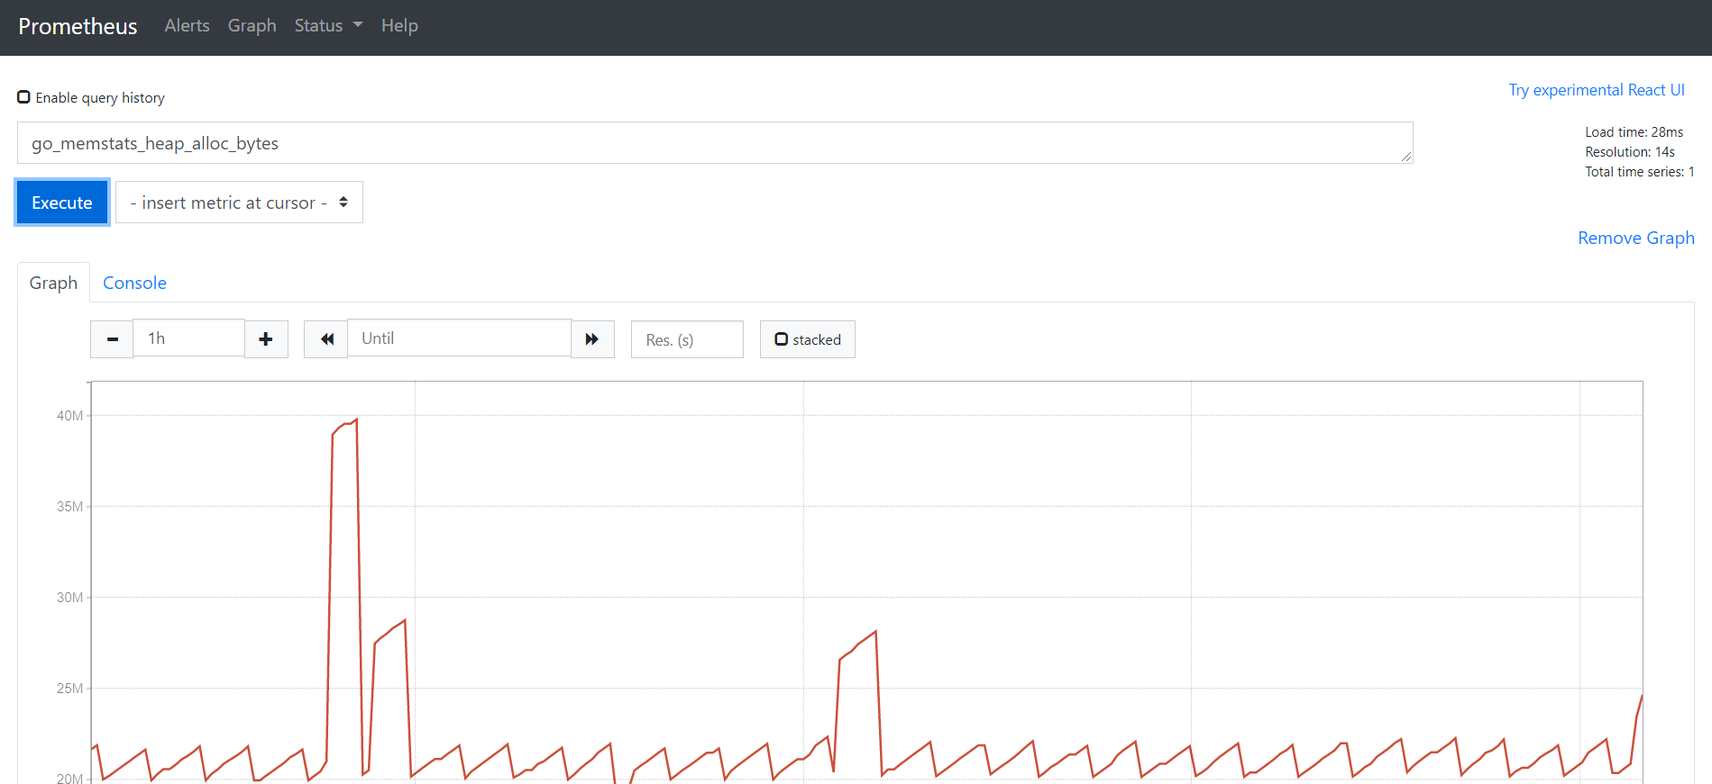
Prometheus
Prometheus is an open-source systems monitoring and alerting toolkit originally built at SoundCloud.
Features:
A multi-dimensional data model with time series data identified by metric name and key/value pairs
PromQL, a flexible query language
Multiple modes of graphing and dashboarding support

Slide 14
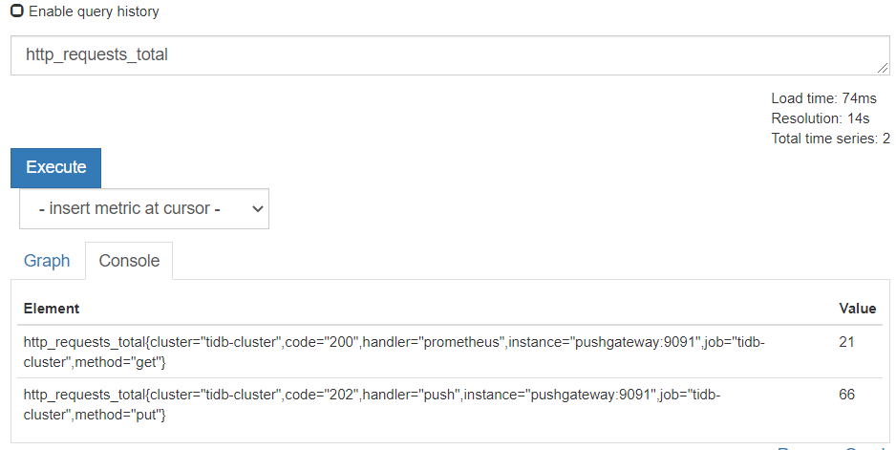
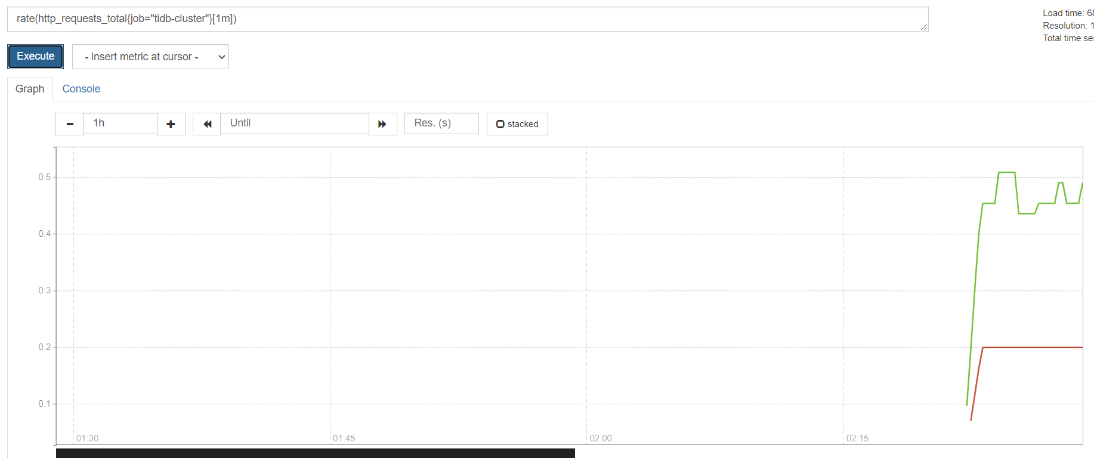
PromQL
Prometheus Query Language , is a functional query language, which lets the user select and aggregate time series data in real time
The expression has four types”
Instant vector
Range vector
Scalar and String
Instant vector Selectors: metirc_name{ tag = value}
E.g:
http_requests_total
http_requests_total{job=“prometheus”, group=“canary”}
Range vector Selectors [times] m/h/s/d/..
E.g:
http_requests_total{job=“prometheus”}[5m], which means we select all the values we have recorded within the last 5 minutes for all time series.

Slide 15
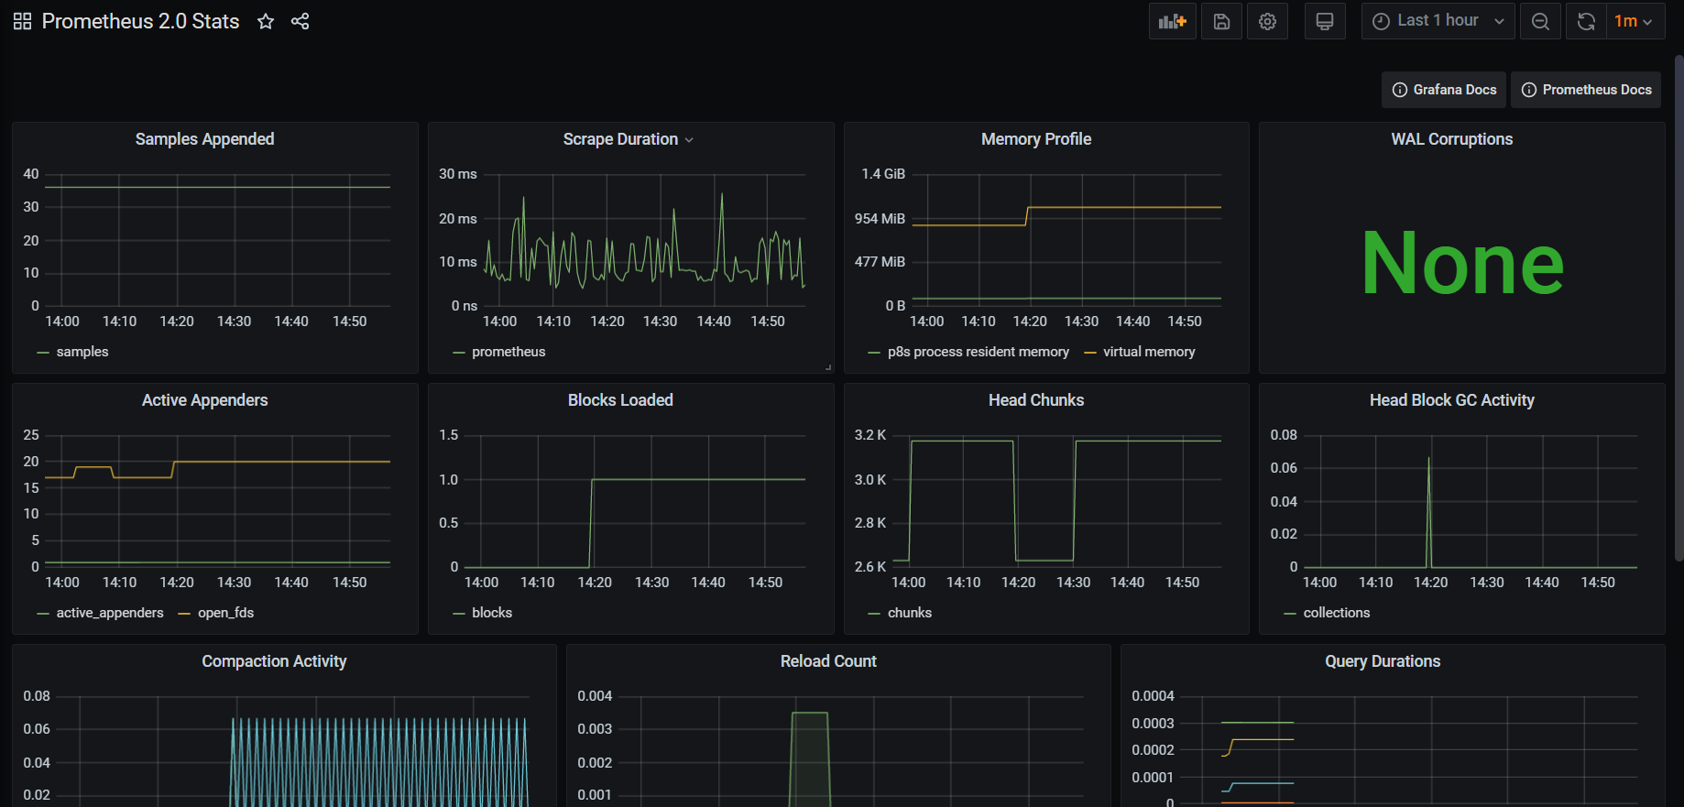
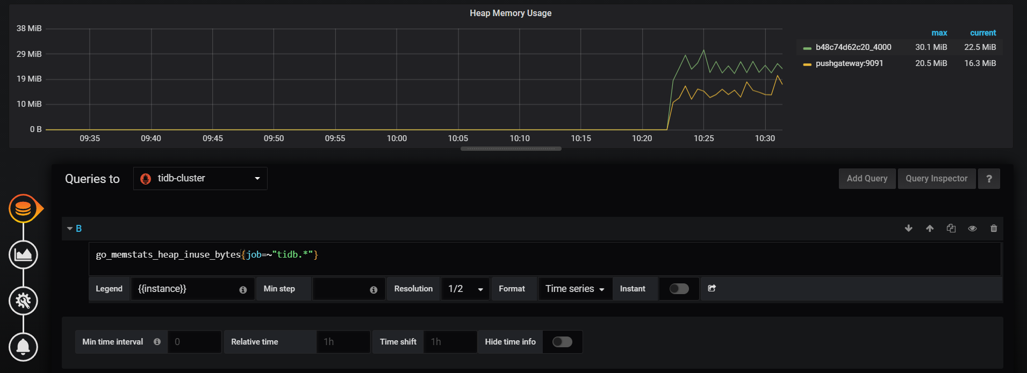
Grafana An analytics platform for all metrics
Visualization : Grafana has a plethora of visualization options to help us understand our data, such as heatmaps, histograms, graphs and geomaps.
Alert: Seamlessly define alerts where it makes sense
Unity: Grafana supports dozens of database, such as OpenTSDB, Prometheus, InfluxDB and so on.
Extend: Discover hundreds of dashboards and plugins in the official library
Collaborate: Bring everyone together, and share data and dashboards across teams.

Slide 16
Thank you.
Contact information:
F name L name
Title
Address
Phone number
Partner logo

