Slide 1


The Survey On Redis Redis: A fast, open source in-memory data source
Keith Wang, SAP
Aug 24, 2020

Slide 2
Content
What’s Redis?
Overview of Redis
Redis’s use cases and key features
How Does the Redis Work?
Redis’s Architecture
Persistence and Replication of Redis
Clustering in Redis
In-Memory Data Storage System
Redis VS Memcached
Reference

Slide 3
What’s Redis?

Slide 4
Redis’s Quick Overview
Redis, which stands for Remote Dictionary Server, is a fast, open-source, in-memory key-value data store for use as a database, cache, message broker, and queue. So we can say that Redis stored data in RAM in form of key-value pairs.
In Redis, key has to be a string but value can be a string, list, set, sorted set or hash.
These are some example of Redis Key-values pairs:
Here Name and profession are keys, and we have their respective values on right.
Name=“SAP”
Profession=[“web”, ”mobile”]

Slide 5
Redis’s Common Use Cases
Use Cases
Mainly：Caching
Developers have turned to Redis when the volume of read and write operations exceed the capabilities of traditional databases. With Redis’s capability to easily persist the data to disk, it is a superior alternative to the traditional memcached solution for caching.
Other：
Publish and Subscribe
Since version 2.0, Redis provides the capability to distribute data utilizing the Publish/Subscribe messaging paradigm. Redis’s simplicity and performance are better than other message queuing systems.
Queues
Use Redis as the backend for queueing background jobs.
Counters
Creating a counter is as simple as determining a name for a key and issuing the HINCRBY command. There is no need to read the data before incrementing, and there are no database schemas to update. Since these are atomic operations, the counters will maintain consistency when accessed from multiple application servers.

Slide 6
Redis’s Key Features
High-Level Data Structures
Provides five possible data types for values. Operations that are unique to those data types are provided and come with well documented time-complexity (Big O notation).
High Performance
Due to its in-memory nature, the project maintainer’s commitment to keeping complexity at a minimum, and an event-based programming model, Redis boasts exceptional performance for read and write operations.
Lightweight With No Dependencies
Written in ANSIC, and has no external dependencies. Works well in all POSIX environments. Windows is not officially supported, but an experimental build is provided by Microsoft.
High Availability
Built-in support for asynchronous, non-blocking, master/slave replication to ensure high availability of data.

Slide 7
Main Advantage and Disadvantage of Redis over DBMS
DBMS store everything in second storage(disk or others) which makes read and write operations very slow. But Redis stores everything in primary memory which is very fast in read and write of data.
Primary memory is limited(much lesser size and expensive than secondary) therefore Redis cannot store large files or binary data. It can only store those small textual information which needs to be accessed, modified and inserted at a very fast rate. If we try to write more data than available memory then we will receive errors.
Redis does not provide any mechanism for datastore backup and recovery. Therefore if there is any hard disk crash or any other kind of disaster then all data will be lost.

Slide 8
How Does Redis Work?

Slide 9
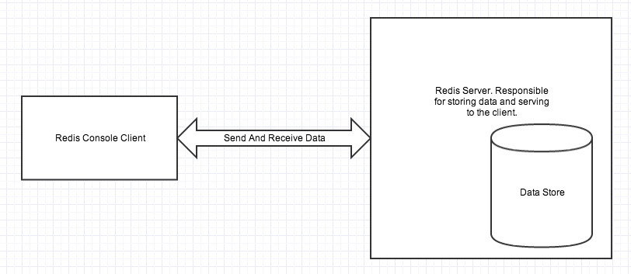
Redis Single Instance Architecture
Redis architecture contains two main processes : Redis Client and Redis Server.
Redis server is responsible for
storing data in memory.
handling all kinds of management and forms the major part of architecture.
Redis client can be Redis console client or any other programming language’s Redis API.
As we saw that Redis stores everything in primary memory. Primary memory is volatile and therefore we will loose all stored data once we restart our Redis server or computer.
Therefore we need a way for datastore persistence .

Slide 10
Persistence of Redis
There are three different ways to make Redis persistence:
RDB Mechanism
RDB makes a copy of all the data in memory and stores them in secondary storage(permanent storage). This happens in a specified interval. So there is chance that you will loose data that are set after RDB’s last snapshot.
AOF(Append Only File)
AOF logs all the write operations received by the server. Therefore everything is persistence. The problem with using AOF is that it writes to disk for every operation and it is a expensive task and also size of AOF file is large than RDB file.
SAVE Command
You can force Redis server to create a RDB snapshot anytime using the Redis console client SAVE command.
You can use AOF and RDB together to get best persistence result.
For more information of Redis persistence refer this official documentation.
Notes:
Save command

Slide 11
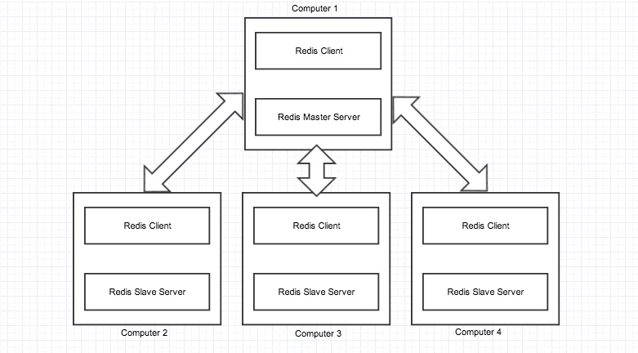
Replication of Redis
Replication is a technique involving many computers to enable fault-tolerance and data accessibility.
All the slaves contain exactly same data as master.
There can be as many as slaves per master server.
When a new slave is inserted to the environment, the master automatically syncs all data to the slave.
All the queries are redirected to master server, master server then executes the operations.
When a write operation occurs, master replicates the newly written data to all slaves.

Slide 12
Replication of Redis
If a slave fails, then also the environment continues working.
when the slave again starts working, the master sends updated data to the slave.
If the master server fails and looses all data
then you should convert a slave to master instead of bringing a new computer as a master.
If master fails but data is persistent(disk not crashed)
starting up the same master server again will bring up the whole environment to running mode.
Replication helped us from disk failures and other kinds of hardware failures.
Replication also helped to execute multiple read/sort queries at a time.

Slide 13
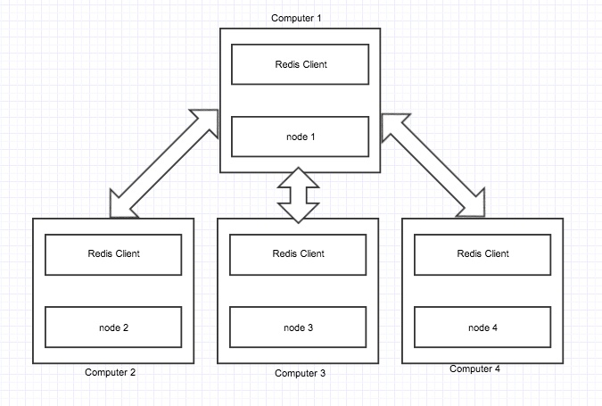
Clustering In Redis
Clustering is a technique by which data can be divided into many computers.
The main advantage is that more data can be stored in a cluster because its a combination of computers.
Suppose we have one Redis server with 64GB of memory
we can have only 64GB of data. Now if we have 10 clustered computers with each 64GB of RAM then we can store 640GB of data.
If one node fails then the whole cluster stops working.
In the above image we can see that data is divided into four nodes. Each node is a Redis server configured as a cluster node.

Slide 14
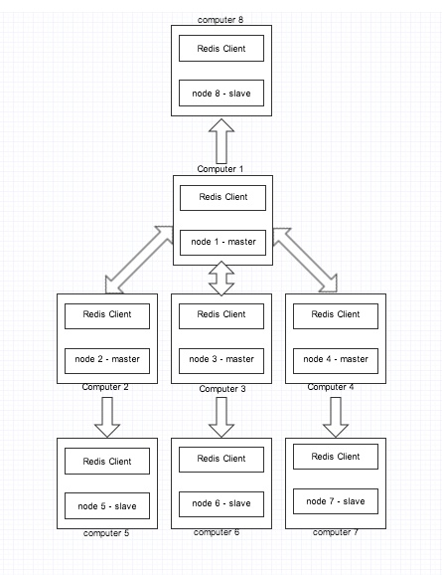
Clustering and Replication
Suppose due to disk crash, one of our node goes down then the whole cluster stops working and never resumes.
There is no way we can recover back the node as the data is completely lost.
To avoid this situation we can take a manual backup of each node regularly.
That is a tough and improper task.
We can rely on replication to solve this problem.
We convert each node server to a master server. And we keep a slave for every master.
if any node(master)fails, the cluster will start using the slave to keep the cluster operating.

Slide 15
Memory management scheme
In Redis, not all data storage occurs in memory.
When the physical memory is full, Redis may swap values not used for a long time to the disk. Redis only caches all the key information.
Exceeding the threshold value, which will trigger the swap operation. Redis calculates the values for the keys to be swapped to the disk based on “swappability = age*log(size_in_memory)”. It then makes these values for the keys persistent into the disk and erases them from memory.
This feature enables Redis to maintain data of a size bigger than its machine memory capacity. The machine memory must keep all the keys and it will not swap all the data.
When Redis swaps the data, the main thread that provides services, and the child thread for the swap operation will share this part of memory.
if you update the data you intend to swap, Redis will block this operation, preventing the execution of such a change until the child thread completes the swap operation.
When you read data from Redis, if the value of the read key is not in the memory, Redis needs to load the corresponding data from the swap file and then return it to the requester.

Slide 16
Redis VS Memcached

Slide 17
The Feature Comparison
Server-end data operations
Redis supports server-end data operations, and owns more data structures and supports richer data operations than Memcached
Memory use efficiency comparison
Memcached has a higher memory utilization rate for simple key-value storage.
if Redis adopts the hash, it will have a higher memory utilization rate because of its compression mode
Performance comparison
Redis only uses single cores while Memcached utilizes multiple cores.
Redis boasts a higher performance than Memcached in small data storage when measured in terms of cores
Memcached outperforms Redis for storing data of 100K or above,
Although Redis has also made some optimizations for storing big data, it is still inferior to Memcached.

Slide 18
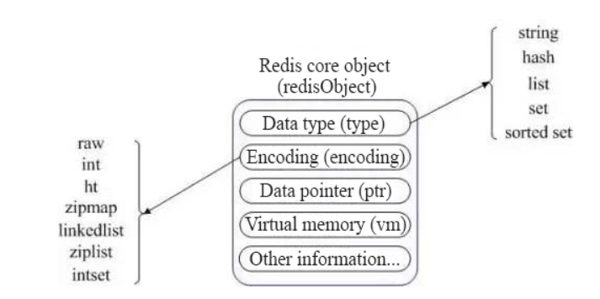
Different Data Types Supported
only supports simple key-value structure(Memcached)
five different data Types(Redis)
Redis uses a Redis Object internally to represent all keys and values.
The type represents the data type of a value object.
The encoding indicates the storage method of different data types in the Redis
Redis stores and represents the associated string as a value type. Of course, the premise is that it is possible to represent the string by a value, such as strings of “123″ and “456”.
Only upon enabling the Redis virtual memory feature will it allocate the vm fields with memory. This feature is off by default.

Slide 19
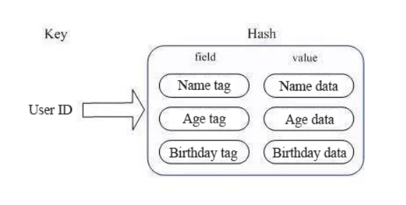
Different Data Types Supported(Take String and Hash as Examples)
String:
When called for the INCR or DECR operations, the system will convert it to the value type for computation. At this time, the redisObject’s encoding field is int.
Hash:
when there are only a few members in the HashMap, Redis opts for one-dimensional arrays for compact storage to save memory, instead of the HashMap structure. At this time, the encoding of the corresponding value redisObject is zipmap.
When the number of members increases, Redis will convert them into the HashMap and the encoding at this time will be ht.

Slide 20
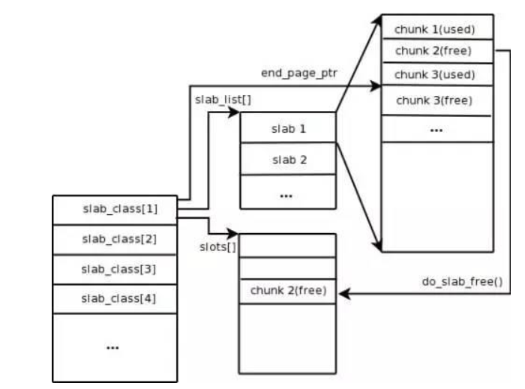
Two different memory management mechanisms
In order to improve the memory management efficiency, memory management solutions will not use the malloc/free calls directly.
Memcached: Slab Allocation mechanism
Mainly philosophy: segment the allocated memory into chunks of specific length to reduce the fragmentation
Redis: zmalloc.h and zmalloc.c instead of malloc/free
When Memcached receives the data sent from the client
it will first select the most appropriate Slab Class according to the data size
query the idle chunk list containing the Slab Class in the Memcached to locate a chunk for storing the data.
When a piece of data expires or is obsolete, and therefore discarded, it is possible to recycle the chunk originally occupied by the record and restore it to the idle list.

Slide 21
Reference

Slide 22
Reference
Redis’s Documentation which is about Redis(open source)
Redislabs-Home of Redis which is about Redis Enterprise Software
Overview of Redis in Amazon
Overview Of Redis Architecture which is about Redis’s Architecture
Redis vs. Memcached: In-Memory Data Storage Systems

Slide 23
Thank you.
Contact information:
Keith Wang
Intern
Address
Phone number
Partner logo

