Slide 1

Job Posting and application management system
Presented by:
Bansi parekh
Guided by:
(Internal)
DR. Chintan d. Gohel
(external)
Yogeshbhai parmar

Slide 2
Introduction of company
Name of Organization : SnakeCode Consultancy Pvt LTD
Type of Organization : IT service, Consulting and Business solutions
Year of Registration : 2023
Address : 605, Siddhraj z square, opp. The Landmark, Podar
International School, Kudasan, Gujarat 382421.
SnakeCode Consultancy Pvt LTD, 2023 માં સ્થપાયેલ, Odoo સોલ્યુશન્સનું વિશિષ્ટ પ્રદાતા છે,જે એન્ટરપ્રાઇઝ અને કૉમ્યૂનિટી વર્ઝન બંને માટે કસ્ટમાઈઝ્ડ સેવાઓ સાથે તમામ ઉધોગોમાં ગ્રાહકોને સેવાઓ આપે છે. અમારી કંપની વ્યવસાયોની અનોખી જરૂચરયાતો, ડ્રાઇવિંગ કાર્યક્ષમતા અને તેમની કામગીરીમાં નવીનતા પૂરી કરે તેવા અનુરૂપ ઉકેલો પહોંચાડવા માટે સમર્પિત છે. SnakeCode Consultancy Pvt LTD, 2023 માં પિનાકીન નાઈ અને યોગેશ પરમાર દ્વારા સ્થપાયેલ, Odoo સોલ્યુશન્સના ઉપયોગ દ્વારા ડિજિટલ યુગ માટે વ્યવસાયિક કામગીરીને આધુનિક બનાવામાં નિષ્ણાંત છે. તેમની કુશળતા અને નવીનતા માટે ના જુસ્સા સાથે, તેઓ અમારા ગ્રાહકો માટે અસાધારણ પરિણામો પોહ્ચાડવામાં અમારી ટીમનું નેતૃત્વ કરે છે.

Slide 3
Introduction
In today's dynamic job market, efficient recruitment processes are essential for organizations to attract and retain top talent. Our project aims to address this need by developing a comprehensive job posting and applicant management system.
In today's fast-paced job market, organizations face challenges in effectively managing job postings and handling large numbers of applicants.
The system will streamline the recruitment process for both employers and job seekers, providing a user-friendly platform for posting job vacancies, managing applications and making informed hiring decisions.

Slide 4
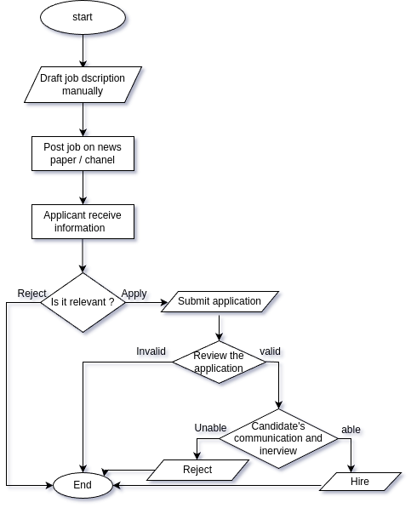
Existing System

Slide 5
Existing System
Manual Job Description Drafting and Distribution
Manual Submission of Applications
Manual Review of Applications and Communication with Candidates
Manual Interview Scheduling and Conducting
Manual Hiring Decisions
Manual Job Offer Extension and Negotiation
Manual Onboarding Processes
Manual Post-Hiring Record-Keeping
Time-Consuming and Error-Prone Process

Slide 6
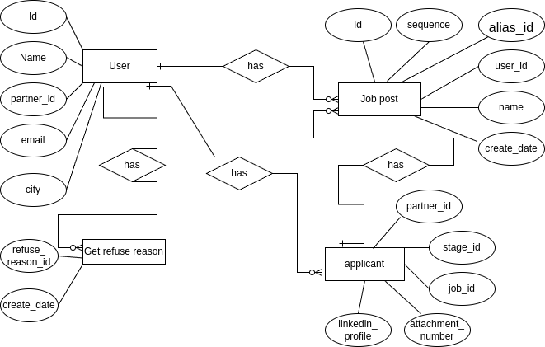
ER diagram

Slide 7
System analysis
Objectives:
    Develop a modern job posting and applicant management system to streamline recruitment processes, enhance candidate experience, optimize recruitment strategies, ensure compliance and promote cost-effectiveness.
• Scope:-
    Create job posts with customizable templates.
    Applicant search and filtering capabilities.
    Resume Parsing and Skill Extraction.
    Interview scheduling and management tools.
    Onboarding checklists and workflows.
    Security features to protect applicant data.
    Allows applicants to submit resumes and applications electronically.
    Sort applicants by job posting and application status (eg, screening, interview).

Slide 8
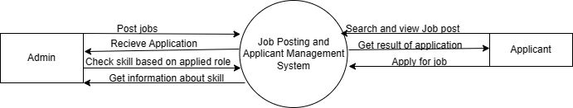
Context Level DFD

Slide 9
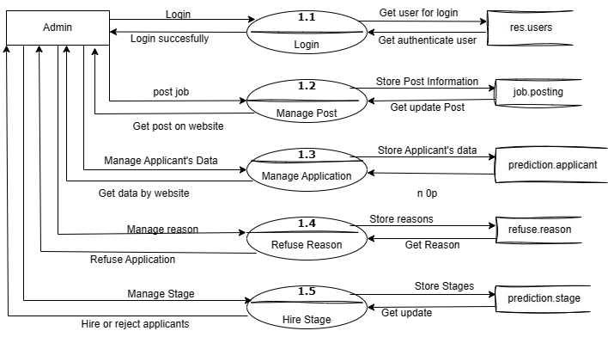
1st Level DFD (admin)

Slide 10
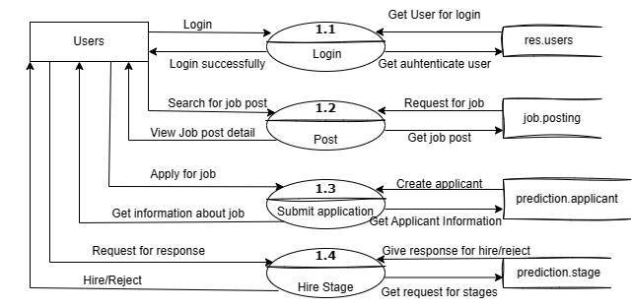
1st Level DFD (User)

Slide 11
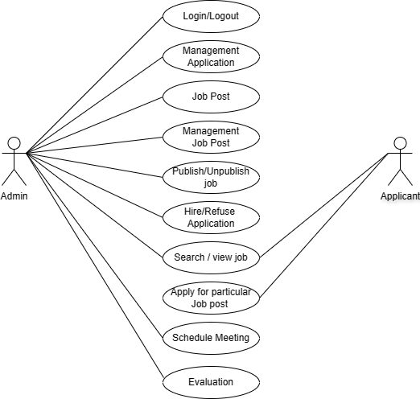
Use case

Slide 12
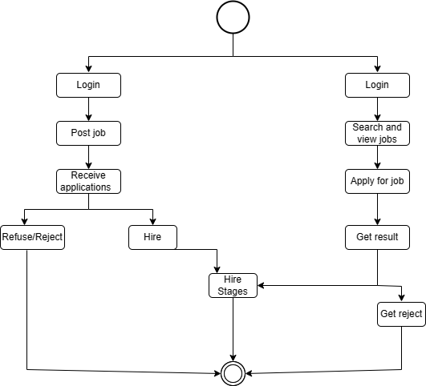
Activity Diagram

Slide 13
Data Disctionary
job_posting
Column | Type | Constraints | Description
Id | Integer | Primary key | unique Reference
sequence | Integer |  | Sequence number
no_of_recruitment | Integer |  | Count recruitment
no_of_hired_employee | Integer |  | Count hired employee
company_id | Integer | FOREIGN KEY | Company id
create_uid | Integer |  | Create user id
alias_id | Integer | FOREIGN KEY | Mail aias
user_id | Integer |  | User id
website_id | integer | FOREIGN KEY | Website id

Slide 14
Data Disctionary
prediction_applicant
Column | Type | Constraints | Description
partner_id | Integer | FOREIGN KEY | Applicant id
stage_id | Integer | FOREIGN KEY | Stage id
job_id | Integer | FOREIGN KEY | Job id
department_id | Integer | FOREIGN KEY | Department id
attachment_number | Integer |  | Attachment numbers
company_id | Integer | FOREIGN KEY | Company id
refuse_reason_id | Integer | FOREIGN KEY | Refuse reason
partner_name | Character |  | Applicant’s name
email_from | Character |  | Applicant’s email
partner_phone | Character |  | Applicant’s phone
linkedin_profile | Character |  | Linkedin profile url

Slide 15
Data dictionary
get_refuse_reason
Column | Type | Constraints | Description
refuse_reason_id | integer | PRIMARY KEY | Unique id
create_uid | integer |  | Create user id
write_uid | integer |  | Write user id
create_date | timestamp |  | Create date
write_date | timestamp |  | Write date

Slide 16
Data dictionary
prediction_stage
Column | Type | Constraints | Description
id | Integer | PRIMARY KEY | Stage id
sequence | Integer |  | Sequence number
name | jsonb |  | Name
requirements | text |  | Requirements
fold | boolean |  | Folds
hired_stage | boolean |  | Hire stage
create_date | timestamp |  | Create date

Slide 17
H/w and S/w environment
Development Tool | Sub lime
Programming language | Python 3.10.2
Technology Used | Odoo 17 Community
Back-end Database | Postgresql 14
Front-End | XML
s/w
OS | Linux mint 20.2
Memory/ RAM | Minimum 4 GB
Processor | Intel i5
Disk Capacity | 500 GB
H/w

Slide 18
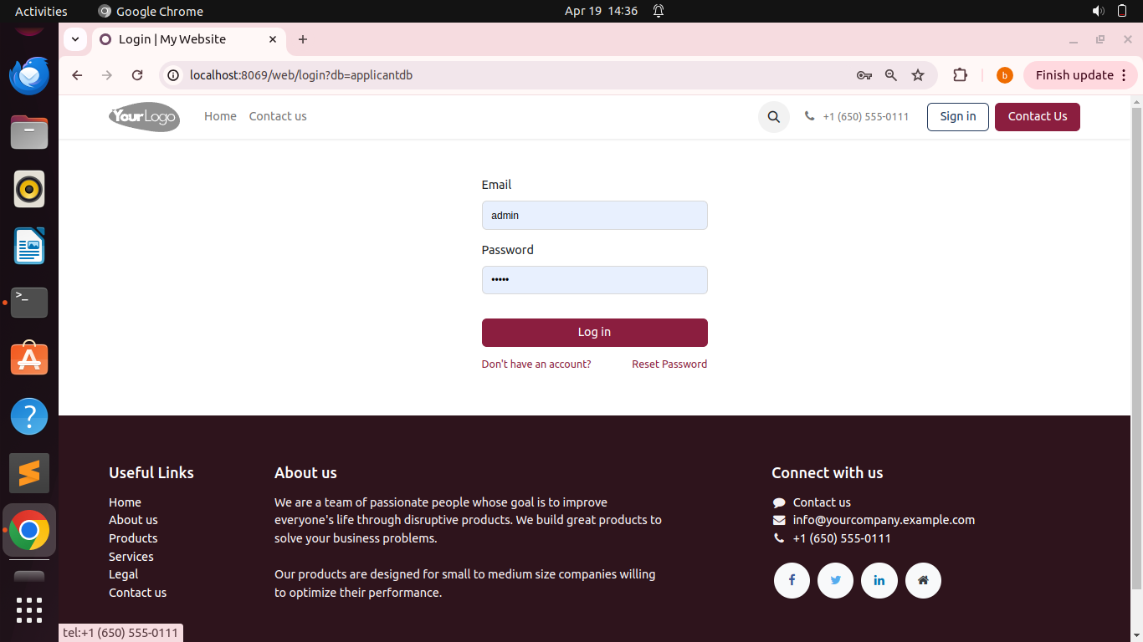
User Interface Design(Login view)

Slide 19
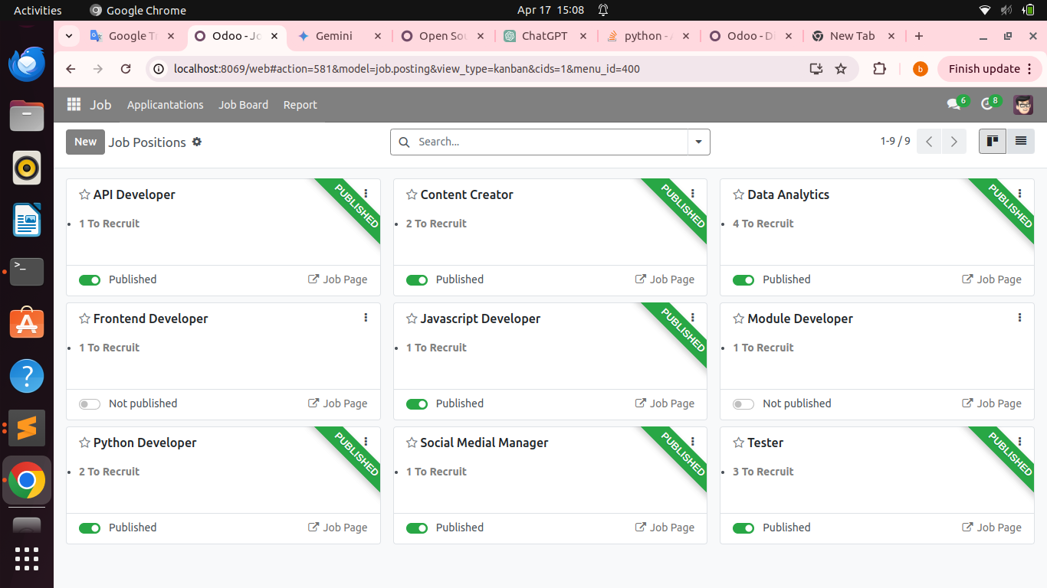
Job board view

Slide 20
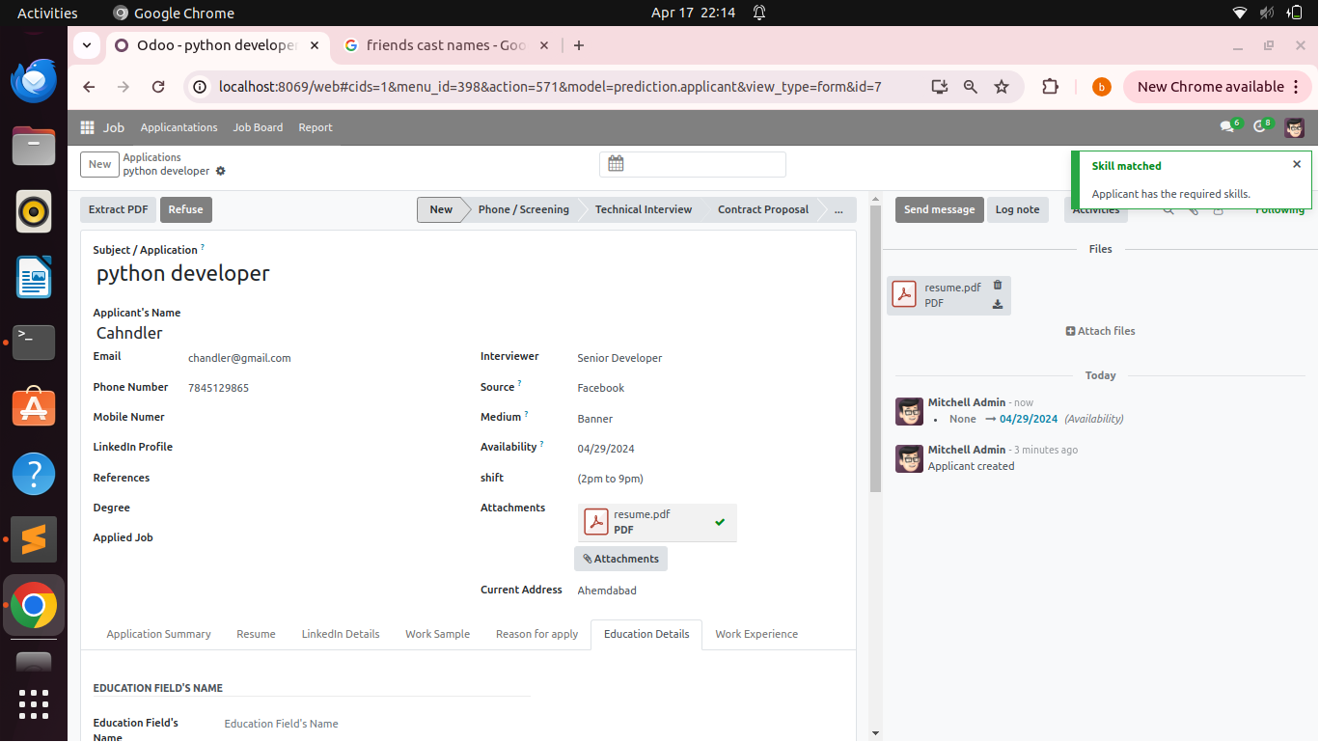
Applicant’s form view

Slide 21
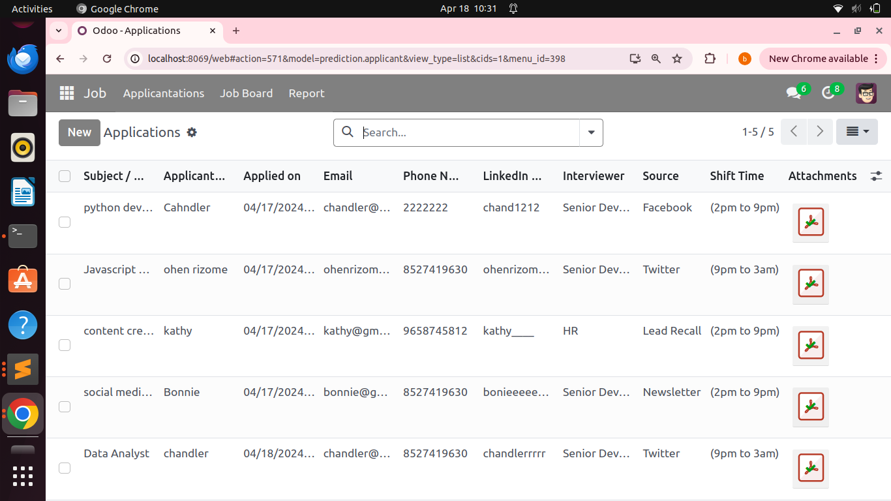
Applicant’s List view

Slide 22
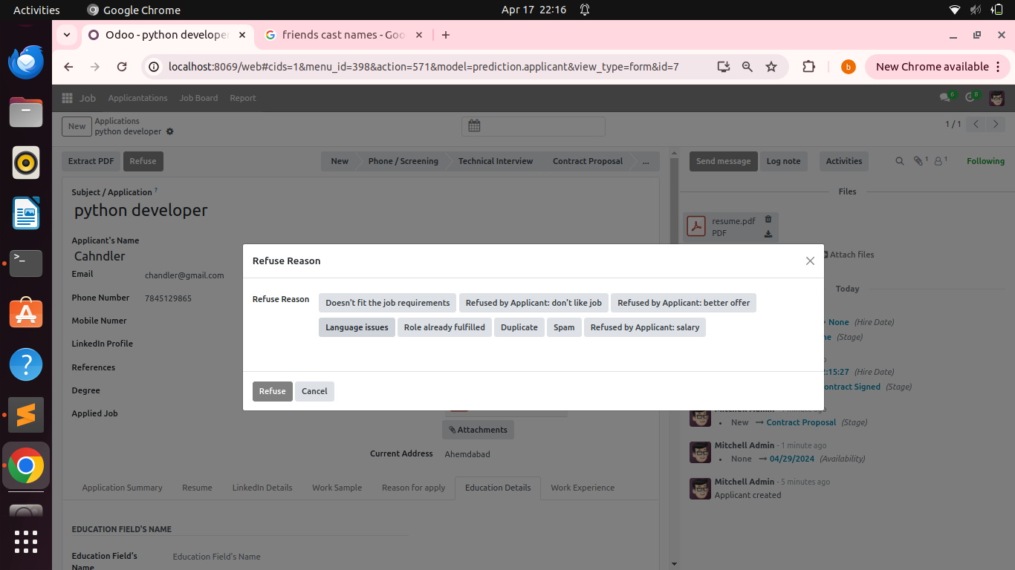
Refuse Reason view

Slide 23
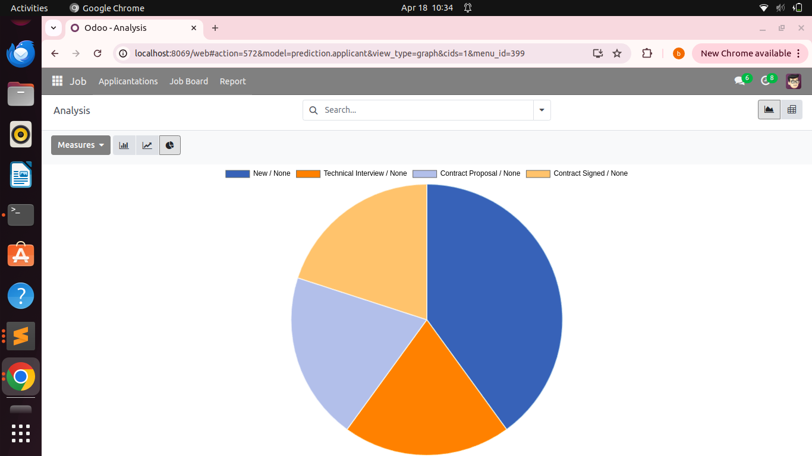
Report view

Slide 24
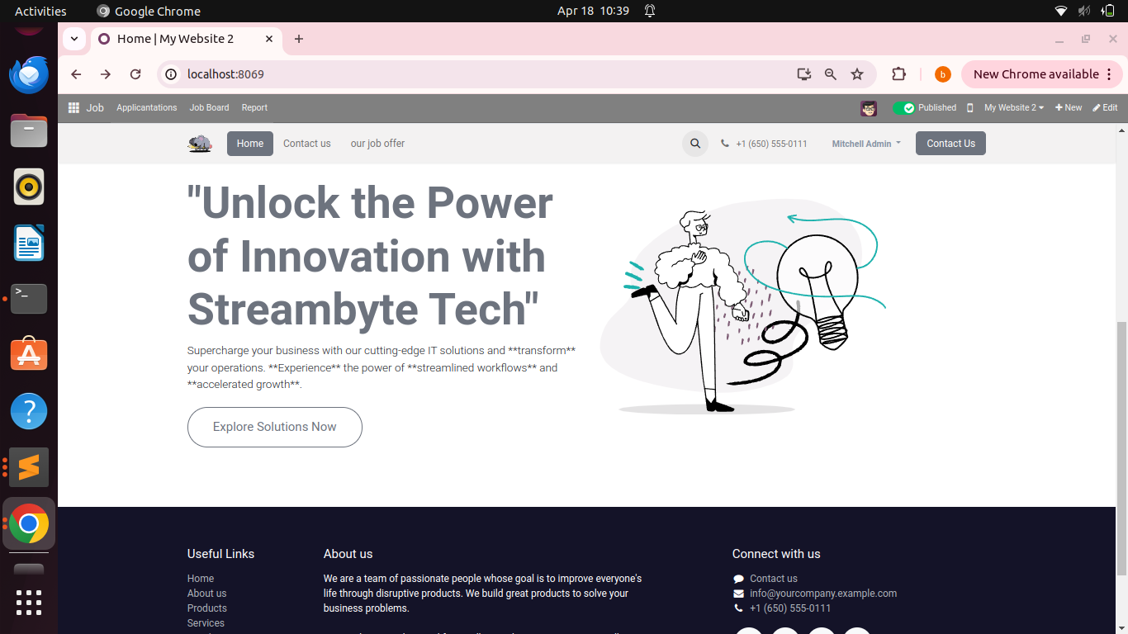
Website Home page

Slide 25
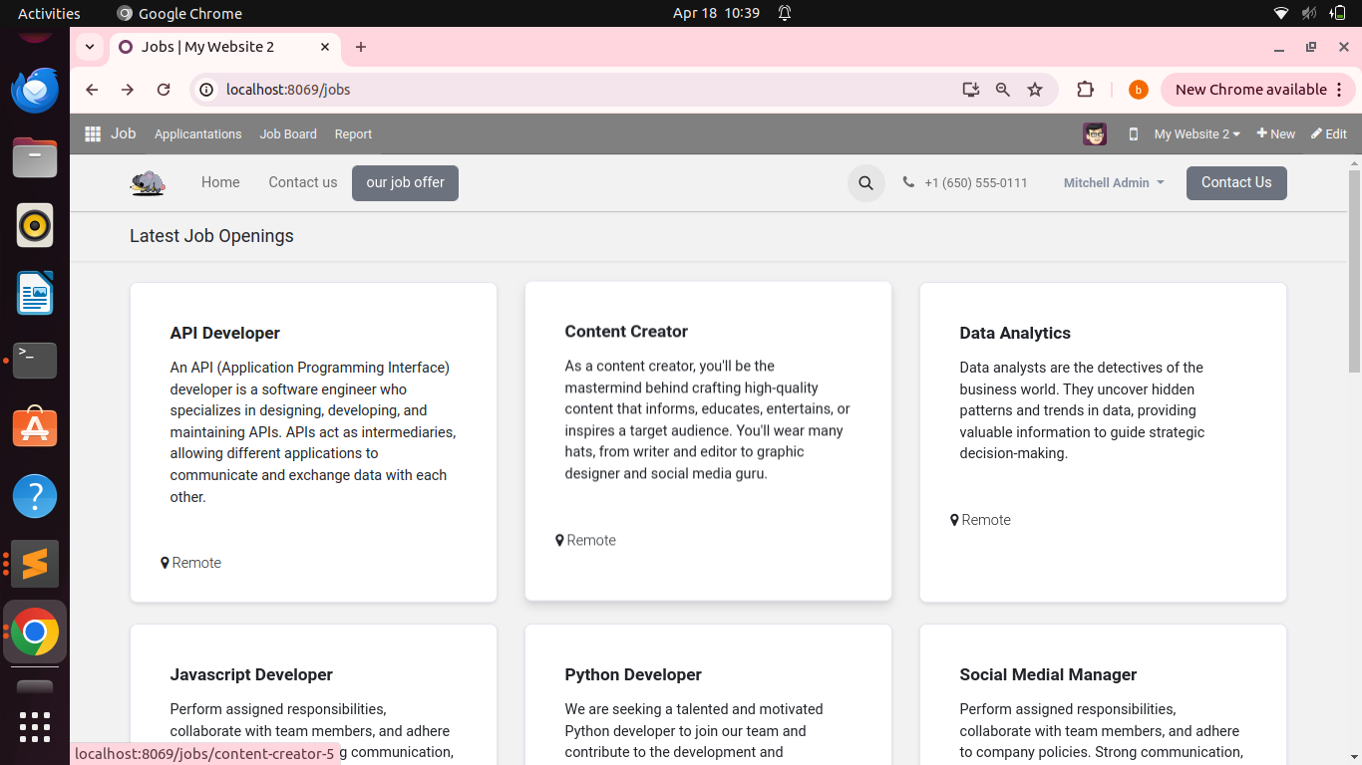
Job post view of web site

Slide 26
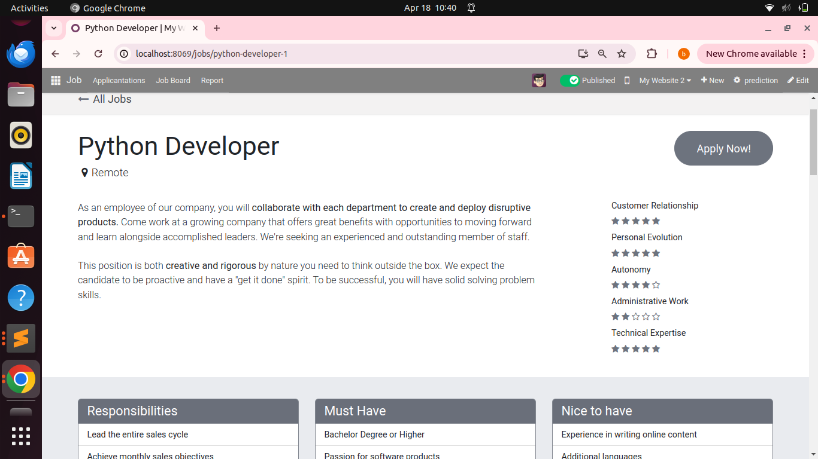
Particular job detail

Slide 27
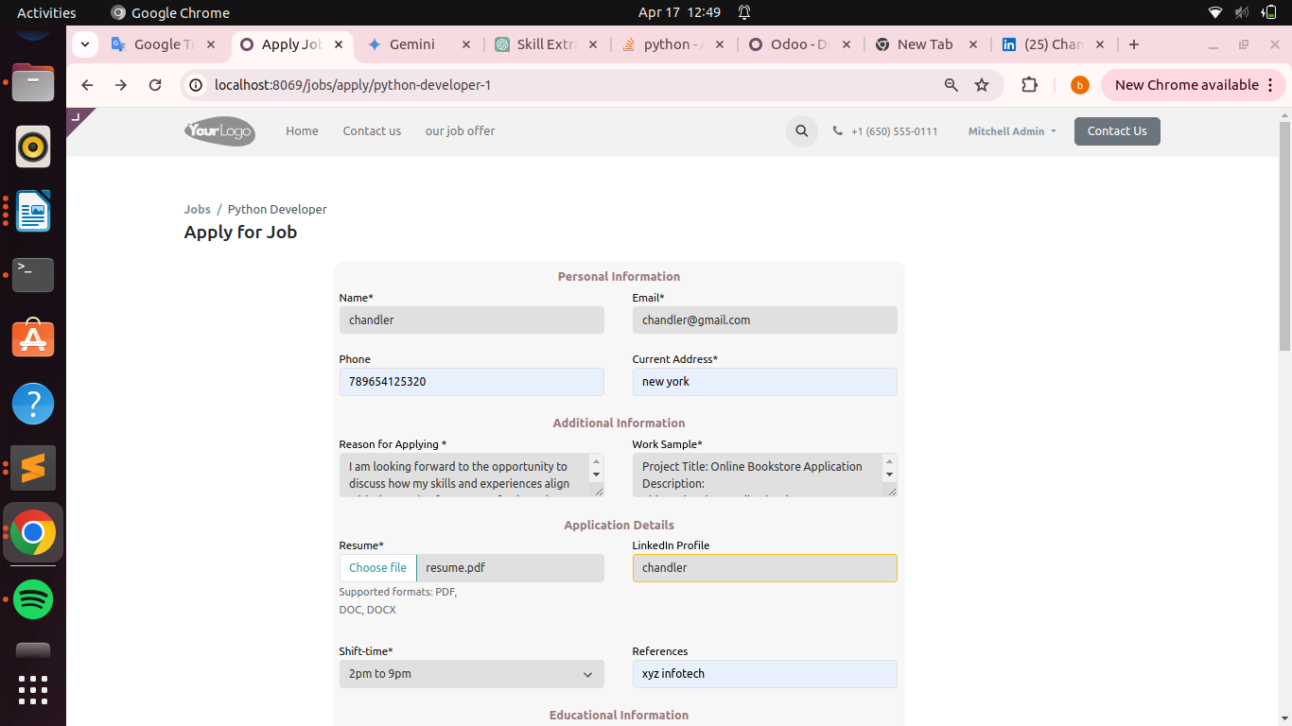
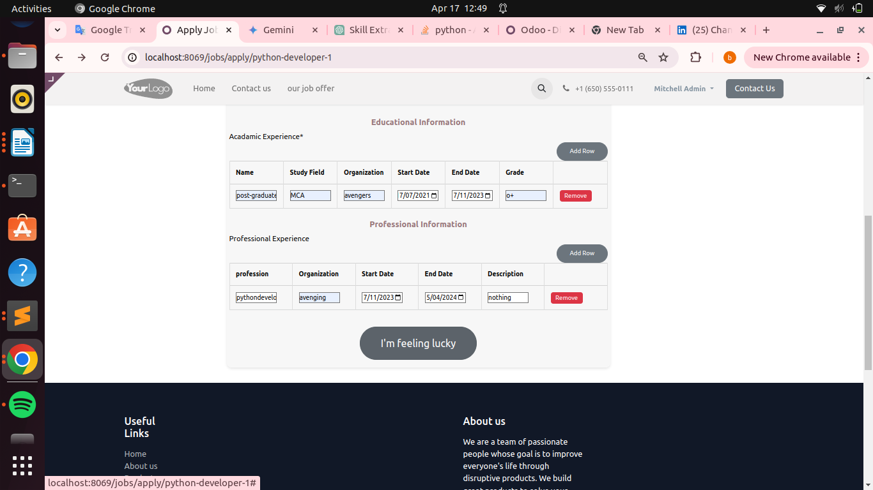
Job Application form

Slide 28
Future Scope
AI and Automation:
    Incorporation of Artificial Intelligence
    Automation for Streamlining Repetitive Tasks
    Improvement of Decision-Making Processes
User Experience:
    Intuitive Interface Design
    User-Friendly Experience for Recruiters
    User-Friendly Experience for Applicants

Slide 29
Thank you

