Slide 1

OFFICIAL BRAND ACCOUNT ADVERTISING: A COMPARATIVE STUDY OF WEIBO AND X
Friday, November 28th 2025
^{Presenter: Shaoxiang Qu}
Notes:
Hi everyone, I’m Shaoxiang Qu,
and my Signature Work’s title is official brand account advertising, a comparative study of Weibo and X.

Slide 2


Background
Notes:
Before discussing about details, let me just give a brief explanation about the background of the study.
In today‘s globalized social media ecosystem, how can corporations communicate their advertising, efficiently across different platforms?
Should they deploy a uniformed, high frequency strategy for blanket coverage,
or is it imperative to tailor the approach, diving deep into the unique culture and user habits of each platform?
To answer this critical question, this research employs large-scale data analytics and in-depth user survey to conduct a systematic,
comparative analysis of advertising strategies and user experience on China’s Weibo, versus international platform, X

Slide 3
Related Work
X. Shi and W. Wan, "A cross-cultural genre analysis of firm-generated advertisements on Twitter and Sina Weibo," Journal of Business and Technical Communication, vol. 36, no. 1, p. 71–104, 2021.
S. G. a. P. S. L. Lisette de Vries, "Popularity of Brand Posts on Brand Fan Pages: An Investigation of the Effects of Social Media Marketing," Journal of Interactive Marketing, vol. 26, no. 2, pp. 83-91, 2012
Notes:
Despite their global importance,
we lack a clear comparative understanding of how corporations advertise on these platforms, and how users truly perceive them.
For example, studies by de Vries et al. only focus on brand fan page behaviors on Facebook, without comparative perspectives.
While study by Shi and Wan focus on content characteristics of Firm-Generated Advertisements like language play, emojis, and contextual visuals on Weibo and X.
And in conclusion, comprehensive understanding that links them
to large-scale behavioral data and user perception is still lacking

Slide 4
Core Questions
• How do official brand accounts differ in posting volume?
• What temporal pattern the posts follow
• What is the 'Perception-Volume Paradox' in cross-platform advertising?
Notes:
My study is designed to fill this gap, and it is guided by 3 core questions
First, what are the quantitative differences in promotional content frequency?
Second, what temporal patterns govern this content?
And third, and most importantly, how do these objective metrics correlate with subjective user experience?

Slide 5
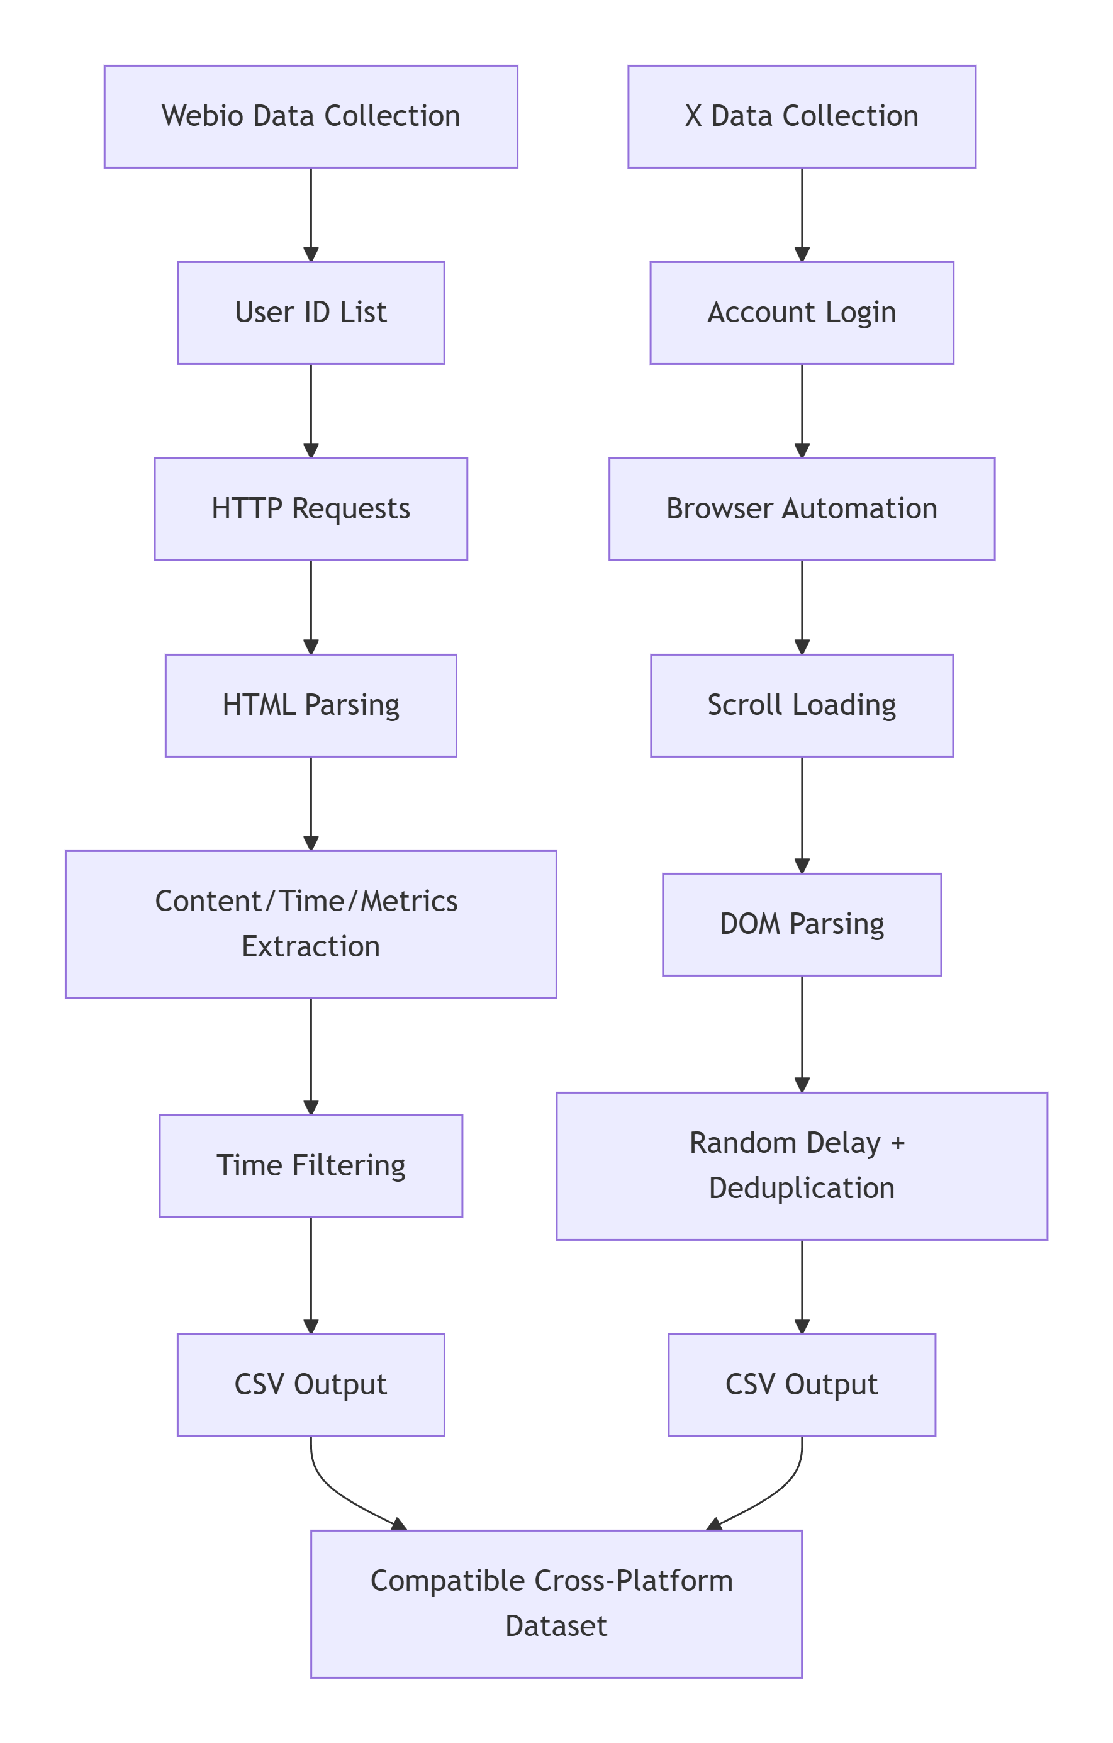
Methodology
Data Collection: Post & Survey
Quantitative Analysis
Data Process
Integration
Notes:
To answer these questions, we employed a sequential explanatory mixed methods design.
The first phase was a large-scale quantitative analysis,
using custom build ethical web scrapers.

Slide 6
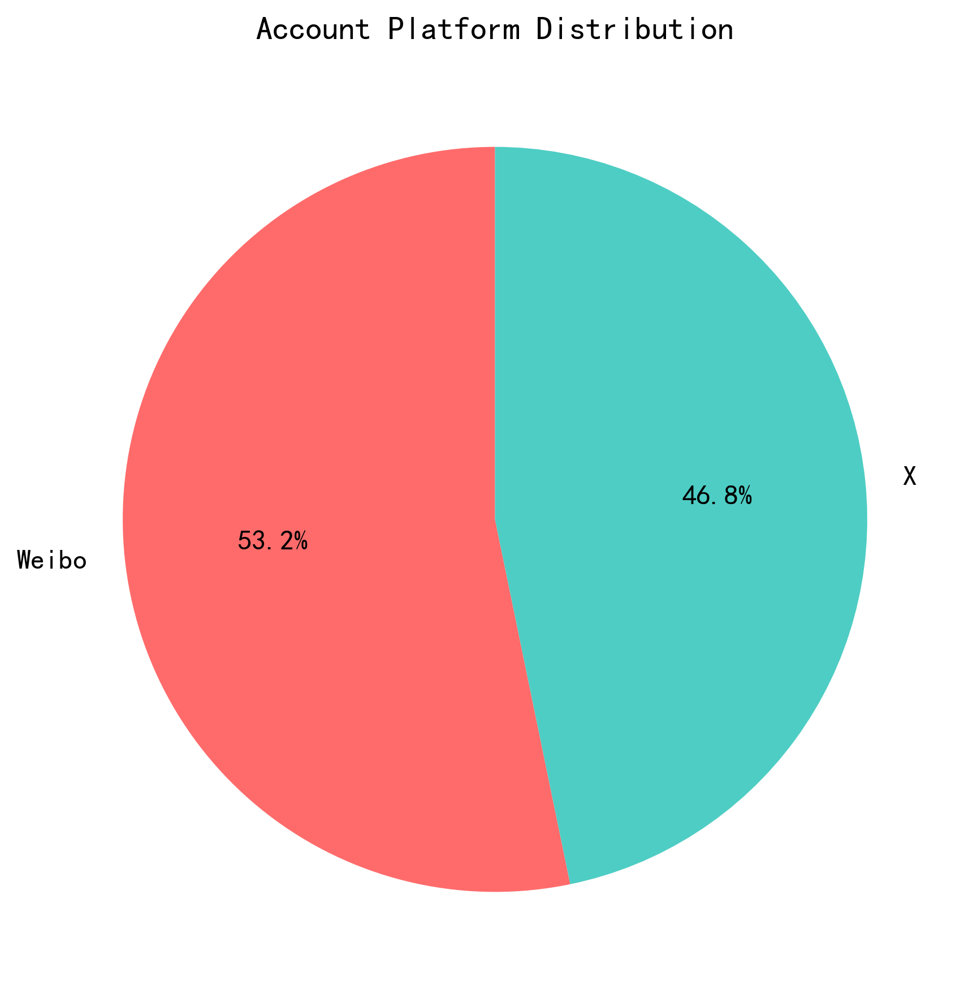
Methodology
Data Collection: Post & Survey
Data Process
Quantitative Analysis
Integration
Notes:
I collected a full year for data from 189 Weibo, and 166 X verified corporate accounts,
across 9 industries.
They are Technology/Internet, E-commerce/Retail, Automotive, Gaming, FMCG/Food & Beverage, Catering/Restaurants, Finance/Payment, Entertainment/Film & TV, and Fashion/Beauty.
The result is a robust data set of over three hundred and forty thousand posts, where Weibo has approximately two hundred and nighty-three thousand posts,
and X has about forty-three thousand and five hundred posts.

Slide 7
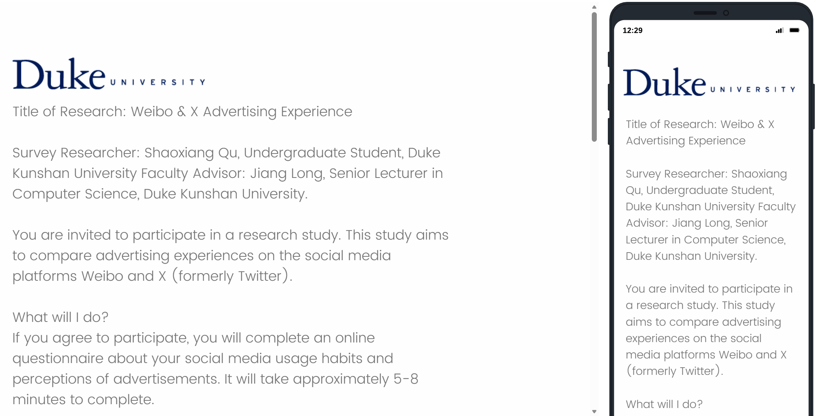
Methodology
Data Collection: Post & Survey
Data Process
Quantitative Analysis
Integration
Notes:
The second phase was a quantitative user experience analysis.
I designed and administrated a bilingual survey and deployed among DKU faculty and students.
The particular participant selection is due to the unique advantage of DKU faculty and students that,
it is more possible that they have used both platforms.
The survey got 98 active users’ respond,
and gives me the opportunity to directly link their perceptions,
to the corporate accounts’ posting behavior we measured.

Slide 8
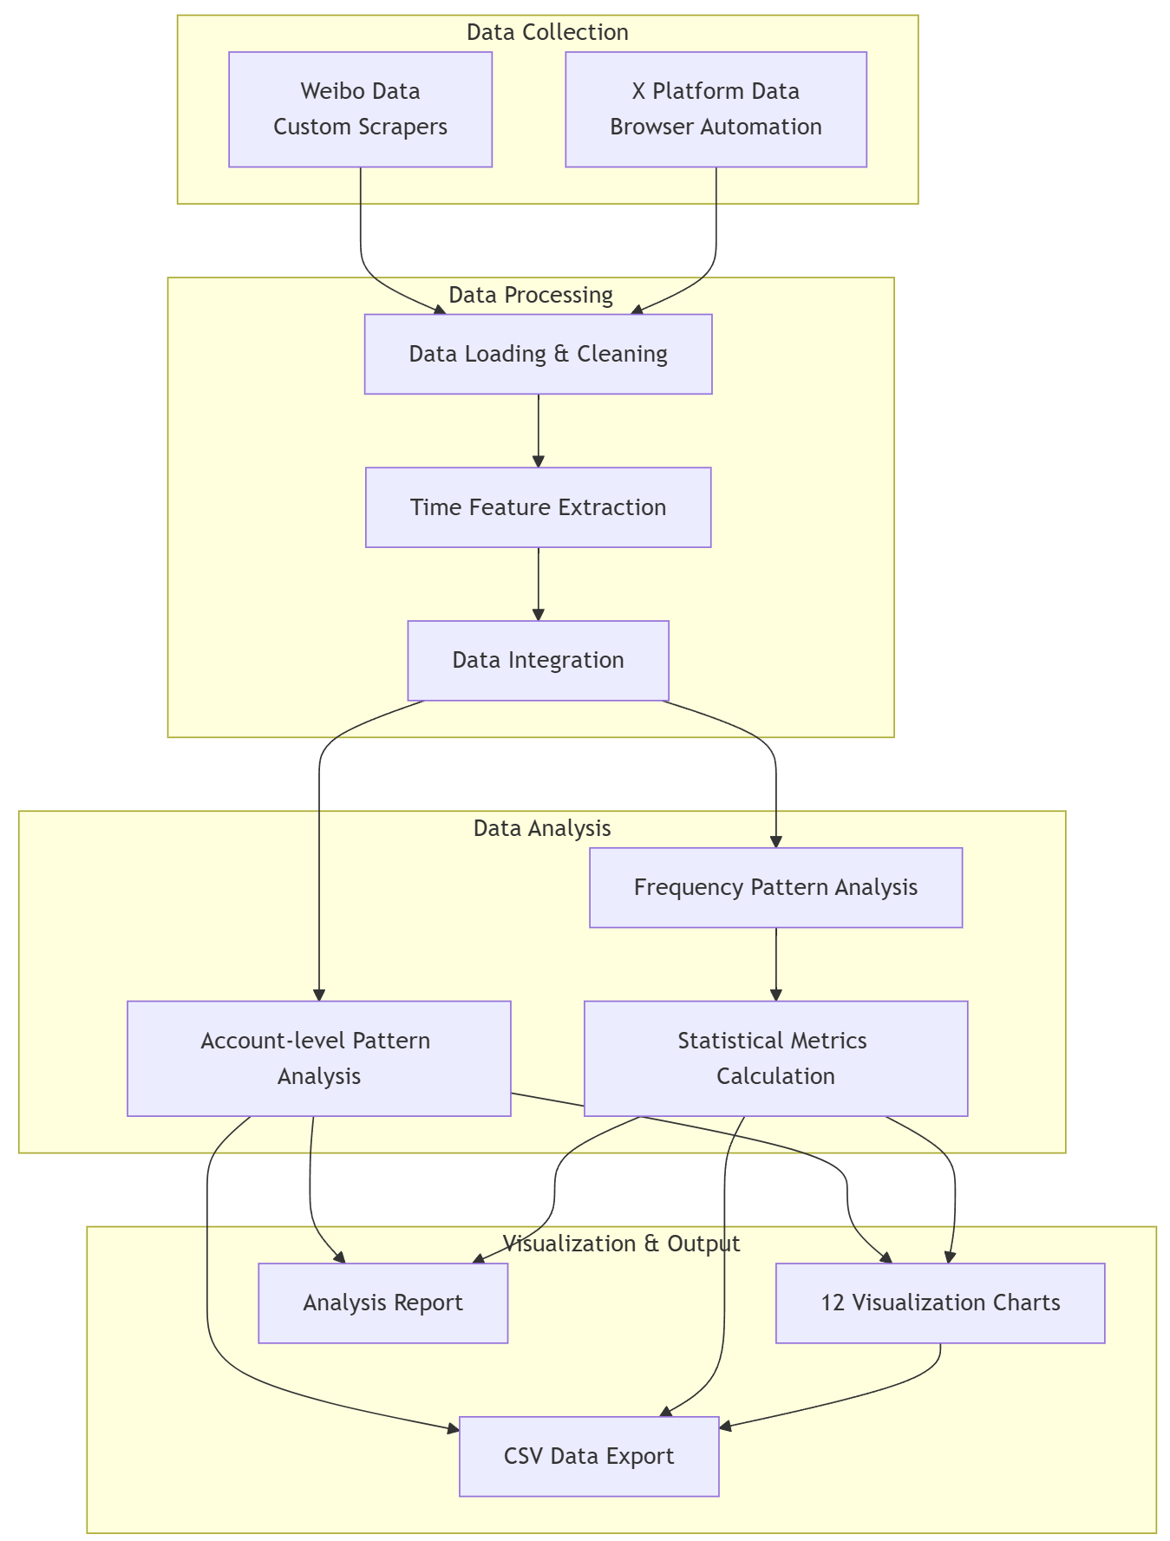
Methodology
Data Collection: Post & Survey
Data Process
Quantitative Analysis
Integration
Notes:
Then, I performed data process, which include data cleaning, time feature extraction, and data integration to directly compare them.
Data analysis happens after that, along with creating visualization charts and data reports.
The final part is integration analysis of the charts and the reports.

Slide 9
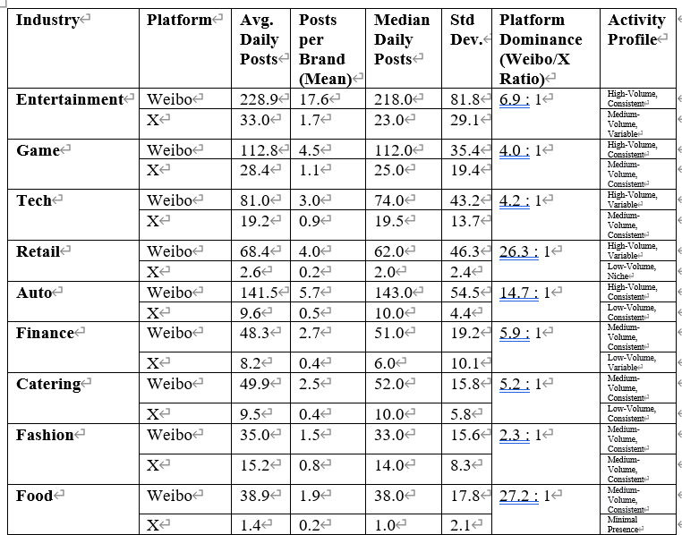
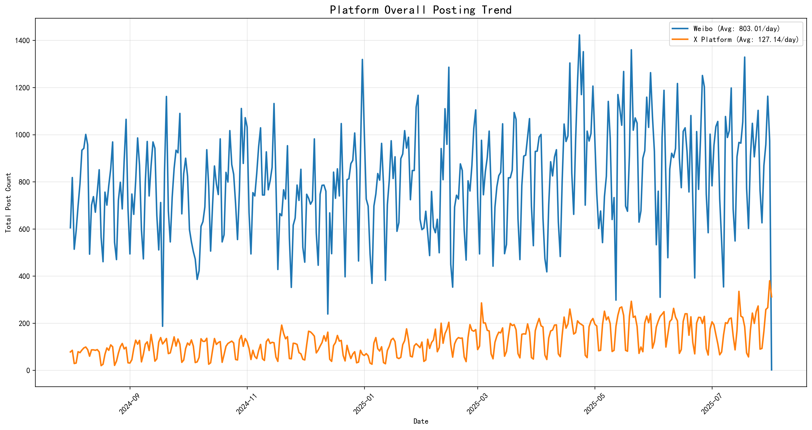
Data Analysis
Notes:
The findings revolved 2 fundamentally different digital ecosystems.
Weibo has a high velocity, event driven model,
with an average of 803 posts per day, which is over 6 times the volume on X.

Slide 10
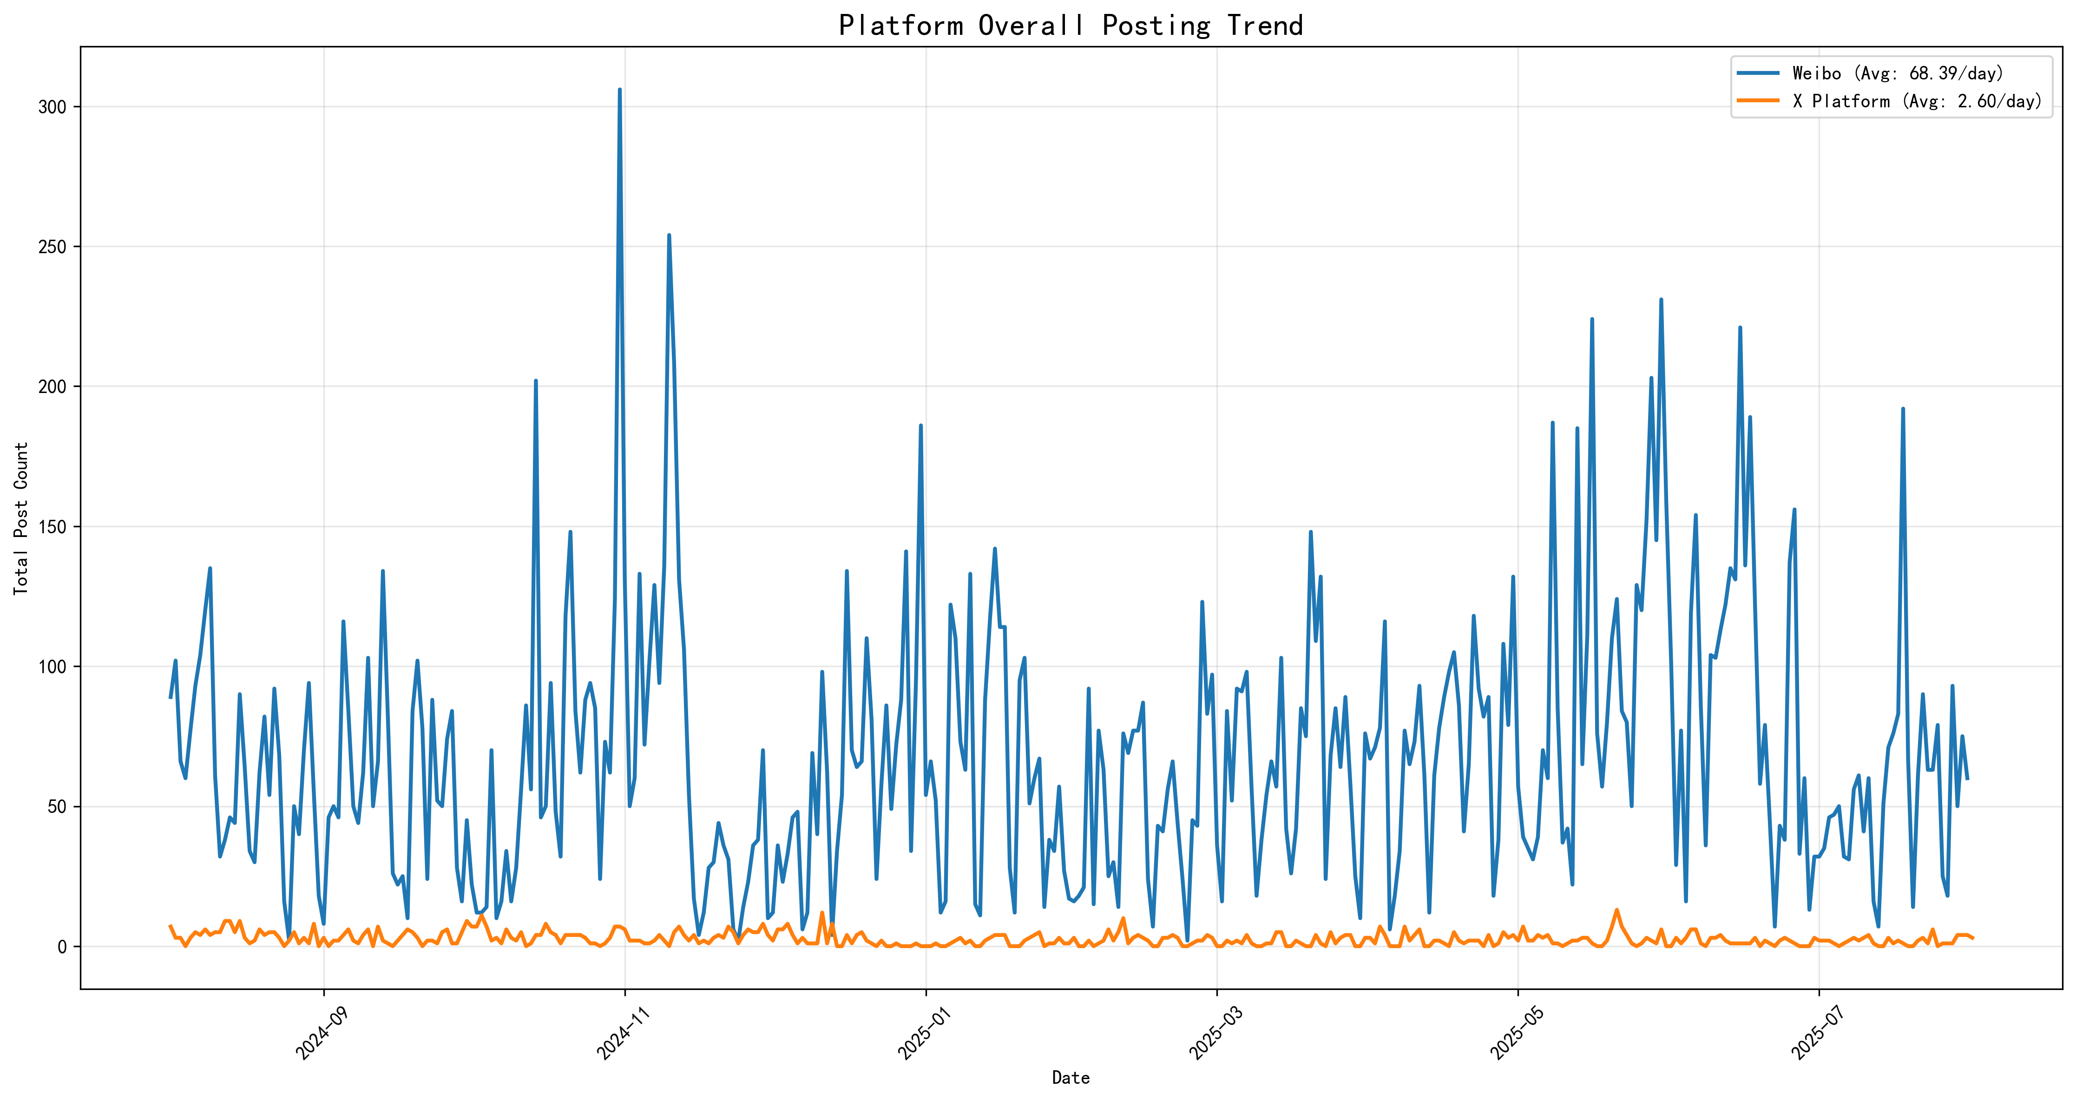
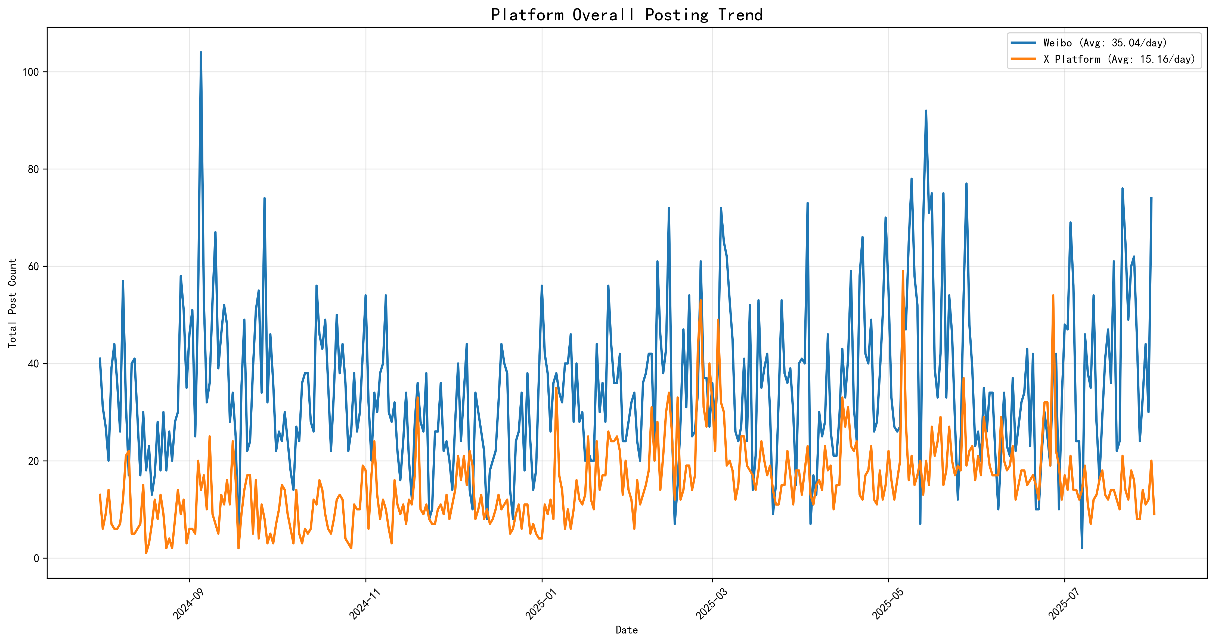
Data Analysis
E-commerce / Retail
Fashion & Beauty
Notes:
And during certain period,
for example, Single’s Day, a commercial festival in China, around November,
or homecoming season around September,
some industries like retail and fashion would have an extreme increase of posting volumes,
as you can see from the graphs.
So, from left to right, it’s August 2024 to August 2025.

Slide 11
Data Analysis
Notes:
The disparity of posting volume is most extreme in sectors like E-commerce / Retail and Food.
Which show about 26 to 27 to 1 preference for Weibo.
This finding, along with the result from the survey, leads us to a core discovery of the study,
the perception volume paradox.

Slide 12
Perception-Volume Paradox
Notes:
While Weibo’s high volume of posts makes ads as more noticeable.
It also correlates with significantly more negative user sentiment.
41 percent of Weibo users report in nectar attitudes,
compared to only 27 percent on X
Simply put, higher exposure does not equal to higher acceptance.

Slide 13
Conclusion
Platforms
Smarter algorithms
Different strategy
Advertisers
Dynamic & Vibrant
Notes:
So, what does this paradox tells us For platforms like Weibo.
The goal isn't necessary to reduce volume,
but to develop smarter algorithms, and reduce user fatigue during high intensity events
For global brands, this is an alert that they may shouldn’t use the same strategy across different social media platforms.
A high frequency, always on approach is needed for Weibo,
while a quality over quantity strategy is more effective on x.
And for advertisers, our survey shows that dynamic videos and vibrant videos are most effective sensory elements.
The key is investing in creative quality, not just inflationary quantity.

Slide 14
Limitations
Limited survey participants
98 survey participants
Limited posting data
Weibo : 189 accounts
X : 166 accounts
Notes:
Then, here are some limitations of my study.
The user survey has a relatively small sample size, while providing valuable qualitative insights,
still makes it hard to generalize this perceptual findings, to broader platform populations.
Additionally, the analysis of corporate posting behavior was based on a set of 355 verified accounts across nine sectors.
While this sample represents key industries and maintains methodological consistency,
it does not encompass the entirety of corporate communication on these platforms.

Slide 15
Future Directions
In-depth Content and Sentiment Analysis
Multimodal Content Integration
Expanded Scope and Generalizability
Investigation of Algorithmic Mechanisms
Notes:
And to build upon this study, future work could include the following methods:
First, employ a in-depth Content and Sentiment Analysis, using Natural Language Processing tools.
Second, analyze images and videos, within posts, to investigate how visual elements,
combined with text, shape user engagement, and advertising perception.
Third, broaden the research to include a more diverse set, of social media platforms,
while collect more posting data, and user feeling data to generalize the current findings.
Finally, explore how platform recommendation algorithms modulate the visibility of corporate content,
and subsequently shape user perception and behavior,
potentially through user studies.

Slide 16
About SW Journey
Notes:
This Signature Work project has profoundly shaped my academic and professional trajectory
And prepared me for the realities of data science work, beyond academia.
And the skills I've honed, technical adaptability, methodological creativity, and contextual interpretation
will continue to guide me, to approach to complex problems,
long after I graduate from DKU

Slide 17
Thanks for watching Shaoxiang Qu Acknowledgements: Mentor: Jiang Long, Survey Participants.
Notes:
And this is the end of my presentation,
I’d like to thank my mentor Long Jiang for all his assistance,
and all the survey participants.
Thank you for listening.

