Slide 1
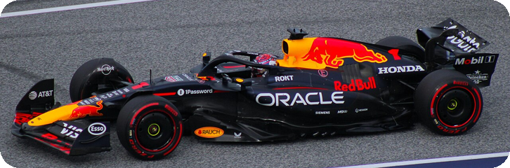


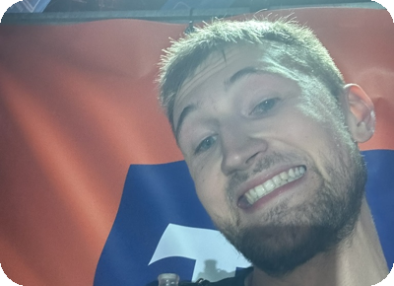
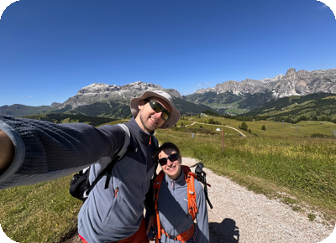
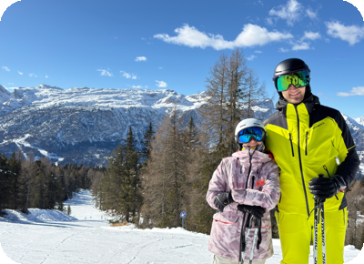
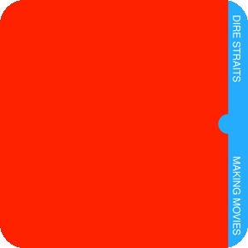
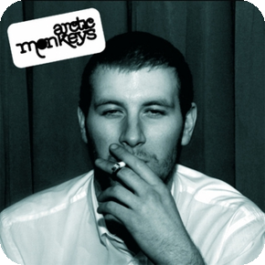
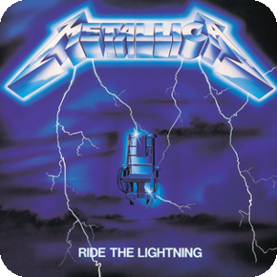
Hi, I'm Mikołaj
22 · maths person · AI student · AI Engineer
ORIGIN
WORK
FORMULA 1
FROM
Strzelin
LIVE IN
Wrocław
HIGH SCHOOL AT WUST
Academic School · 2022
STUDY
AI · 5th year · WUST
AI Engineer
working since August 2025
Accenture → Connells Group
UK property services · HQ: Milton Keynes · remote
Red Bull Racing
fan since 2022 · HQ: Milton Keynes
HOBBIES
MUSIC
+ computer games · guitar
Running
Night Half Marathon · < 2 h
Hiking
Tatras · Sudetes · Dolomites
Skiing
Alta Badia, Italy
Dire Straits
London · Mum
Arctic Monkeys
Sheffield · me
Metallica
USA, not UK! · Dad

