Slide 1

PROJEKT PRI PREDMETU ISKANJE IN EKSTRAKCIJA PODATKOV S SPLETA: VoLIBOLI
Teodor Janez Podobnik
Ljubljana
24.5.2023

Slide 2

Agenda
Problem Description
Proposed Solution
WebScraper Component
PDFScraper Component
GraphQL (vs. REST)
Backend & Frontend
Infrastructure

Slide 3
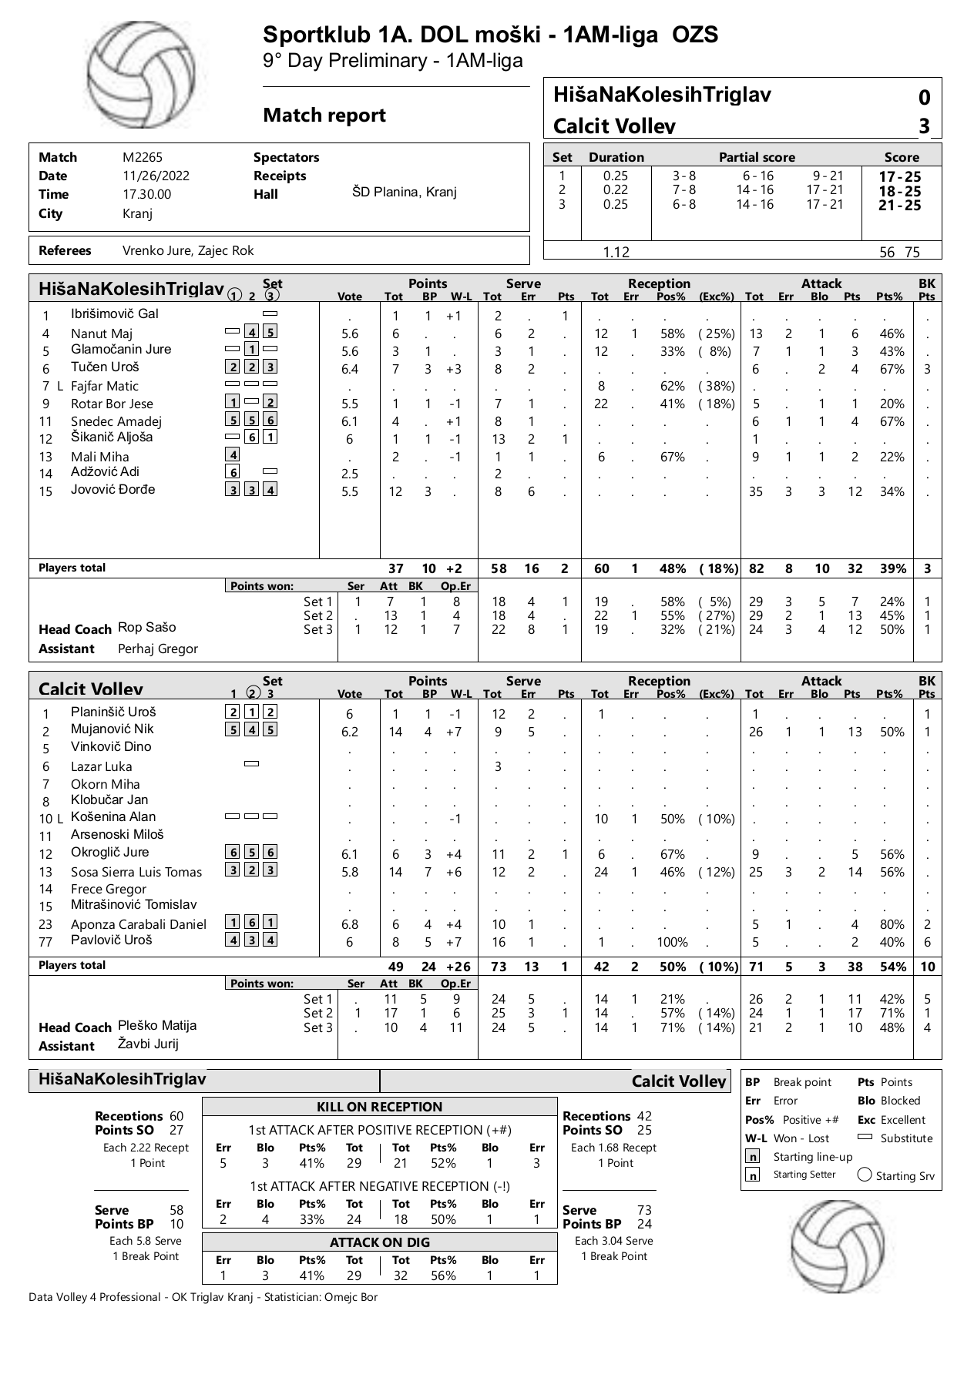
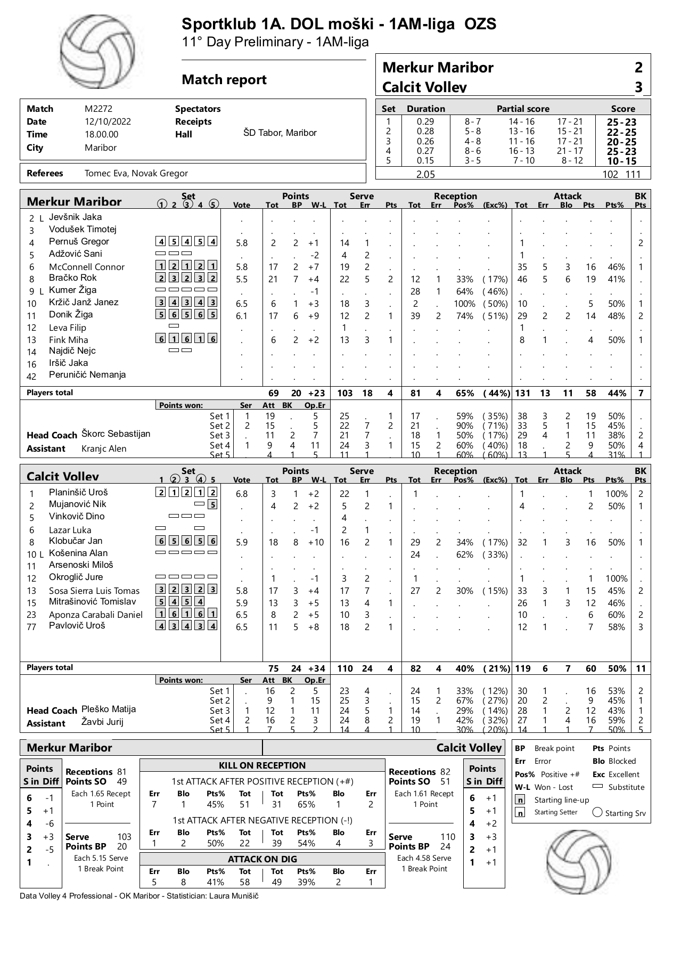
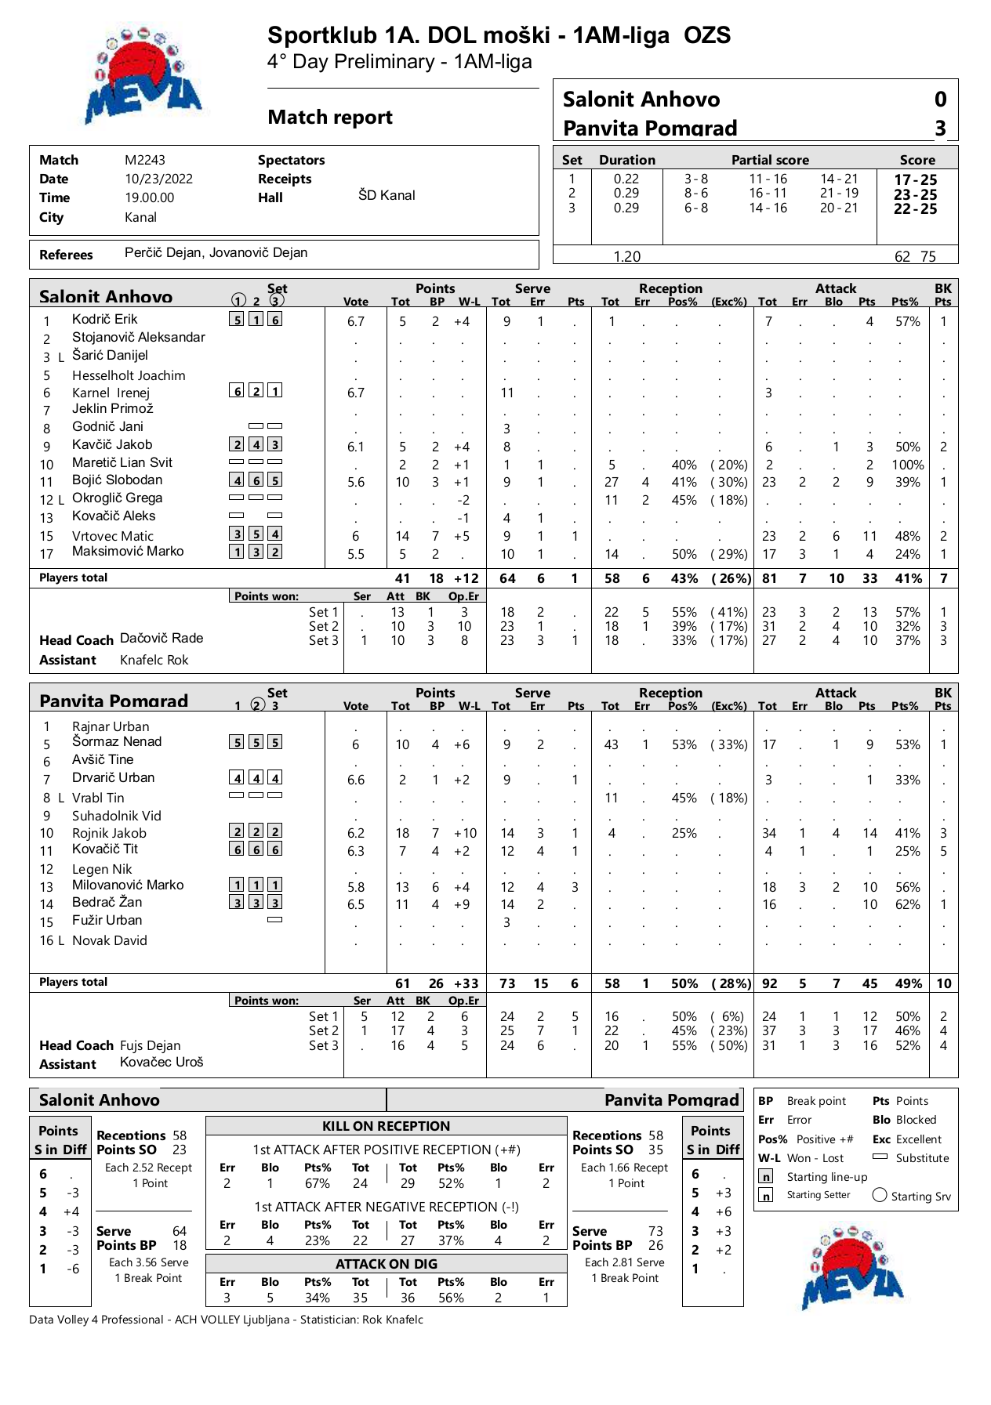
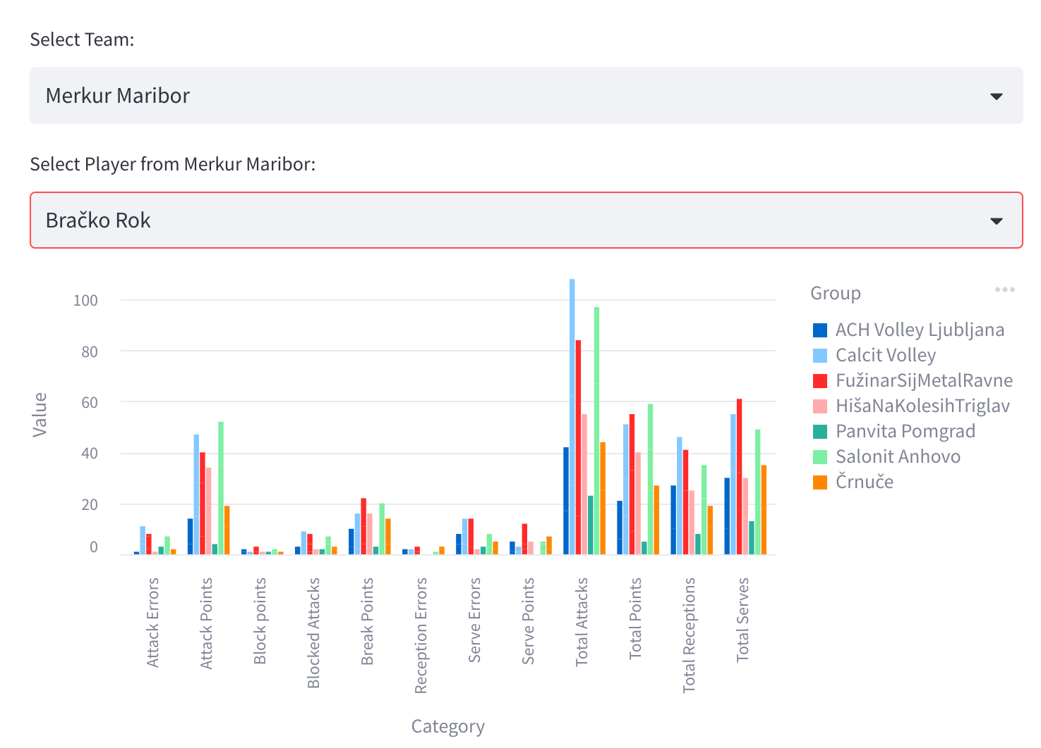
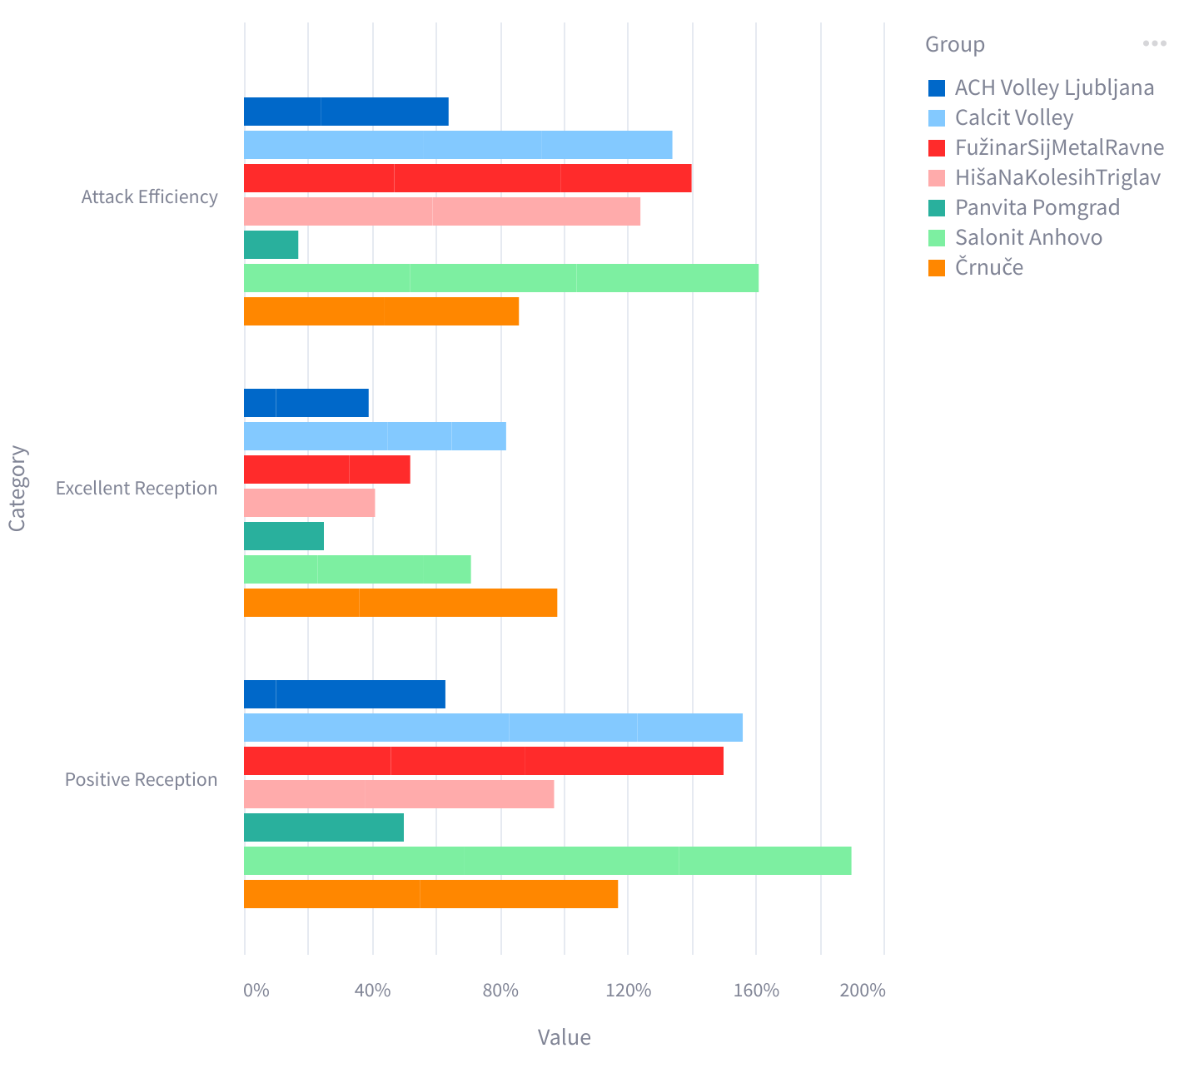
Problem Description
Complex/Dense structure
Numbers vs. Graph
Interactivity
Customizability

Slide 4
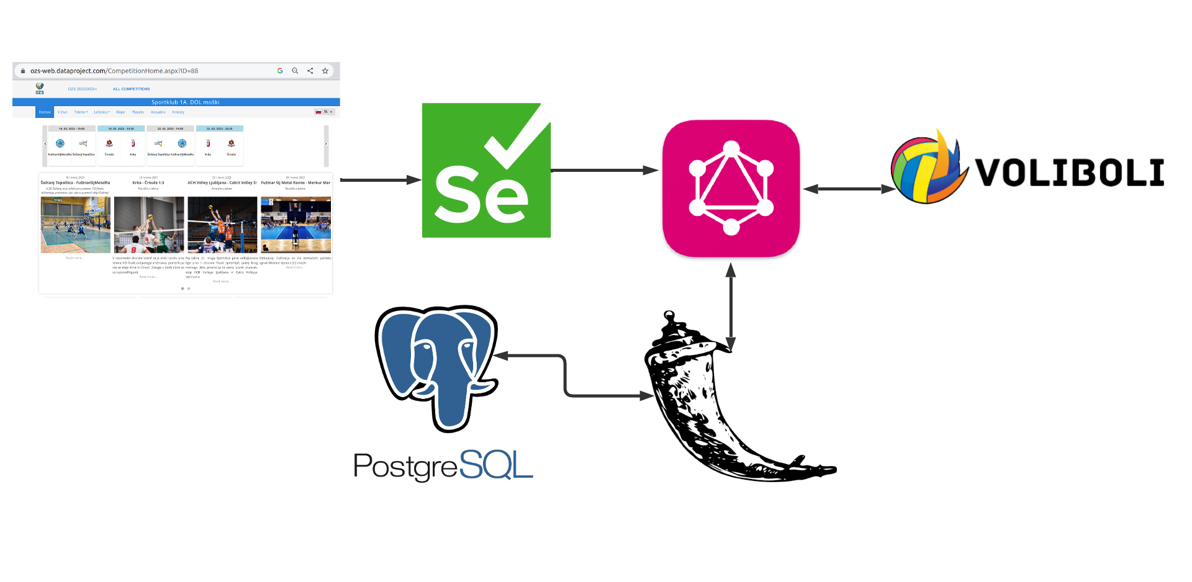
Proposed Solution
Automate Data Search and Extraction
Store and Aggregate data
Interactive UI

Slide 5
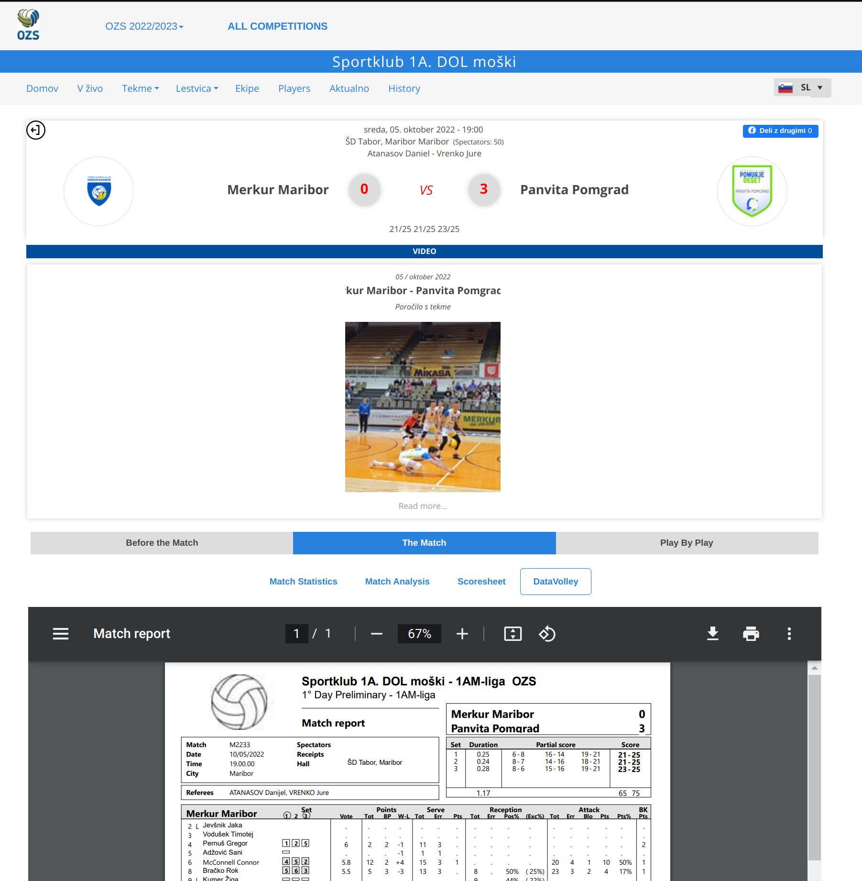
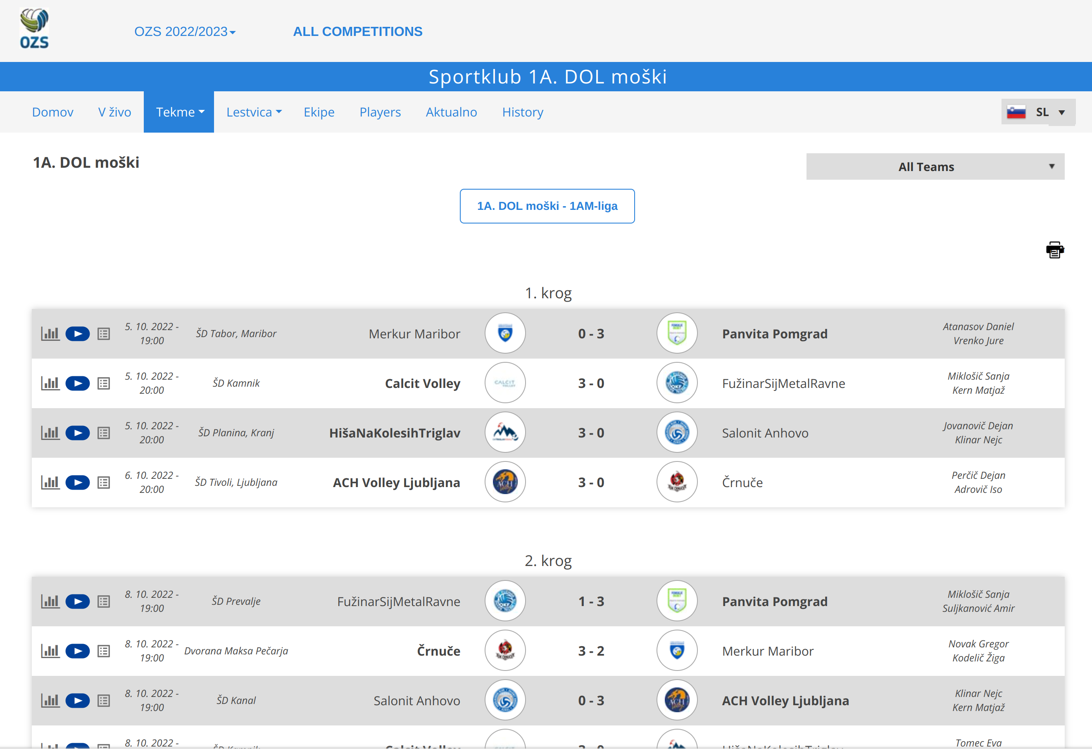
WebScraper Component
Selenium
Xpath
Retry Mechanism
Hash trick

Slide 6
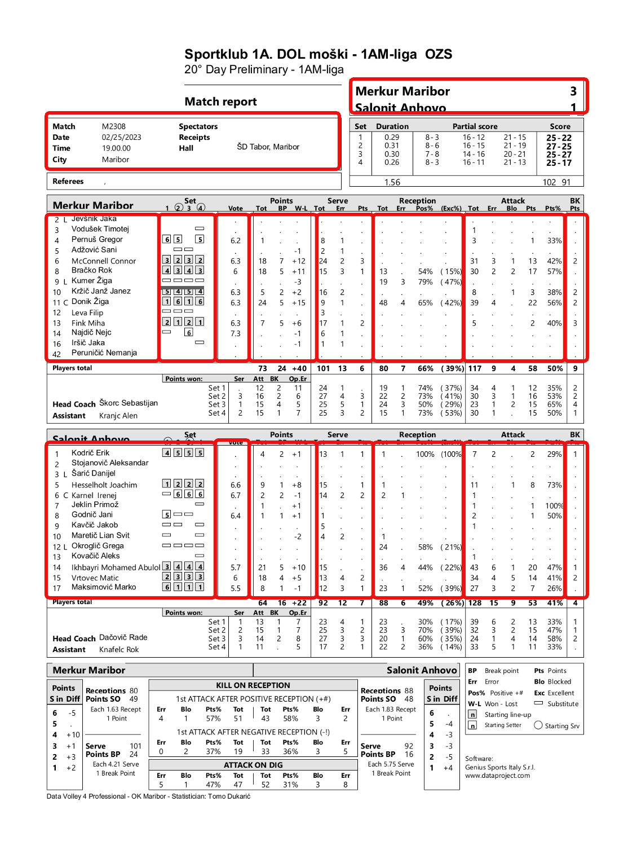
PDFScraper Component
File to Database
Tabula-py
Fixed structure
Column vs. Row parsing
Multiprocessing

Slide 7
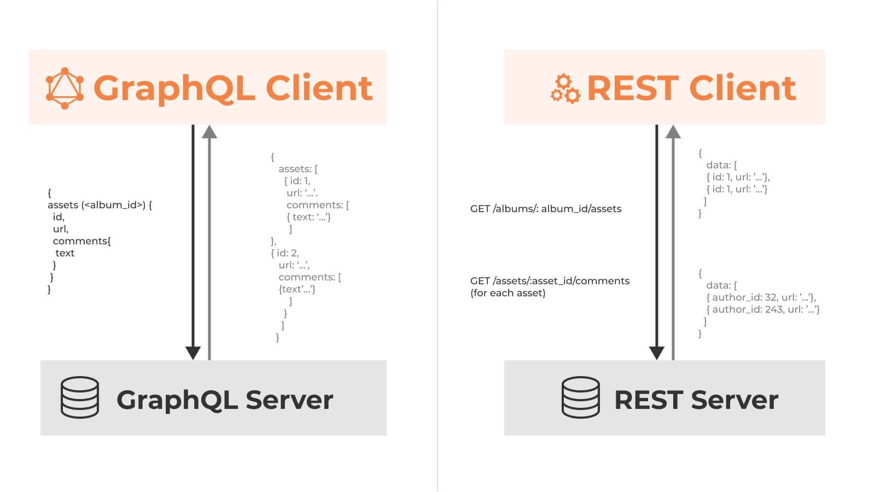
GraphQL (vs. REST)
Ariadne
Complexity & Flexibility
Network traffic

Slide 8
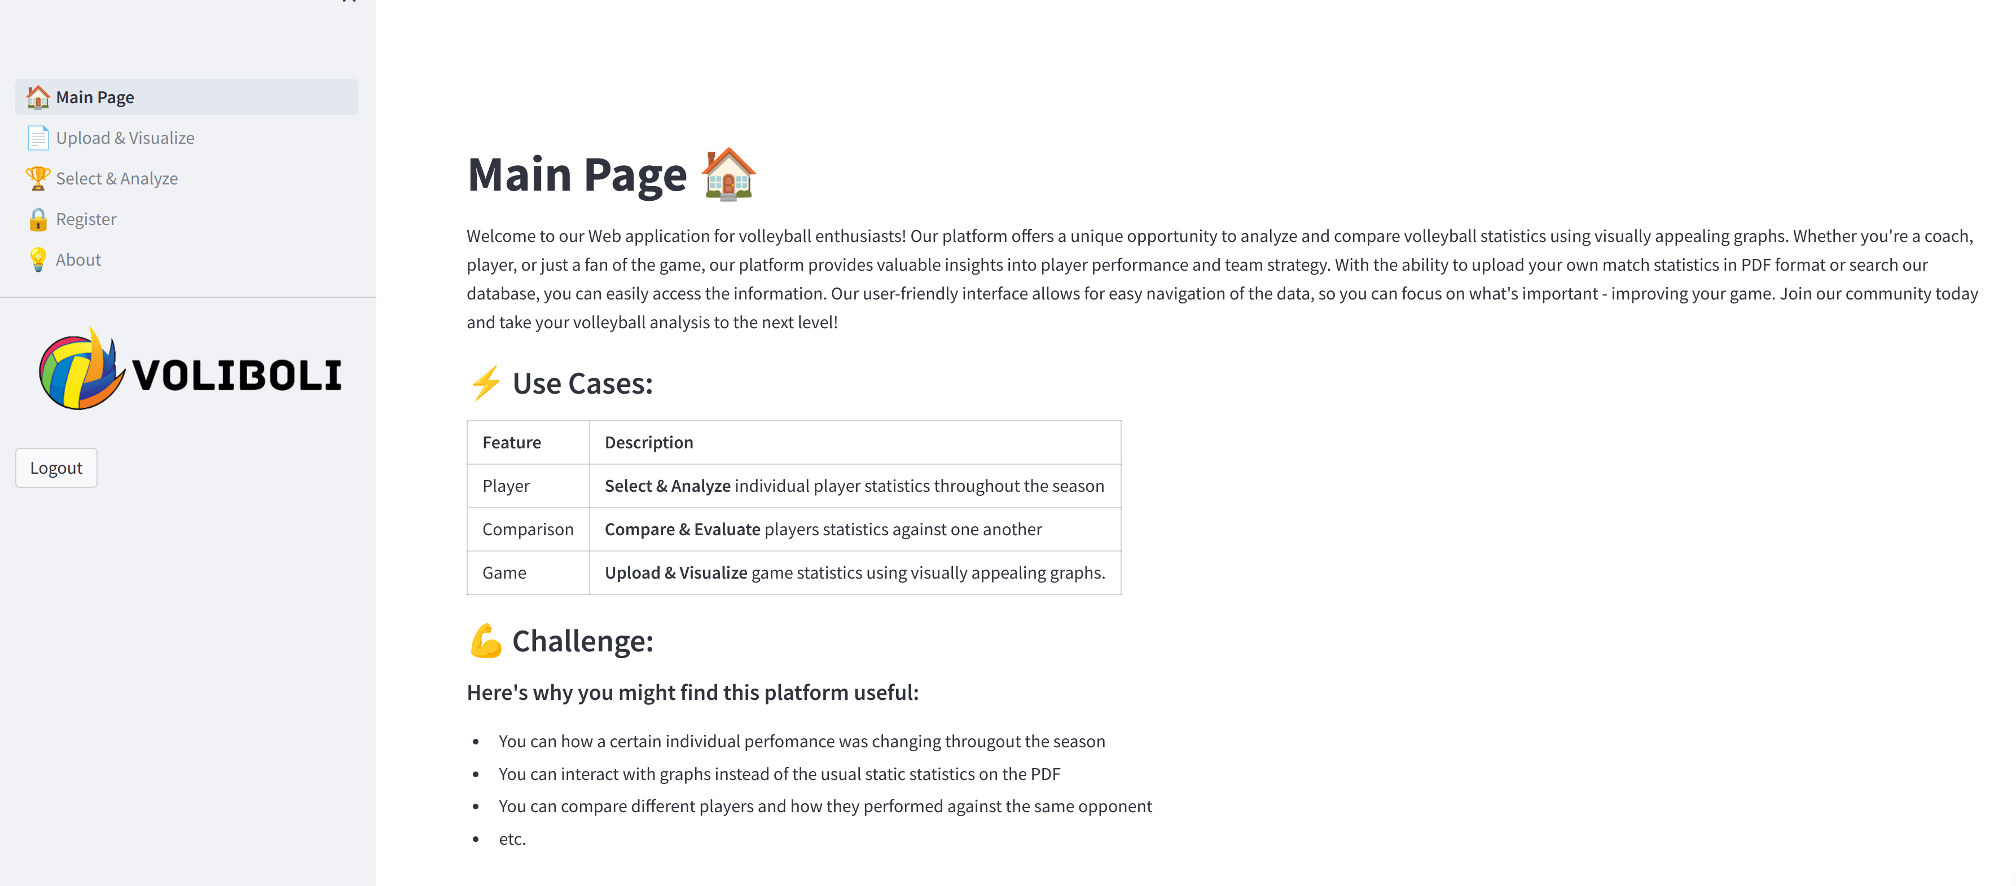
Backend & Frontend
Flask + PostgresQL (ORM)
Streamlit
https://voliboli.lrk.si/

Slide 9
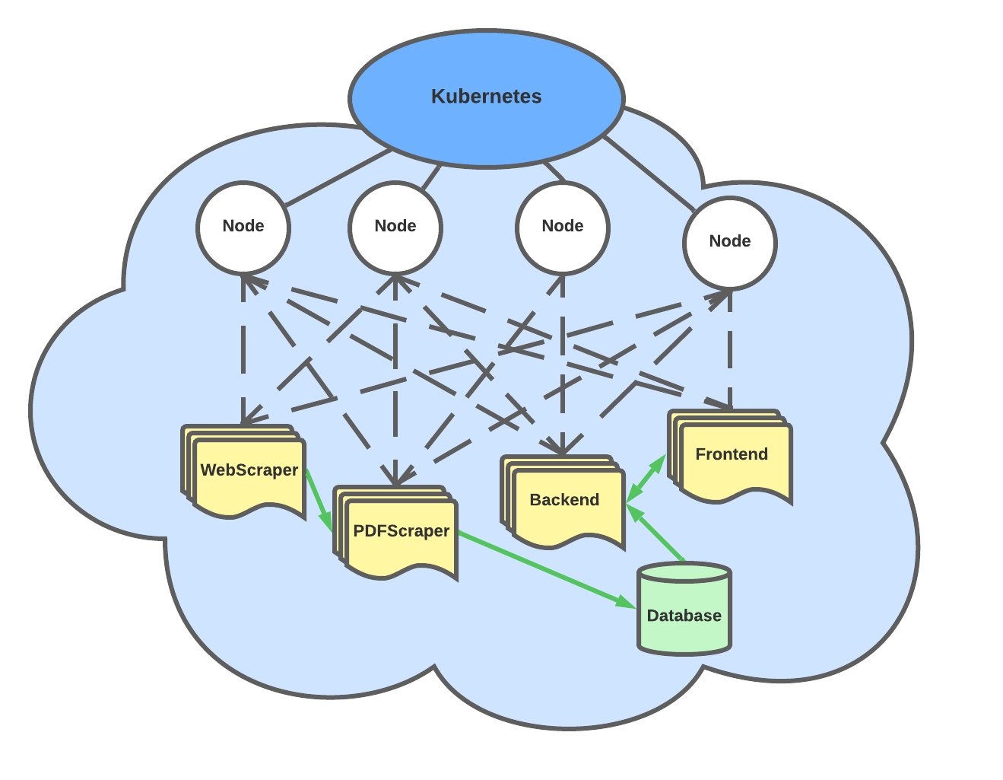

Infrastructure
Kubernetes (MicroK8s)
CronJob – 00:00 Wednesday, Saturday
Persistent Database

