Slide 1

Agenda:
10 slides
2 notebooks
Presenter:
Volkov Dmitry

Slide 2
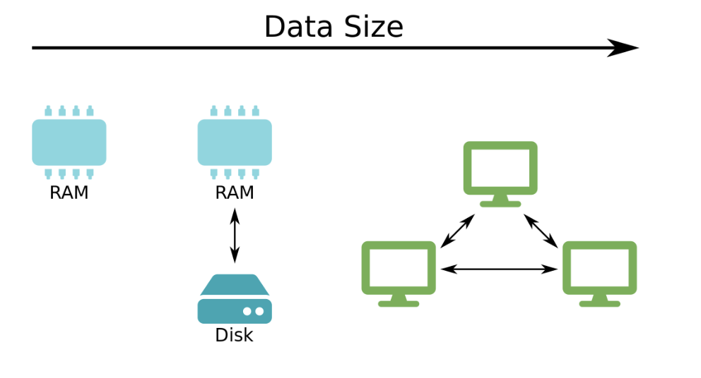
Data exceeds RAM
Data exceeds RAM
The computer will start to use *virtual memory* and data will be *paged* back and forth between RAM and disk. Relative to RAM access, retrieving data from disk is slow. As the size of the data grows, paging becomes more intense and the computer begins to spend more and more time waiting for data. Performance plummets.
1 GB – pandas
10 GB – pandas + better computer
100 GB - ???
1000 GB - ???
1
Notes:
Data in RAM
The performance of a Machine Learning model depends on data. In general, more data is a good thing. If an algorithm is able to train on a larger set of data, then its ability to generalize to new data will inevitably improve. However, there are some practical constraints. If the data can fit entirely into RAM then the algorithm can operate efficiently. What happens when those data no longer fit into memory?
Data exceeds RAM
The computer will start to use *virtual memory* and data will be *paged* back and forth between RAM and disk. Relative to RAM access, retrieving data from disk is slow. As the size of the data grows, paging becomes more intense and the computer begins to spend more and more time waiting for data. Performance plummets.
Data distributed across a cluster
How then do we deal with truly large datasets? One option is to distribute the problem across multiple computers in a cluster. Rather than trying to handle a large dataset on a single machine, it's divided up into partitions which are processed separately. Ideally each data partition can fit into RAM on a single computer in the cluster. This is the approach used by Spark.

Slide 3



History of Apache Spark
2004 MapReduce publication from Google [1]
2006 Doug Cutting developed Hadoop with Yahoo!
2008 Hadoop became a top-level Apache project. MapReduce paradigm integrated into Hadoop.
Hadoop had some problems:
Not the fastest solution
Low-level API
2009 First implementation of Spark by Berkeley PhD Matei Zaharia
2013 Spark become an open-source project [2]
https://doi.org/10.1145/1327452.1327492
https://github.com/apache/spark
2

Slide 4






What is Spark?
powered-by Spark
Spark is a general purpose framework for cluster computing. It is popular for two main reasons:
Generally much faster than other Big Data technologies like Hadoop, because it does most processing in memory
It has a developer-friendly interface which hides much of the complexity of distributed computing.
3
HH.ru experiment
Notes:
What is Spark?

Slide 5
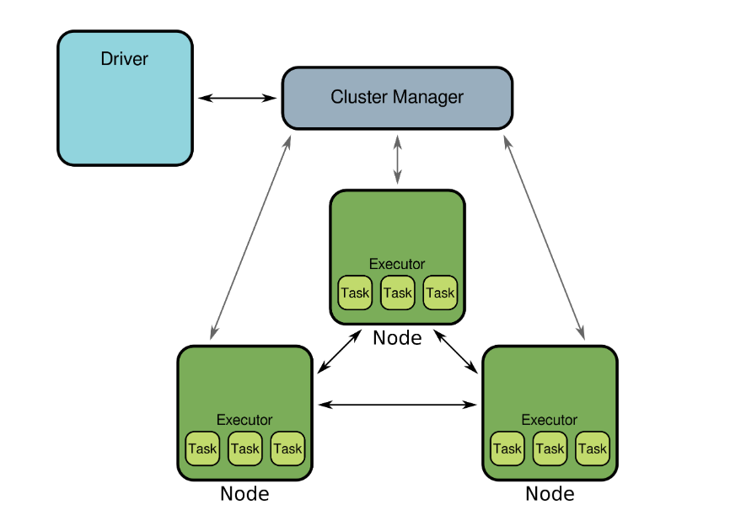
Spark Architecture
Driver
Every application running on the Spark cluster has a driver program. Using the Spark API, the driver communicates with the cluster manager, which in turn distributes work to the nodes.
Cluster manager
A cluster manager allocates resources and coordinates activity across the cluster.
Nodes
The cluster itself consists of one or more nodes. Each node is a computer with CPU, RAM and physical storage.
Executors
On each node Spark launches an executor process which persists for the duration of the application. Work is divided up into tasks, which are simply units of computation. The executors run tasks in multiple threads across the cores in a node.
Apache Spark works in a master-slave architecture where the master is called “Driver” and slaves are called “Workers”.
4

Slide 6
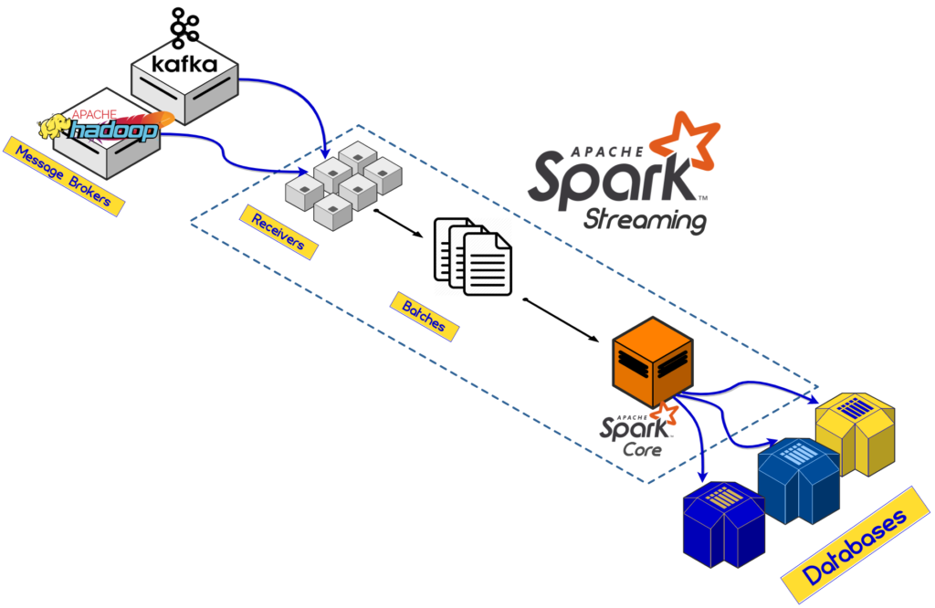
Spark Eco System
Apache Spark
Spark SQL
Spark Streaming
MLlib
(Machine Learning)
GraphX
(Graph Computaion)
5

Slide 7


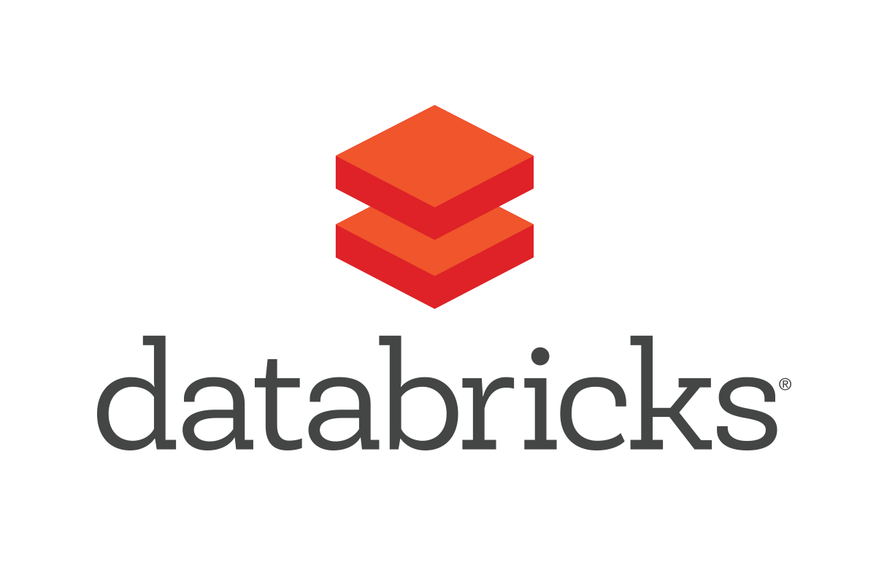



Spark Integrations
5

Slide 8





Core Spark API
6

Slide 9

What is PySpark?
PySpark is a Spark library written in Python to run Python application using Apache Spark capabilities, using PySpark we can run applications parallelly on the distributed cluster (multiple nodes).
7

Slide 10
Practice Time!

