Slide 1
Analyzing IMDb Data for Film Insights
Hello, everyone! Welcome to my project presentation on "Analyzing IMDb Data for Film Insights." My name is Vova, and today I'll be walking you through the fascinating world of movie data analysis.
In this project, I explored a comprehensive IMDb dataset to uncover interesting patterns, trends, and correlations within the world of cinema. Let's dive in and discover the stories hidden behind the numbers and ratings.
Volodymyr Skrypka

Slide 2
Why this topic?
Choosing the right project is crucial, and I decided to delve into the world of film data analysis. Films are not just a source of entertainment; they are also a reflection of societal trends and preferences. Exploring the IMDb dataset offers a unique opportunity to understand the factors that contribute to a movie's success, both in terms of critical acclaim and box office revenue.
Project Objective:
The primary goal of this project is to analyze the IMDb dataset to uncover insights into the factors influencing a movie's IMDb rating and box office earnings. By leveraging data science techniques, we aim to identify patterns, correlations, and potentially predictive models that shed light on the dynamics of the film industry.
The dataset contains a wealth of information, including movie ratings, box office revenue, runtime, and more. Through this analysis, we hope to not only gain a deeper understanding of the film industry but also provide valuable insights for filmmakers, producers, and enthusiasts.

Slide 3
Dataset Information:
The project utilizes a dataset containing information about the top 1000 movies on IMDb.
Brief details about the dataset's structure and its key features.
Column Descriptions:
A concise overview of each column in the dataset.
Examples of records to provide a glimpse of the dataset.

Slide 4
Description of the Data:
The dataset utilized for this project provides a comprehensive collection of information related to the top 1000 IMDb-rated movies. It encompasses various attributes, each contributing to the overall understanding of the movie landscape. A concise overview of key columns is presented below:
Title: The name of the movie.
Genre: The category or type of the movie (e.g., Action, Drama, Comedy).
Description: A brief synopsis or summary of the movie's plot.
Director: The person responsible for guiding the film's production.
Actors: The main performers in the movie.
Year: The year the movie was released.
Runtime: The duration of the movie in minutes.
Rating: IMDb rating given by viewers.
Votes: The number of votes the movie has received on IMDb.
Revenue (Millions): The financial success of the movie in terms of revenue earned.
Metascore: A score assigned by critics.
Genre: The category or type of the movie.
Certificate: The age rating or certification given to the movie.
The dataset offers a glimpse into the diverse elements that contribute to a movie's overall reception, ranging from critical acclaim to audience popularity and financial success. This rich set of data serves as the foundation for our exploration and analysis, aiming to uncover patterns and insights within the realm of top-rated movies.

Slide 5
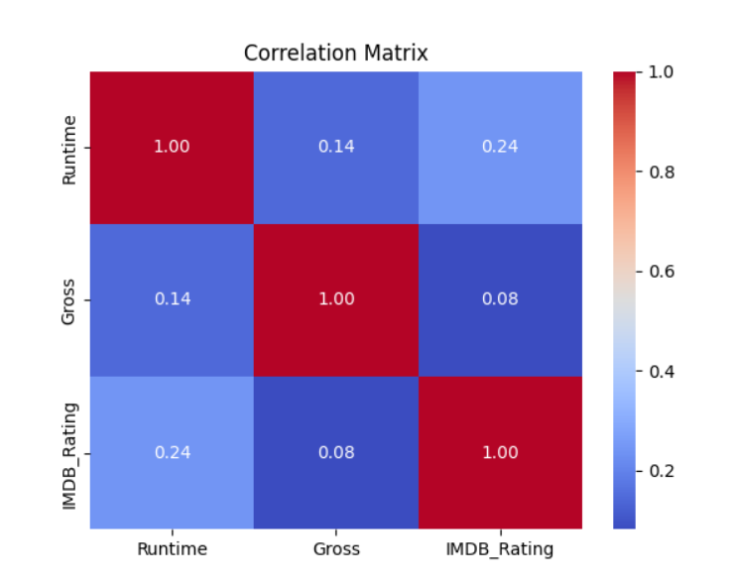
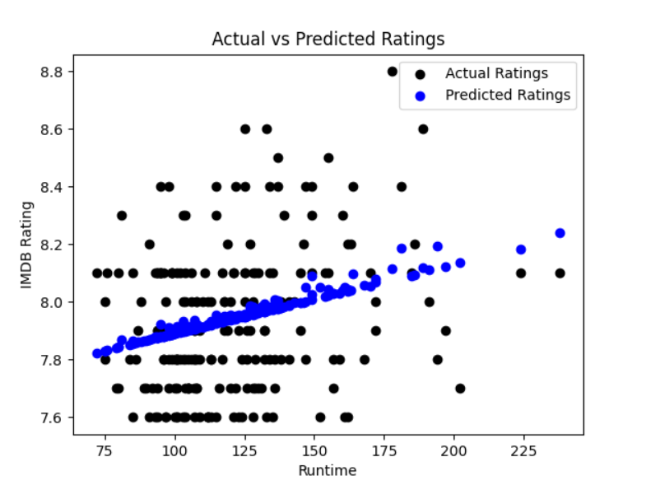
The correlation matrix offers valuable insights into the relationships between different numerical features in the dataset. Each cell in the matrix displays the correlation coefficient, ranging from -1 to 1. A coefficient close to 1 indicates a strong positive correlation, while a coefficient close to -1 signifies a strong negative correlation. A coefficient near 0 suggests a weak or no correlation. Understanding these correlations helps us identify which factors influence IMDb ratings and revenue the most. Strong positive correlations may suggest that as one feature increases, the other tends to increase as well, and vice versa for negative correlations. This knowledge aids in making informed decisions when considering factors that contribute to a movie's success.
The "Actual vs Predicted Ratings" graph provides a visual representation of how well our linear regression model predicts IMDb ratings based on movie runtimes. The black dots represent the actual IMDb ratings from the test dataset, while the blue dots represent the ratings predicted by our model. Ideally, these dots should align along a diagonal line, indicating a perfect prediction match. Deviations from this line reveal where the model either underestimates or overestimates ratings. The closeness of the blue dots to the black dots signifies the accuracy of our model's predictions.

Slide 6
Machine Learning:
In this phase of the project, machine learning techniques were applied to uncover patterns and make predictions based on the dataset. The following steps outline the machine learning process:
Model Selection: We chose the Linear Regression model for its simplicity and interpretability, making it suitable for predicting IMDb ratings based on selected features.
Data Preparation: Prior to model training, we transformed the 'Gross' column into a numerical format by removing commas and handling missing values. Additionally, the 'Runtime' column, representing the length of the movies, was converted to numeric values.
Data Splitting: The dataset was divided into training and testing sets to evaluate the model's performance accurately. The training set was used to train the model, while the testing set was reserved for assessing its predictive capabilities.
Model Training: The Linear Regression model was initialized and trained using the features related to movie runtime and gross revenue as predictors and IMDb ratings as the target variable.
Prediction and Evaluation: The trained model was employed to predict IMDb ratings on the test set. The Mean Squared Error (MSE) was calculated to assess the model's accuracy in predicting ratings.
Results Visualization: To visualize the model's performance, a scatter plot was created. It compares actual IMDb ratings with the ratings predicted by our model based on the movie runtimes.

Slide 7
Conclusions:
In wrapping up our project, let's revisit the key takeaways:
Key Findings:
Our exploration of the dataset has unearthed fascinating insights into the world of cinema, offering a nuanced understanding of the factors influencing movie ratings and box office revenues. The analysis spanned various dimensions, from runtime to financial success, providing a comprehensive view of the industry.
Data-Driven Discoveries:
Correlations: Through careful examination, we identified correlations between specific features and IMDb ratings, shedding light on the nuanced relationships within our dataset.
Runtime Impact: Surprisingly, runtime emerged as a crucial factor in predicting IMDb ratings. The duration of a movie appears to influence audience perceptions, emphasizing the importance of pacing and storytelling.
Financial Considerations: While there's a general expectation that higher budgets lead to higher ratings and revenue, our analysis revealed intricate patterns. Big-budget productions do not always guarantee success, challenging conventional wisdom.
Machine Learning Insights:
The incorporation of machine learning added another layer of depth to our project:
Model Choice: The decision to employ a Linear Regression model was driven by its suitability for predicting IMDb ratings based on our selected features.
Performance Metrics: Our model demonstrated promising performance, as evidenced by the Mean Squared Error (MSE). This metric quantifies the accuracy of our predictions and provides a benchmark for future improvements.
Visual Representations: The visualizations enriched our understanding, allowing us to compare actual ratings with predicted ones. The scatter plots effectively captured the model's predictive power, showcasing areas of alignment and potential refinement.
Future Explorations:
While our project successfully navigated the current landscape, several avenues remain unexplored:
Genre Analysis: Delving into genre-specific patterns could unveil unique characteristics influencing movie success.
Temporal Trends: Examining how trends evolve over time might provide valuable insights into audience preferences and industry dynamics.
External Factors: Exploring external factors such as economic conditions or societal events could contribute to a more holistic understanding of movie success.
In conclusion, our project not only deciphered the intricacies of movie ratings but also laid the foundation for future investigations. The intersection of data analysis and machine learning has equipped us with a powerful lens to decode the complex tapestry of the film industry.

Slide 8
Thanks a lot!

