Slide 2
Embedded Pro-Camp
Oleksandr Kolosov
MCU and periphery
8/31/2018

Slide 3
Agenda
What is microcontroller?
CPU
Memory
Periphery

Slide 4
What is microcontroller?

Slide 5
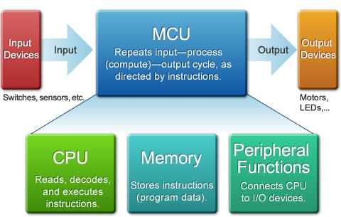
What is MCU?
MCU structure
CPU
Memory
Peripheral Functions
Photo is example for placement and max. size

Slide 6
CPU

Slide 7
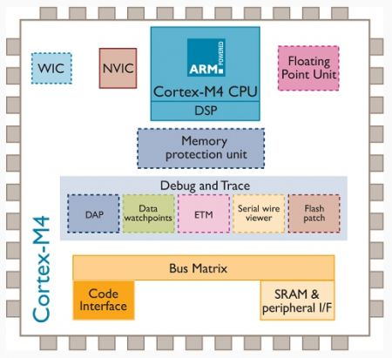
Cortex M3 processor
Cortex M3 processor info
The Cortex-M4 processor is the first ARM processor based on the ARMv7 architecture
The central Cortex-M4 core is based on Harvard architecture
The Cortex-M4 processor is a 32-nit processor, with a 32-bit wide data path, register bank and memory interface
Photo is example for placement and max. size

Slide 8
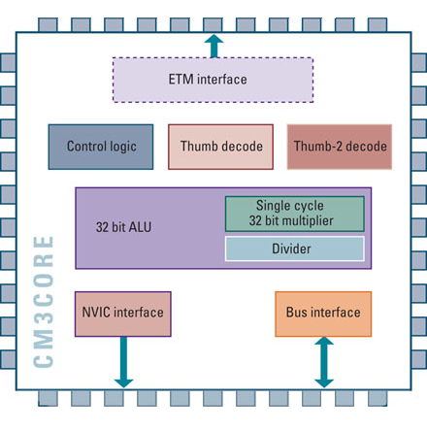
Cortex M4 core
Cortex M3 core structure
3 stage pipeline
Thumb and Thumb-2 instruction set
Hardware division support
Single cycle multiplier
3-stage pipeline
Photo is example for placement and max. size
Register bank

Slide 9
Instruction set
ARM instructions are a fixed length of 32 bits
Thumb instructions are a fixed length of 16 bits
Thumb-2 instructions can be ether 16-bit or 32-bit
Thumb-2 gives approximately 26% improvement in code density over ARM
Thumb-2 gives approximately 25% improvement in performance over Thumb

Slide 10
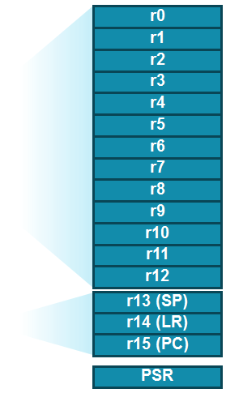
ARM register bank
ARM operation modes
User – normal execution mode
FIQ – Fast interrupt mode
IRQ – Interrupt mode
SVC – Supervisor mode
ABT – Memory access failure
UND – Undefined instruction executed

Slide 11
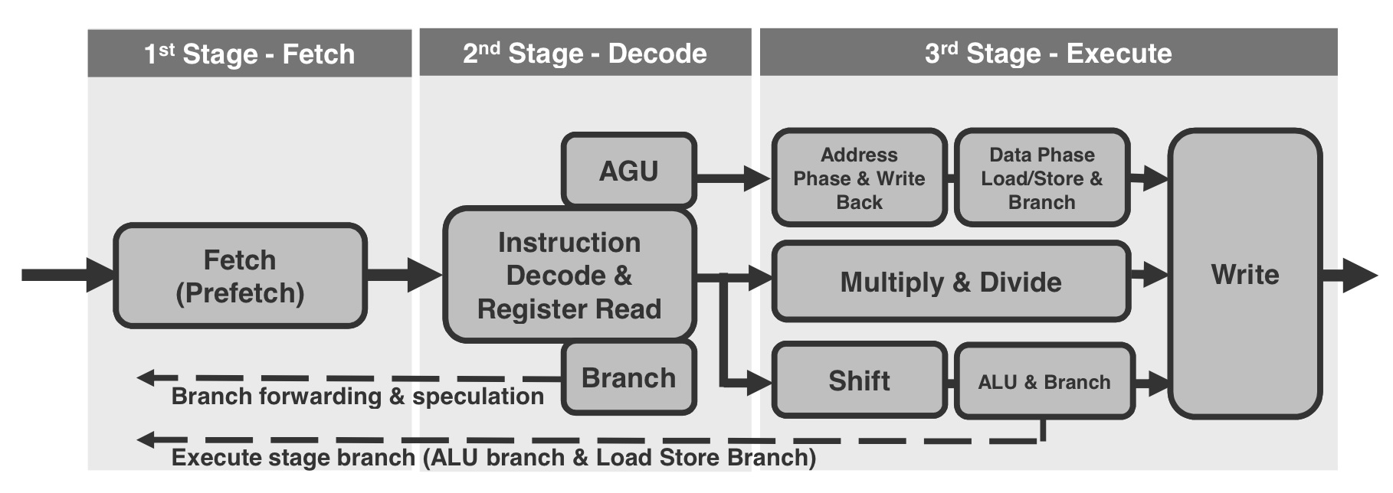
Cortex M3 pipeline

Slide 12
Memory

Slide 13
Memory types
Type | Volatile | Writable | Erase size | Max Erase Cycles | Cost | Speed
SRAM | Yes | Yes | Byte | Unlimited | Expensive | Fast
DRAM | Yes | Yes | Byte | Unlimited | Moderate | Moderate
Masked ROM | No | No | n/a | n/a | Inexpensive | Fast
PROM | No | Once (programmer) | n/a | n/a | Moderate | Fast
EPROM | No | Yes (programmer) | Entire Chip | Limited | Moderate | Fast
EEPROM | No | Yes | Byte | Limited | Expensive | Fast to read, slow to write
Flash | No | Yes | Page | Limited | Moderate | Fast to read, slow to write
NVRAM | No | Yes | Byte | Unlimited | Expensive | Fast

Slide 14
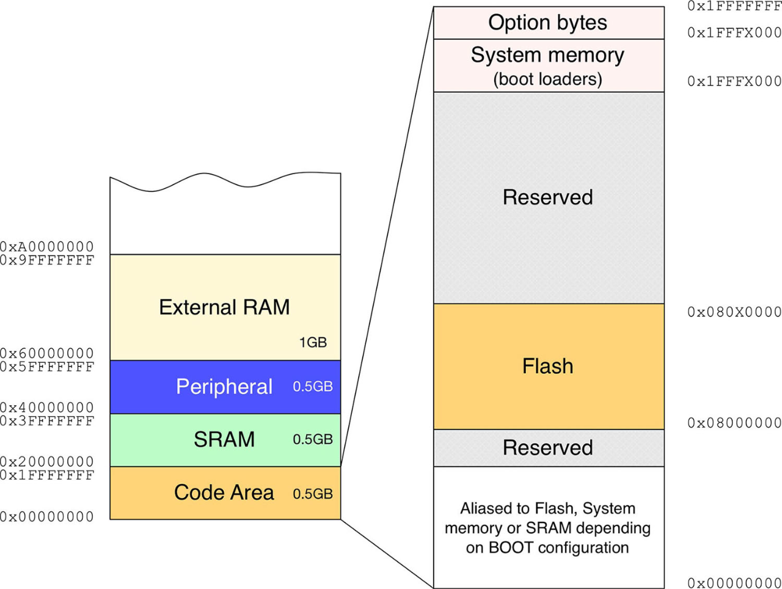
STM32 Memory map

Slide 15
Periphery

Slide 16
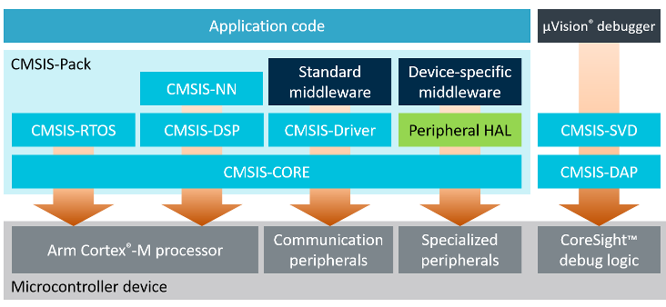
CMSIS
The Cortex Microcontroller Software Interface Standard (CMSIS) provides a single standard across all Cortex-Mx processor series vendors. It enables code re-use and code sharing across software projects and reduces time-to-market for new embedded application

Slide 17
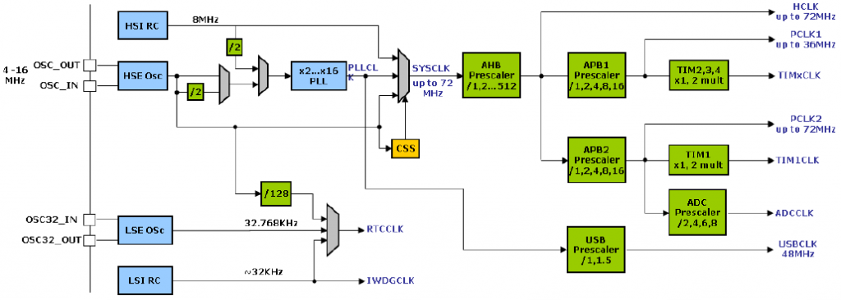
Clocking

Slide 18
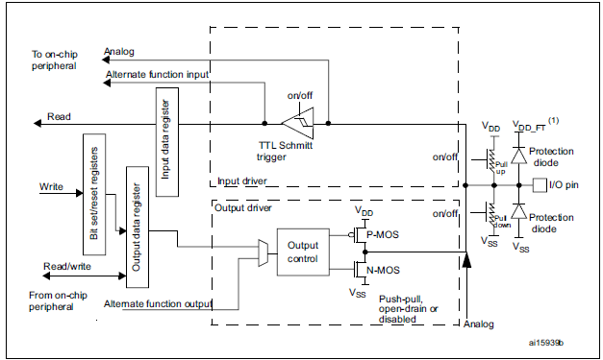
GPIO

Slide 19
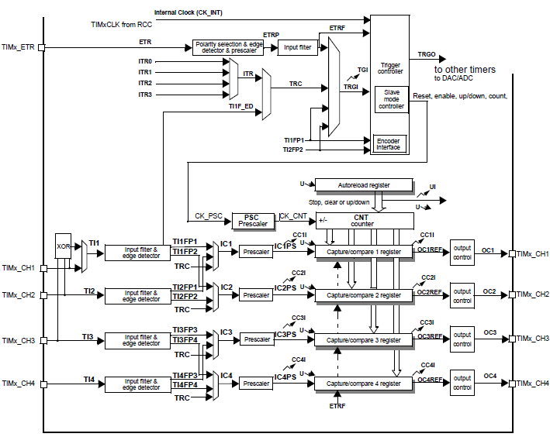
Timers

Slide 20
UART
UART description
UART1
TX
TX
UART2
Full duplex
Asynchronous
Only one pair can be connected
Both devices in pair are equal
CTS and RTS could be used to flow control
RX
RX
GND
GND
0
Data Bits 5-8
P
1
Start bit
Stop bit
Optional parity bit

Slide 21
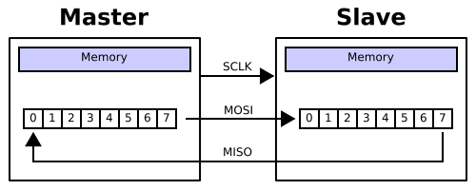
SPI
SPI description
Full duplex
Synchronous
Master/slave relationship
Can be attached multiple devices on same bus.
Very fast

Slide 22
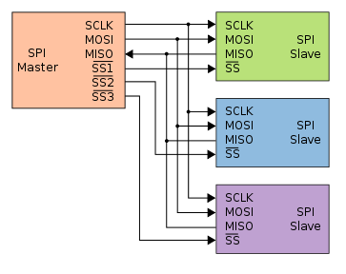
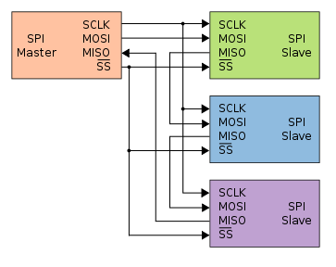
SPI topology
Star topology
Ring topology

Slide 23
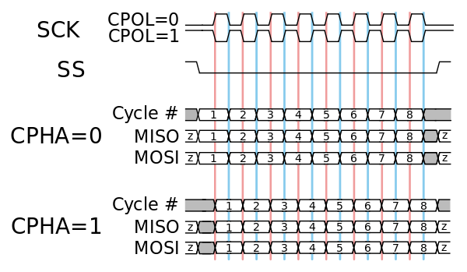
SPI timing diagram

Slide 24
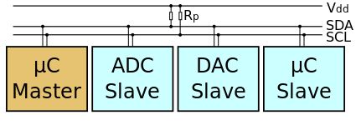
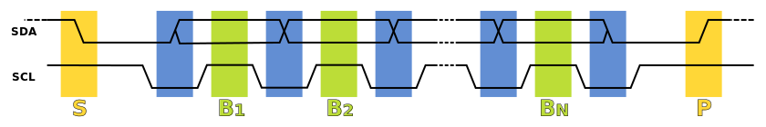
I2C
I2C description
Half duplex
Synchronous
Master/slave relationships
Can be attached multiple devices on same bus.

Slide 25
Q&A

Slide 26
Home task
Ex1: Develop application that communicates with PC trough UART
Application should send just echo.
You should use only CMSIS library.
UART driver should contains following functions:
init();
open();
read();
write();
close();
deinit();

Slide 27
Thank you

