Slide 1
A single-cell resolution map of mouse haematopoietic stem and progenitor cell differentiation
Nestorowa et. al., 2016
Norah, Bailey, Vlad, Amber

Slide 2
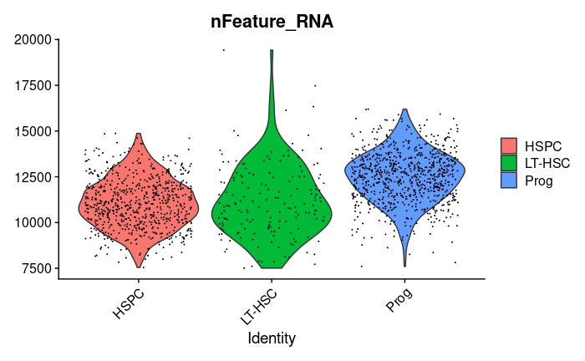

Slide 3
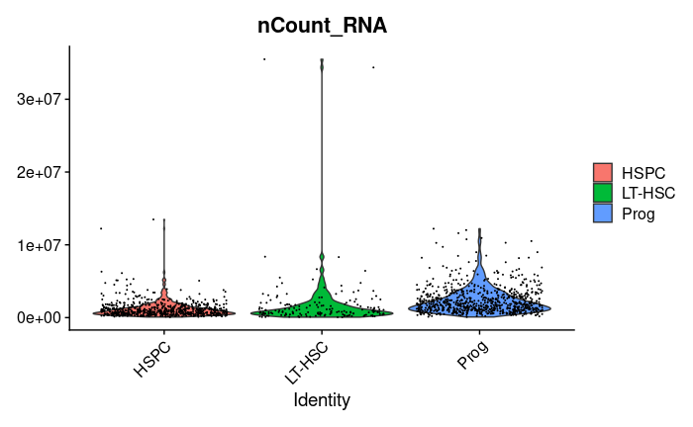

Slide 4
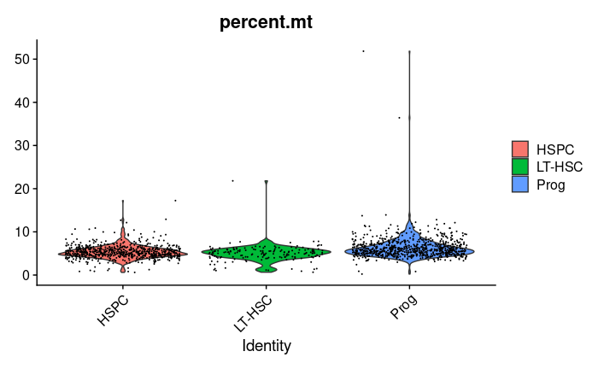

Slide 5
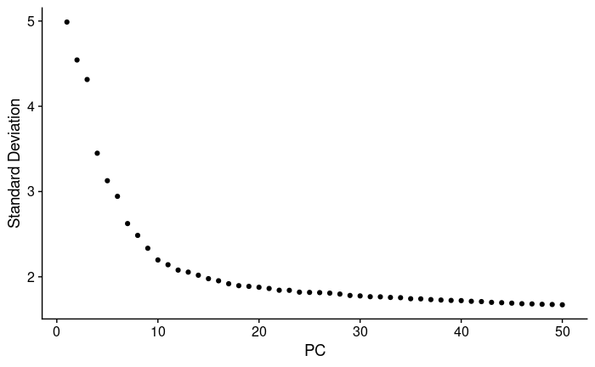
% var of 50th PC: 33.4%

Slide 6
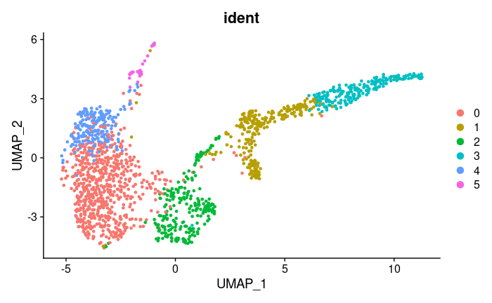
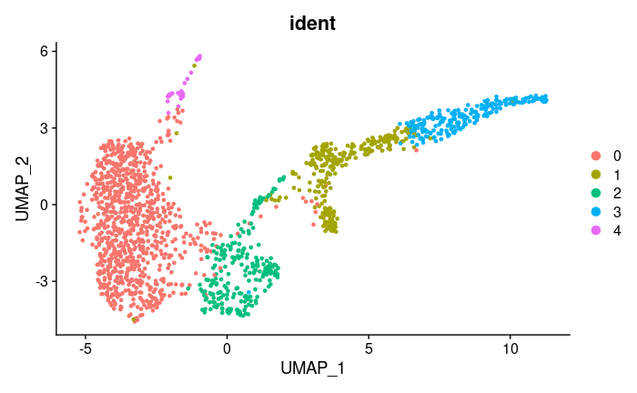
Resolution : 0.3
Resolution : 0.5

Slide 7
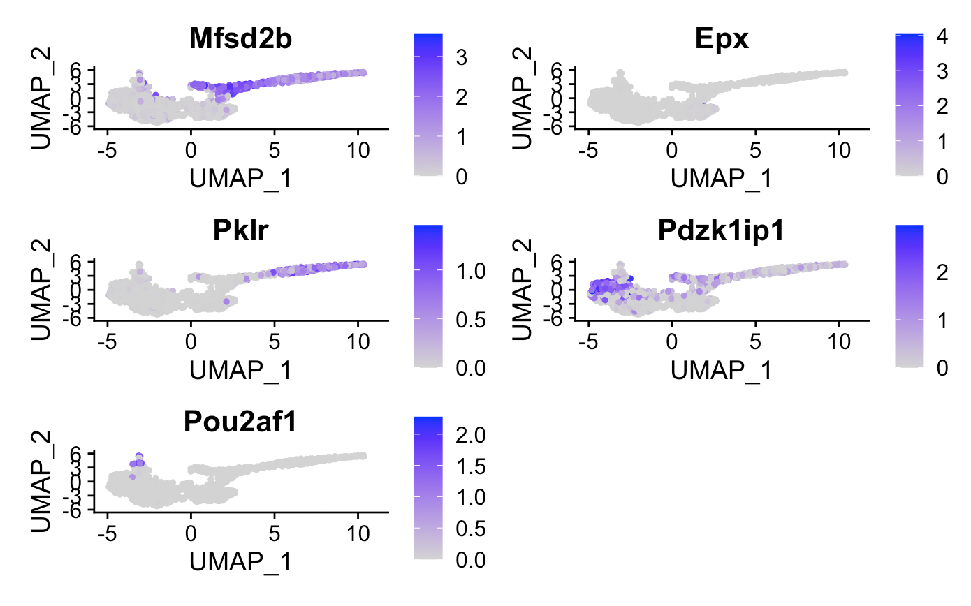

Slide 8
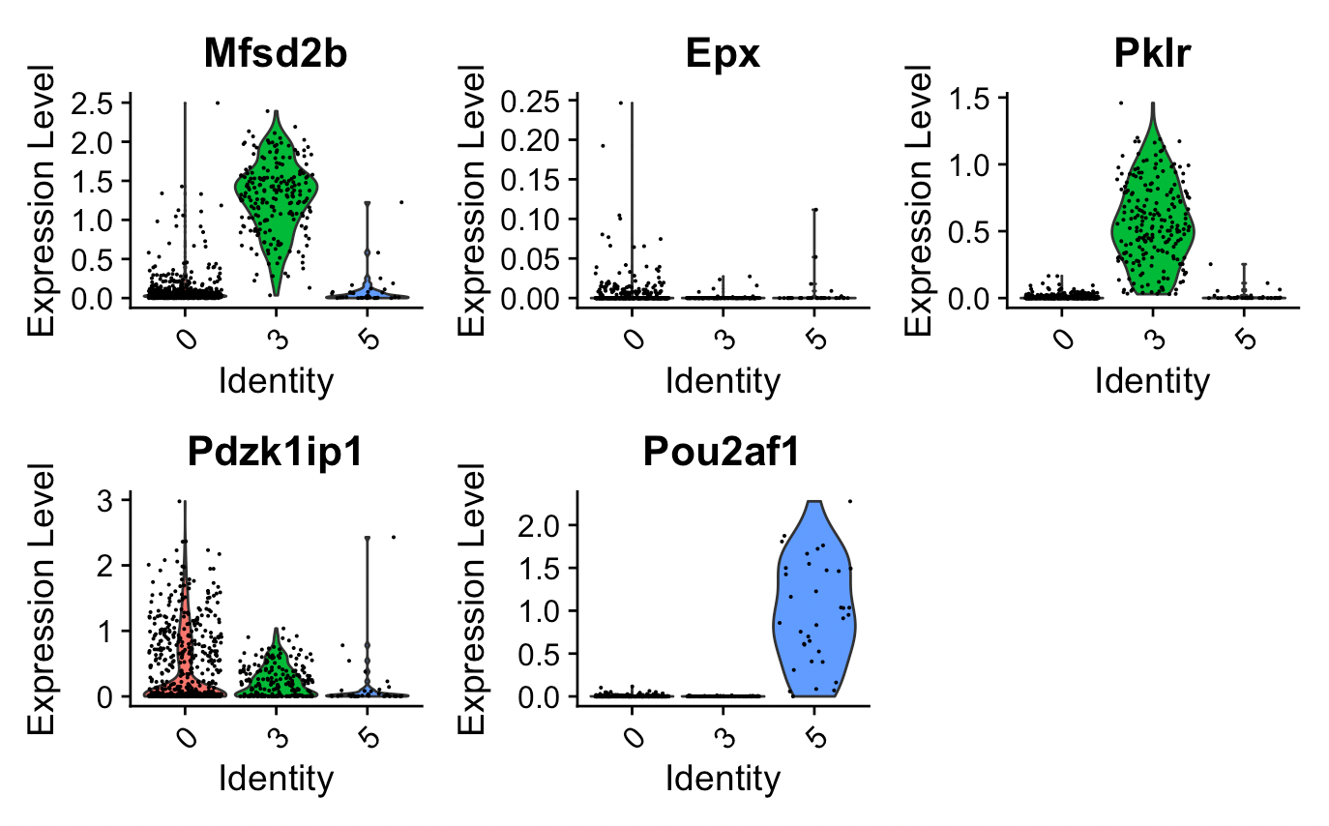

Slide 9
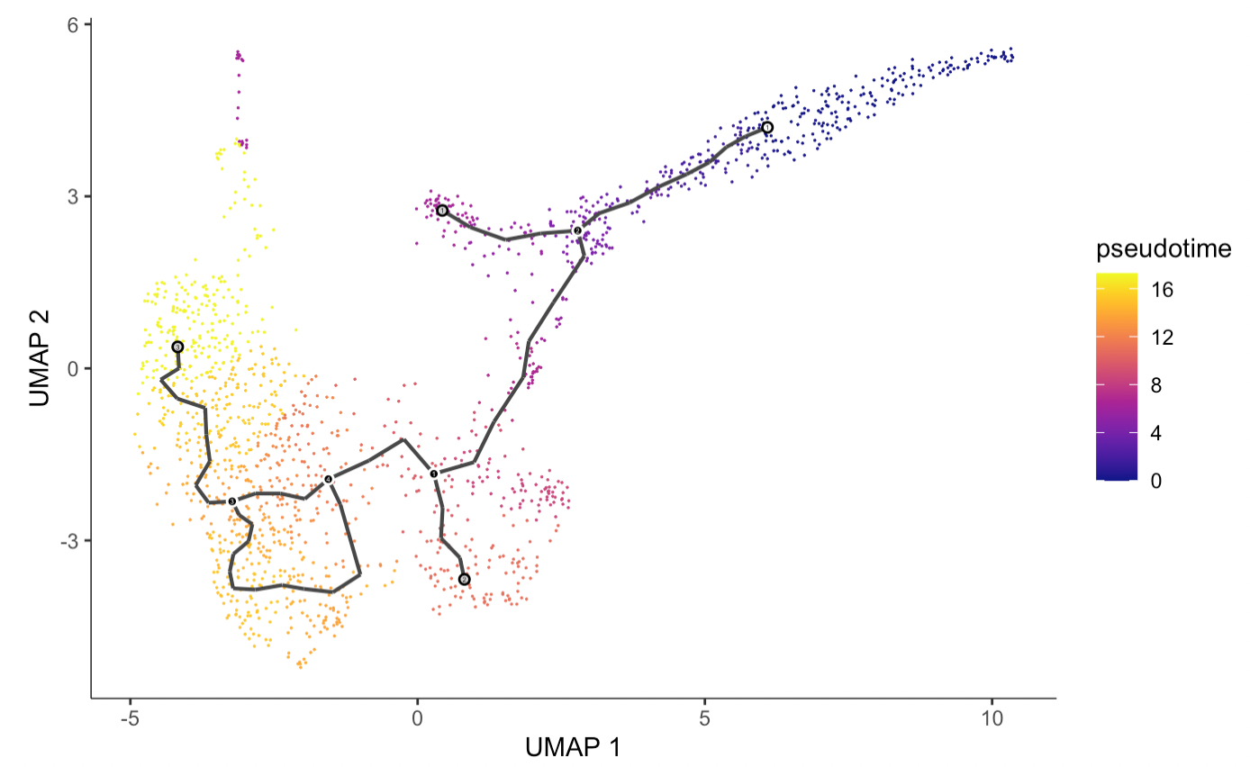
Prog

