Slide 1
FLEXBOX
By Volodymyr Karanevych

Slide 2
AGENDA
What is FLEXBOX?
Flex container
Flex-direction
Flex-wrap
Justify-content
Align-items
Align-content
Flex items
Order
Flex-grow
Flex-shrink
Flex-basis
Flex
Align-self
Attention

Slide 3
WHAT IS FLEXBOX?

Slide 4
INTRODUCTION
The Flexbox Layout aims at providing a more efficient way to lay out, align and distribute space among items in a container, even when their size is unknown and/or dynamic.

Slide 5
FLEX CONTAINER

Slide 6
FLEX CONTAINER
An area of a document laid out using flexbox is called a flex container. To create a flex container, we set the value of the area's container's display property to flex or inline-flex.
Default properties:
  Items display in a row (the flex-direction property's default is row).
  The items start from the start edge of the main axis.
  The items do not stretch on the main dimension, but can shrink.
  The items will stretch to fill the size of the cross axis.
  The flex-wrap property is set to nowrap.

Slide 7
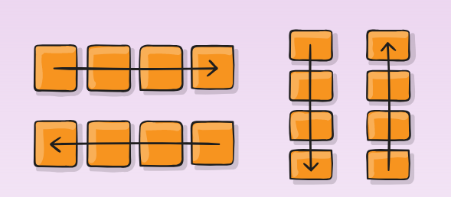
FLEX-DIRECTION
When working with flexbox you need to think in terms of two axes — the main axis and the cross axis. The main axis is defined by the flex-direction property, and the cross axis runs perpendicular to it.
flex-direction:
  row
  row-reverse
  column
  column-reverse

Slide 8
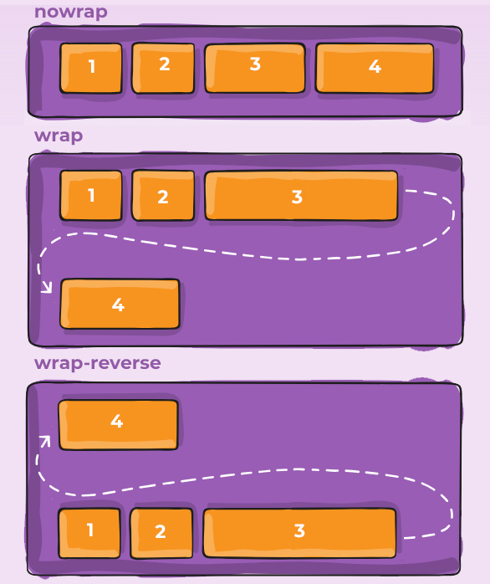
FLEX-WRAP
  flex-wrap
  nowrap
  wrap
  wrap-reverse
flex-flow is a shorthand flex-direction
and flex-wrap properties, which together
define the flex container's main and
cross axes.
flex-flow: flex-direction flex-wrap ;

Slide 9
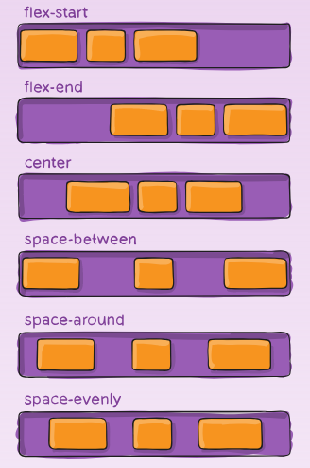
JUSTIFY-CONTENT
  justify-content
  flex-start
  flex-end
  center
  space-between
  space-around
  space-evenly
This defines the alignment along the main axis.

Slide 10
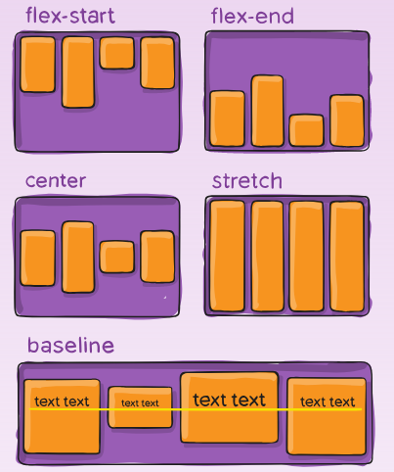
ALIGN-ITEMS
  align-items
  flex-start
  flex-end
  center
  stretch
  baseline
This defines the alignment along the cross axis.

Slide 11
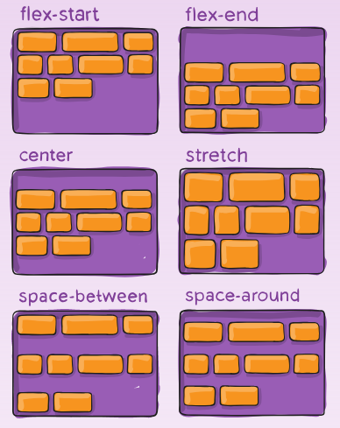
ALIGN-CONTENT
  align-content
  flex-start
  flex-end
  center
  stretch
  space-between
  space-around
This aligns a flex container's lines in the cross-axis.
Note: this property has no effect when there is only
one line of flex items.

Slide 12
FLEX
ITEMS

Slide 13
FLEX-ITEMS
Flex items are all direct children of flex container.

Slide 14
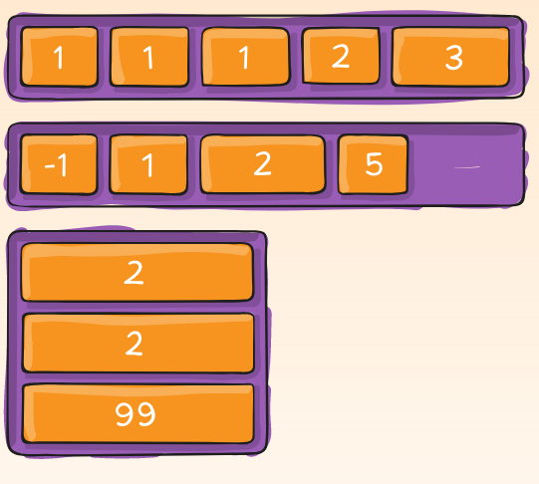
ORDER
order: integer ;
Determines the order of output of
flex items within the flex container.

Slide 15
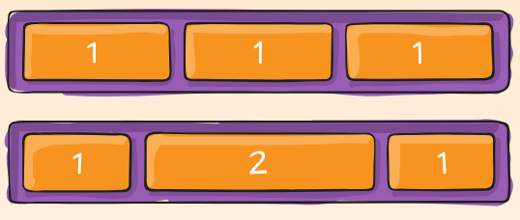
FLEX-GROW
This sets how much of the
remaining space in the flex
container should be assigned to
that item.
flex-grow: number ;

Slide 16
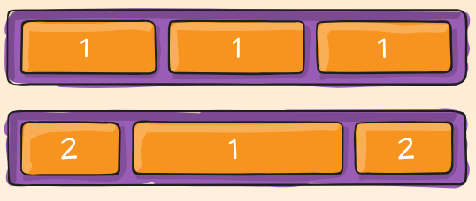
FLEX-SHRINK
If the size of all flex items is larger
than the flex container, items
shrink to fit according to
flex-shrink.
flex-shrink: number;

Slide 17
FLEX-BASIS
  flex-basis:
  length(%, px)
  auto
This defines the default size of an element before the remaining space is distributed.

Slide 18
FLEX
This is the shorthand for flex-grow, flex-shrink and flex-basis combined.
The second and third parameters (flex-shrink and flex-basis) are optional.
flex: flex-grow flex-shrink flex-basis ;

Slide 19
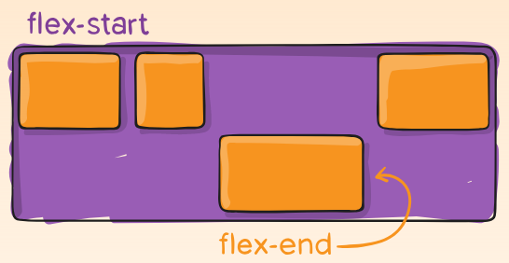
ALIGN-SELF
  align-self:
  auto
  flex-start
  flex-end
  center
  baseline
  stretch
This allows the default alignment (or the one specified by align-items) to be overridden for individual flex items.

Slide 20
ATTENTION

Slide 21
ATTENTION
Note that float, clear and vertical-align have no effect on a flex item.
There is more of the flexbox and flex items properties. But they are not supported widely yet.

Slide 22
USED MATERIALS
https://developer.mozilla.org/en-US/docs/Web/CSS/CSS_Flexible_Box_Layout
https://webref.ru/css
https://css-tricks.com/snippets/css/a-guide-to-flexbox/
https://www.w3schools.com/Css/css3_flexbox.asp

Slide 23
THANK YOU

