Slide 1


Monkey See, Monkey Do
Volodymyr Orlov, Ivan Charkin
SMU MSDS 6306 Doing Data Science

Slide 2
Goal
Train a robot that learns to imitate a trader by looking only at a signal generated by his/her strategy.
Strategies employed by a trader are subject to following constrains:
A strategy should not get any other input except for daily stock/eft quotes.
A strategy followed by a trader should not change over time.

Slide 3

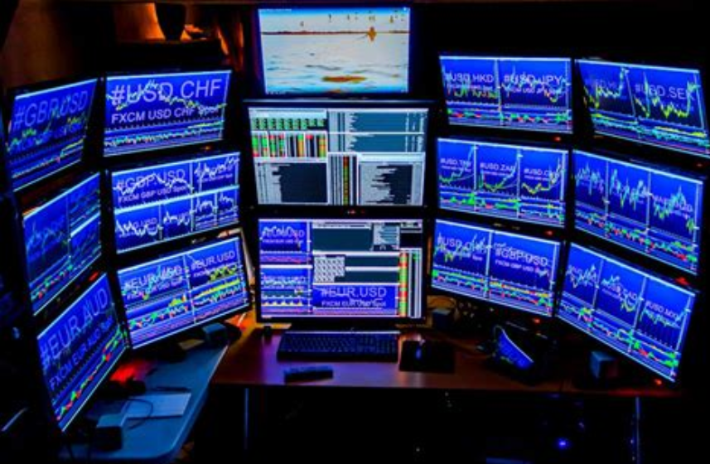

Background
Difference between traditional "investing" and "trading"
People doing investing research individual companies and make trading decisions based on news, company reports, golfing with people in the know, etc.
The technical traders base their decisions on the previous price pattern of the stock.
In turn the technical traders can be divided into two rough categories:
mathematical model traders - attempt to devise a mathematical model predicting stock behavior using oscillators, various indicators etc.
psychology traders - trying to predict emotions of traders who own or are considering trading the stock.
We are trying to emulate trading patters of a person not basing his decisions on mathematical models

Slide 4
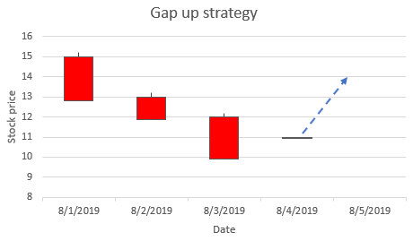
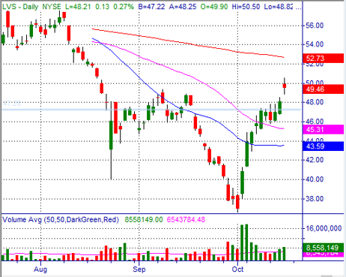
Example 1 - Gap up after downtrend
Stock which has been falling in price for multiple days.
Continuous selling of the stock likely depleted the ranks of the people who want to sell the stock and potentially attracted short sellers who sold the stock short in hopes of further falling prices.
One day after several days of falling prices the stock opens up at a higher value than the previous day close.
This event will potentially attract buyers who will anticipate reversal of the direction of the stock and will be attracted by relatively cheap prices. At the same time the short sellers may panic that the stock is going to go up which mean losing money and will start covering their positions (buying) driving the stock price even higher.

Slide 5
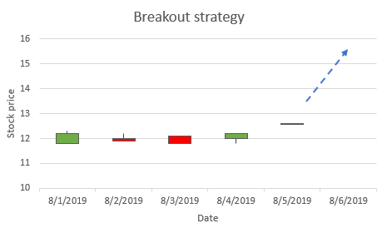
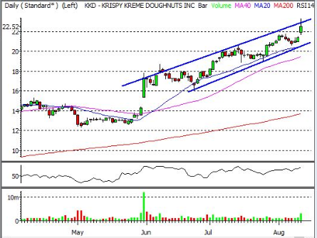
Example 2 - Breakout
If the price of a stock stays relatively flat for an extended period of time there is a higher probability of this stock to continue moving in the same direction after the stock price left the "flat" zone.
There are multiple underlying reasons for stocks staying at roughly the same price.
For example if the price of the stock reaches a round number such as 50, a lot of owners of the stock will be selling the stock because that is a round number they decided they were waiting for the stock to reach before selling it.
Even if there are many people willing to buy the stock, the pressure from the sellers will keep the stock down.

Slide 6
Data generation
As an input for teaching the robot real stock data from Yahoo Financial was used
Daily prices (Open, Close, High, Low) were collected for Dow 30 stocks
15 years of data were analyzed
Simple strategy described on previous slides were used to generate the BUY signal
Only Long trading was used (no Short selling)

Slide 7
Robot Models
One way to think about this problem is to imagine a robot that attempts to learn a general form of a mapping from a d-dimensional features, , where to a categorical output Y , signal, where
A robot is a function
We need not only a flexible function f but also to automate search for a best subset of features that maximizes likelihood of an observed signal
$$ϕ:X→Y$$
$$X=(x1,x2,...,x_{L})$$
$$x_{l}∈{IR}^{d}$$
$$y∈Y=\{y_{1},y_{2},...,y_{K}\}$$
$$\overset{̂}{y}=f(x,θ)$$
$$\underset{y∈Y}{argmax}\{p(Y=y)\overset{d}{\underset{i=1}{∏}}p(X_{i}|Y=y)\}$$

Slide 8
Idea №1: Evolving a Solution for a Turing-Complete Machine
A Turing-complete machine is capable of simulating any computer algorithm¹.
The infinite monkey theorem states that² a monkey hitting keys at random on a typewriter keyboard for an infinite amount of time will almost surely type a given text, such as the complete works of William Shakespeare
Generate N Solutions
010100111011001
111011011101110
…
001100111011010
Evaluate
010100111011001→0.01
111011011101110→0.05
…
001100111011010→0.02
(1)
(2)
Select k < N
010100111011001→0.01✗
111011011101110→0.05✓
…
001100111011010→0.02✓
(3)
Evolve
111011011101110
X
001100111011010
=
001100111101110
(4)
1https://www.cs.virginia.edu/~robins/Turing_Paper_1936.pdf
²https://en.wikipedia.org/wiki/Infinite_monkey_theorem

Slide 9
Idea №2. FC-LSTM¹
Input: we take 60 quotes, preceding each trading day and turn this sequence into a 60x4 tensor
The network applies a series of linear and non-linear transformations at each layer
Output: we apply a softmax function to the output of the final layer to turn a vector of 3 real numbers into probabilities
Input (60x4)
LSTM (16)
LSTM (32)
Dense (3)
Output (Buy/Sell/None)
1 https://arxiv.org/pdf/1308.0850.pdf

Slide 10
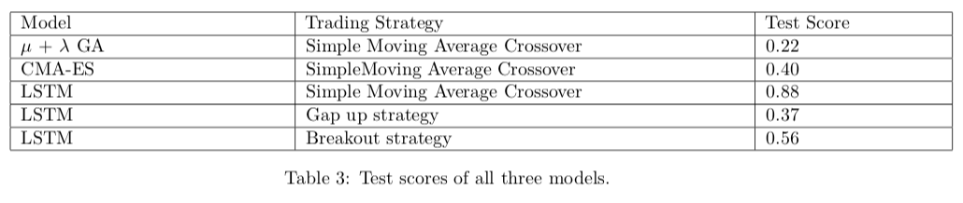
Results

Slide 11
Conclusion
We think that this might be a NP-hard problem, because searching for the solution that matches the signal can exceed polynomial time.
A genetic algorithm reduce search time but we have not found this reduction sufficient enough to turn this problem into a P-hard.
Our LSTM model uses a better optimization technique, that is based on a gradient descent but this method doesn’t work well for highly non-convex error functions and might get trapped in numerous suboptimal local minima.

Slide 12
Why is it so hard‽
The probability that a monkey will correctly spell
“To be or not to be”
D3
P2
110
1111
111
$$P=(\frac{1}{7})^{18}=6.14×{10}^{−16}$$
With 1 million monkeys each typing a word per second we it will take
D1
$$\frac{7^{18}}{1×{10}^{6}∗3.154×{10}^{7}}=50years$$
P1
010
011
D2

Slide 13
Q&A
https://github.com/ VolodymyrOrlov/MSDS6306_project2

