Slide 1

Monkey See, Monkey Do
Volodymyr Orlov, Ivan Charkin

Slide 2
Goal
We want to scrape stock and ETF quotes from NASDAQ's website.
We want to train a robot that learns to imitate a trader by looking only at a signal generated by his/her strategy. Strategies employed by a trader are subject to following constrains:
A strategy should not get any other input except for daily stock/eft quotes.
A strategy followed by a trader should not change over time.

Slide 3
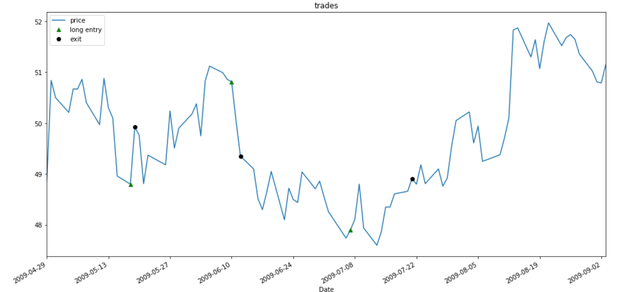
Trader’s signal

Slide 4
An example. Gap Up Strategy

Slide 5
Classification
{0, 1, 2}, a set of signals are labels, Y
Features are extracted from price at k previous days, X1, X2, X3 … Xk

Slide 6
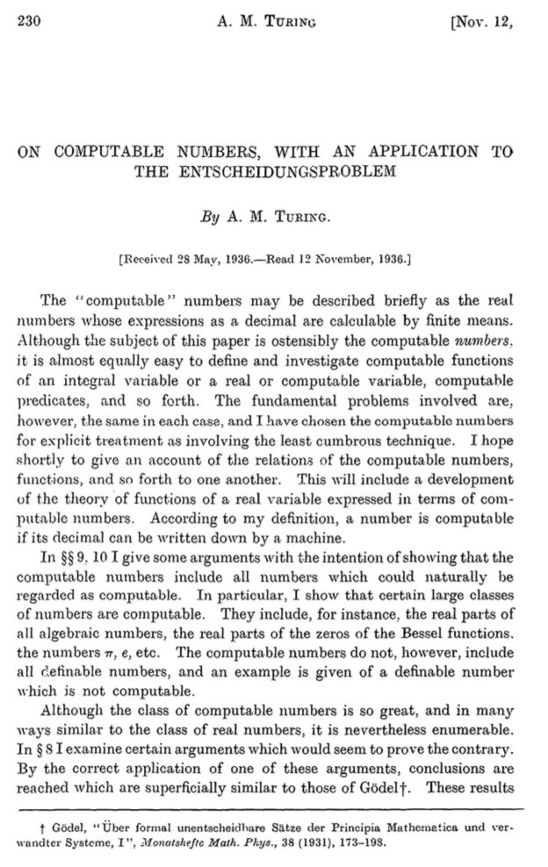
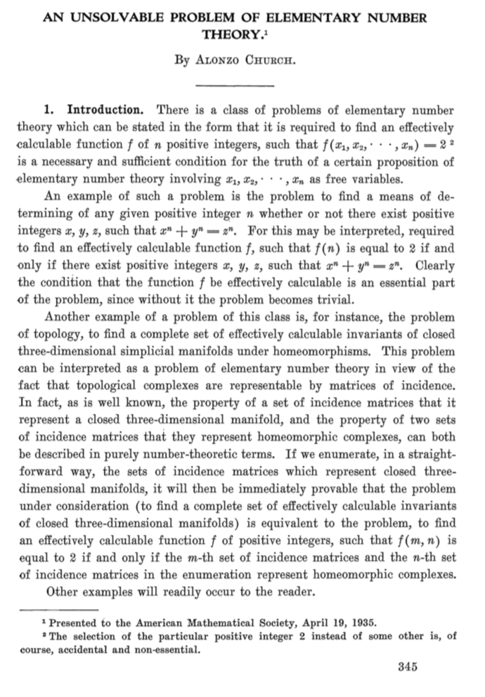
Universal Turing machine
A Turing machine is capable of simulating any computer algorithm.

Slide 7
Infinite monkey theorem
The infinite monkey theorem states that a monkey hitting keys at random on a typewriter keyboard for an infinite amount of time will almost surely type a given text, such as the complete works of William Shakespeare¹
¹https://en.wikipedia.org/wiki/Infinite_monkey_theorem

Slide 8
Infinite Monkey, v 2.0

Slide 9
Idea №1. Evolve Code for a Turing-complete Machine
Generate N Solutions
010100111011001
111011011101110
…
001100111011010
Evaluate
010100111011001→0.01
111011011101110→0.05
…
001100111011010→0.02
(2)
(1)
(3)
Select k < N
010100111011001→0.01✗
111011011101110→0.05✓
…
001100111011010→0.02✓
Evolve
111011011101110
X
001100111011010
=
001100111101110
(4)

Slide 10
Idea №2. FC-LSTM¹
Gradient-based method
Hard to train because search space is rugged and non-convex,
Input (60x4)
LSTM (16)
LSTM (32)
Dense (3)
Output (Buy/Sell/None)
¹ https://arxiv.org/pdf/1308.0850.pdf

Slide 11
Why is it so hard‽
The probability that a monkey will correctly spell
“To be or not to be”
$$P=(\frac{1}{7})^{18}=6.14×{10}^{-16}$$
With 1 million monkeys each typing a word per second we will be searching for
$$\frac{7^{18}}{1×{10}^{6}*3.154×{10}^{7}}=50years$$

Slide 12
Search Space
D3
1111
P2
110
111
D1
P1
010
011
D2

