Slide 1
FTOT 2023.3 Users Group Meeting
November 2, 2023

Slide 2
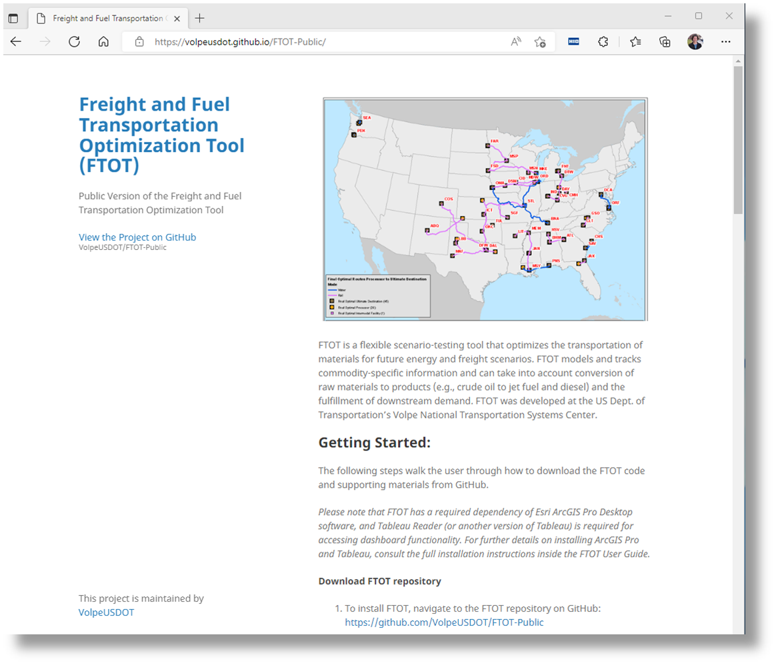
FTOT Landing Page
volpeusdot.github.io/FTOT-Public
FTOT is an open-source tool available on GitHub.
Includes full documentation and “Quick Start” scenarios, default datasets, video tutorials.
Updated versions released quarterly.
Issues/bugs/requests can be raised on GitHub site.
We welcome feedback and suggestions, additional projects, collaborations.

Slide 3
Agenda
XLSX template and FTOT Tool for input file creation
Incorporation of CO₂ emissions-related costs in optimization
User-defined input parameters
Additional cost definitions within FTOT
Updated reporting
North American multimodal network
Other updates
FTOT-SCR aligned with FTOT version 2023.2
Emissions calculations by vehicle load
Bug fixes
[Time permitting] XLSX template demo

Slide 4
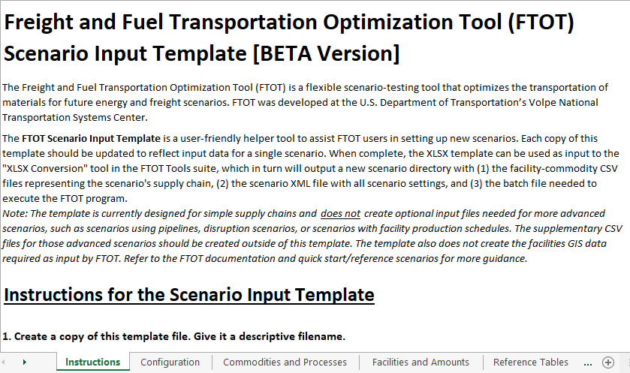
User Support: XLSX template and conversion tool
Goal: Help users get their scenario data into FTOT input files
Two components
Excel-based input data template
Complementary FTOT Tool to convert XLSX workbook into corresponding FTOT input files
Creates a batch file, a scenario XML, and all facility-commodity CSV files*
Example XLSX workbooks have been included with the FTOT codebase
*Currently does not create required GIS inputs or optional CSV files

Slide 5
New Functionality: Emissions-based optimization
Incorporation of CO₂ emissions-related costs in optimization
Involves updates to
Input parameters in scenario XML
Cost definitions within FTOT
Reporting metrics
This is an optional feature – FTOT defaults to standard transport cost-based optimization in absence of related XML elements
New Reference Scenario (renumbered RS8) demonstrating functionality
Notes:
Added new functionality to incorporate carbon dioxide (CO2) emissions-related costs into the FTOT route optimization problem. Users can now set what share of (i) impeded transport cost and (ii) CO2 cost to combine in a composite routing cost for route optimization using optional Transport_Cost_Scalar, CO2_Cost_Scalar, and CO2_Unit_Cost elements in the scenario XML. Users can specify the cost per unit of CO2 emissions and separate scaling factors (in a range from 0.0 to 1.0) for the impeded transport cost component and CO2 cost component. The default is to use the full value of impeded transport cost (scaling factor of 1.0) and to zero out CO2 emissions cost (scaling factor of 0.0), which leads to a transportation cost-only optimization approach.

Slide 6
New Functionality: Emissions-based optimization (2)
User-defined input parameters in scenario XML
Transport_CO2_Scalar
Share of impeded transport cost to use in the optimization
Accepts decimal from 0.0 to 1.0 (defaults to 1.0)
CO2_Cost_Scalar
Share of carbon cost to use in the optimization
Accepts decimal from 0.0 to 1.0 (defaults to 0.0)
CO2_Unit_Cost
String for cost per unit of CO₂ emissions
Defaults to ‘191 USD/ton’
XML elements are optional and excluded from all QS and RS templates except for the new RS8 on CO₂-based optimization
Notes:
Added new functionality to incorporate carbon dioxide (CO2) emissions-related costs into the FTOT route optimization problem. Users can now set what share of (i) impeded transport cost and (ii) CO2 cost to combine in a composite routing cost for route optimization using optional Transport_Cost_Scalar, CO2_Cost_Scalar, and CO2_Unit_Cost elements in the scenario XML. Users can specify the cost per unit of CO2 emissions and separate scaling factors (in a range from 0.0 to 1.0) for the impeded transport cost component and CO2 cost component. The default is to use the full value of impeded transport cost (scaling factor of 1.0) and to zero out CO2 emissions cost (scaling factor of 0.0), which leads to a transportation cost-only optimization approach.

Slide 7
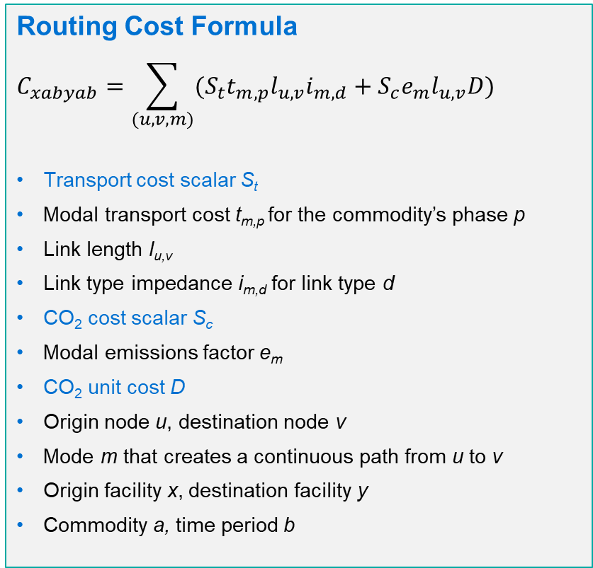
New Functionality: Emissions-based optimization (3)
CO₂ cost is included in routing cost when CO2_Cost_Scalar is non-zero
Routing cost is used to select optimal routes and facilities
Previously, routing cost only included impeded transport cost
Added two new reporting lines for CO₂ scenarios:
Fraction of routing cost from transport
CO₂ cost
Routing Cost Formula
$$C_{xabyab}=\sum_{(u,v,m)}{{(S}_{t}t_{m,p}l_{u,v}i_{m,d}}+S_{c}e_{m}l_{u,v}D)$$
Transport cost scalar S_{t}
Modal transport cost t_{m,p} for the commodity’s phase p
Link length l_{u,v}
Link type impedance i_{m,d} for link type d
CO₂ cost scalar S_{c}
Modal emissions factor e_{m}
CO₂ unit cost D
Origin node u, destination node v
Mode m that creates a continuous path from u to v
Origin facility x, destination facility y
Commodity a, time period b
Notes:
Added new functionality to incorporate carbon dioxide (CO2) emissions-related costs into the FTOT route optimization problem. Users can now set what share of (i) impeded transport cost and (ii) CO2 cost to combine in a composite routing cost for route optimization using optional Transport_Cost_Scalar, CO2_Cost_Scalar, and CO2_Unit_Cost elements in the scenario XML. Users can specify the cost per unit of CO2 emissions and separate scaling factors (in a range from 0.0 to 1.0) for the impeded transport cost component and CO2 cost component. The default is to use the full value of impeded transport cost (scaling factor of 1.0) and to zero out CO2 emissions cost (scaling factor of 0.0), which leads to a transportation cost-only optimization approach.

Slide 8
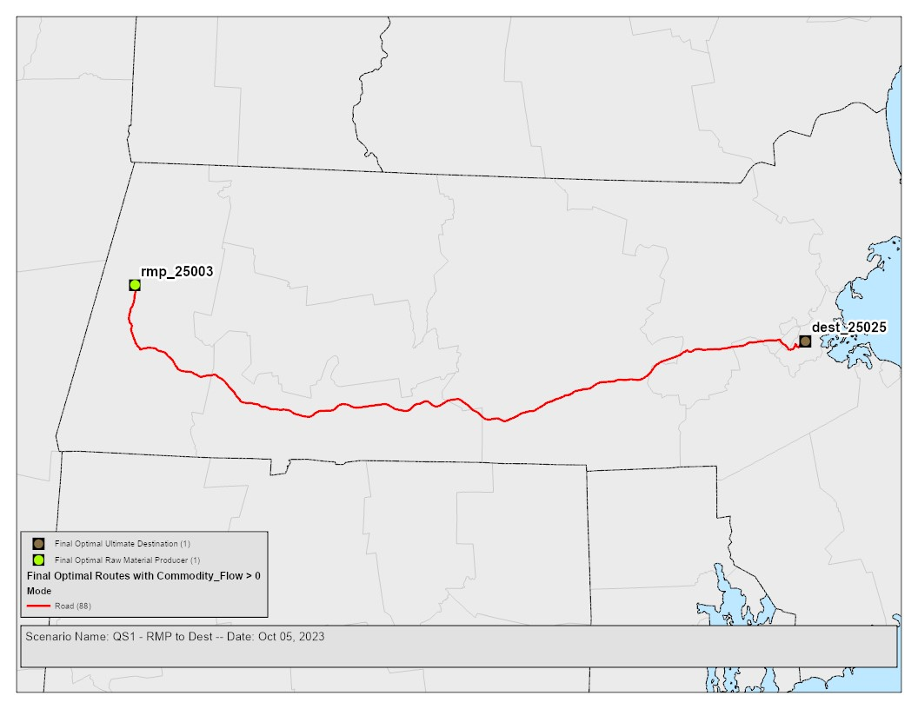
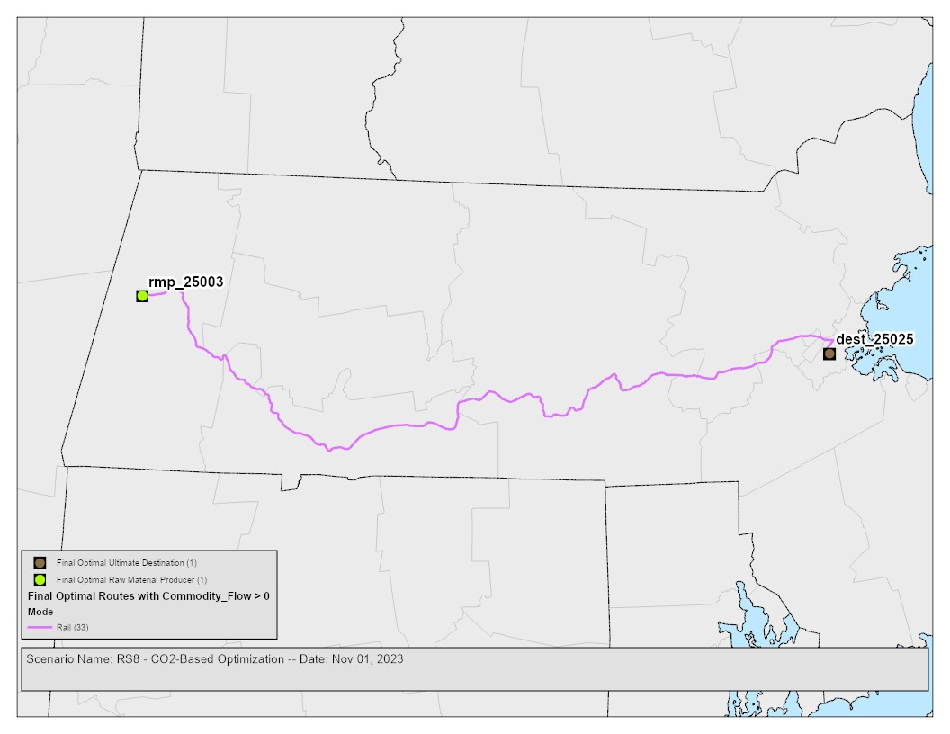
New Functionality: Emissions-based optimization (4)
Mode | Link Type | Transport Cost ($) | Impeded Transport Cost ($) | CO₂ Cost ($)
Road | Interstate | 2200.00 | 2200.00 | 117.48
Road | Freeways & arterials | 2200.00 | 2420.00 | 117.48
Road | Minor arterials | 2200.00 | 2640.00 | 117.48
Road | Collectors & local roads | 2200.00 | 2860.00 | 117.48
Rail | Class 1 owned STRACNET | 470.00 | 470.00 | 44.85
Rail | Other STRACNET | 470.00 | 517.00 | 44.85
Rail | Class 1 owned non-STRACNET | 470.00 | 564.00 | 44.85
Rail | Class 1 rights non-STRACNET | 470.00 | 611.00 | 44.85
Rail | All other rail | 470.00 | 658.00 | 44.85
Water | High volume | 320 | 320.00 | 79.80
Water | Medium volume | 320 | 416.00 | 79.80
Water | Low volume | 320 | 512.00 | 79.80
Above: QS1 routed with only transport cost
Right: QS1 routed with only CO₂ cost
Comparison of transport, impeded transport, and CO₂ costs across FTOT modes and link types, assuming 100 miles transporting 100 tons of solid commodity
Notes:
Added new functionality to incorporate carbon dioxide (CO2) emissions-related costs into the FTOT route optimization problem. Users can now set what share of (i) impeded transport cost and (ii) CO2 cost to combine in a composite routing cost for route optimization using optional Transport_Cost_Scalar, CO2_Cost_Scalar, and CO2_Unit_Cost elements in the scenario XML. Users can specify the cost per unit of CO2 emissions and separate scaling factors (in a range from 0.0 to 1.0) for the impeded transport cost component and CO2 cost component. The default is to use the full value of impeded transport cost (scaling factor of 1.0) and to zero out CO2 emissions cost (scaling factor of 0.0), which leads to a transportation cost-only optimization approach.

Slide 9
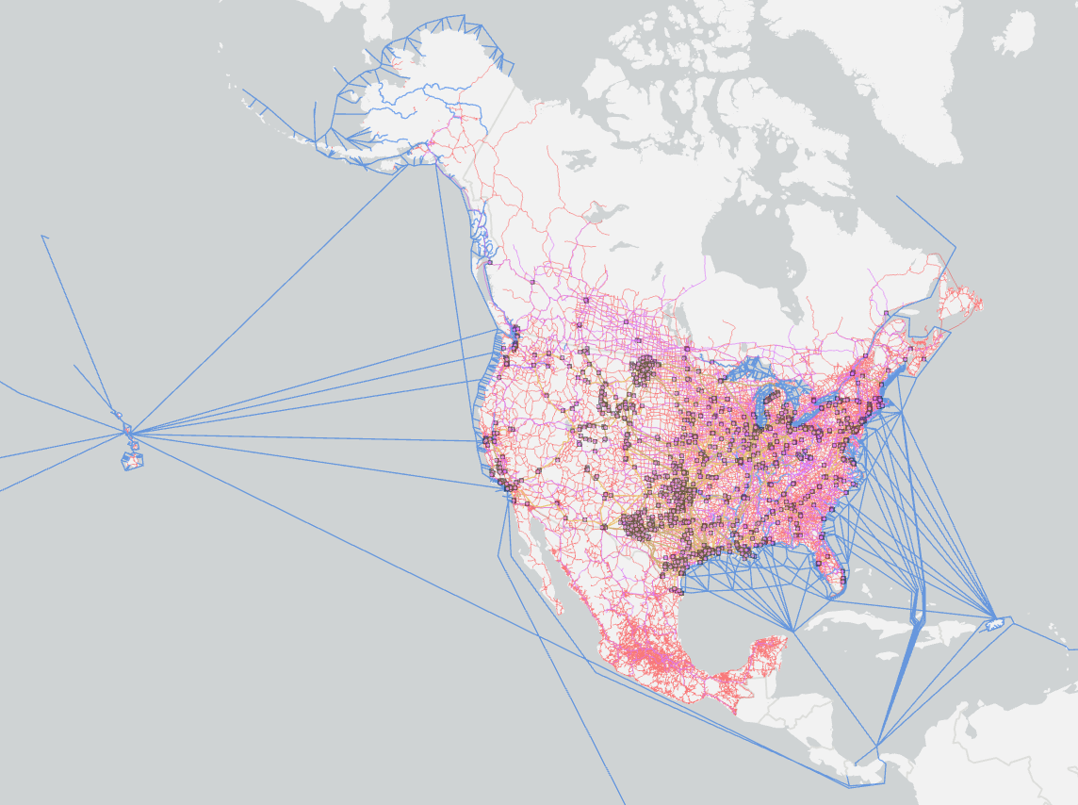
New Resource: North American Multimodal Network
Draft North American multimodal network integrates available Canadian, Mexican and Alaska/Hawaii network data
Network includes road, rail, waterway, and intermodal facility data for Canada, along with rail and road data for Mexico
Facilitates North American scenarios with a scope beyond the continental United States
Available upon request from the FTOT Team
More details are available in Appendix B of the Technical Documentation
Continental United States scenarios should continue to use the default FTOT network (better road data, smaller file size)

Slide 10
Other Updates
Aligned FTOT-SCR with FTOT version 2023.2, bringing in new FTOT base functionality from the last four releases.
Made the impedance weights CSV file optional. Weights default to 1.0 if the CSV is not found.
Updated methodology and reporting for full vs. partial vehicle loads
Decimal vehicle loads used for calculation of…
Number of vehicles, vehicle-distance traveled, road CO2, and fuel burn metrics
Non-road CO2 on artificial links
However, nearest full truckload used for non-CO2 emissions on road
Coming Soon: Tutorial video on updating custom network for use in FTOT

Slide 11
Other Updates
Bug fixes:
Link impedances. Corrected a bug in how impedances were assigned to unrecognized link types. If an impedance weights CSV file is provided but a link type in the modal feature class is not recognized, FTOT now correctly applies the maximum weight listed for that mode.
Detailed emissions reporting. Corrected a bug in how detailed emissions factors were assigned to road types missing values for either the limited_access or urban attributes.
Network density reduction (NDR). Corrected a bug related to use of NDR for scenarios involving multiple processes, a subset of which are candidate generation processes.
Tableau dashboard. Corrected a bug in the Tableau workbook summary graphs for transport cost, network used, vehicle-distance traveled, fuel burn, and CO2 and made other minor fixes and improvements.

Slide 12
Demo: XLSX template and conversion tool

