Slide 1
Case Presentation 2
Group 6
0856621 王彥儒 0856076 楊晴淮
0556066 黃粵丞 309553025 王鈺豪

Slide 2
Agenda
1. DenseNet
Pre Processing Data
Model Training
Validation
2. Windowing Classification
Pre Processing Data
Classification
Results
K-Fold Ensemble
3. Conclusion

Slide 3
Method 1- DenseNet

Slide 4
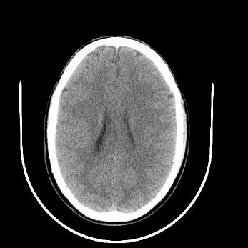
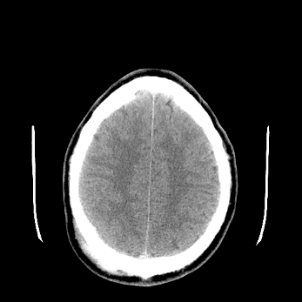
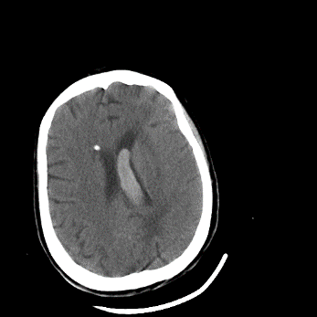
Pre Processing Data
Goal: Convert .dcm file to .png file via dicom info.
We read .dcm file using pydicom library
Then we retrieve required data from dicom info.
Pixel Array
Rescale Intercept
Rescale Slope
Study Instance UID < this data will be used in next section
Image Position < this data will be used in next section
We use Rescale Intercept/Slope to convert Pixel Array to Hounsfield unit in order to get more precise pixel value.
Then use apply_voi_lut() function – Since DICOM datasets require window width/level rescaling of the pixel intensities.
We save filename/Study Instance UID/Image Position as .csv file to do other operations.

Slide 5
Pre Processing Data
Goal: Find the images of same patient.
We use Study Instance UID to find which images are from the same patient since we will randomly combine the images of the same patient.
We give the Slice ID for the images of the same patient based on Z-axis of Image Position field.
So now we have .csv file that contains following fields:
Filename
Study Instance UID
Slice ID
Classes (epidural, intraventricular, etc..)

Slide 6
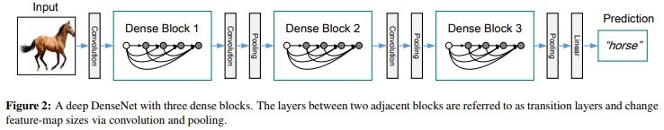
Model Training
Using DenseNet-121 with pre-trained Model
Before training, we use np.concatenate() to concatenate images from same patients at second dimension as our image input.
Retrieve label from .csv file to make label tensor.
Image Size = 256
Training Batch = 32
Validating Batch = 16
Epoch = 30

Slide 7
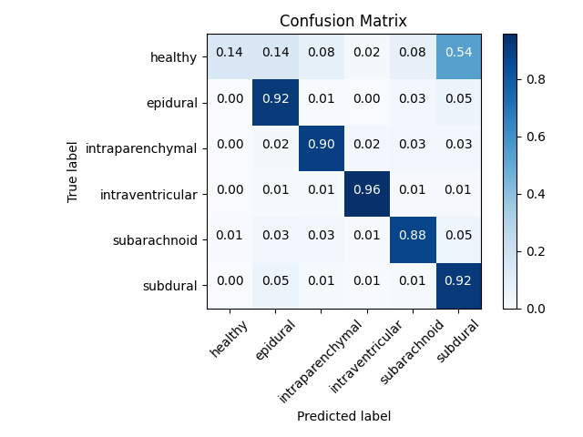
Validation
Using 30-epochs trained model
About 79% accuracy (1496/1893) with confidence threshold > 0.4

Slide 8
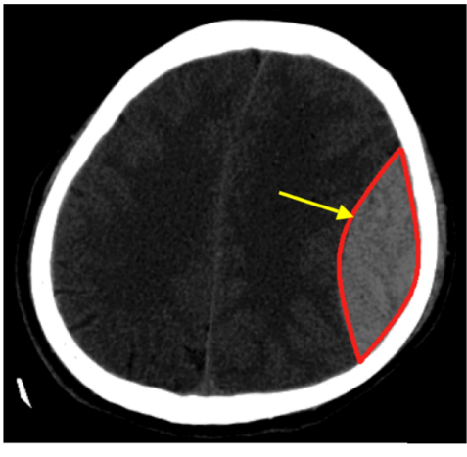
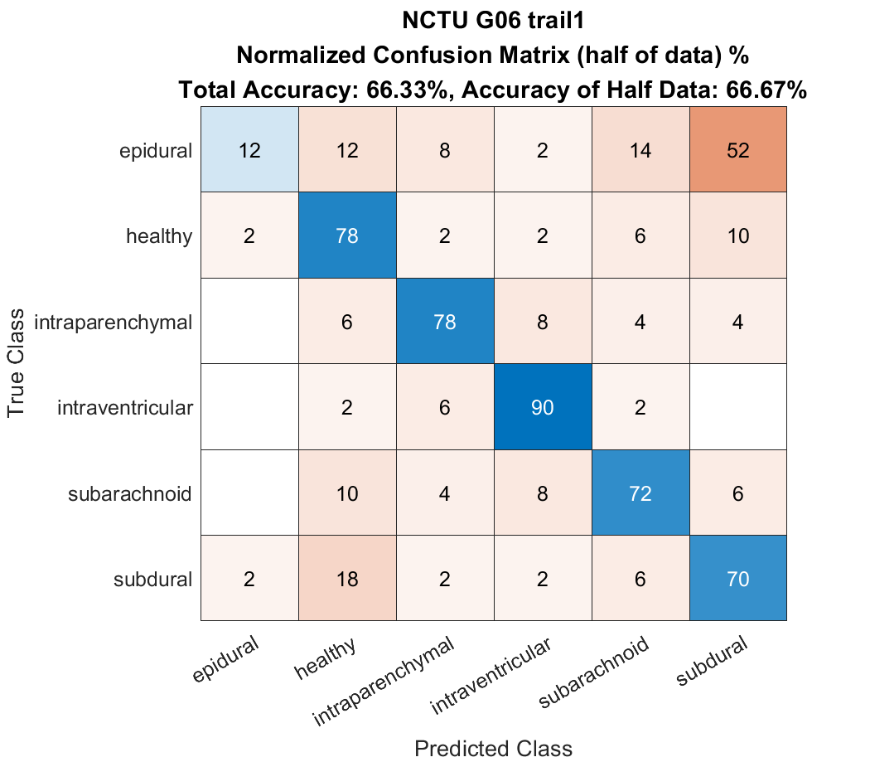
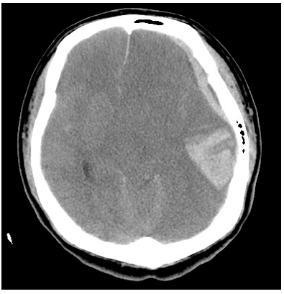
Validation
Using 30-epochs trained model
About 66% accuracy of testing data with confidence threshold > 0.4
硬腦膜上出血
硬腦膜下血腫

Slide 9
Summary
We use the DenseNet as our model in training, since it has feed-forward feature that can reuse the features extracted from previous layers, thus it can be trained in something detail images such as CT image.
But we found that the model has the defect of predicting the CT image of healthy person.
We might be need to tune the training data since we don’t make the same number of images in all classes when we split training data and validation data.
Number of images in different categories [775, 181, 617, 574, 561, 651]
Github repo. : https://github.com/Voltage-x/case-presentation-2

Slide 10
Method 2- Windowing Classification

Slide 11
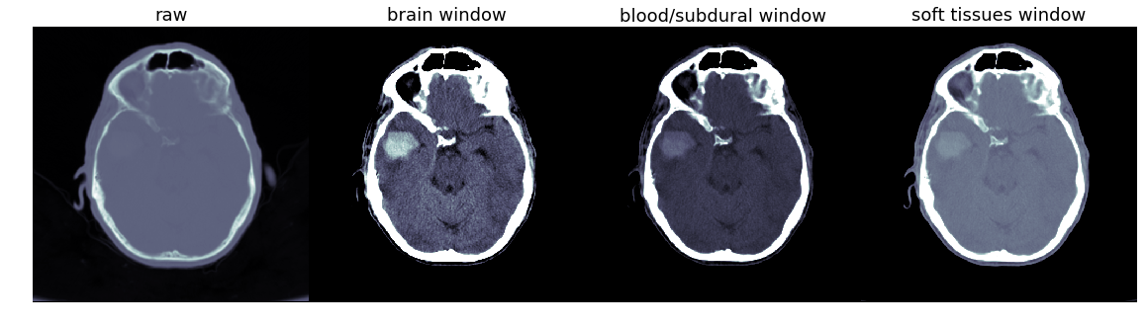
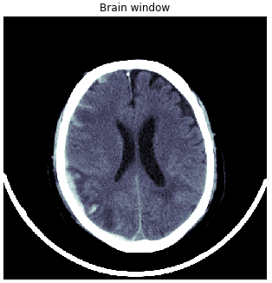
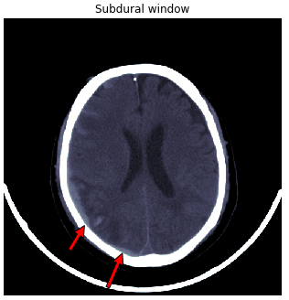
Pre Processing Data
Three Window Policies
Using 3 types of windows to assign them to each channel of images
原始
Brain window: W80 L40
硬膜: W200 L80
軟組織: W380 L40

Slide 12
Pre Processing Data
Three Window Policies
Using 3 types of windows to assign them to each channel of images
原始
Brain window: W80 L40
硬膜: W200 L80
軟組織: W380 L40
Brain Matter window W = 80, L = 40 Voxels displayed range from 0 to 80 ( Lower limit = 40 - (80/2), upper limit = 40 + (80/2) ) Voxel values outside this range will be completely black or white.

Slide 13
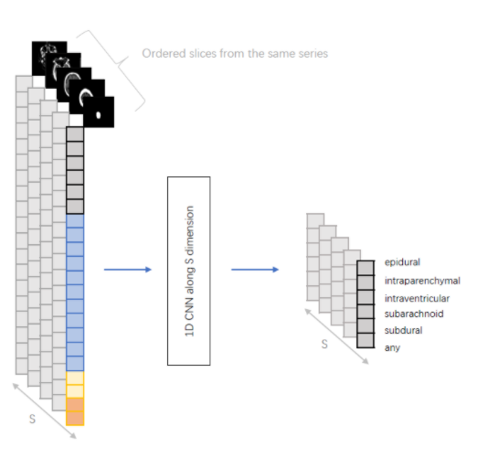
Pre Processing Data
Consecutive Window Policies
Stack 3 consecutive slices to a 3-channel image
More precise but hard to get on our small dataset

Slide 14
Classification
Model Architecture
SE ResNeXt50_32x4d (with ImageNet pretrain 79% top-1) - 77%
SE ResNeXt101_32x4d (with ImageNet pretrain 80% top-1) - 78%
ResNeXt50_32x4d (with SWSL – 82% top-1) - 75%
EfficientNet-b4 (with ImageNet pretrain – 83% top-1) - 72%
TResNet_XL-448 (with ImageNet pretrain – 83% top-1) – 75%
Vision Transformer (ViT Large) (with ImageNet pretrain – 85% top-1) – 70%
Hyper-parameters
Input Image Resolution: 512x512
Augmentation: Random crop, HVflip, Rotation, Contrast, Brightness
Training setting: 4 epochs, batch size 28
Optimizer: Adam initial learning rate 1e-4, decay 0.4 every epoch
Test time augmentation

Slide 15
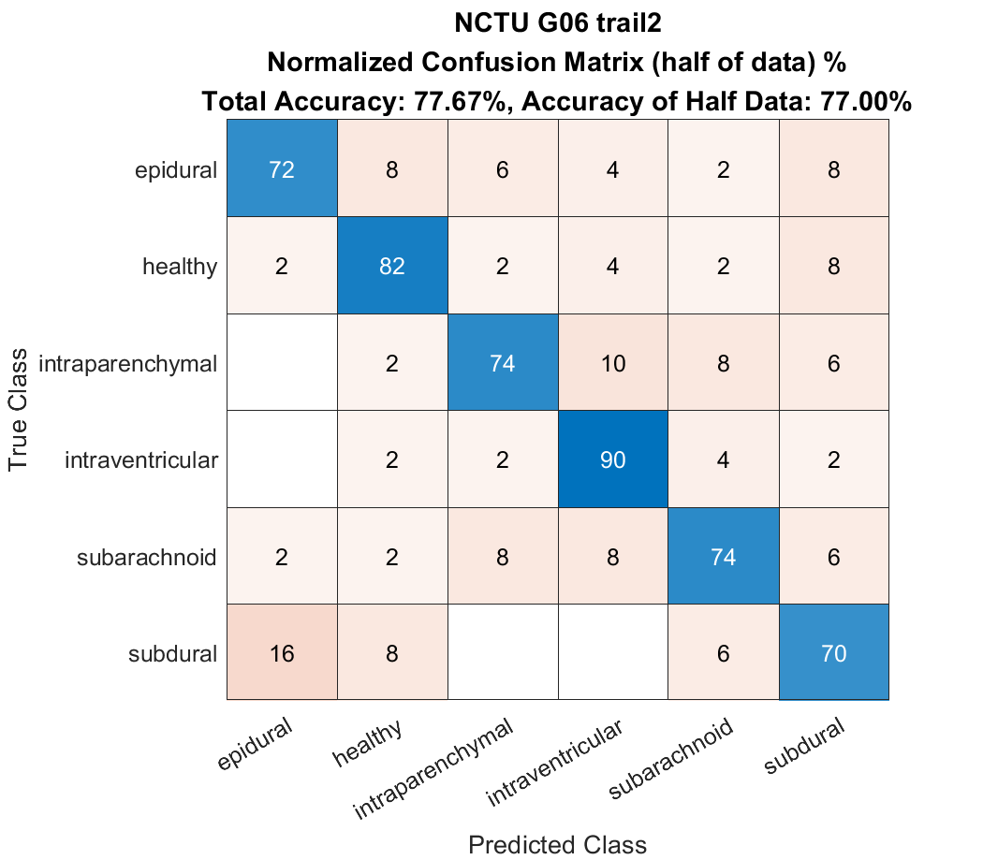
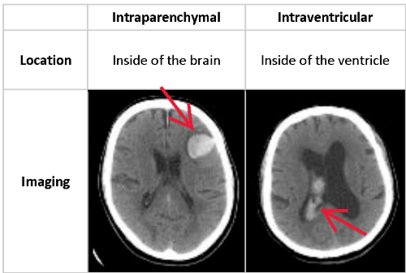
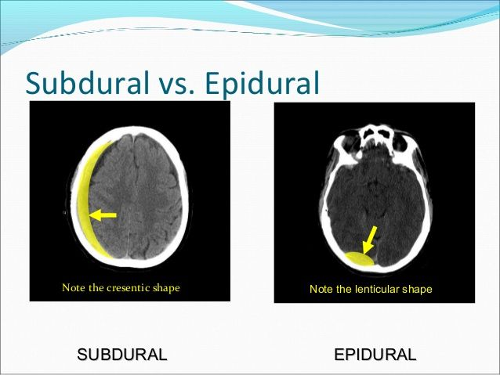
Result - SE ResNeXt50

Slide 16
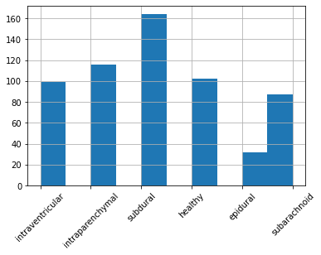
K-Fold & Ensemble Method
Divided Training data into 10 fold
Training SE ResNeXt 50 & 101 (Total 20 models)
Stacking XGBoost, LightGBM, Catboost with average
Final score: 72%

Slide 17
Summary
Different from traditional image classification. Digital Imaging
and Communications in Medicine (DICOM) are quite tricky in
the data preprocessing.
Testing accuracy is not positively correlated to ImageNet top-1 accuracy.
Squeeze and Excitation (SE) module might provide better
attention to specific areas or patterns.
Github repo. : https://github.com/Voltage-x/case-presentation-2

Slide 18
Citation
https://github.com/SeuTao/RSNA2019_Intracranial-Hemorrhage-Detection
Huang, G., Liu, Z., Van Der Maaten, L., & Weinberger, K. Q. (2017). Densely connected convolutional networks. In Proceedings of the IEEE conference on computer vision and pattern recognition (pp. 4700-4708).
11th Place Solution (Appian)
4th Place Solution (Miranda X)
Introduction to DICOM & Voxels

