Slide 1
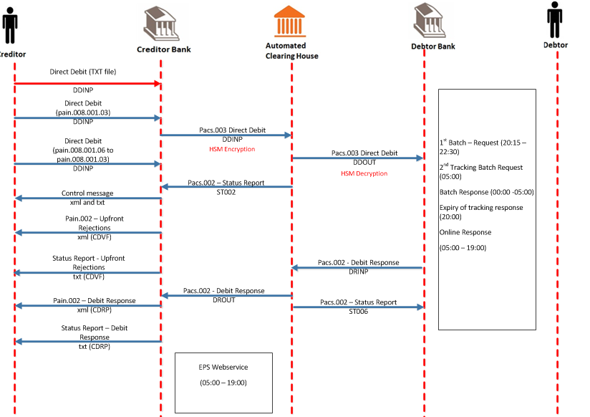
Batch Collections

Slide 2
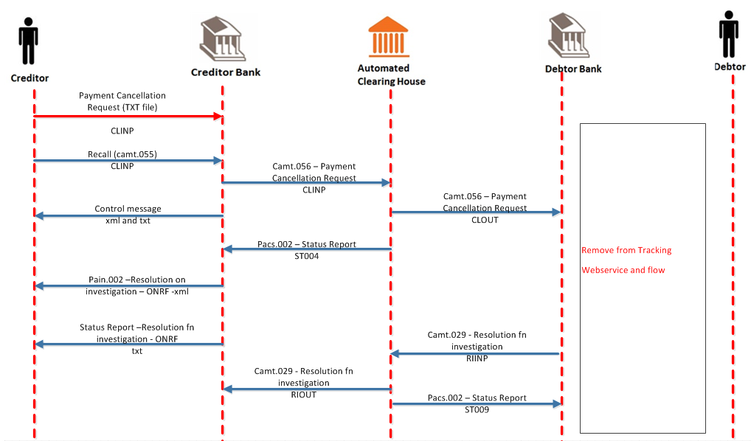
Payment Cancellation-Recalls

Slide 3
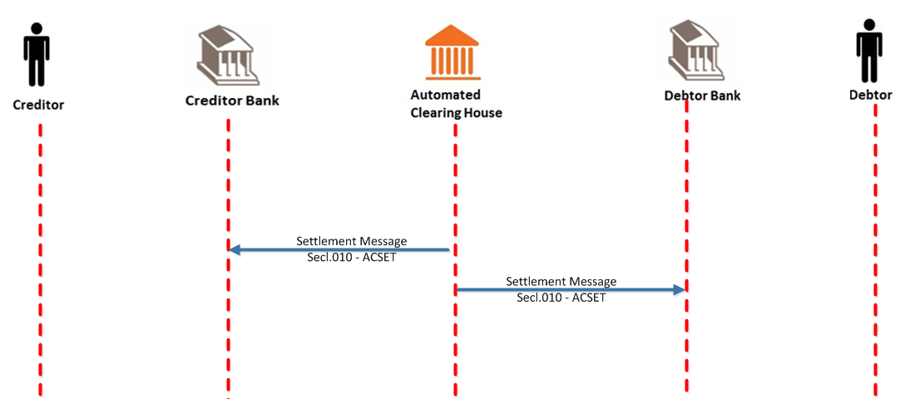
Settlement Report

