Slide 1


Contiguous Memory Allocation Simulator
This presentation introduces a command-line interface (CLI) simulator.
It visualizes contiguous memory allocation strategies.
Supported methods include First-Fit, Best-Fit, and Worst-Fit.
Users can allocate, release, compact, and view memory status.
by Voltaik

Slide 2





Functionality & Supported Commands
RQ <process>
RL <process>
C
STAT
Requests memory for a process.
Releases memory for a process.
Compacts memory, collapsing holes.
Displays current memory status.
The simulator provides key commands for memory management.
These functions cover allocation, deallocation, and system health checks.
The 'X' command safely exits the application.

Slide 3




Internal Data Structures
Dictionary Representation
List Model
Manipulation
Each memory block is a dictionary.
A list of dictionaries models memory segments.
It allows easy insertion, removal, and merging.
Keys include 'start', 'size', 'end', and 'process'.
This structure is highly adaptable.
Both allocated and free blocks are tracked.
The simulator uses a Python list of dictionaries.
This setup efficiently manages memory blocks.

Slide 4
Implementation Highlights
1
request_memory()
Implements First-Fit, Best-Fit, Worst-Fit logic.
Finds suitable memory based on strategy.
2
release_memory()
Frees process-occupied memory blocks.
Merges newly created adjacent free holes.
3
merge_blocks()
Combines adjacent free memory blocks.
Reduces external fragmentation effectively.
4
compact_memory_and_collapse_holes()
Rearranges allocated blocks to the front.
Consolidates all free space at the end.
Core functions manage memory allocation lifecycle.
Robust error handling ensures stable operations.

Slide 5

Big Test Case & Output
Total Mem Size : 1000000
RQ P1 200000 F
RL P2
RQ P2 300000 B
RQ P4 250000 B
RQ P3 100000 W
STAT
STAT
RQ P5 100000 F
RL P1
RQ P6 50000 W
RL P3
STAT
STAT
C
C
STAT
STAT
RQ P7 700000 F
RQ P8 50000 B
STAT
RQ P9 100000 W
X
This comprehensive test case evaluates all simulator features.
It covers various allocation, release, and compaction scenarios.

Slide 6
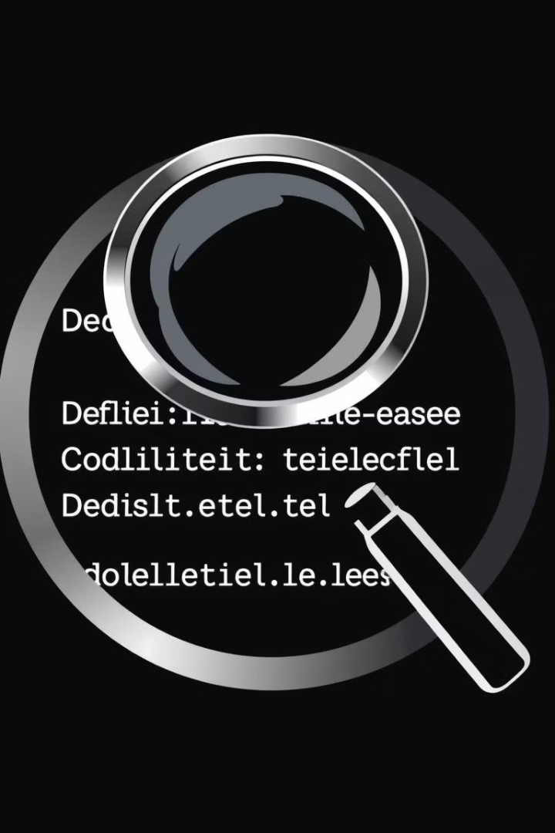
What This Test Verifies
Allocation Strategies
Tests First-Fit, Best-Fit, and Worst-Fit.
Hole Management
Verifies hole reuse post-release.
Ensures proper merging of adjacent holes.
Memory Compaction
Confirms correct memory defragmentation.
Error Handling
Checks for graceful handling of insufficient memory.
Validates accurate STAT reporting throughout.
The extensive test case rigorously validates simulator logic.
It ensures robustness under various memory conditions.

Slide 7
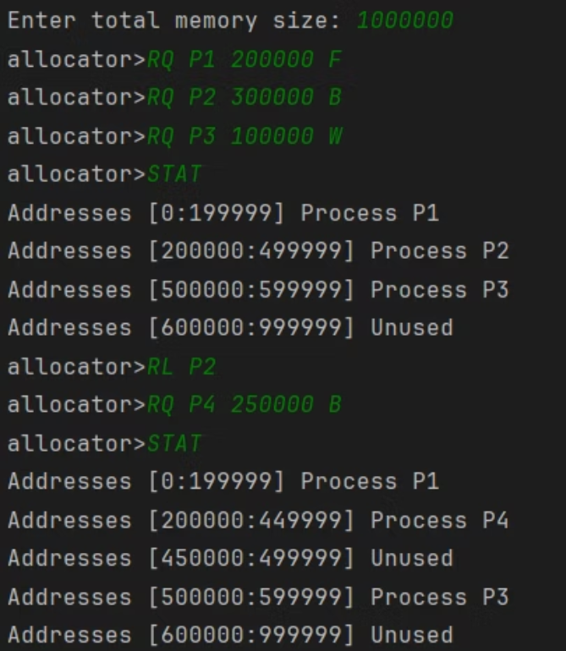
Outputs (1)
The first output shows initial memory allocations.
P1, P2, P3 are placed using different strategies.
The STAT command confirms memory utilization.
Notice how different strategies result in varying free space distributions.

Slide 8
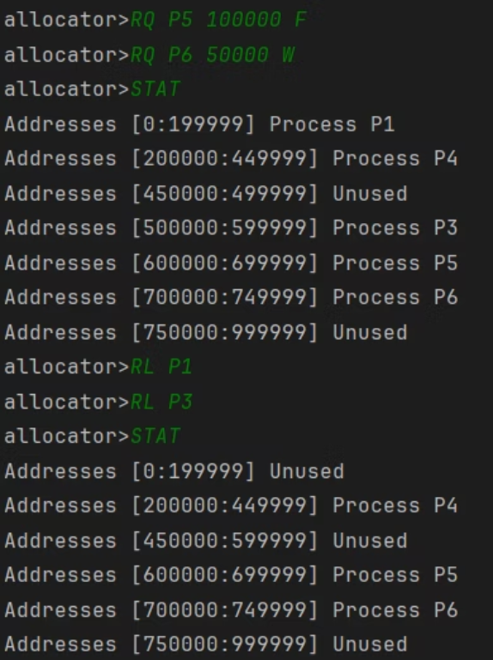
Outputs (2)
This section demonstrates memory release and re-allocation.
P2 is released, creating a new hole.
P4 then requests memory, ideally reusing the freed space.
Observe the resulting memory map and hole consolidation.

Slide 9
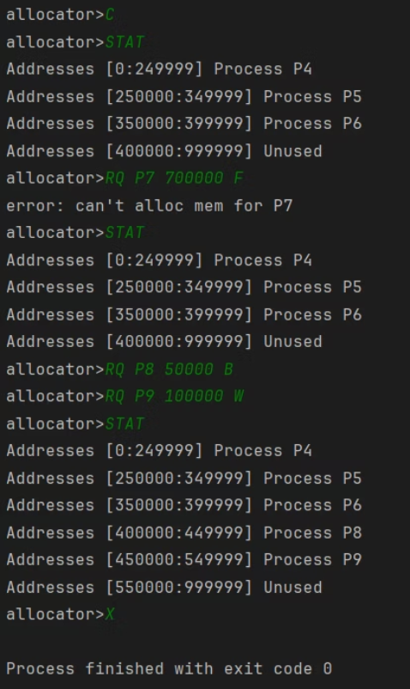
Outputs (3)
The final output illustrates compaction and subsequent allocations.
Compaction moves all used blocks together, merging holes.
This creates a large contiguous free space.
New processes (P7, P8, P9) then utilize this consolidated area.

