Slide 1

Paging Memory Allocation Simulator
This presentation introduces a command-line interface (CLI) simulator.
It simulates how memory is allocated and translated using pages and frames.

Slide 2

Concept of Paging
1- Memory is divided into fixed-size frames.
2- Processes are split into pages of the same size.
3- Pages are stored in non-contiguous frames.
4-Each process has its own page table.
Unlike contiguous allocation, paging solves external fragmentation by allowing non-contiguous placement of pages in memory.

Slide 3




Functionality & Supported Commands
RQ <process><size>
RL <process>
TR <process><page><offset>
STAT
Requests (size) of Frames for a process
Releases memory for a process.
Translates virtual address to physical
Displays current memory status.
Simple interface to interact with the memory system.
The ‘EXIT' command safely exits the application.

Slide 4

Internal Data Structures
Mem
Memsize
pagetable
List representing memory frames
Dictionary mapping process names to list of frame indices
Counter for remaining free frames
sizeofframe
Defines the size of each frame
This model mimics how real operating systems manage memory.

Slide 5
Implementation Highlights
1
add_process(Mem,pagetable,Memsize,process,initialsize)
Allocates free frames to a process
Updates page table and memory
2
delete_process(Mem,pagetable,Memsize,process)
Frees all frames of a process
Removes it from the page table
3
translate(Mem,pagetable,Memsize,inp(string),sizeofframes)
Converts a page number and offset to a physical address
Also Includes robust error handling for invalid input or memory overflow.

Slide 6
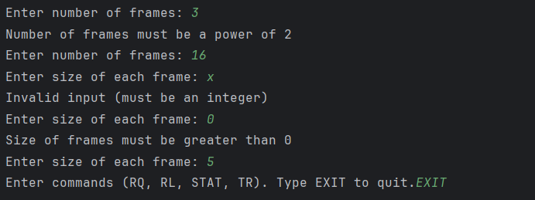
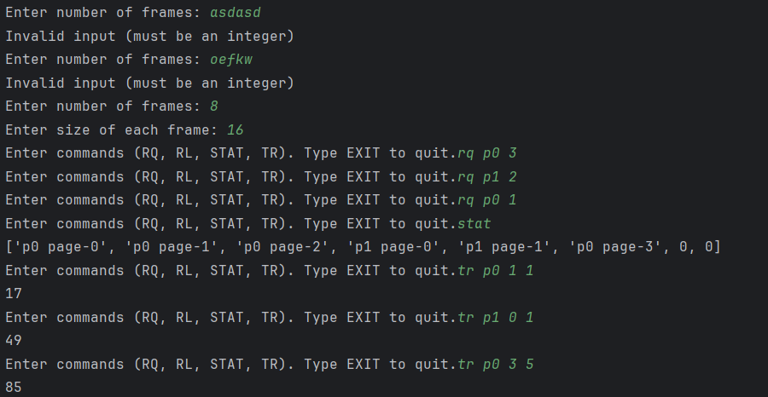
Test Case (1)
When the program runs, it first asks for the number of
frames, which must be an integer and a power of 2, followed
by the size of each frame, which must be a positive integer.
Then, it enters a loop where it accepts commands: RQ to
request memory for a process, RL to release memory, STAT
to display the current memory layout, and TR to translate and
print the physical address of a page.
In this example, I requested 3 frames for P0, which took the
first three frames; then 2 frames for P1, which occupied the
fourth and fifth; and later requested one more frame for P0,
which was allocated to the sixth frame. Finally, I used the TR
command to calculate and print the physical addresses for
both P0 and P1.

Slide 7
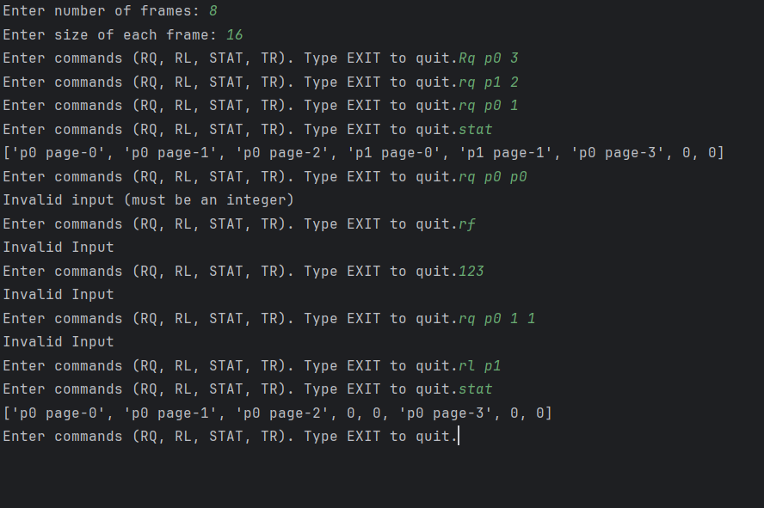
Test Case (2)
Here, I used the RL command to delete the P1 process, which
was removed from memory and left behind 0s (indicating empty
frames).
I also intentionally entered incorrect command lines to
highlight the program’s error handling, which responds
appropriately to invalid inputs.

Slide 8
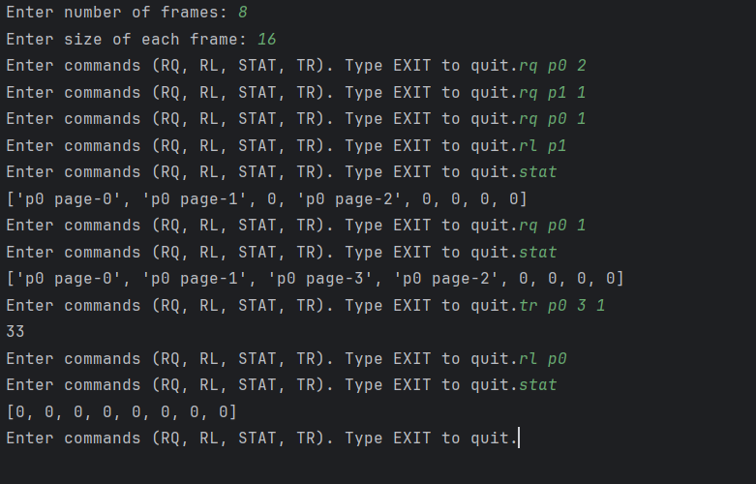
Test Case (3)
This example shows how paging works effectively. I allocated
pages to P0 and P1, released P1, then reused its frame for
P0—demonstrating how paging allows non-contiguous
memory use.
The TR command accurately translated a virtual address, and
STAT showed clear memory updates. This highlights how
paging avoids fragmentation and makes dynamic memory
use efficient.

