Slide 1
AIT 105 Artificial Intelligence Constraint Satisfaction Problems

Slide 2
Constraint Satisfaction Problem
A constraint satisfaction problem (CSP) is a problem that requires its solution within some limitations or conditions also known as constraints
It is defined as the triple (V, D, C) where
V is a set of variables X₁, ... , X_{n}.
D is the union of a set of domain sets D₁,...,D_{n}, where D_{i} is the domain of possible values for variable X_{i}.
C is a set of constraints on the values of the variables, which can be pairwise (simplest and most common) or k at a time.

Slide 3
Constraint Satisfaction Problems
Must be
Hot&Sour
Soup
No
Peanuts
Chicken
Dish
Appetizer
Total Cost
< $30
Pork Dish
No
Peanuts
Vegetable
Not Both
Spicy
Seafood
Rice
Not
Chow Mein
Constraint Network
Notes:
Unary, binary and N-ry constraints.

Slide 4
Real World Samples of CSP
Assignment problems
e.g., who teaches what class
Timetabling problems
e.g., which class is offered when and where?
Hardware configuration
Transportation scheduling
Factory scheduling

Slide 5

Example: Map-Coloring
Variables WA, NT, Q, NSW, V, SA, T
Domains D_{i} = {red,green,blue}
Constraints: adjacent regions must have different colors
e.g., WA ≠ NT, or (WA,NT) in {(red,green),(red,blue),(green,red), (green,blue),(blue,red),(blue,green)}

Slide 6

Example: Map-Coloring
Solutions are complete and consistent assignments, e.g., WA = red, NT = green,Q = red,NSW = green,V = red,SA = blue,T = green

Slide 7
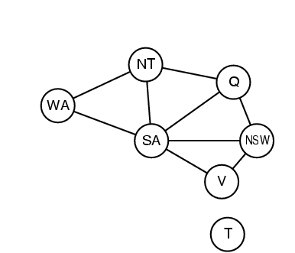
Constraint Graph

Slide 8
Varieties of constraints
Unary constraints involve a single variable,
e.g., SA ≠ green
Binary constraints involve pairs of variables,
e.g., value(SA) ≠ value(WA)
Higher-order constraints involve 3 or more variables
Preferances

Slide 9
The Consistent Labeling Problem
Let P = (V,D,C) be a constraint satisfaction problem.
An assignment is a partial function f : V -> D that assigns
a value (from the appropriate domain) to each variable
A consistent assignment or consistent labeling is an
assignment f that satisfies all the constraints.
A complete consistent labeling is a consistent labeling
in which every variable has a value.

Slide 10
Standard Search Formulation
state: (partial) assignment
initial state: the empty assignment { }
successor function: assign a value to an unassigned variable that does not conflict with current assignment
→ fail if no legal assignments
goal test: the current assignment is complete
(and is a consistent labeling)
This is the same for all CSPs regardless of application.
Every solution appears at depth n with n variables → we can use depth-first search.
Path is irrelevant, so we can also use complete-state formulation.

