Slide 1

HILL CLIMBING

Slide 2
INTRODUCTION
Hill climbing algorithm is a local search algorithm which continuously moves in the direction of increasing elevation/value to find the peak of the mountain or best solution to the problem. It terminates when it reaches a peak value where no neighbor has a higher value.
Hill climbing algorithm is a technique which is used for optimizing the mathematical problems. One of the widely discussed examples of Hill climbing algorithm is Traveling-salesman Problem in which we need to minimize the distance traveled by the salesman.
It is also called greedy local search as it only looks to its good immediate neighbor state and not beyond that.
A node of hill climbing algorithm has two components which are state and value.
Hill Climbing is mostly used when a good heuristic is available.
In this algorithm, we don't need to maintain and handle the search tree or graph as it only keeps a single current state.

Slide 3
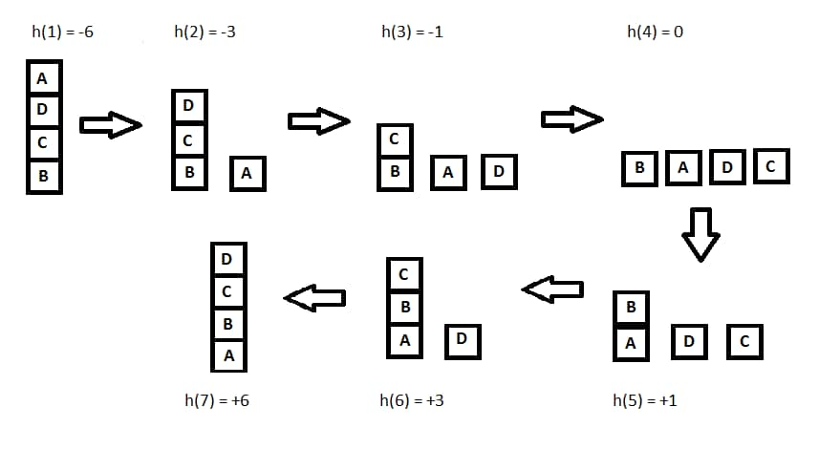
INTRODUCTION

Slide 4
FEATURES
Following are some main features of Hill Climbing Algorithm:
Generate and Test variant: Hill Climbing is the variant of Generate and Test method. The Generate and Test method produce feedback which helps to decide which direction to move in the search space.
Greedy approach: Hill-climbing algorithm search moves in the direction which optimizes the cost.
No backtracking: It does not backtrack the search space, as it does not remember the previous states.

Slide 5
STATE SPACE DIAGRAM FOR HILL CLIMBING
The state-space diagram is a graphical representation of the set of states our search algorithm can reach vs the value of our objective function(the function which we wish to maximize).
• X-axis: denotes the state space i.e states or configuration our algorithm may reach.
• Y-axis: denotes the values of objective function corresponding to a particular state.
The best solution will be a state space where the objective function has a maximum value(global maximum).

Slide 6
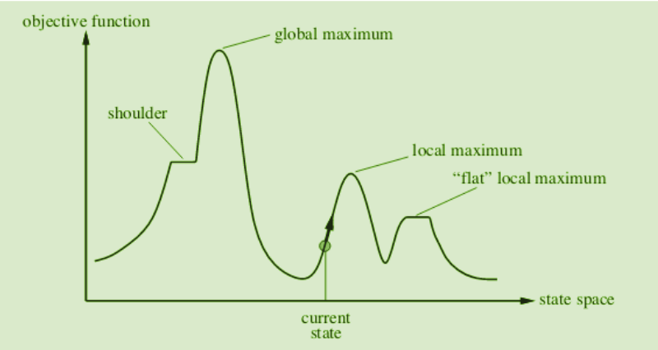
DIAGRAMATIC REPRESENTATION

Slide 7
Different regions in the State Space Diagram:
• Local maximum: It is a state which is better than its neighboring state however there exists a state which is better than it(global maximum). This state is better because here the value of the objective function is higher than its neighbors.
• Global maximum: It is the best possible state in the state space diagram. This is because, at this stage, the objective function has the highest value.
• Plateau/flat local maximum: It is a flat region of state space where neighboring states have the same value.
• Ridge: It is a region that is higher than its neighbors but itself has a slope. It is a special kind of local maximum.
• Current state: The region of the state space diagram where we are currently present during the search.
• Shoulder: It is a plateau that has an uphill edge

Slide 8
Problems in different regions in Hill climbing
Hill climbing cannot reach the optimal/best state(global maximum) if it enters any of the following regions :
• Local maximum: At a local maximum all neighboring states have a value that is worse than the current state. Since hill-climbing uses a greedy approach, it will not move to the worse state and terminate itself. The process will end even though a better solution may exist.
To overcome the local maximum problem: Utilize the backtracking technique. Maintain a list of visited states. If the search reaches an undesirable state, it can backtrack to the previous configuration and explore a new path.
• Plateau: On the plateau, all neighbors have the same value. Hence, it is not possible to select the best direction.
To overcome plateaus: Make a big jump. Randomly select a state far away from the current state. Chances are that we will land in a non-plateau region.
• Ridge: Any point on a ridge can look like a peak because movement in all possible directions is downward. Hence the algorithm stops when it reaches this state.
To overcome Ridge: In this kind of obstacle, use two or more rules before testing. It implies moving in several directions at once.

Slide 9
TYPES OF HILL CLIMBING
Hill climbing comes with its own flavors, each with its own approach to finding the optimal solution:
1.Simple hill climbing
2.Steepest-Ascent hill climbing
3.Stochastic hill climbing

Slide 10
1.SIMPLE HILL CLIMBING
Simple hill climbing is the simplest way to implement a hill climbing algorithm.
It only evaluates the neighbor node state at a time and selects the first one which optimizes current cost and set it as a current state.
It only checks it's one successor state, and if it finds better than the current state, then move else be in the same state. This algorithm has the following features:
Less time consuming
Less optimal solution and the solution is not guaranteed

Slide 11
ALGORITHIM FOR SIMPLE
Evaluate the initial state. If it is a goal state then stop and return success. Otherwise, make the initial state as the current state.
Loop until the solution state is found or there are no new operators present which can be applied to the current state.
Select a state that has not been yet applied to the current state and apply it to produce a new state. Perform these to evaluate the new state.
If the current state is a goal state, then stop and return success.
If it is better than the current state, then make it the current state and proceed further.
If it is not better than the current state, then continue in the loop until a solution is found. -Exit from the function.

Slide 12
STEEPEST-ASCENT HILL CLIMBING
The steepest-Ascent algorithm is a variation of simple hill climbing algorithm. This algorithm examines all the neighboring nodes of the current state and selects one neighbor node which is closest to the goal state. This algorithm consumes more time as it searches for multiple neighbors

Slide 13
ALGORITHIM FOR STEEPEST-ASCENT
Evaluate the initial state. If it is a goal state then stop and return success. Otherwise, make the initial state as the current state.
Repeat these steps until a solution is found or the current state does not change
Select a state that has not been yet applied to the current state.
Initialize a new ‘best state’ equal to the current state and apply it to produce a new state.
Perform these to evaluate the new state
If the current state is a goal state, then stop and return success.
If it is better than the best state, then make it the best state else continue the loop with another new state.
Make the best state as the current state and go to Step 2 of the second point.
Exit from the function.

Slide 14
STOCHASTIC HILL CLIMBING
Stochastic hill climbing does not examine for all its neighbor before moving. Rather, this search algorithm selects one neighbor node at random and decides whether to choose it as a current state or examine another state.

Slide 15
ALGORITHIM FOR STOCHASTIC
Evaluate the initial state. If it is a goal state then stop and return success. Otherwise, make the initial state the current state.
Repeat these steps until a solution is found or the current state does not change.
Select a state that has not been yet applied to the current state.
Apply the successor function to the current state and generate all the neighbor states.Among the generated neighbor states which are better than the current state choose a state randomly (or based on some probability function).
If the chosen state is the goal state, then return success, else make it the current state and repeat step 2 of the second point.
Exit from the function.

Slide 16
PYTHON CODE FOR THE TYPES

Slide 17
APPLICATIONS OF HILL CLIMBING
The hill climbing algorithm finds applications in various domains within artificial intelligence and optimization:
Machine Learning: Hill climbing can be used for hyperparameter tuning in machine learning algorithms, finding the best combination of hyperparameters for a model.
Robotics: In robotics, hill climbing can help robots navigate through physical environments, adjusting their paths to reach a destination.
Network Design: It can be used to optimize network topologies and configurations in telecommunications and computer networks.
Game Playing: In game playing AI, hill climbing can be employed to develop strategies that maximize game scores.
Natural Language Processing: It can optimize algorithms for tasks like text summarization, machine translation, and speech recognition.

Slide 18
ADVANTAGES OF HILL CLIMBING
Simplicity: Hill climbing is straightforward to understand and implement, making it an excellent choice for solving basic optimization problems.
Memory Efficiency: It doesn't require significant memory resources since it only stores the current state and explores nearby solutions.
Quick Convergence: Hill climbing often converges rapidly to a local maximum, making it suitable for problems where finding a good solution quickly is more critical than finding the global optimum.

Slide 19
DISADVANTAGES OF HILL CLIMBING
Local Optima: Hill climbing is prone to getting stuck in local optima, especially in complex, multi-modal landscapes where multiple peaks exist.
Lack of Exploration: It can be myopic, as it only explores nearby solutions. It may miss a globally optimal solution if it requires moving away from the current position initially.
Sensitivity to Initial State: The quality of the solution found is highly dependent on the initial state, making it sensitive to the starting point.

Slide 20
CONCLUSION///summary

